Slide 1

59 Construct Inheritance
Peter H. Chen

Slide 2
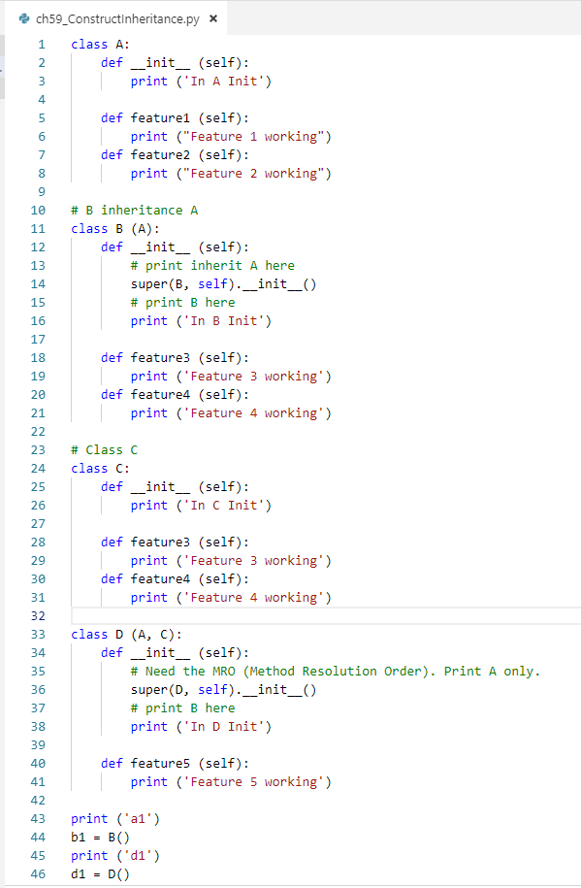
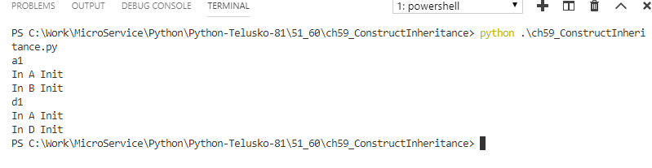
59 Construct Inheritance
https://www.youtube.com/watch?v=6P-P879BcHQ&list=PLsyeobzWxl7poL9JTVyndKe62ieoN-MZ3&index=59
Constructor in Inheritance
MRO (Method Resolution Order)
How to print both current and inherited constructor? Use super (childB, self).__init__()
For multiple inheritances, only the left inheritance constructor is called.

Slide 3
End of Chapter

