Slide 1

25 break/pass: Part 2
Peter H. Chen

Slide 2
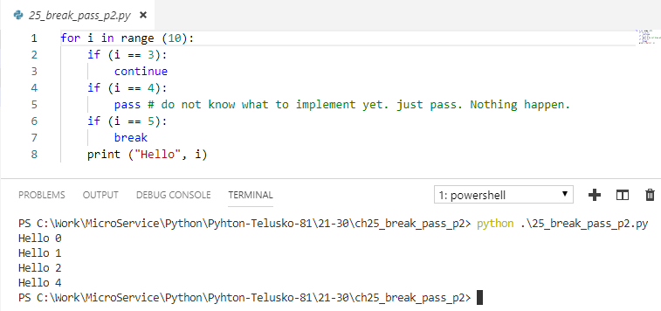
25 break/pass: Part 2
https://www.youtube.com/watch?v=JCRpVwtVL4I&list=PLsyeobzWxl7poL9JTVyndKe62ieoN-MZ3&index=25
If you do not something need to be implement. Just put pass there. Nothing impact. Will be implemented later.

Slide 3
End of Chapter

