Slide 1

27 for else
Peter H. Chen

Slide 2
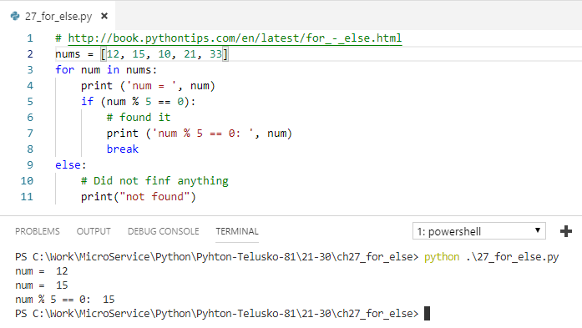
27 for else
https://www.youtube.com/watch?v=38svC3U7hVo&list=PLsyeobzWxl7poL9JTVyndKe62ieoN-MZ3&index=27
Other language never use for … else
If you cannot find anything in the loop, then print “not found”

Slide 3
End of Chapter

