Slide 1

53 Init Method
Peter H. Chen

Slide 2
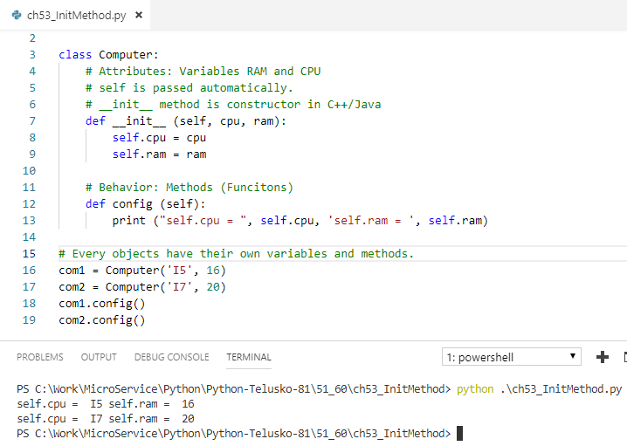
53 Init Method
https://www.youtube.com/watch?v=WIP3-woodlU&list=PLsyeobzWxl7poL9JTVyndKe62ieoN-MZ3&index=53
__init__ method is like constructor in C++/Java.
The first argument is self. The self is like this pointer in C++/Java.
You can assign the variables and used self for other method to access the data.

Slide 3
End of Chapter

