Slide 1

54 Constructor and Self
Peter H. Chen

Slide 2
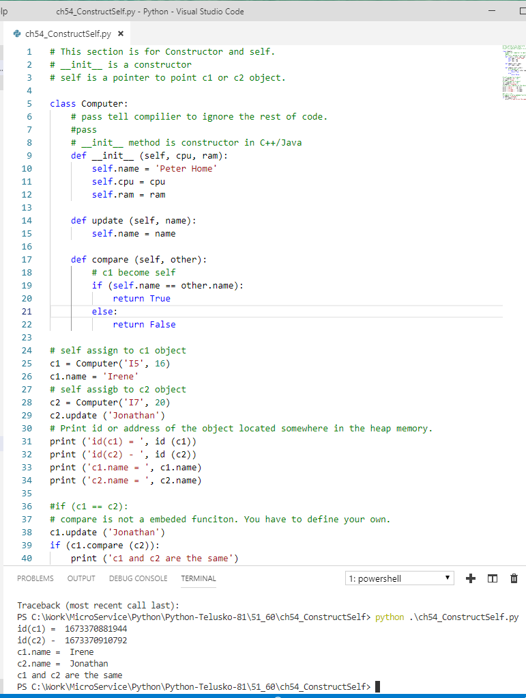
54 Constructor and Self
https://www.youtube.com/watch?v=ic6wdPxcHc0&list=PLsyeobzWxl7poL9JTVyndKe62ieoN-MZ3&index=54
The print (id(obj)) prints the location of object in the heap memory.
The size of an object? Depends on the number of variables.
Who responsible the size of object? Constructor
There is no compare in the python class. You have to define your own.
The self points to the current object.

Slide 3
End of Chapter

