Slide 1

28 Prime Number
Peter H. Chen

Slide 2

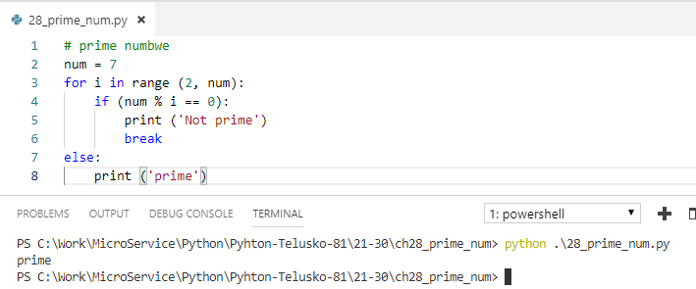
28 Prime Number
https://www.youtube.com/watch?v=SpTAxH_Geow&list=PLsyeobzWxl7poL9JTVyndKe62ieoN-MZ3&index=28
Prime number: Only can be divided by 1 and itself.

Slide 3
End of Chapter

