Slide 1

35 Function
Peter H. Chen

Slide 2
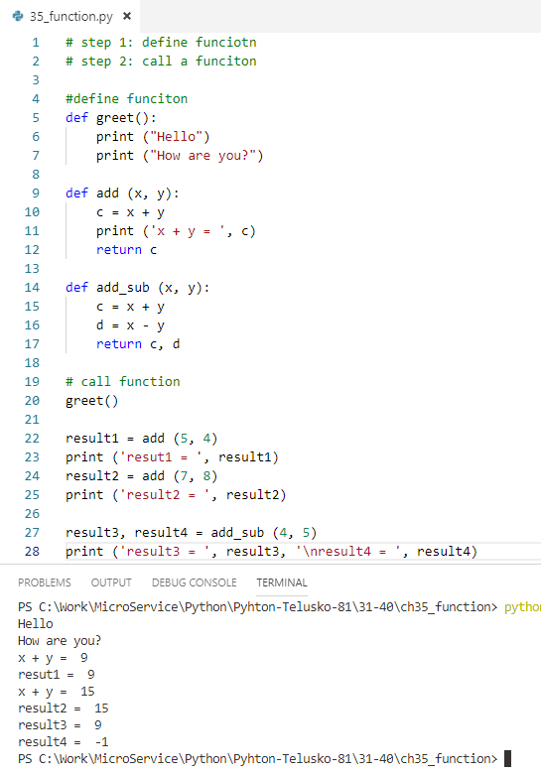
35 Function
https://www.youtube.com/watch?v=BVfCWuca9nw&list=PLsyeobzWxl7poL9JTVyndKe62ieoN-MZ3&index=35
Function: reduce the complexity, repeat call for the similar task.

Slide 3
End of Chapter

