Slide 1

55 Instance and Class Variables
Peter H. Chen

Slide 2
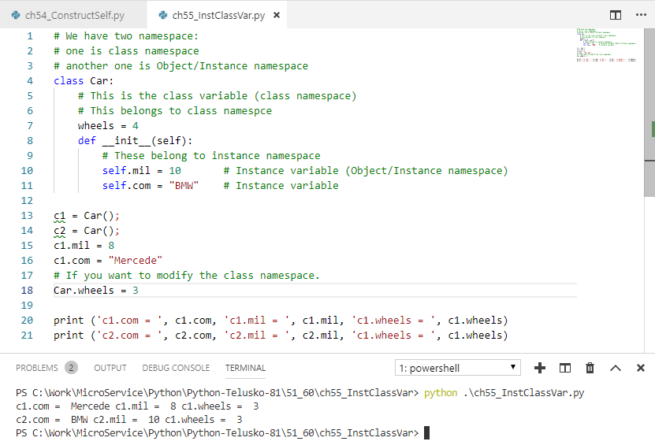
55 Instance and Class Variables
https://www.youtube.com/watch?v=RSQjxL5WRNM&list=PLsyeobzWxl7poL9JTVyndKe62ieoN-MZ3&index=55
Class variable vs. Instance variable:
Class variable: variables in the class but outside the method.
Instance variable: variables inside the method.

Slide 3
End of Chapter

