Slide 1

56 Instance, Class, and Static Method
Peter H. Chen

Slide 2
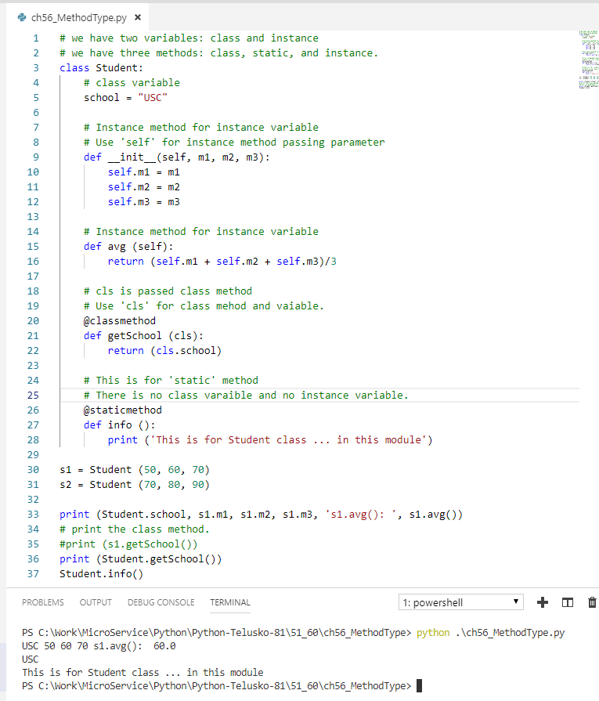
56 Instance, Class, and Static Method
https://www.youtube.com/watch?v=lVfGQOzzRCM&list=PLsyeobzWxl7poL9JTVyndKe62ieoN-MZ3&index=56
Method Types: Instance Method, Class Method, and static method.
Variable only have two types: Class and Instance variable.
Instance method print the instance variable.
Class method print the class variable.
Static method print nothing to do with Instance variable and Class variable.

Slide 3
End of Chapter

