Slide 1

31 numpy
Peter H. Chen

Slide 2
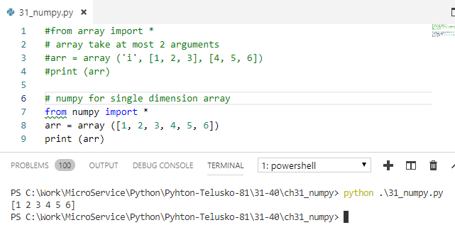
31 numpy
https://www.youtube.com/watch?v=8LlXhtfNZEQ&list=PLsyeobzWxl7poL9JTVyndKe62ieoN-MZ3&index=31
Numpy:
We saw the single array.
Now, we have multiple dimensions. It can be 2 dimension, 3-dimensions, and etc.
2 dimension array, we can use matrix.
Python does not have multiple dimensional array.
We have to use numpy for multiple dimensional array.

Slide 3
End of Chapter

