Slide 1

32 numpy Array
Peter H. Chen

Slide 2
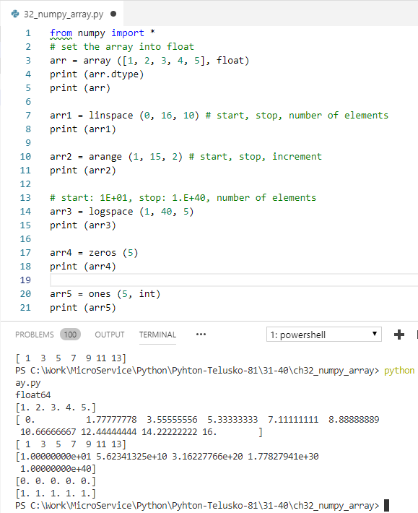
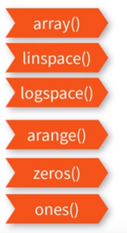
32 numpy Array
https://www.youtube.com/watch?v=8LlXhtfNZEQ&list=PLsyeobzWxl7poL9JTVyndKe62ieoN-MZ3&index=31
Numpy for different array operation.

Slide 3
End of Chapter

