Slide 1

24 break/pass
Peter H. Chen

Slide 2
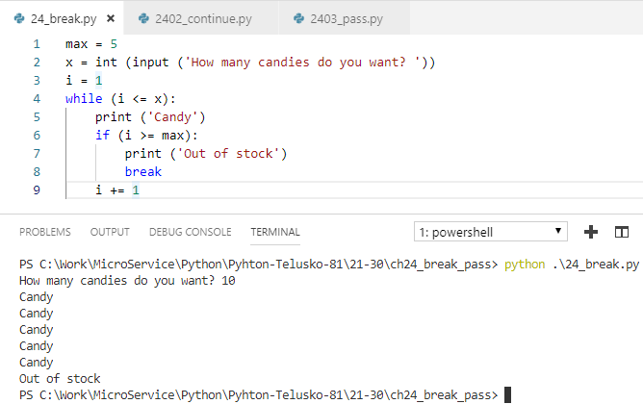
24 break/pass
https://www.youtube.com/watch?v=yCZBnjF4_tU&list=PLsyeobzWxl7poL9JTVyndKe62ieoN-MZ3&index=24
We discusses keywords for for/while loop: break, continue, and pass.

Slide 3
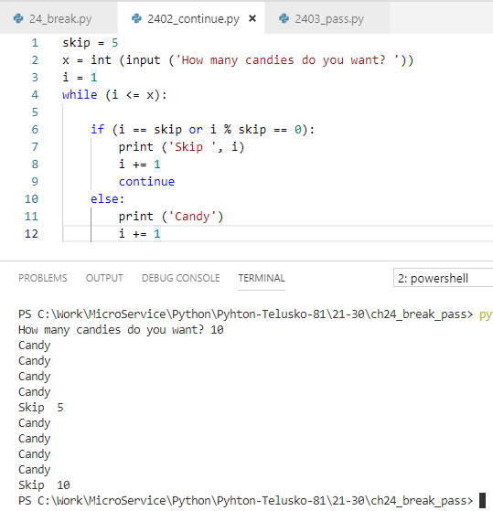
24 break/pass
https://www.youtube.com/watch?v=yCZBnjF4_tU&list=PLsyeobzWxl7poL9JTVyndKe62ieoN-MZ3&index=24
Continue: skip this one and continue the next one.

Slide 4
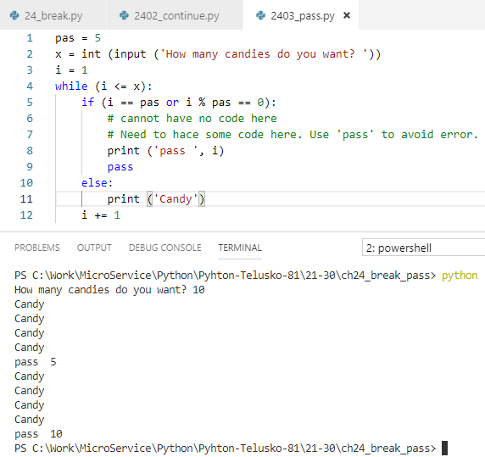
24 break/pass
https://www.youtube.com/watch?v=yCZBnjF4_tU&list=PLsyeobzWxl7poL9JTVyndKe62ieoN-MZ3&index=24
Cannot have empty block. We use ‘pass’ to avoid compilation error for empty block.

Slide 5
End of Chapter

