Slide 1

1 Python Unit Testing
Peter H. Chen

Slide 2
1 Python Unit Testing
  https://www.youtube.com/watch?v=l32bsaIDoWk&list=PLeo1K3hjS3utzQYDNRNluzqJqpMXx6hHu&index=1
A good programmer will always test your code before move into the production.
A very good programmer will always automated test your code before move perform the testing.
Python offers three basic frameworks for writing automated test: unittest, nose, and pytest. Among three, pytest is the best.
We will write pytest in these sections.

Slide 3
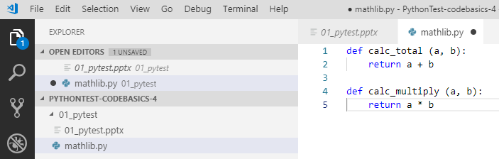
1 Python Unit Testing
  https://www.youtube.com/watch?v=l32bsaIDoWk&list=PLeo1K3hjS3utzQYDNRNluzqJqpMXx6hHu&index=1
We have the following functions to be tested. We would like to write the unit test.

Slide 4
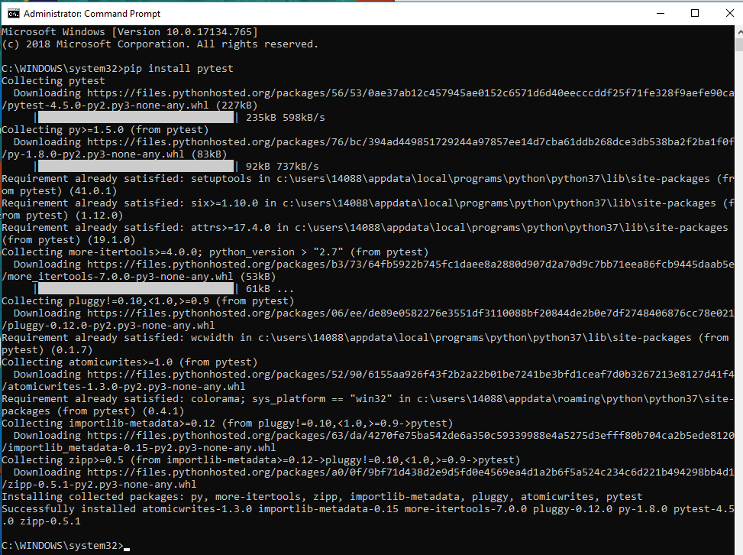
1 Python Unit Testing
  https://www.youtube.com/watch?v=l32bsaIDoWk&list=PLeo1K3hjS3utzQYDNRNluzqJqpMXx6hHu&index=1
First, we install the pytest.
Open command prompt with system admission mode (You need system admission privilege to prevent the write permission error)
> pip install pytest

Slide 5
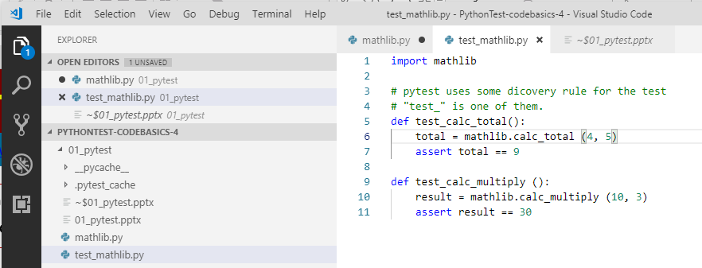
1 Python Unit Testing
  https://www.youtube.com/watch?v=l32bsaIDoWk&list=PLeo1K3hjS3utzQYDNRNluzqJqpMXx6hHu&index=1
In the same folder of mathlib.py, create a file “test_mathlib.py”.
Note: the file name has to be “test_” in front of functions to be tested.

Slide 6
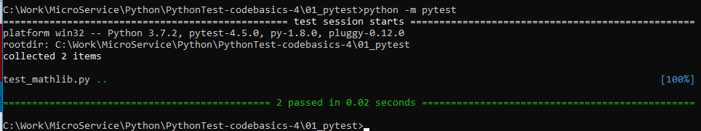
1 Python Unit Testing
  https://www.youtube.com/watch?v=l32bsaIDoWk&list=PLeo1K3hjS3utzQYDNRNluzqJqpMXx6hHu&index=1
First way, in the same folder.
> python –m pytest
Pytest framework will test recursively perform all the test with file names started with “test_”.

Slide 7
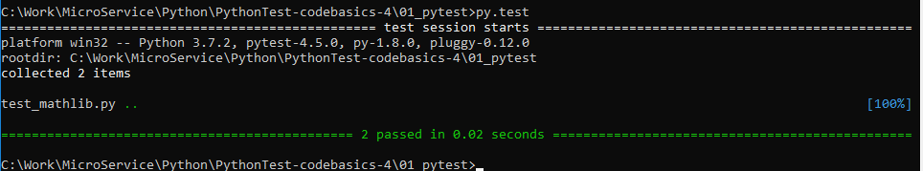
1 Python Unit Testing
  https://www.youtube.com/watch?v=l32bsaIDoWk&list=PLeo1K3hjS3utzQYDNRNluzqJqpMXx6hHu&index=1
Second way, in the same folder.
> py.tests
It says that 2 tests passed in 0.02 seconds.

Slide 8
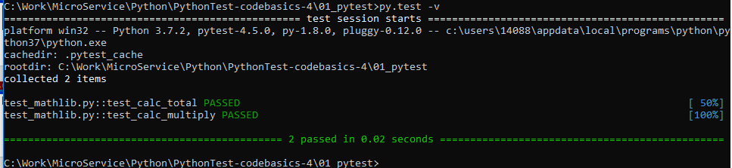
1 Python Unit Testing
  https://www.youtube.com/watch?v=l32bsaIDoWk&list=PLeo1K3hjS3utzQYDNRNluzqJqpMXx6hHu&index=1
If you want to see the detail output
> py.test –v
Display all the details test result.
Note: –v: means verbose.
It will list all the test names and result passed or failed.

Slide 9
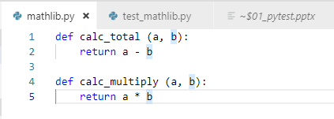
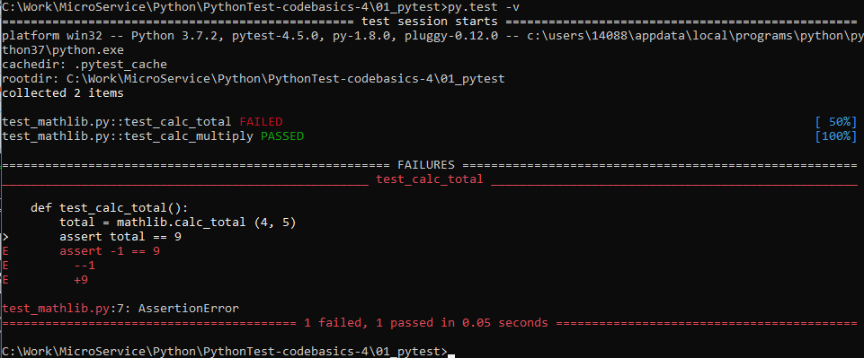
1 Python Unit Testing
  https://www.youtube.com/watch?v=l32bsaIDoWk&list=PLeo1K3hjS3utzQYDNRNluzqJqpMXx6hHu&index=1
Some one modify the mathlib calc_total into subtraction by accident.
You got the failed messages as follow.

Slide 10
1 Python Unit Testing
  https://www.youtube.com/watch?v=l32bsaIDoWk&list=PLeo1K3hjS3utzQYDNRNluzqJqpMXx6hHu&index=1
Note: The prefix “test_” of file name and prefix “test_” of test function are required for pytest framework to find the testes .

Slide 11
End of Chapter

