Slide 1

8 Predict
Peter H. Chen

Slide 2
8 Predict
https://www.youtube.com/watch?v=2f-NjDUvZIE&list=PLZbbT5o_s2xrwRnXk_yCPtnqqo4_u2YGL&index=8
Predict
We will use the model to make the prediction.
Prediction
The prediction process also called inference (judgment or deduction) process.
The process is called inference as the model gain its knowledge from the training dataset and use model to infer a prediction or result.
Specifically, the test dataset is used for inference after the training has concluded.

Slide 3
8 Predict
https://www.youtube.com/watch?v=2f-NjDUvZIE&list=PLZbbT5o_s2xrwRnXk_yCPtnqqo4_u2YGL&index=8
Create the Test Dataset
We will create the test dataset in the same way as we created for the training dataset.
The test dataset is created as below.
test_labels = []
test_samples = []
for i in range(10):
# The 5% of younger individuals who did experience side effects
random_younger = randint(13,64)
test_samples.append(random_younger)
test_labels.append(1)
# The 5% of older individuals who did not experience side effects
random_older = randint(65,100)
test_samples.append(random_older)
test_labels.append(0)
for i in range(200):
# The 95% of younger individuals who did not experience side effects
random_younger = randint(13,64)
test_samples.append(random_younger) test_labels.append(0)
# The 95% of older individuals who did experience side effects
random_older = randint(65,100)
test_samples.append(random_older)
test_labels.append(1)
test_labels = np.array(test_labels)
test_samples = np.array(test_samples)
test_labels, test_samples = shuffle(test_labels, test_samples)
scaled_test_samples = scaler.fit_transform(test_samples.reshape(-1,1))

Slide 4
8 Predict
https://www.youtube.com/watch?v=2f-NjDUvZIE&list=PLZbbT5o_s2xrwRnXk_yCPtnqqo4_u2YGL&index=8
Evaluate the Test Dataset
To get the predictions from the model with the test dataset, we call model.predict()
For predict () function, we pass in the test sample x = scaled_test_samples, batch_size = 10, and set verbose=0.
The output predictions has two probabilities for two classes experienced and no experience.
Note: In the prediction (inference) stage, we only pass in the x data. We do not pass the labels for the test dataset.

Slide 5
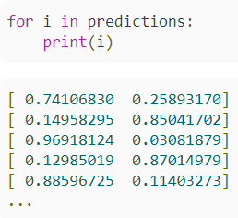
8 Predict
https://www.youtube.com/watch?v=2f-NjDUvZIE&list=PLZbbT5o_s2xrwRnXk_yCPtnqqo4_u2YGL&index=8
Prediction Result
To see what the model's predictions look like, we can iterate over them and print them out.
Each element in the predictions list has a length of 2.
The sum of the two values in each list is 1.
The reason is because the two columns contain probabilities for each possible outcome: experienced side effect and did not experience side effect.
Each elements in the predictions list is a probabilities distribution over all possible outputs.
The first column contains the probability for each patient not experienced side effects, which label 0.
The second column contains the probability for each patient experienced with side effect, which label 1.

Slide 6
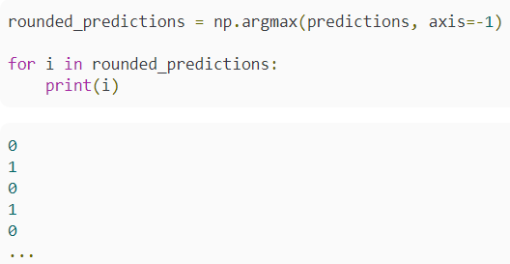
8 Predict
https://www.youtube.com/watch?v=2f-NjDUvZIE&list=PLZbbT5o_s2xrwRnXk_yCPtnqqo4_u2YGL&index=8
Use argmax for prediction
The argmax() finds the biggest number (biggest probability) index of each row.
The axis = -1 is along the row axis.

Slide 7
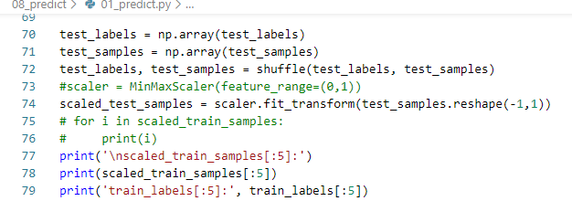
8 Predict
https://www.youtube.com/watch?v=2f-NjDUvZIE&list=PLZbbT5o_s2xrwRnXk_yCPtnqqo4_u2YGL&index=8
Keras Code:
Prepare Test Data

Slide 8
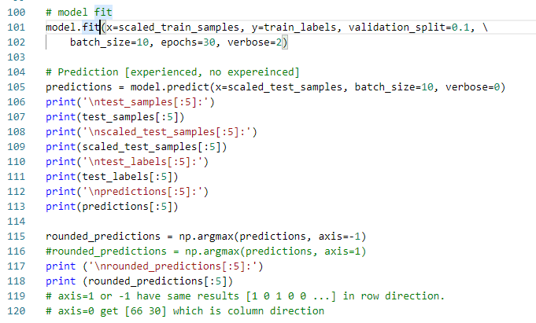
8 Predict
https://www.youtube.com/watch?v=2f-NjDUvZIE&list=PLZbbT5o_s2xrwRnXk_yCPtnqqo4_u2YGL&index=8
Keras Code:
Prediction and argmax()

Slide 9
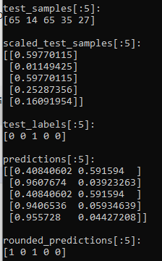
8 Predict
https://www.youtube.com/watch?v=2f-NjDUvZIE&list=PLZbbT5o_s2xrwRnXk_yCPtnqqo4_u2YGL&index=8
Keras Code:
Prediction results:

Slide 10
8.1 Quiz

Slide 11
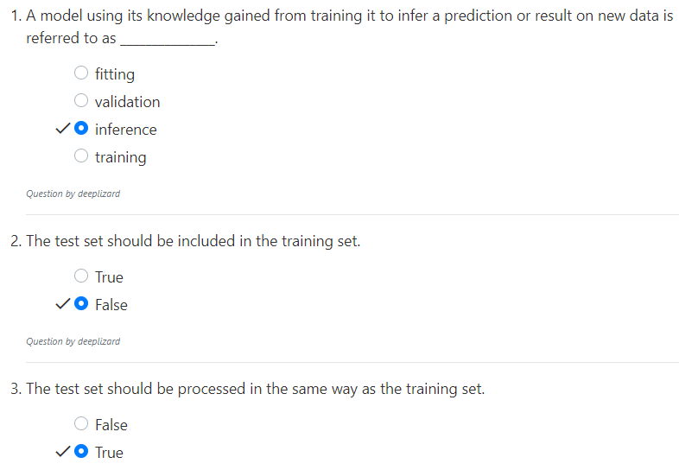
8.1 Quiz
https://www.youtube.com/watch?v=2f-NjDUvZIE&list=PLZbbT5o_s2xrwRnXk_yCPtnqqo4_u2YGL&index=8
Quiz

Slide 12
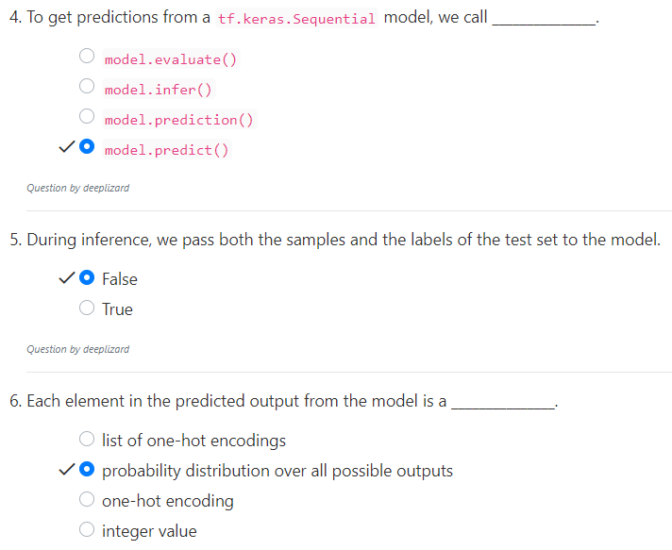
8.1 Quiz
https://www.youtube.com/watch?v=2f-NjDUvZIE&list=PLZbbT5o_s2xrwRnXk_yCPtnqqo4_u2YGL&index=8
Quiz

Slide 13
End of Chapter

