Slide 1

9 Confusion Matrix
Peter H. Chen

Slide 2
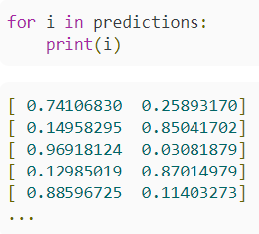
9 Confusion Matrix
https://www.youtube.com/watch?v=km7pxKy4UHU&list=PLZbbT5o_s2xrwRnXk_yCPtnqqo4_u2YGL&index=9
Confusion Matrix
We discuss how to create the confusion matrix.
Below are the probabilities for predictions.

Slide 3
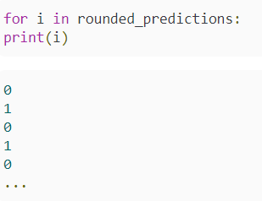
9 Confusion Matrix
https://www.youtube.com/watch?v=km7pxKy4UHU&list=PLZbbT5o_s2xrwRnXk_yCPtnqqo4_u2YGL&index=9
Confusion Matrix
Most probable prediction for each sample.
With confusion matrix, we can see how well the model predicts on test data.

Slide 4
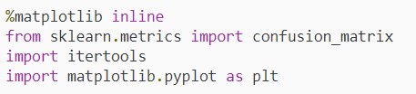
9 Confusion Matrix
https://www.youtube.com/watch?v=km7pxKy4UHU&list=PLZbbT5o_s2xrwRnXk_yCPtnqqo4_u2YGL&index=9
Plot a Confusion Matrix
First, import libraries.
The confusion matrix will be plotting from scikit-learn.
Create confusion matrix and assign it to the variable cm.
We pass the true labels test_labels and predicted labels rounded_predictions.

Slide 5
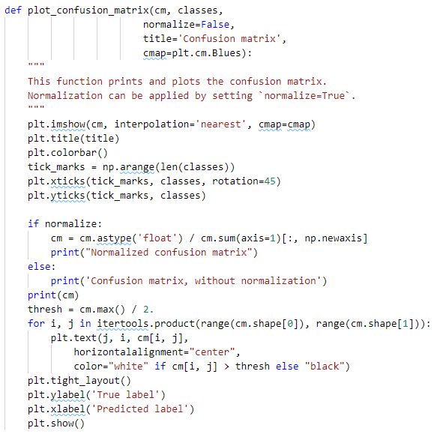
9 Confusion Matrix
https://www.youtube.com/watch?v=km7pxKy4UHU&list=PLZbbT5o_s2xrwRnXk_yCPtnqqo4_u2YGL&index=9
Plot a Confusion Matrix

Slide 6
9 Confusion Matrix
https://www.youtube.com/watch?v=km7pxKy4UHU&list=PLZbbT5o_s2xrwRnXk_yCPtnqqo4_u2YGL&index=9
Plot a Confusion Matrix
Next, we define the labels for the confusion matrix. In our case, the labels are titled “no side effects” and “had side effects.”
Plot a Confusion Matrix

Slide 7
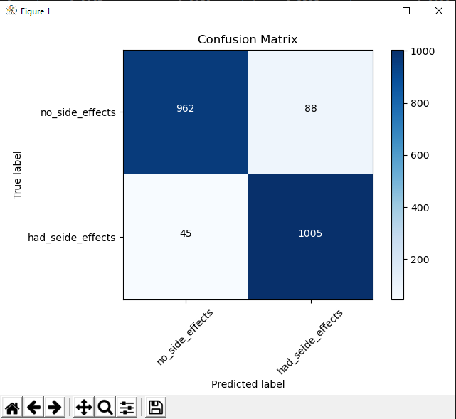

9 Confusion Matrix
https://www.youtube.com/watch?v=km7pxKy4UHU&list=PLZbbT5o_s2xrwRnXk_yCPtnqqo4_u2YGL&index=9
Plot a Confusion Matrix

Slide 8
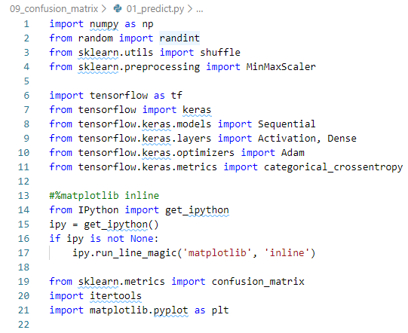
9 Confusion Matrix
https://www.youtube.com/watch?v=km7pxKy4UHU&list=PLZbbT5o_s2xrwRnXk_yCPtnqqo4_u2YGL&index=9
Keras Code:
Import libraries.

Slide 9
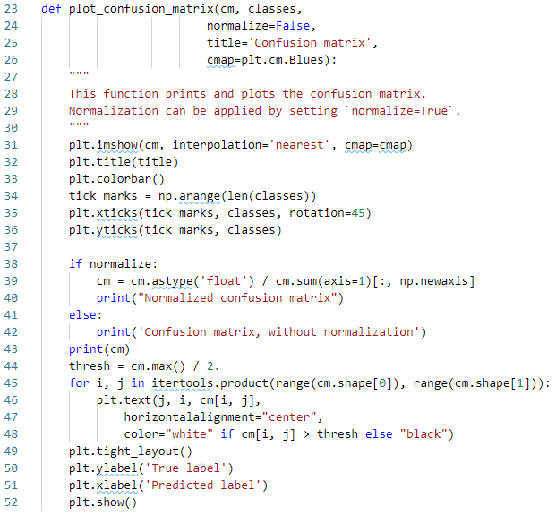
9 Confusion Matrix
https://www.youtube.com/watch?v=km7pxKy4UHU&list=PLZbbT5o_s2xrwRnXk_yCPtnqqo4_u2YGL&index=9
Keras Code:
Plot confusion matrix.

Slide 10

9 Confusion Matrix
https://www.youtube.com/watch?v=km7pxKy4UHU&list=PLZbbT5o_s2xrwRnXk_yCPtnqqo4_u2YGL&index=9
Keras Code:
Create cm = plot_confusion_matrix ()
Create cm_plot_labels
Call plot_confusion_matrix()

Slide 11
9 Confusion Matrix
https://www.youtube.com/watch?v=km7pxKy4UHU&list=PLZbbT5o_s2xrwRnXk_yCPtnqqo4_u2YGL&index=9
Plot a Confusion Matrix: Result

Slide 12
9.1 Quiz

Slide 13
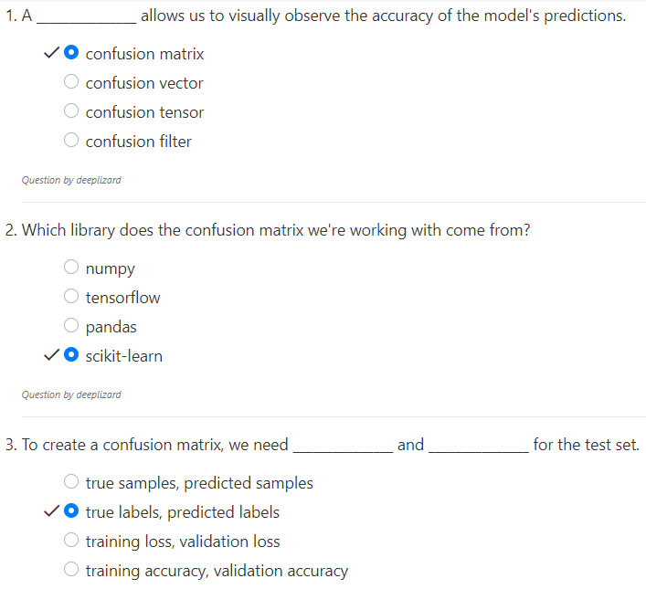
9.1 Quiz
https://www.youtube.com/watch?v=km7pxKy4UHU&list=PLZbbT5o_s2xrwRnXk_yCPtnqqo4_u2YGL&index=9
Quiz

Slide 14
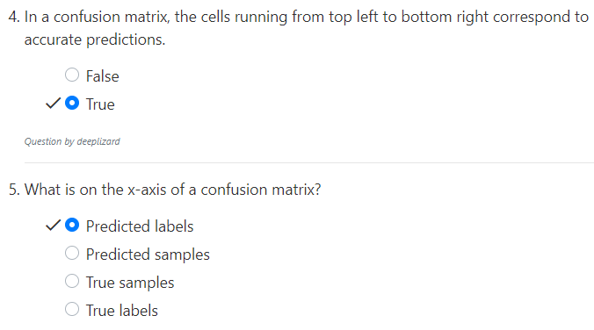
9.1 Quiz
https://www.youtube.com/watch?v=km7pxKy4UHU&list=PLZbbT5o_s2xrwRnXk_yCPtnqqo4_u2YGL&index=9
Quiz

Slide 15
End of Chapter

