Slide 1

26 Pure Component
Peter H. Chen

Slide 2
26 Pure Component
https://www.youtube.com/watch?v=YCRuTT31qR0&list=PLC3y8-rFHvwgg3vaYJgHGnModB54rxOk3&index=26
Pure Component
We discuss the Pure Component in this discussion.
PureComponent is used for Performance Optimization. If your React component's render() function renders the same result given the same props and state, you can use PureComponent for a performance boost in some cases.
The biggest difference between React pure component vs a regular React component is that a React component doesn’t implement shouldComponentUpdate() by default.
On the other hand, React pure component does implement shouldComponentUpdate() by default, and by performing a shallow comparison on React state and props values.

Slide 3
26 Pure Component
https://www.youtube.com/watch?v=YCRuTT31qR0&list=PLC3y8-rFHvwgg3vaYJgHGnModB54rxOk3&index=26
Pure Component
You can see that even the App component extends from react.component.
It turns out there is a second way to create a class component and that is by extending the pure component class from React.
What is the difference between the component class and the pure component class?
When should we use one over the other?
Look at the example.

Slide 4
26 Pure Component
https://www.youtube.com/watch?v=YCRuTT31qR0&list=PLC3y8-rFHvwgg3vaYJgHGnModB54rxOk3&index=26
Pure Component
In order to see the difference, we create the following class components:
Create ./components/PureComp.js for pure component.
Create ./components/RegComp.js for regular component.
Create ./components/ParentComp.js for parent component. The Parent component that is capable of changing its state.
The component tree is shown on the right.
App Component
Parent Component
Regular
Component
Pure Component

Slide 5
26 Pure Component
https://www.youtube.com/watch?v=YCRuTT31qR0&list=PLC3y8-rFHvwgg3vaYJgHGnModB54rxOk3&index=26
Pure Component
component that is capable of changing its state.
Note:
in pure component, we type ‘rpce’ (React Pure Component ES7)
We import { PureComponent } from ‘react’
What is the difference of Pure Component and Class Component?

Slide 6
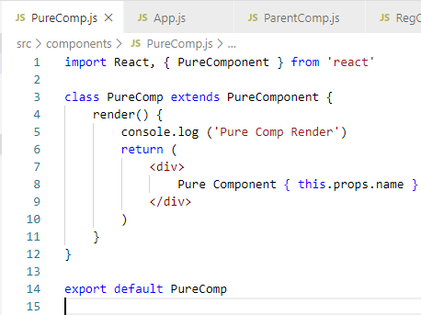
26 Pure Component
https://www.youtube.com/watch?v=YCRuTT31qR0&list=PLC3y8-rFHvwgg3vaYJgHGnModB54rxOk3&index=26
Pure Component
We create the PureComp.js.
In PureComp.js, we type ‘rpce’ (React Pure Component ES7) to create a pure component.
You can see the difference of pure component class and regular class component.
In stead of importing the { Component } from React, we are now importing { PureComponent} from React.
We also extending the same (PureComponent).

Slide 7
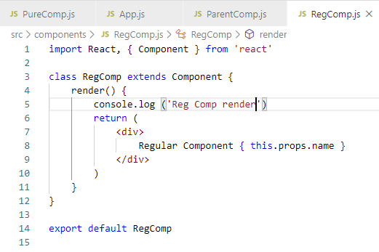
26 Pure Component
https://www.youtube.com/watch?v=YCRuTT31qR0&list=PLC3y8-rFHvwgg3vaYJgHGnModB54rxOk3&index=26
Regular Component
In the RegComp.js, we type rce (React Component ES7) to import the { Component} from React.

Slide 8
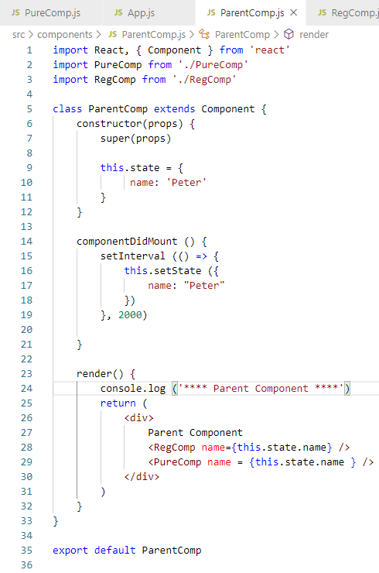
26 Pure Component
https://www.youtube.com/watch?v=YCRuTT31qR0&list=PLC3y8-rFHvwgg3vaYJgHGnModB54rxOk3&index=26
Parent Component
In the Parent Component, we also type rce (React Component for ES7) for the regular class component.
In the ParentComp.js, we can see it is importing { Component } from React.
The Parent class Component includes the capability to changing the state inside the Parent Component.
Type ‘rcon’ (React Constructor) before the render function.
In this.state, we add the name: ‘Peter’

Slide 9
26 Pure Component
https://www.youtube.com/watch?v=YCRuTT31qR0&list=PLC3y8-rFHvwgg3vaYJgHGnModB54rxOk3&index=26
Parent Component
Add componentDidMount().
> componentDidMount () {
> setInterval (() => {
> this.state ({ name: ‘Peter’})
> }, 2000)
> }
In the render (), we add regular component and pure component.

Slide 10
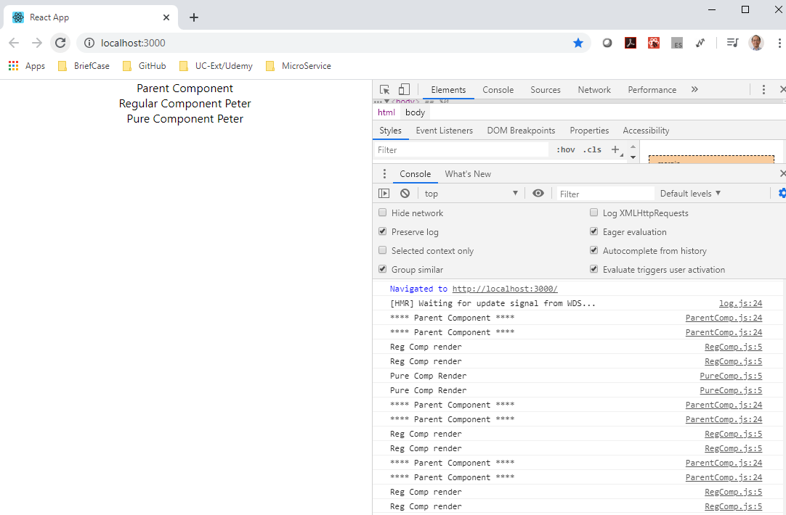
26 Pure Component
https://www.youtube.com/watch?v=YCRuTT31qR0&list=PLC3y8-rFHvwgg3vaYJgHGnModB54rxOk3&index=26
Pure Component
Note: SetInterval is for Regular component, not for Pure Component.

Slide 11
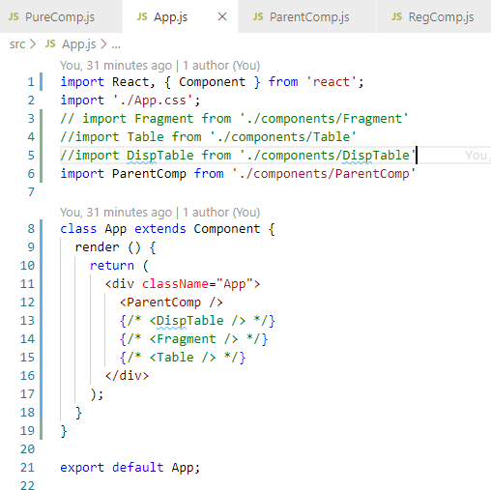
26 Pure Component
https://www.youtube.com/watch?v=YCRuTT31qR0&list=PLC3y8-rFHvwgg3vaYJgHGnModB54rxOk3&index=26
App Component
Finally, in App.js, we add the parent component.

Slide 12
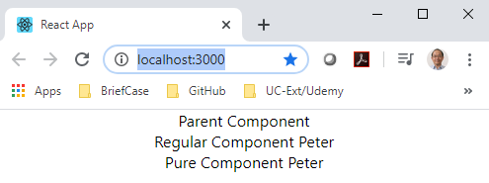
26 Pure Component
https://www.youtube.com/watch?v=YCRuTT31qR0&list=PLC3y8-rFHvwgg3vaYJgHGnModB54rxOk3&index=26
App Component
Now, look at the browser.
You should able to see the expected output: parent component, regular component, and pure component.

Slide 13
26.1 Add console.log

Slide 14
26.1 Add console.log
https://www.youtube.com/watch?v=YCRuTT31qR0&list=PLC3y8-rFHvwgg3vaYJgHGnModB54rxOk3&index=26
What is the Concern?
What we really concern about in this example is when the render method is called in each of the components.
We go back the code and add the console.log () statement in all of these three components.

Slide 15
26.1 Add console.log
https://www.youtube.com/watch?v=YCRuTT31qR0&list=PLC3y8-rFHvwgg3vaYJgHGnModB54rxOk3&index=26
Parent Component
Add Console.log in parent component.

Slide 16
26.1 Add console.log
https://www.youtube.com/watch?v=YCRuTT31qR0&list=PLC3y8-rFHvwgg3vaYJgHGnModB54rxOk3&index=26
Pure Component
Add console.log() in pure component.

Slide 17
26.1 Add console.log
https://www.youtube.com/watch?v=YCRuTT31qR0&list=PLC3y8-rFHvwgg3vaYJgHGnModB54rxOk3&index=26
Regular Component
Add console.log () in Regular component.

Slide 18
26.2 Check Console in browser

Slide 19
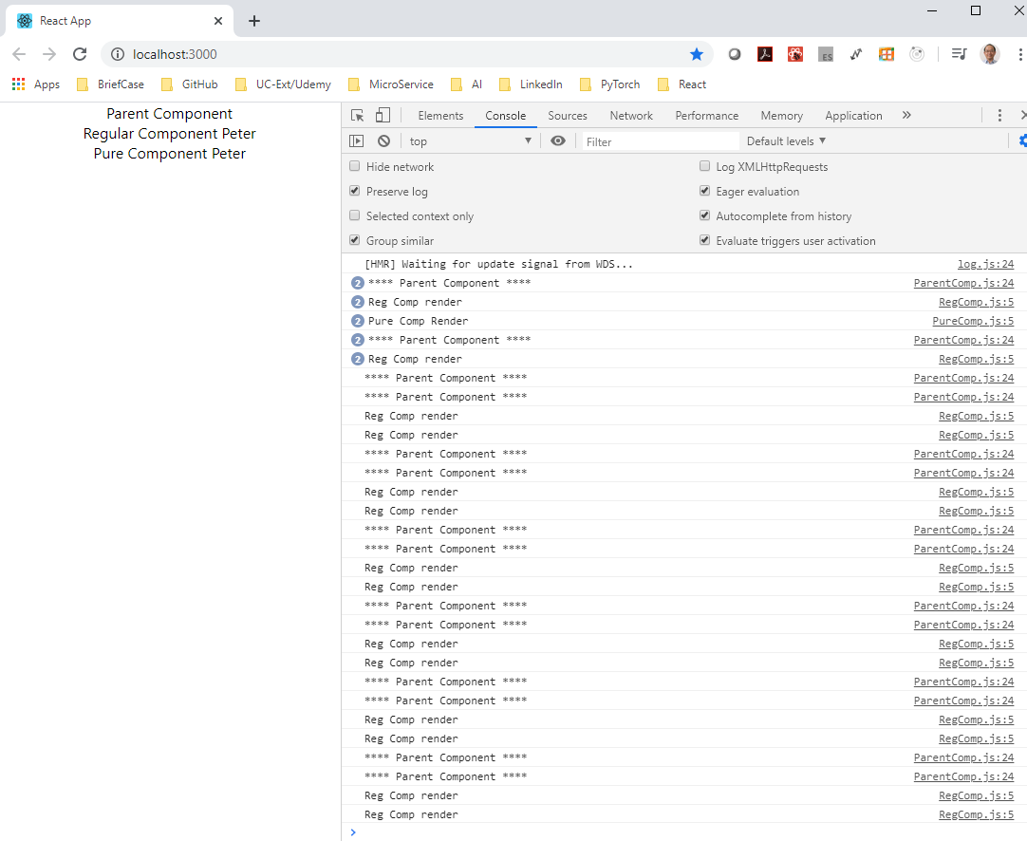
26.2 Check Console in Browser
https://www.youtube.com/watch?v=YCRuTT31qR0&list=PLC3y8-rFHvwgg3vaYJgHGnModB54rxOk3&index=26
Check Console in Browser
Initially, we have parent render, Regular Component, and Pure Component render.
But, after that, every two seconds, the set state method is called which will re-render the parent component.

Slide 20
26.2 Check Console in Browser
https://www.youtube.com/watch?v=YCRuTT31qR0&list=PLC3y8-rFHvwgg3vaYJgHGnModB54rxOk3&index=26
Check Console in Browser
If parent component re-render, the child component will also re-render.
Unless, your return false from shouldComponentUpdate.
We should see the render method from both regular component and pure components being logged.

Slide 21
26.2 Check Console in Browser
https://www.youtube.com/watch?v=YCRuTT31qR0&list=PLC3y8-rFHvwgg3vaYJgHGnModB54rxOk3&index=26
Check Console in Browser
However, we only see the regular component log message but not the pure component.
Every two seconds, the Parent component and regular component are re-render.
But the pure component is never re-rendered.

Slide 22
26.2 Check Console in Browser
https://www.youtube.com/watch?v=YCRuTT31qR0&list=PLC3y8-rFHvwgg3vaYJgHGnModB54rxOk3&index=26
Check Console in Browser
This is the difference between the regular component class and pure component class.

Slide 23
26.3 Regular vs. Pure Component

Slide 24
26.3 Regular vs. Pure Component
https://www.youtube.com/watch?v=YCRuTT31qR0&list=PLC3y8-rFHvwgg3vaYJgHGnModB54rxOk3&index=26
Pure Component
Regular Component
A regular component does not implement the shouldComponentUpdate method.
It always returns true by default.
Pure Component
A Pure component, on the other hand, implement the shouldComponentUpdate method
with a shallow props and state comparison.
What is exactly the shallow props and state comparison?

Slide 25
26.4 Shallow Comparison

Slide 26
26.4 Shallow Comparison
https://www.youtube.com/watch?v=YCRuTT31qR0&list=PLC3y8-rFHvwgg3vaYJgHGnModB54rxOk3&index=26
Shallow Comparison (SC)
Shallow props and state comparison
We take a look at shallow comparison with respect to primitive type and complex type.

Slide 27
26.4 Shallow Comparison
https://www.youtube.com/watch?v=YCRuTT31qR0&list=PLC3y8-rFHvwgg3vaYJgHGnModB54rxOk3&index=26
Shallow Comparison (SC):
Primitive Types
For two primitive types a and b in numbers, strings, and Boolean.
a (SC) b returns true if a and b have the same value and are of the same type.
e.g., string ‘Peter’ (SC) string ‘Peter’ return true
Complex Types
For two complex types a and b in numbers, strings, and Boolean.
a (SC) b returns true if a and b reference the exact object.
e.g.,
var a = [1, 2, 3];
var b = [1, 2, 3];
var c = a;
var ab_eq = (a === b); // false
var ac_eq = (a === c); // true
e.g.,
var a = { x:1, y: 2 };
var b = { x:1, y: 2 };
var c = a;
var ab_eq = (a === b); // false
var ac_eq = (a === c); // true

Slide 28
26.4 Shallow Comparison
https://www.youtube.com/watch?v=YCRuTT31qR0&list=PLC3y8-rFHvwgg3vaYJgHGnModB54rxOk3&index=26
Pure Component
A pure component implement shouldComponentUpdate with a shallow porp and state comparison.
Difference?
SC of prevState with currentState
SC of prevProps with currentProps
Re-render component

Slide 29
26.5 Summary of Pure Component

Slide 30
26.5 Summary of Pure Component
https://www.youtube.com/watch?v=YCRuTT31qR0&list=PLC3y8-rFHvwgg3vaYJgHGnModB54rxOk3&index=26
Summary of Pure Component
We can create a component by extending the PureCompoent class.
A PureComponent implements the shouldComponentUpdate lifecycle method by performing a shallow comparison on the props and state of the component.
If there is no difference, the component is not re-rendered- Performance boost.
It is a good idea to ensure that all the children components are also pure to avoid unexpected behavior.
Never mutate the state. Always return a new object that reflects the new state.
It is safe to use regular components most of the time unless you have a performance need in some components.

Slide 31
26.6 Quiz

Slide 32
26.6 Quiz
https://www.youtube.com/watch?v=YCRuTT31qR0&list=PLC3y8-rFHvwgg3vaYJgHGnModB54rxOk3&index=26
Quiz
1. What is difference between the pure component and regular component?
Ans:
a) PureComponent is used for Performance Optimization.
b) The biggest difference between React pure component vs a regular React component is that a React component doesn’t implement shouldComponentUpdate() by default.
c) On the other hand, React pure component does implement shouldComponentUpdate() by default, and by performing a shallow comparison on React state and props values. If all the props and state are the same, shouldComponentUpdate() return false, i.e., never update any UI component.

Slide 33
End of Chapter

