Slide 1
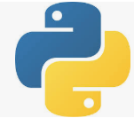
2 Skip/Select Run Test
Peter H. Chen

Slide 2
2 Skip/Select Run Test
https://www.youtube.com/watch?v=nv9zw454bEk&list=PLeo1K3hjS3utzQYDNRNluzqJqpMXx6hHu&index=2
Topics:
Skip Test
Select Run Test
Custom markers.

Slide 3
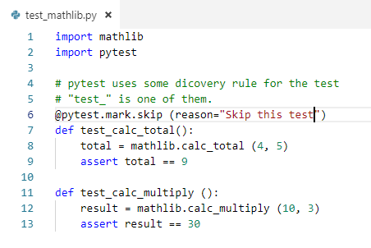
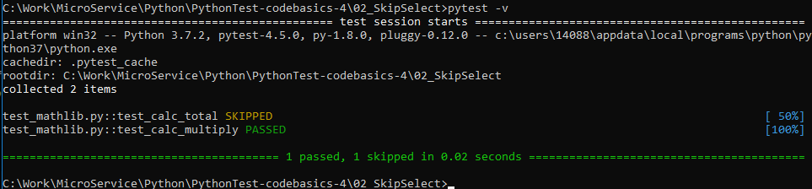
2 Skip/Select Run Test
https://www.youtube.com/watch?v=nv9zw454bEk&list=PLeo1K3hjS3utzQYDNRNluzqJqpMXx6hHu&index=2
Right now, we have two tests calc_total() and calc_multiply().
If we want to skip some of the test, how can we do that?
Import pytest and use @pytest.mark.skip () as below:

Slide 4
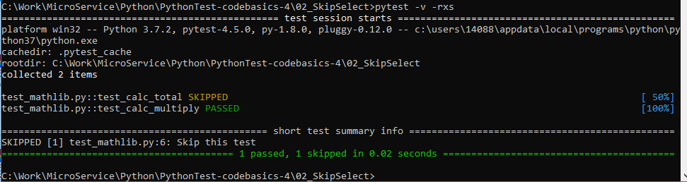
2 Skip/Select Run Test
https://www.youtube.com/watch?v=nv9zw454bEk&list=PLeo1K3hjS3utzQYDNRNluzqJqpMXx6hHu&index=2
If you wan to see the reason, use the option “-rxs”:
> pytest –v -rxs

Slide 5
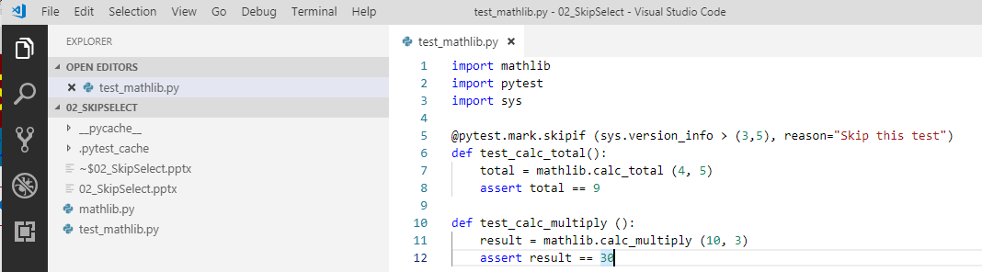
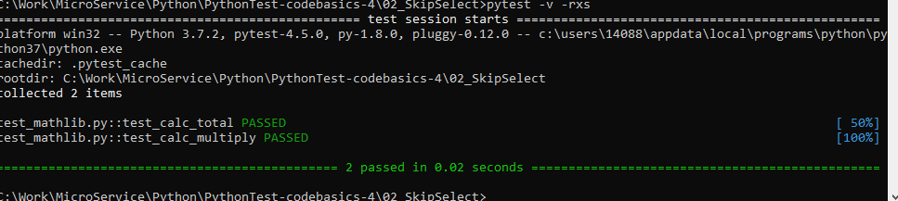
2 Skip/Select Run Test
https://www.youtube.com/watch?v=nv9zw454bEk&list=PLeo1K3hjS3utzQYDNRNluzqJqpMXx6hHu&index=2
I want to skip this test if python version is greater then 3.5. How to do that?

Slide 6
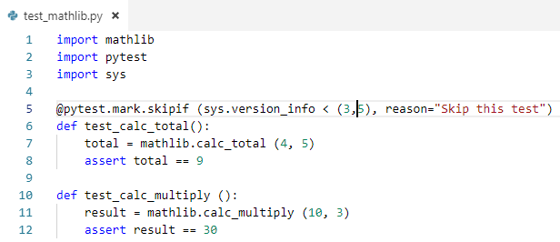
2 Skip/Select Run Test
https://www.youtube.com/watch?v=nv9zw454bEk&list=PLeo1K3hjS3utzQYDNRNluzqJqpMXx6hHu&index=2
I want to skip this test if python version is less then 3.5. How to do that?

Slide 7
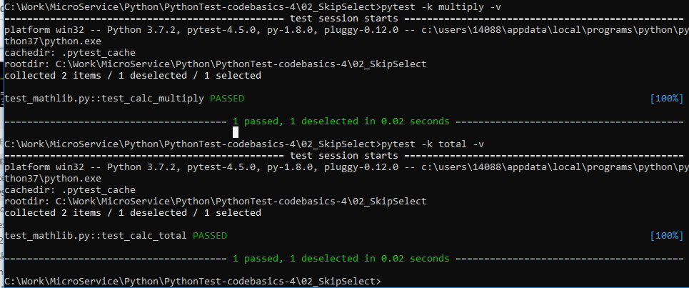
2 Skip/Select Run Test
https://www.youtube.com/watch?v=nv9zw454bEk&list=PLeo1K3hjS3utzQYDNRNluzqJqpMXx6hHu&index=2
I want to run tests based on their names.
I want to select the test name with “multiply”
> pytest –k multiply
I want to select the test name with “total”
> pytest –k total

Slide 8
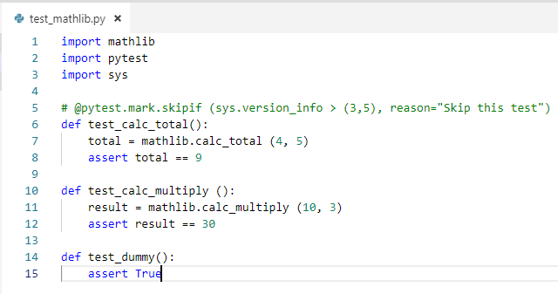
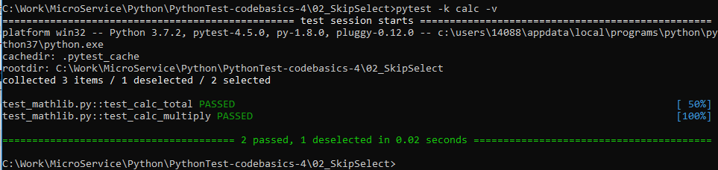
2 Skip/Select Run Test
https://www.youtube.com/watch?v=nv9zw454bEk&list=PLeo1K3hjS3utzQYDNRNluzqJqpMXx6hHu&index=2
How to select tests with “calc”?
> pytest –k calc -v

Slide 9
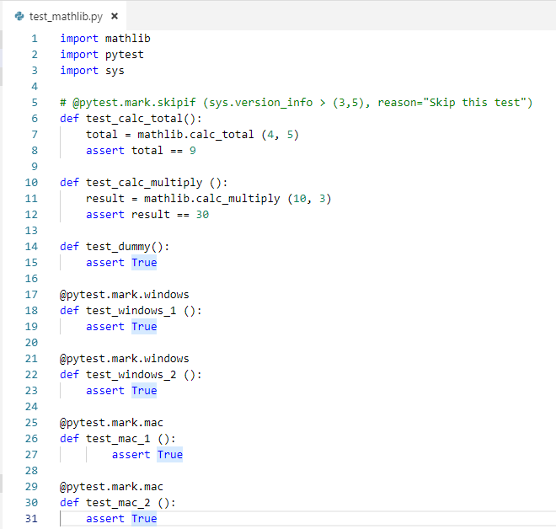
2 Skip/Select Run Test
https://www.youtube.com/watch?v=nv9zw454bEk&list=PLeo1K3hjS3utzQYDNRNluzqJqpMXx6hHu&index=2
How to group the test? Use custom marker to group the tests.
We group into “@pytest.mark.windows” and “@pytest.mark.mac”

Slide 10
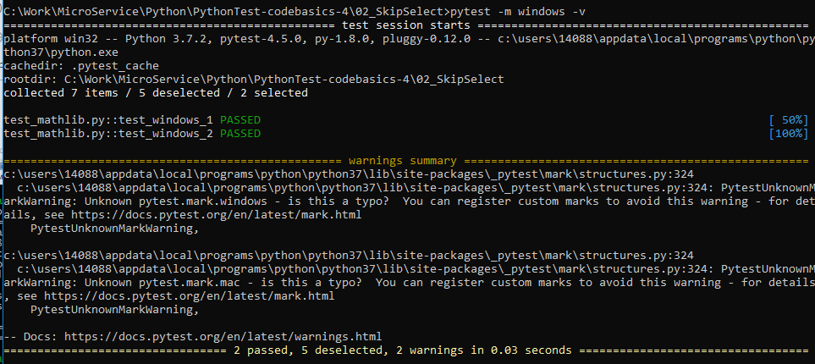
2 Skip/Select Run Test
https://www.youtube.com/watch?v=nv9zw454bEk&list=PLeo1K3hjS3utzQYDNRNluzqJqpMXx6hHu&index=2
Test mark with window
> pytest –m windows -v
Test mark with mac
> pytest –m mac –v
There are warning messages.

Slide 11
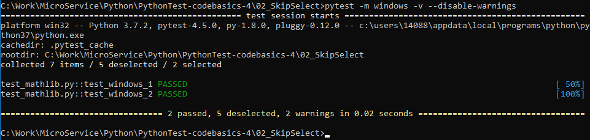
2 Skip/Select Run Test
https://www.youtube.com/watch?v=nv9zw454bEk&list=PLeo1K3hjS3utzQYDNRNluzqJqpMXx6hHu&index=2
We can use “—disable-warnings” to remove the warning messages.
> pytest –m windows –v –disable-warnings

Slide 12
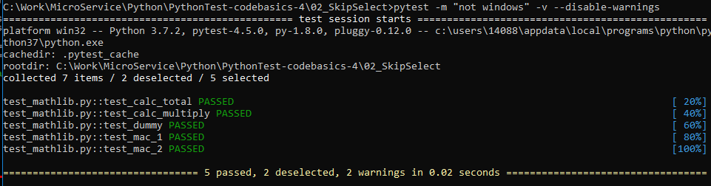
2 Skip/Select Run Test
https://www.youtube.com/watch?v=nv9zw454bEk&list=PLeo1K3hjS3utzQYDNRNluzqJqpMXx6hHu&index=2
How to test all the tests which is “not windows”?
> ptest –m “not windows” –v –disable-warnings

Slide 13
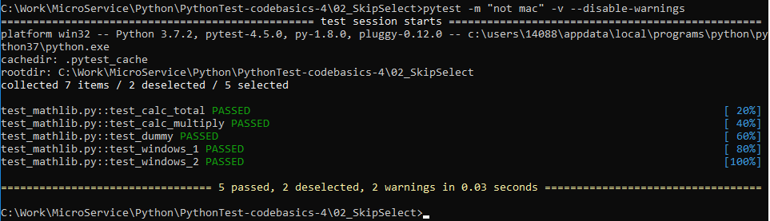
2 Skip/Select Run Test
https://www.youtube.com/watch?v=nv9zw454bEk&list=PLeo1K3hjS3utzQYDNRNluzqJqpMXx6hHu&index=2
How to test all the tests which is “not mac”?
> ptest –m “not mac” –v –disable-warnings

Slide 14
End of Chapter

