Slide 1

3 Fixture
Peter H. Chen

Slide 2
3 Fixture
https://www.youtube.com/watch?v=IVrGz8w0H8c&list=PLeo1K3hjS3utzQYDNRNluzqJqpMXx6hHu&index=3
This section discusses fixtures.
We want to verify John’s employee ID
Verify Tom’s employee ID

Slide 3
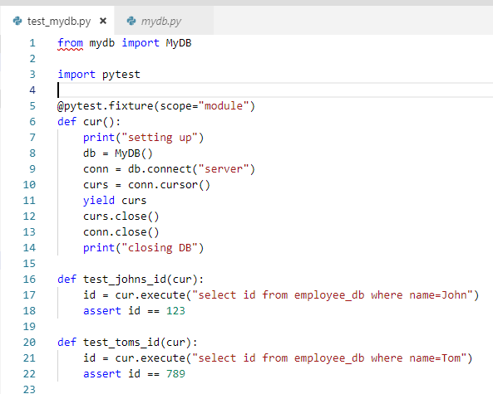
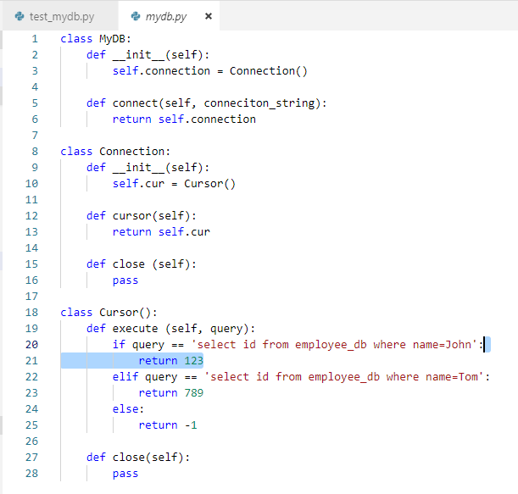
3 Fixture
https://www.youtube.com/watch?v=IVrGz8w0H8c&list=PLeo1K3hjS3utzQYDNRNluzqJqpMXx6hHu&index=3
From file mydb.py import class/module MyDB defined in mydb.py
Import framework pytest
@pytest.fixture …

Slide 4
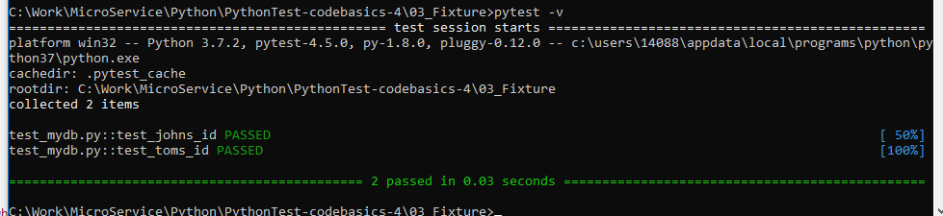
3 Fixture
https://www.youtube.com/watch?v=IVrGz8w0H8c&list=PLeo1K3hjS3utzQYDNRNluzqJqpMXx6hHu&index=3
Remove the folders .pytest_cache and __pycache__.
These files keep the errors.
> pytest -v

Slide 5
End of Chapter

