Slide 1

4 Parameter
Peter H. Chen

Slide 2

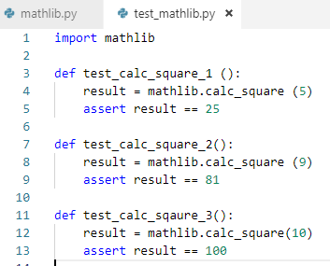
4 Parameter
https://www.youtube.com/watch?v=2EGgtlf7BN0&list=PLeo1K3hjS3utzQYDNRNluzqJqpMXx6hHu&index=4
This section discusses pytest Parameters.
Pass parameter into function (parameter).

Slide 3
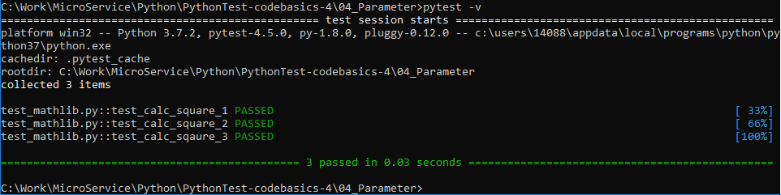
4 Parameter
https://www.youtube.com/watch?v=2EGgtlf7BN0&list=PLeo1K3hjS3utzQYDNRNluzqJqpMXx6hHu&index=4
Run pytest
> pytest -v

Slide 4
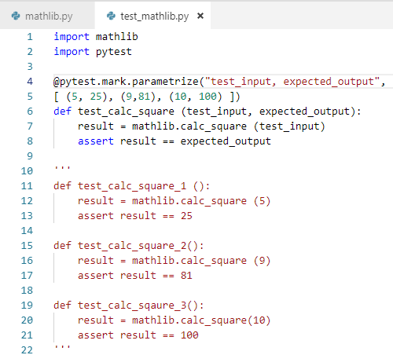
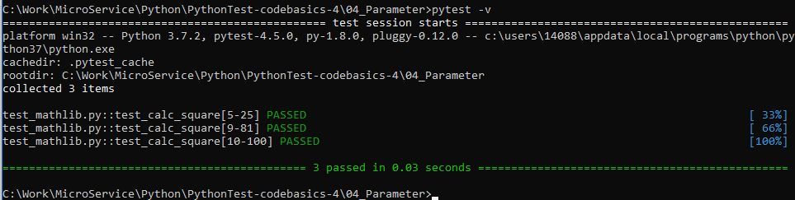
4 Parameter
https://www.youtube.com/watch?v=2EGgtlf7BN0&list=PLeo1K3hjS3utzQYDNRNluzqJqpMXx6hHu&index=4
It is better to use one test function and expected value.
import pytest
@pytest.mark.parametrize (“test_input, expected_output”, [(5, 25) …])

Slide 5
End of Chapter

