Slide 1

5 Multi-Layer Perceptrons (1)
Peter H. Chen

Slide 2
5 Multi-Layer Perceptrons (1)
https://www.tensorflow.org/tutorials/
List of Topics
What is a single-layer Perceptron?
Half-plane classifier
Rectangle classifier
Activation functions
Weight initialization
Cost functions
TF and Perceptrons
Back propagation

Slide 3
5 Multi-Layer Perceptrons (1)
https://www.tensorflow.org/tutorials/
NNs and Terminology (1)
Shallow Neural Network:
A NN with one output and one hidden layer aka two-layered neural network (input layer is not counted)
Deep Neural Network (DNN):
A NN with three or more hidden layers
No difference in computation versus shallow NNs
Very deep NNs have 10 or more layers

Slide 4
5 Multi-Layer Perceptrons (1)
https://www.tensorflow.org/tutorials/
NNs and Terminology (2)
Supervised learning problems:
The data set contains the correct output
look for relationship between the input and the output
Supervised learning problems:
"regression" problems or
"classification" problems
Examples of supervised learning:
Image classification via CNNs

Slide 5
5 Multi-Layer Perceptrons (1)
https://www.tensorflow.org/tutorials/
NNs and Terminology (3)
Regression:
we want to predict results within a continuous output, so we map input variables to some continuous function (e.g., housing prices)
Classification:
we want to predict results in a discrete output, so we map input variables into discrete categories such (e.g., cat vs non-cat)

Slide 6
5 Multi-Layer Perceptrons (1)
https://www.tensorflow.org/tutorials/
NNs and Terminology (4)
Unsupervised learning:
data sets do not contain our output
NN classifies the data by identifying a relationship between the data set
"clustering" algorithms (are classification algorithms)
unsupervised learning examples:
video games, Go, and so forth

Slide 7
5 Multi-Layer Perceptrons (1)
https://www.tensorflow.org/tutorials/
What is Perceptrons? (1)
smallest unit in a neural network
can have multiple inputs
the unit performs computations:
=> (input vector) x (the weights matrix)
generates a single value output
ex: a binary value to classify two classes

Slide 8
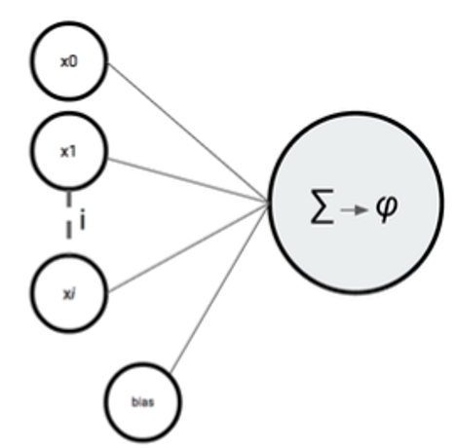
5 Multi-Layer Perceptrons (1)
https://www.tensorflow.org/tutorials/
What is Perceptrons? (2)
bias

Slide 9
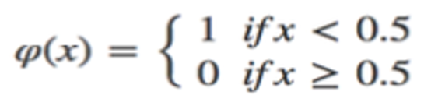
5 Multi-Layer Perceptrons (1)
https://www.tensorflow.org/tutorials/
What is Perceptrons? (3)

Slide 10
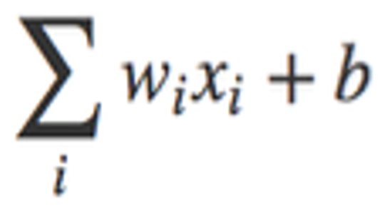
5 Multi-Layer Perceptrons (1)
https://www.tensorflow.org/tutorials/
What is Perceptrons? (4)

Slide 11
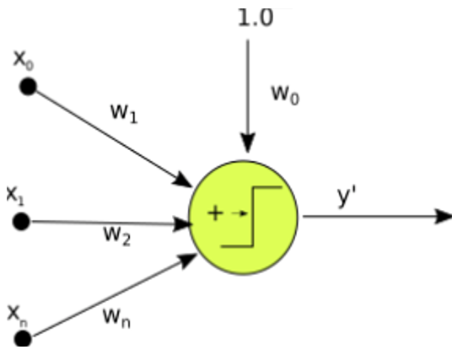
5 Multi-Layer Perceptrons (1)
https://www.tensorflow.org/tutorials/
Single Perceptrons? (1)

Slide 12
5 Multi-Layer Perceptrons (1)
https://www.tensorflow.org/tutorials/
Perceptron Algorithm
Initialize weights randomly (low values)
Compute inner product of vector and weights
Compare with the threshold value
EX: output 1 if w*x + b > 0 (else output 0)
Adjust weights and repeat process

Slide 13
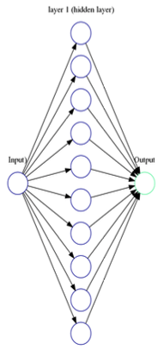
5 Multi-Layer Perceptrons (1)
https://www.tensorflow.org/tutorials/
One-Layer Perceptron

Slide 14
5 Multi-Layer Perceptrons (1)
https://www.tensorflow.org/tutorials/
Classifier Example #1 (1)
Given some red dots and blue dots
Red dots are in the upper half plane
Blue dots in the lower half plane
How to decide if a point is red or blue?

Slide 15
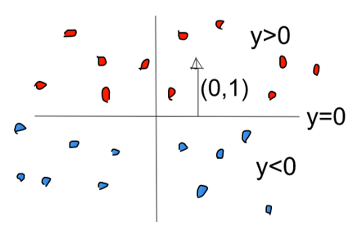
5 Multi-Layer Perceptrons (1)
https://www.tensorflow.org/tutorials/
Classifier Example #1 (2)

Slide 16
5 Multi-Layer Perceptrons (1)
https://www.tensorflow.org/tutorials/
Classifier Example #1 (3)
X
0
The neuron
fires if y >= 0
0
1
Y

Slide 17
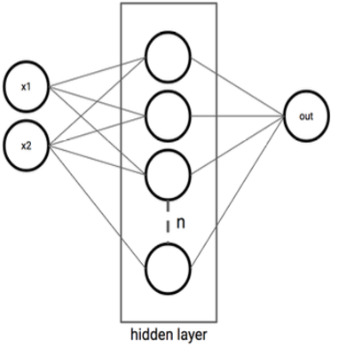
5 Multi-Layer Perceptrons (1)
https://www.tensorflow.org/tutorials/
One Hidden Layer NN

Slide 18
5 Multi-Layer Perceptrons (1)
https://www.tensorflow.org/tutorials/
Classifier Example #2 (1)
Given some red dots and blue dots
Red dots are inside a unit square
Blue dots are outside the unit square
How to decide if a point is red or blue?

Slide 19
5 Multi-Layer Perceptrons (1)
https://www.tensorflow.org/tutorials/
Classifier Example #2 (2)
Two input nodes X and Y
One hidden layer with 4 nodes (one per line)
X & Y weights are the (x, y) values of the inward pointing perpendicular vector of each side
The threshold values are the negative of the y-intercept (or the x-intercept)
The outbound weights are all equal to 1
The threshold for the output node is 4

Slide 20
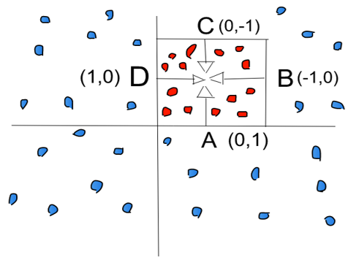
5 Multi-Layer Perceptrons (1)
https://www.tensorflow.org/tutorials/
Classifier Example #2 (3)

Slide 21
5 Multi-Layer Perceptrons (1)
https://www.tensorflow.org/tutorials/
Classifier Example #2 (4)
0
0
A
1
X
1
 | X | Y
A | 0 | 1
B | -1 | 0
C | 0 | -1
D | 1 | 0
-1
B
0, -1, 0, 1
-1
1
0
4
1
0
C
1
Y
-1
-1
1, 0, -1, 0
1
0
D
0

Slide 22
5 Multi-Layer Perceptrons (1)
https://www.tensorflow.org/tutorials/
Classifier Exercise #1
Describe an NN for a triangle
Describe an NN for a pentagon
Describe an NN for an n-gon (convex)
Describe an NN for an n-gon (non-convex)

Slide 23
5 Multi-Layer Perceptrons (1)
https://www.tensorflow.org/tutorials/
Classifier Exercise #2
Create an NN for an OR gate
Create an NN for a NOR gate
Create an NN for an AND gate
Create an NN for a NAND gate
Create an NN for an XOR gate
=> requires TWO hidden layers

Slide 24
5 Multi-Layer Perceptrons (1)
https://www.tensorflow.org/tutorials/
Classifier Example #2
A few points to keep in mind:
A “step” activation function (0 or 1)
No back propagation
No cost function
=> no learning involved

Slide 25
5 Multi-Layer Perceptrons (1)
https://www.tensorflow.org/tutorials/
Activation Functions tbd
ReLU (CNNs)
Softmax (FC layer in CNNs)
Sigmoid + Tanh (LSTMs)
ReLU6 (TensorFlow)
ELU (variant of ReLU)

Slide 26
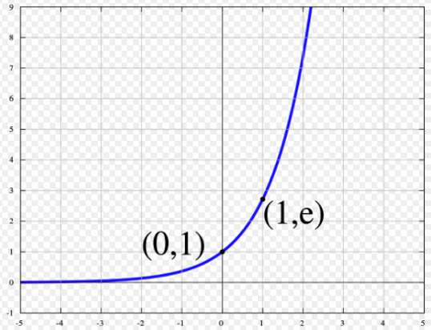
5 Multi-Layer Perceptrons (1)
https://www.tensorflow.org/tutorials/
Euler’s Function

Slide 27
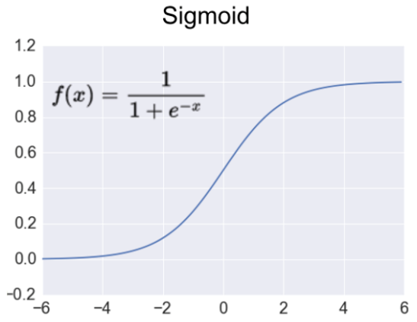
5 Multi-Layer Perceptrons (1)
https://www.tensorflow.org/tutorials/
The sigmoid Activation Function

Slide 28
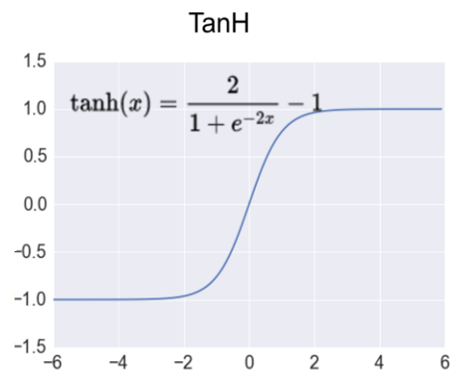
5 Multi-Layer Perceptrons (1)
https://www.tensorflow.org/tutorials/
The tanh Activation Function

Slide 29
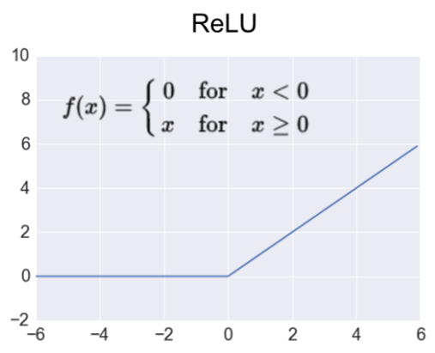
5 Multi-Layer Perceptrons (1)
https://www.tensorflow.org/tutorials/
The ReLU Activation Function

Slide 30
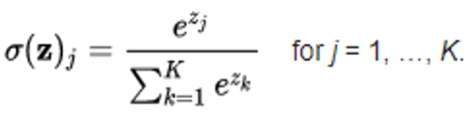
5 Multi-Layer Perceptrons (1)
https://www.tensorflow.org/tutorials/
The softmax Activation Function

Slide 31
5 Multi-Layer Perceptrons (1)
https://www.tensorflow.org/tutorials/
Activation Functions in Python
import numpy as np
...
# Python sigmoid example:
z = 1/(1 + np.exp(-np.dot(W, x)))
...
# Python tanh example:
z = np.tanh(np.dot(W,x));
# Python ReLU example:
z = np.maximum(0, np.dot(W, x))

Slide 32
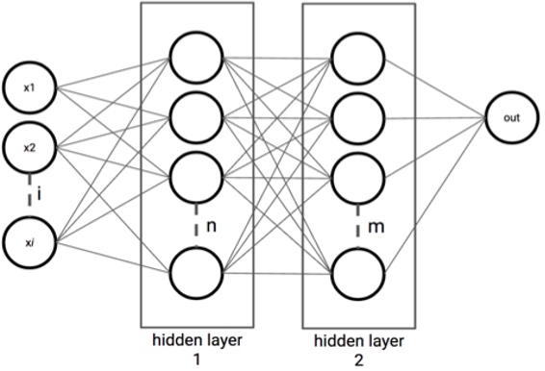
5 Multi-Layer Perceptrons (1)
https://www.tensorflow.org/tutorials/
Two Hidden Layers NN

Slide 33
5 Multi-Layer Perceptrons (1)
https://www.tensorflow.org/tutorials/
TF and Perceptrons tbd
Import MNIST data
Hyperparameters
Network Parameters
Store layers weight & bias
Create model
Construct model
Define loss and optimizer
Evaluate model
Initialize variables (default values)
Start training

Slide 34
End of Chapter

