Slide 1

5 Multi-Layer Perceptrons (2)
Peter H. Chen

Slide 2
5 Multi-Layer Perceptrons (2)
https://www.tensorflow.org/tutorials/
List of Topics
Calculating Backprop:
  Derivatives
  Partial derivatives
  Chain rule
Multi-Layer Perceptrons
MLPs and XOR

Slide 3
5 Multi-Layer Perceptrons (2)
https://www.tensorflow.org/tutorials/
Calculating Backpropagation
Involves the chain rule
Products of partial derivatives
Paths to nodes

Slide 4
5 Multi-Layer Perceptrons (2)
https://www.tensorflow.org/tutorials/
Basic Derivatives
f(x) = x^3 f'(x) = 3*x^2
f(x) = x^n f'(x) = n*x^(n-1)
f(x) = sin(x) f'(x) = cos(x)
f(x) = cos(x) f'(x) = -sin(x)
f(x) = log(x) f'(x) = 1/x
f(x) = e^x f'(x) = e^x

Slide 5

5 Multi-Layer Perceptrons (2)
https://www.tensorflow.org/tutorials/
More Derivatives (Optional)
Product Rule:
f(x) = g(x)*h(x)
f'(x) = g'(x)*h(x) + g(x)*h’(x)
Quotient Rule:
f(x) = g(x)/h(x)
Quotient Rule:

Slide 6
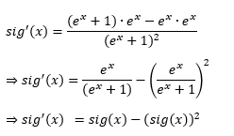
5 Multi-Layer Perceptrons (2)
https://www.tensorflow.org/tutorials/
Sigmoid Derivative (Optional)
sig(x) = (e^x)/[e^x + 1]
[e^x + 1]*e^x - e^x*e^x
sig'(x) = ------------------------
[e^x + 1]^2
e^x | e^x |
= ----------- - |----------- | ^2
[e^x + 1] |[e^x + 1]|
= sig(x) – (sig(x))^2

Slide 7
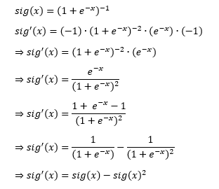
5 Multi-Layer Perceptrons (2)
https://www.tensorflow.org/tutorials/
Sigmoid Derivative (Optional)
sig(x) = [1 + e^(-x)]^(-1)
sig'() = (-1)*[1+e^(-x)]^(-2)*e^(-x)*(-1)
= [1+e^(-x)]^(-2) * e^(-x)
e^(-x)
= ------------
[1+e^(-x)]^2
1 + e^(-x) - 1
= --------------
[1+e^(-x)]^2
1 + e^(-x) - 1
= --------------
[1+e^(-x)]^2
1 1
= ---------- - ------------
[1+e^(-x)] [1+e^(-x)]^2
= sig(x) - sig(x)^2

Slide 8
5 Multi-Layer Perceptrons (2)
https://www.tensorflow.org/tutorials/
Product Rule for Derivatives (1)
Example #1:
f(x) = (x^2 + 1)*[log(x) – 5]
f’(x) = (2*x)*[log(x) – 5] + (x^2 + 1)*(1/x)
Example #2:
f(x) = [sin(x)+3]*[log(cos(x)]
f’(x) = cos(x)*[log(cos(x))]+[sin(x)+3]*(1/cos(x))*(-sin(x))
Product Rule for Derivatives (2)
Example #3:
f(x,y) = (x^2 + y)*[x*log(y)–5]
df(x,y)/dx = (2*x)*[x*log(y)–5] + (x^2 + y)*[log(y)]
Example #4:
f(x,y) = (x^2 + y)*[x*log(y)–5]
df(x,y)/dy = (1)*[x*log(y)–5] + (x^2 + y)*[x/y]

Slide 9
5 Multi-Layer Perceptrons (2)
https://www.tensorflow.org/tutorials/
Chain Rule Derivatives
The Chain Rule (full derivatives):
f(x) = g(h(x)) then
f'(x) = g'(h(x)) * h’(x)
Example #1:
f(x) = (x^2 + 5)^3 = z^3
g(z) = z^3 and h(x) = x^2 + 5
g'(z) = 3*z^2
h'(x) = 2*x
f'(x) = 3*z^2 * 2*x
f'(x) = 3*(x^2+5)^2 * 2*x

Slide 10
5 Multi-Layer Perceptrons (2)
https://www.tensorflow.org/tutorials/
Partial Derivatives (1)
Example #1:
f(x,y) = 2*x + 5*y
df/dx = 2
df/dy = 5
Example #2:
f(x,y) = x * y
df/dx = y
df/dy = x
Partial Derivatives (2)
Example #3:
f(x,y) = x^2 + y^3
df/dx = 2*x
df/dy = 3*y^2
Example #4:
f(x,y) = x^2 * y^3
df/dx = 2*x * y^3
df/dy = x^2 * 3*y^2

Slide 11
5 Multi-Layer Perceptrons (2)
https://www.tensorflow.org/tutorials/
Partial Derivatives (3)
Example #5:
L = y*z so dL/dy = z and dL/dz = y
y = x^2 so dy/dx = 2*x
z = w^3 so dz/dw = 3*w^2
dL/dx = dL/dy * dy/dx
= z * 2*x
dL/dw = dL/dz * dz/dw
= y * 3*w^2
Partial Derivatives (4)
Example #6:
L = f(z)
z = g(y)
y = w^3 so dy/dw = 3*w^2
dL/dw = dL/dz * dz/dw
= y * 3*w^2
Example #7:
L -> z -> y -> x
dL/dx = dL/dz * dz/dy * dy/dx

Slide 12
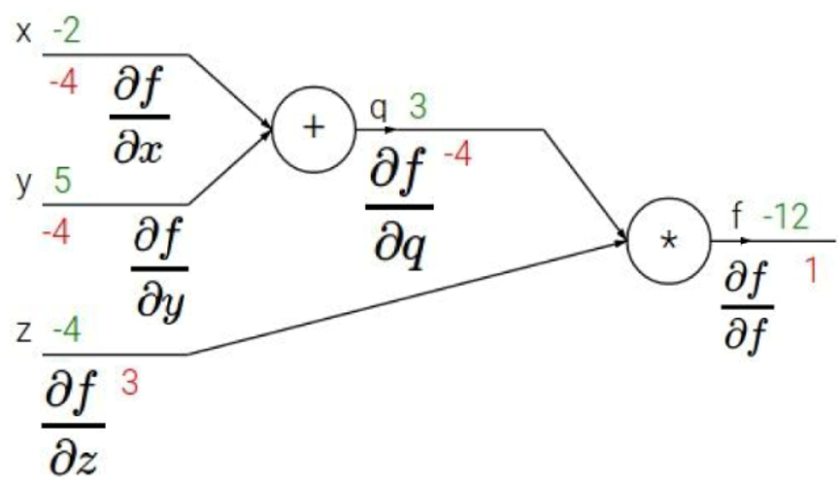
5 Multi-Layer Perceptrons (2)
https://www.tensorflow.org/tutorials/
Backpropagation (Example 1) (1)

Slide 13
5 Multi-Layer Perceptrons (2)
https://www.tensorflow.org/tutorials/
Backpropagation (Example 1) (2)
f = q * z
q = x + y
df/dq = z
df/dz = q
dq/dx = 1
dq/dy = 1

Slide 14
5 Multi-Layer Perceptrons (2)
https://www.tensorflow.org/tutorials/
Backpropagation (Example 1) (3)
df/dx = df/dq * dq/dx
= z * 1
= (-4) * 1 = -4
df/dy = df/dq * dq/dy
= (-4) * 1
= (-4) * 1 = -4
https://mc.ai/under-the-hood-of-neural-networks-part-1-fully-connected/
https://medium.com/@abhigoku10/topic-dl02-understanding-backpropagation-ff9a35328638

Slide 15
5 Multi-Layer Perceptrons (2)
https://www.tensorflow.org/tutorials/
Logarithms (base 10) (1)
Example #1:
log(10^0) = 0 [10^0 = 1]
log(10^1) = 1
log(10^2) = 2
log(10^3) = 3
log(10^5) = 5
. . .
if 0 < x < 1 then log(x) < 0
Example #2:
log(10^a) = a (and a*log(10) = a

Slide 16
5 Multi-Layer Perceptrons (2)
https://www.tensorflow.org/tutorials/
Logarithms (2)
Main results:
log(a*b) = log(a) + log(b)
log(a/b) = log(a) - log(b)
log(1/x) = -log(x)
Example #3:
10^2 * 10^3 = 10^5 so:
log(10^2 * 10^3) = log(10^5)
= 5
= 2 + 3
= log(10^2) + log(10^5)
Example #4:
log(a1*a2*…*an) = log(a1)+. . .+log(an)

Slide 17
5 Multi-Layer Perceptrons (2)
https://www.tensorflow.org/tutorials/
Logarithms (3)
Example #5:
log(a^n) = n*log(a)
Example #6:
log(a^m * b^n) = log(a^m) + log(b^n)
= m*log(a) + n*log(b)
Linear Interpolation of A and B:
A*(t) + B*(1-t) ( 0 <= t <= 1)

Slide 18
5 Multi-Layer Perceptrons (2)
https://www.tensorflow.org/tutorials/
Claude Shannon's Entropy (optional) (1)
The measure of information entropy associated with each possible data value is the negative logarithm of the probability mass function for the value.
Claude Shannon and information entropy
"A Mathematical Theory of Communication" [1948]
=> the higher the entropy the greater the disorder
https://towardsdatascience.com/must-know-information-theory-concepts-in-deep-learning-ai-e54a5da9769d

Slide 19
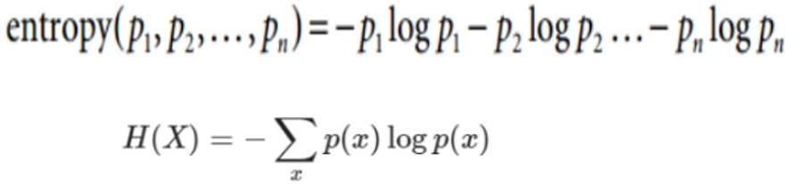
5 Multi-Layer Perceptrons (2)
https://www.tensorflow.org/tutorials/
Claude Shannon's Entropy (optional) (2)

Slide 20
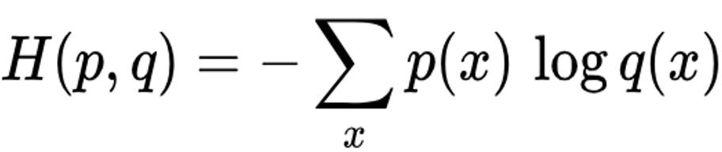
5 Multi-Layer Perceptrons (2)
https://www.tensorflow.org/tutorials/
What is Cross Entropy? (1)
It’s based on Shannon’s entropy
p(x) and q(x): probability distributions
Replace p(x)log p(x) with p(x)log q(x)
=> use this info in the next slide…
What is Cross Entropy? (2)

Slide 21
5 Multi-Layer Perceptrons (2)
https://www.tensorflow.org/tutorials/
Cross Entropy? (3)
For p(x) and q(x) in the previous slide:
p(x) and q(x) are probability distributions
Suppose p(x) = a
Suppose q(x) = b
=> use this info in the next slide…

Slide 22
5 Multi-Layer Perceptrons (2)
https://www.tensorflow.org/tutorials/
What is Cross Entropy (binary)? (4)
p(event1) = a ( 0 < a < 1)
p(!event1) = 1-a
q(event1) = b ( 0 < b < 1)
q(!event1) = 1-b
Cross Entropy Loss term LossT:
LossT = a^(b) * (1-a)^(1-b)
log(LossT) = log(a^b) + log[(1-a)^(1-b)]
= b*log(a) + (1-b)*log(1-a)
* Cross Entropy = -(sum of LossT terms)

Slide 23
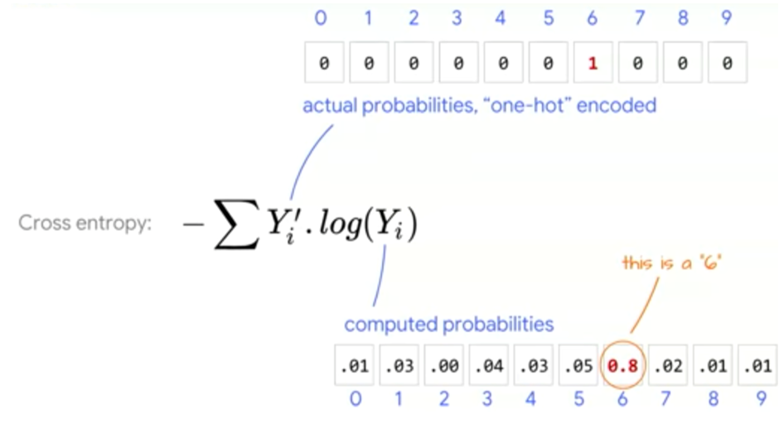
5 Multi-Layer Perceptrons (2)
https://www.tensorflow.org/tutorials/
What is Cross Entropy (binary)? (5)
Cross Entropy: Example

Slide 24
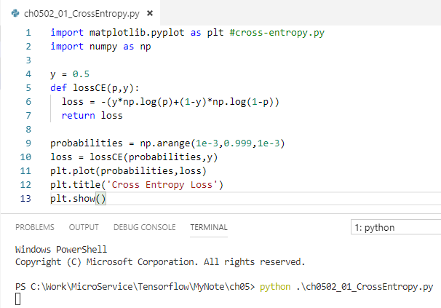
5 Multi-Layer Perceptrons (2)
https://www.tensorflow.org/tutorials/
What is Cross Entropy (binary)? (6)
import matplotlib.pyplot as plt #cross-entropy.py
import numpy as np
y = 0.5
def lossCE(p,y):
loss = -(y*np.log(p)+(1-y)*np.log(1-p))
return loss
probabilities = np.arange(1e-3,0.999,1e-3)
loss = lossCE(probabilities,y)
plt.plot(probabilities,loss)
plt.title('Cross Entropy Loss')
plt.show()

Slide 25
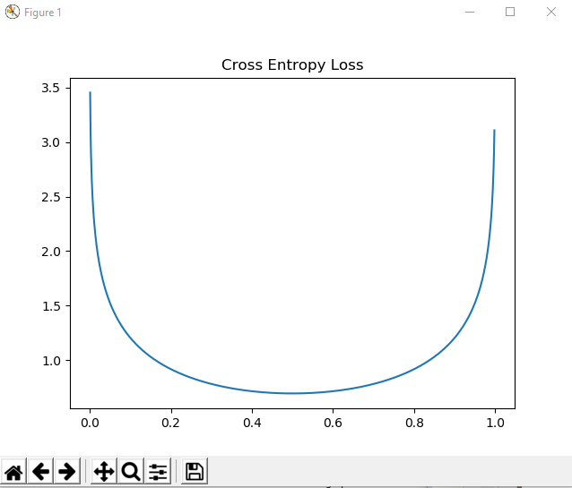
5 Multi-Layer Perceptrons (2)
https://www.tensorflow.org/tutorials/
What is Cross Entropy (binary)? (6)
> python ch0503_01_CrossEntropy.py

Slide 26
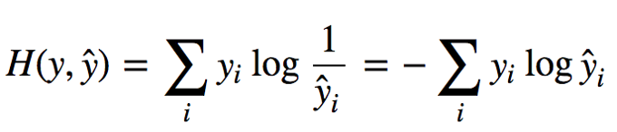
5 Multi-Layer Perceptrons (2)
https://www.tensorflow.org/tutorials/
What is Cross Entropy (binary)? (6)
Categorical Cross Entropy

Slide 27
5 Multi-Layer Perceptrons (2)
https://www.tensorflow.org/tutorials/
Kullback-Leibler Divergence (1)
Generalizes notion of cross entropy
difference between two probability functions
the expected extra message-length per datum that must be communicated if a code that is optimal for a given (wrong) distribution Q is used, compared to using a code based on the true distribution P.
https://mc.ai/under-the-hood-of-neural-networks-part-1-fully-connected/
Kullback-Leibler Divergence (2)
KL(P,Q) = Kullback-Leibler Divergence
H(P,Q) = cross entropy
H(P) = entropy
=> KL(P,Q) = H(P,Q) – H(P)

Slide 28
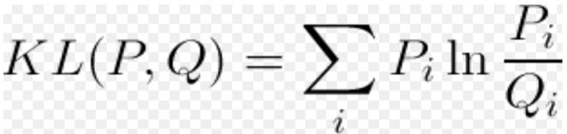
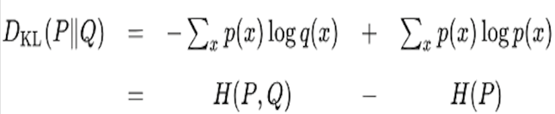
5 Multi-Layer Perceptrons (2)
https://www.tensorflow.org/tutorials/
Kullback-Leibler Divergence (3)
Kullback-Leibler Divergence (4)

Slide 29
5 Multi-Layer Perceptrons (2)
https://www.tensorflow.org/tutorials/
Jensen-Shannon Divergence
Alternative to Kullback-Leibler divergence
https://www.quora.com/Why-isnt-the-Jensen-Shannon-divergence-used-more-often-than-the-Kullback-Leibler-since-JS-is-symmetric-thus-possibly-a-better-indicator-of-distance

Slide 30
5 Multi-Layer Perceptrons (2)
https://www.tensorflow.org/tutorials/
What is TFLearn?
Available only for TensorFlow
included in TF code
involves tensors (but easier than TF)
supports TensorBoard (in hour #4)
Home page: tflearn.org
Working with TFLearn
Perform the following steps:
define a model
load the model
train the model
evaluate the model

Slide 31
5 Multi-Layer Perceptrons (2)
https://www.tensorflow.org/tutorials/
TFLearn and Logical OR (1)
import tflearn #tflearn-or.py
# Logical OR operator and “truth” values:
OR = [[0., 0.],[0., 1.],[1., 0.],[1., 1.]]
Y_truth = [[0.], [1.], [1.], [1.]]
neural_net = tflearn.input_data(shape=[None, 2])
neural_net = tflearn.fully_connected(neural_net, 1, activation='sigmoid')
neural_net = tflearn.regression(neural_net, optimizer='sgd', learning_rate=2, loss='mean_square’)
# Train the neural network #tflearn-or.py
model = tflearn.DNN(neural_net)
model.fit(OR, Y_truth, n_epoch=2000,
snapshot_epoch=False)
# Test final prediction
print("Testing OR operator")
print("0 or 0:", model.predict([[0., 0. ]]))
print("0 or 1:", model.predict([[0., 1. ]]))
print("1 or 0:", model.predict([[1., 0. ]]))
print("1 or 1:", model.predict([[1., 1. ]]))

Slide 32
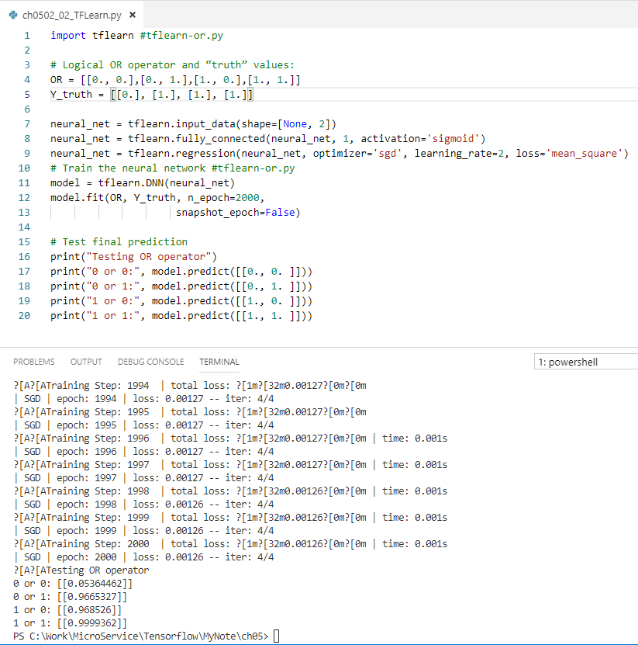
5 Multi-Layer Perceptrons (2)
https://www.tensorflow.org/tutorials/
TFLearn and Logical OR (2)

Slide 33
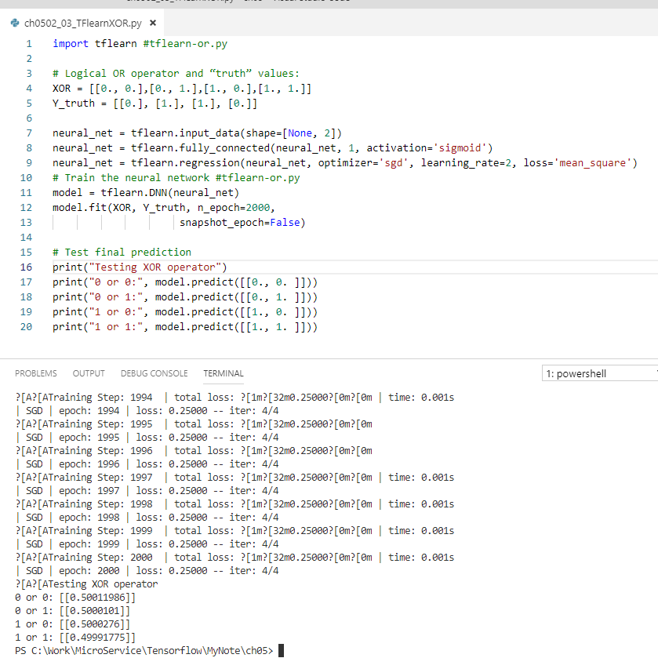
5 Multi-Layer Perceptrons (2)
https://www.tensorflow.org/tutorials/
TFLearn Exercise (3)
Use tflearn-or.py for the exercises:
1) TFLearn code to solve an XOR gate
2) TFLearn code to solve an AND gate
3) TFLearn code to solve an OR gate
4) TFLearn code to solve a NAND gate
XOR: The XOR all around 0.5. It does not work

Slide 34
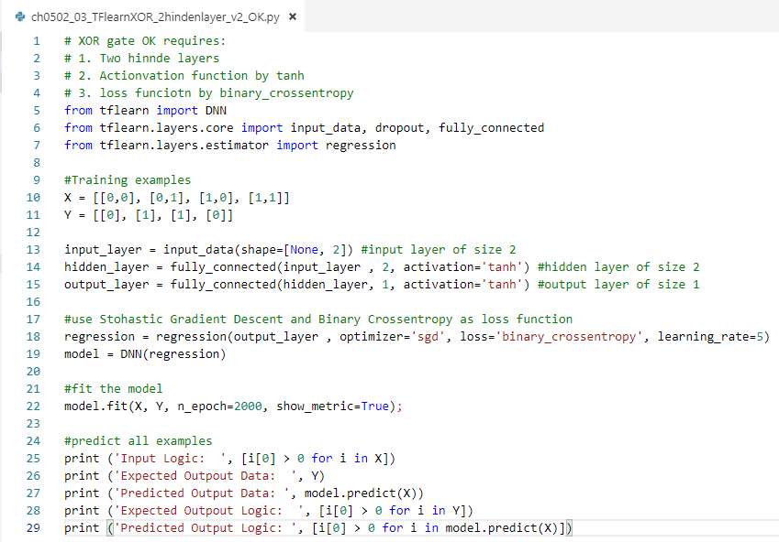
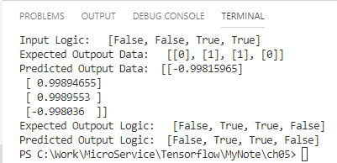
5 Multi-Layer Perceptrons (2)
https://www.tensorflow.org/tutorials/
XOR:
Use 2 hinder layer,
Change sigmoid to tanh function, and
Change loss function to binary_corssentropy
TFLearn Exercise (3)
Use tflearn-or.py for the exercises:
1) TFLearn code to solve an XOR gate
2) TFLearn code to solve an AND gate
3) TFLearn code to solve an OR gate
4) TFLearn code to solve a NAND gate

Slide 35
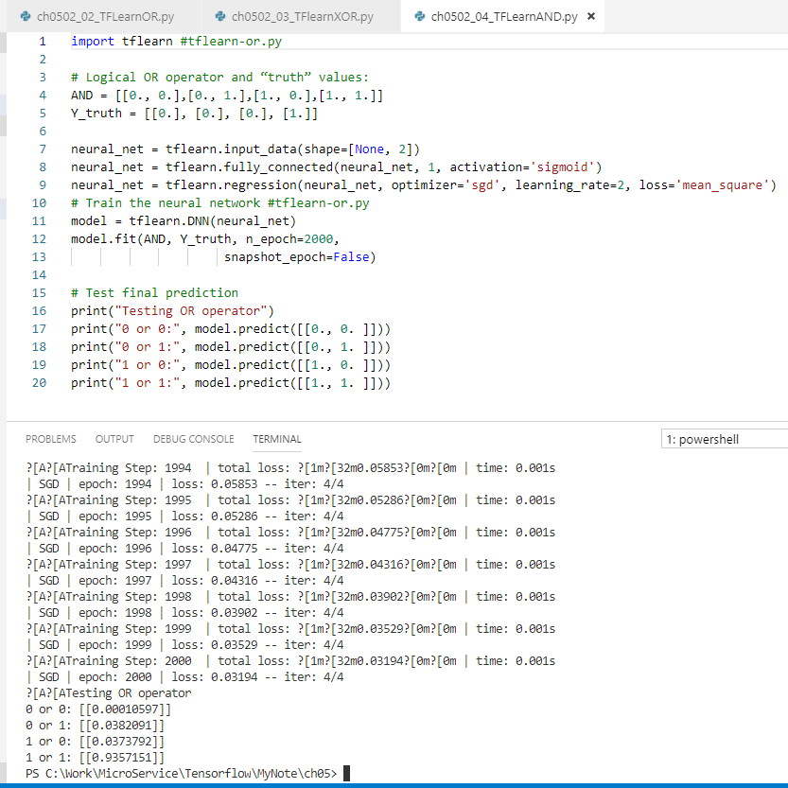
5 Multi-Layer Perceptrons (2)
https://www.tensorflow.org/tutorials/
TFLearn Exercise (3)
Use tflearn-or.py for the exercises:
1) TFLearn code to solve an XOR gate
2) TFLearn code to solve an AND gate
3) TFLearn code to solve an OR gate
4) TFLearn code to solve a NAND gate
AND

Slide 36
5 Multi-Layer Perceptrons (2)
https://www.tensorflow.org/tutorials/
TFLearn Exercise (3)
Use tflearn-or.py for the exercises:
1) TFLearn code to solve an XOR gate
2) TFLearn code to solve an AND gate
3) TFLearn code to solve an OR gate
4) TFLearn code to solve a NAND gate
OR

Slide 37
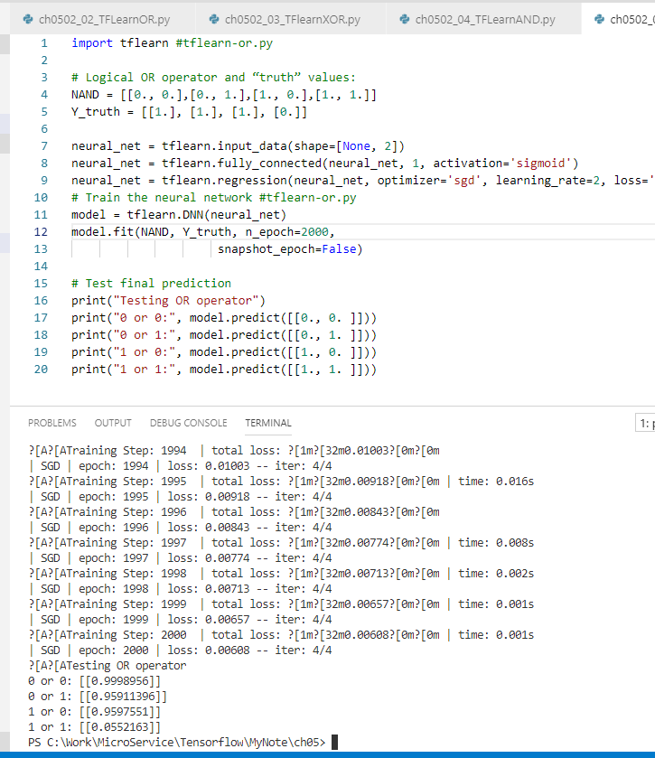
5 Multi-Layer Perceptrons (2)
https://www.tensorflow.org/tutorials/
TFLearn Exercise (3)
Use tflearn-or.py for the exercises:
1) TFLearn code to solve an XOR gate
2) TFLearn code to solve an AND gate
3) TFLearn code to solve an OR gate
4) TFLearn code to solve a NAND gate
NAND

Slide 38
5 Multi-Layer Perceptrons (2)
https://www.tensorflow.org/tutorials/
TFLearn Solution
Solutions:
tflearn-xor.py
tflearn-and.py
tflearn-nor.py
tflearn-nand.py
Can you solve more complex gates?

Slide 39
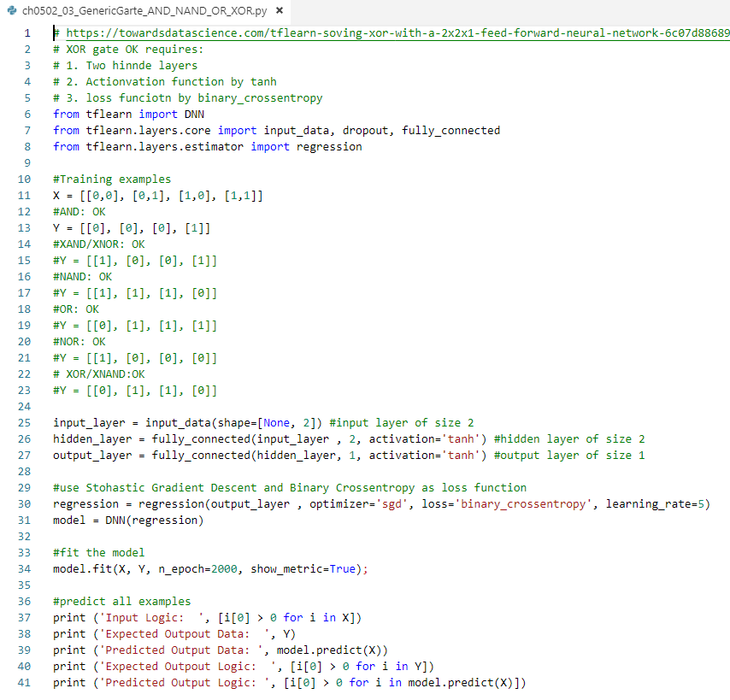



5 Multi-Layer Perceptrons (2)
https://www.tensorflow.org/tutorials/
Can you use tflearn to provide a generic solution for XOR, XAND/XNOR, NABD, OR, NOR, XOR/XNAND?
Solution:
Use one hidden layer, tanh, bindary_crossentropy as code.
Test results as below:
#AND: OK
Y = [[0], [0], [0], [1]]
#XAND/XNOR: OK
Y = [[1], [0], [0], [1]]
#NAND: OK
Y = [[1], [1], [1], [0]]
#NOR: OK
Y = [[1], [0], [0], [0]]
#OR: OK
Y = [[0], [1], [1], [1]]
# XOR/XNAND:OK
Y = [[0], [1], [1], [0]]

Slide 40
5 Multi-Layer Perceptrons (2)
https://www.tensorflow.org/tutorials/
TFLearn Solution
Solutions:
tflearn-xor.py
tflearn-and.py
tflearn-nor.py
tflearn-nand.py
Can you solve more complex gates?

Slide 41
5 Multi-Layer Perceptrons (2)
https://www.tensorflow.org/tutorials/
TFLearn and Titanic Dataset
TFLearn tutorial and more samples:
http://tflearn.org/tutorials/quickstart.html
Dataset: titanic.csv
Launch Python script (optional):
python titanic.py

Slide 42
5 Multi-Layer Perceptrons (2)
https://www.tensorflow.org/tutorials/
Summary Session
Calculating Backprop:
Derivatives
Partial derivatives
Chain rule
Working with Logarithms
Fundamentals of Cross-entropy
TFLearn (and logical gates)

Slide 43
End of Chapter

