Slide 1

5 Multi-Layer Perceptrons (3)
Peter H. Chen

Slide 2
5 Multi-Layer Perceptrons (3)
https://www.tensorflow.org/tutorials/
List of Topics
Configuring # of layers in NNs
What is logits?
MLP with cross_entropy (1)
MLP with cross_entropy (2)
Adam Optimizer
MLP and variable batch size
What is Regularization?
What is Exponential Decay?
MLP with L2 Regularization
Bias versus Variance

Slide 3
5 Multi-Layer Perceptrons (3)
https://www.tensorflow.org/tutorials/
What is logits?
a technique borrowed by ML from statistics
the "go-to" method for binary classification problems
also called "log odds" and "logit”
If an event has probability p then:
1) Its odds are p/(1-p)
2) the logit function = log-of-odds = log[p/(1-p)]

Slide 4
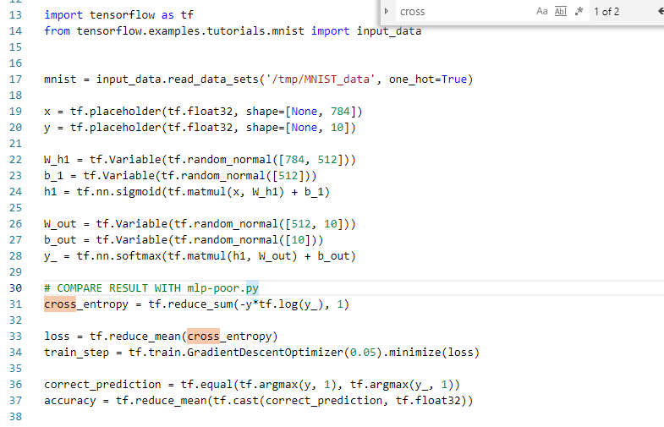
5 Multi-Layer Perceptrons (3)
https://www.tensorflow.org/tutorials/
MLP with cross_entropy (1)
=> read Week 5/Hour 2 PPT for cross_entropy
Code sample: mlp-good.py
# COMPARE RESULT WITH mlp-poor.py
cross_entropy = tf.reduce_sum(-y*tf.log(y_), 1)
loss = tf.reduce_mean(cross_entropy)
train_step = tf.train.GradientDescentOptimizer(0.05).minimize(loss)
correct_prediction = tf.equal(tf.argmax(y, 1), tf.argmax(y_, 1))

Slide 5
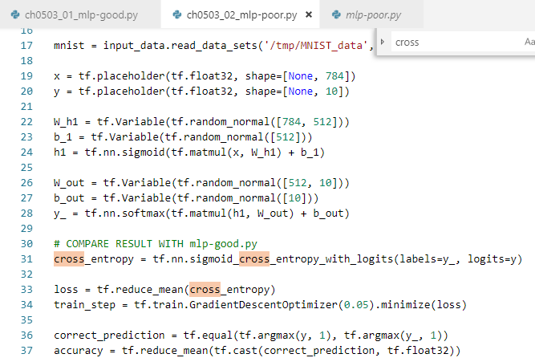
5 Multi-Layer Perceptrons (3)
https://www.tensorflow.org/tutorials/
MLP with cross_entropy (2)
=> read Week 5/Hour 2 PPT for cross_entropy
Code sample: mlp-poor.py
# COMPARE RESULT WITH mlp-good.py
cross_entropy = tf.nn.sigmoid_cross_entropy_with_logits(labels=y_, logits=y)
loss = tf.reduce_mean(cross_entropy)
train_step = tf.train.GradientDescentOptimizer(0.05).minimize(loss)
Exercise:
1) use a different optimizer

Slide 6
5 Multi-Layer Perceptrons (3)
https://www.tensorflow.org/tutorials/
Adam Optimizer
works well across a wide range of ML architectures
highly recommended optimization algorithm
combines gradient descent with momentum and RMSprop algorithms
Advantages of Adam:
Relatively low memory requirements
but higher than gradient descent and gradient descent with momentum
Can work well even with a limited hyperparameters tuning

Slide 7




5 Multi-Layer Perceptrons (3)
https://www.tensorflow.org/tutorials/
MLP and variable batch size
Code sample: mnist-batchsize.py
for i in range(1000):
batch = mnist.train.next_batch(50) # SET BATCH SIZE
train_step.run(feed_dict={x: batch[0], y_: batch[1]})
Exercise:
1) experiment with different batch size
2) determine the size for the best result
Batch Size
100
50
25
5

Slide 8
5 Multi-Layer Perceptrons (3)
https://www.tensorflow.org/tutorials/
What is Regularization? (1)
helps to solve over fitting problem
works well on training data but performing poorly on validation (test) data
Regularization solves this problem:
1) adds a penalty term to the cost function and
2) controls model complexity with a penalty term

Slide 9
5 Multi-Layer Perceptrons (3)
https://www.tensorflow.org/tutorials/
What is Regularization? (1)
helps to solve over fitting problem
works well on training data but performing poorly on validation (test) data
Regularization solves this problem:
1) adds a penalty term to the cost function and
2) controls model complexity with a penalty term
What is Regularization? (2)
Regularization is generally useful for:
1) Large number of variables
2) Low ratio of (# observations)/(# of variables)
3) high multi-collinearity
Two main types of regularization:
L1 Regularization (absolute value of differences)
L2 Regularization (square of differences)
https://developers.google.com/machine-learning/crash-course/generalization/peril-of-overfitting

Slide 10
5 Multi-Layer Perceptrons (3)
https://www.tensorflow.org/tutorials/
L2 => Add Vector Weights to MSE
Let W = current weights in our model
W = (w1, w2, …, wn)
Size of W = ||W||^2 = w1^2 + . . . + wn^2
L2-regularization:
New Cost function = MSE + ||W||^2
L1 versus L2 Regularization
L2 and L1 penalize weights differently:
L2 penalizes weight**2
L1 penalizes |weight|
In general: L2 performs better than L1
L2 is efficient in terms of computation

Slide 11
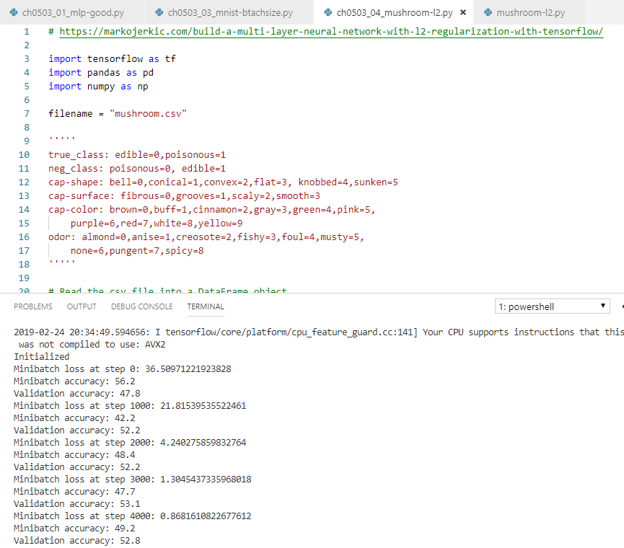
5 Multi-Layer Perceptrons (3)
https://www.tensorflow.org/tutorials/
What is Exponential Decay?
A technique for updating the learning_rate
TF API: tf.train.exponential_decay()
SEE code sample => mushroom-l2.py
CODE SNIPPET:
# Create a decaying learning rate
# start, global step, decay step, decay rate, staircase
learn_rate = tf.train.exponential_decay(start_learn_rate, global_step, 100000, 0.5, staircase=True)
optimizer = tf.train.AdamOptimizer(learn_rate).minimize(loss)

Slide 12
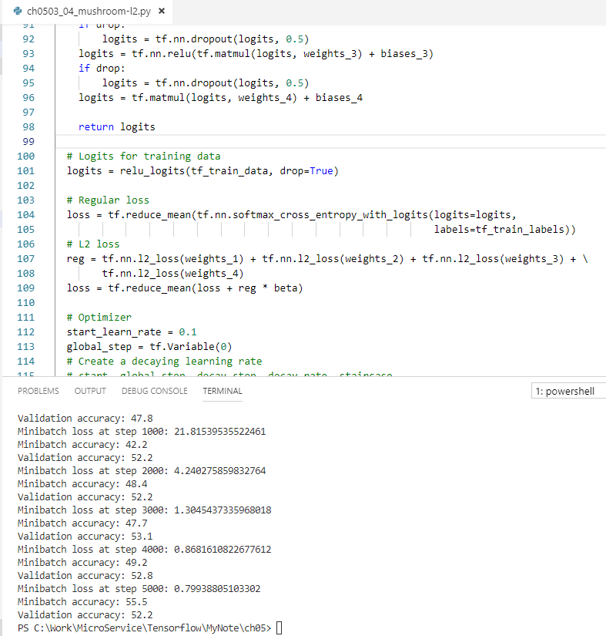
5 Multi-Layer Perceptrons (3)
https://www.tensorflow.org/tutorials/
MLP with L2 Regularization
See code sample: mushroom-l2.py
TensorFlow API: tf.nn.l2_loss()
Look at this code snippet for L2 loss:
reg = tf.nn.l2_loss(weights_1) + \
tf.nn.l2_loss(weights_2) + \
tf.nn.l2_loss(weights_3) + \
tf.nn.l2_loss(weights_4)
loss = tf.reduce_mean(loss + reg*beta)

Slide 13
5 Multi-Layer Perceptrons (3)
https://www.tensorflow.org/tutorials/
ML and Feature Scaling
standardizes the range of features of data
standardization: a standard normal distribution
subtract the mean and divide by the stddev
performed during the data preprocessing step
Gradient descent benefits from feature scaling

Slide 14

5 Multi-Layer Perceptrons (3)
https://www.tensorflow.org/tutorials/
Data Normalization vs Standardization
Performing data normalization:
Let Minx = minimum of Xi values
Let Maxx = maximum of Xi values
Calculate new Xi values as follows:
Bias-Variance Tradeoff
The notion (Concept) of “bias”:
1) an error from wrong assumptions in a learning algorithm
2) High bias can/might cause an algorithm to miss relevant relations between features and target outputs (underfitting)
The notion of “variance”:
1) The expected value of the squared deviation from the mean
2) High variance can/might cause an algorithm to model the random noise in the training data, rather than the intended outputs (aka overfitting)

Slide 15
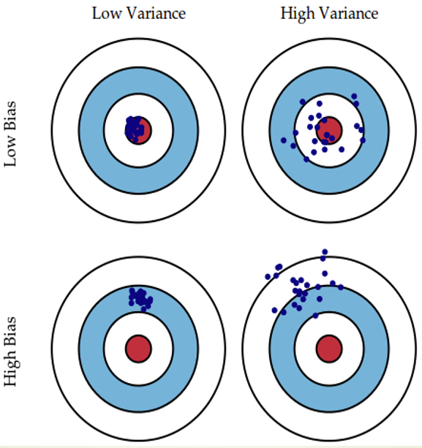
5 Multi-Layer Perceptrons (3)
https://www.tensorflow.org/tutorials/
Bias-Variance Tradeoff:

Slide 16
5 Multi-Layer Perceptrons (3)
https://www.tensorflow.org/tutorials/
Model Size and Bias/Variance (1)
Adding parameters to a model:
increases its complexity
increases the variance
decreases the bias
=> dealing with bias and variance is dealing with underfitting and overfitting

Slide 17
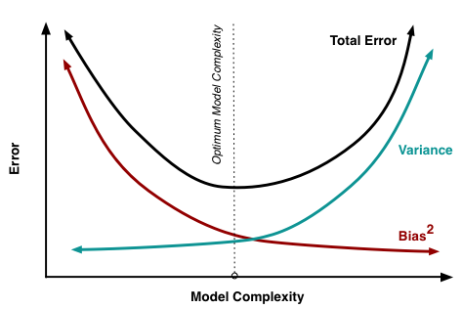
5 Multi-Layer Perceptrons (3)
https://www.tensorflow.org/tutorials/
Model Size and Bias/Variance (2)

Slide 18
5 Multi-Layer Perceptrons (3)
https://www.tensorflow.org/tutorials/
What is R-Squared? (1)
R-squared measures how close the data is to the fitted regression line (regression coefficient)
R-squared is always between 0 and 100%:
0% indicates that the model explains none of the variability of the response data around its mean
100% indicates that the model explains all the variability of the response data around its mean
In general: higher R-squared indicates a better model

Slide 19
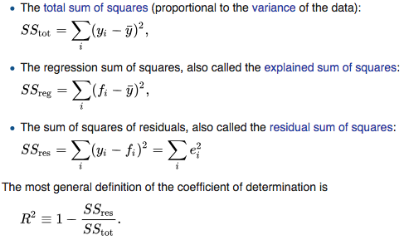
5 Multi-Layer Perceptrons (3)
https://www.tensorflow.org/tutorials/
What is R-Squared? (2)

Slide 20
5 Multi-Layer Perceptrons (3)
https://www.tensorflow.org/tutorials/
Limitations of R-Squared (1)
R-squared cannot determine whether the coefficient estimates and predictions are biased
R-squared does not indicate whether a regression model is adequate
Hence, it's possible to have a low R-squared value for a good model, or a high R-squared value for a poorly fitting model.
Limitations of R-Squared (2)
=> High R-squared Values are preferred (YES)
Are High R-squared Values ALWAYS Good? (no)
are Low R-squared Values ALWAYS Bad? (no)
R-squared often < 50% for predicting human behavior
=> Evaluate R-squared values in conjunction with residual plots, other model statistics, and subject area knowledge

Slide 21
5 Multi-Layer Perceptrons (3)
https://www.tensorflow.org/tutorials/
Confusion Matrix (or Error Matrix) (1): a specific table layout that allows visualization of the performance of an algorithm
a table with two rows and two columns
the # of false positives, false negatives, true positives, and true negatives
more detailed analysis than proportion of correct classifications (accuracy)
Accuracy: not a reliable metric for performance of a classifier
It yields misleading results if the data set is unbalanced:
when the numbers of observations in different classes vary greatly
https://en.wikipedia.org/wiki/Confusion_matrix

Slide 22
5 Multi-Layer Perceptrons (3)
https://www.tensorflow.org/tutorials/
Confusion Matrix (or Error Matrix) (2):
Precision versus Recall
precision = tp / (tp + fp)
tp = # of true positives
fp = # of false positives
precision: the ability of the classifier to avoid “false positives”
recall = tp / (tp + fn)
tp = # of true positives
fn = # of false negatives
recall: the ability of the classifier to find all positive samples

Slide 23
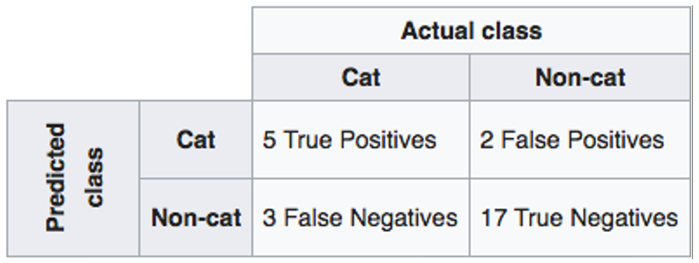
5 Multi-Layer Perceptrons (3)
https://www.tensorflow.org/tutorials/
Confusion Matrix (or Error Matrix) (3):

Slide 24
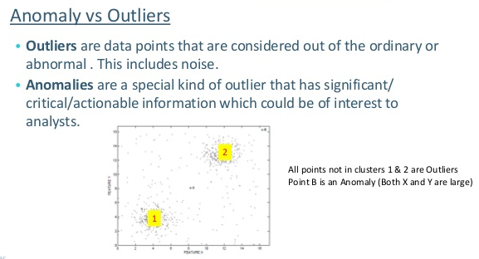
5 Multi-Layer Perceptrons (3)
https://www.tensorflow.org/tutorials/
Other Terms/Indicators (MATH)
Anomaly (versus outlier):
Anomalies are outliers but not necessarily the converse
B
Kurtosis

Slide 25
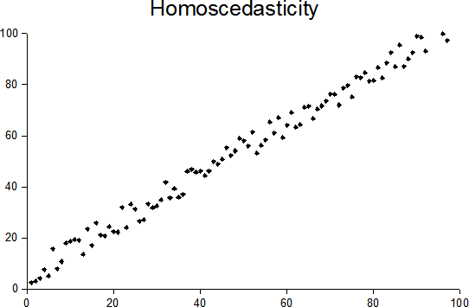
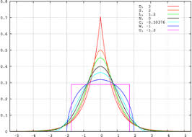
5 Multi-Layer Perceptrons (3)
https://www.tensorflow.org/tutorials/
Other Terms/Indicators (MATH)
Homoscedasticity:
All random variables have the same (finite) variance
p-values (between 0 and 1):
https://en.wikipedia.org/wiki/P-value
Kurtosis (The sharpness of distribution):
a measure of the “tailedness” of a prob distribution
Kurtosis

Slide 26
End of Chapter

