Slide 1

5.2 NN Calculation
Peter H. Chen

Slide 2


5.2 NN Calculation
https://www.youtube.com/watch?v=0e0z28wAWfg
This document explains the input flow to the output in forward pass and backward pass values calculation in the neural networks:
Input Layer
Hidden Layer
Output Layer
H1
y1
H1 = x1 * w1 + x2 * w2 + b1
X1
w1
w5
w6
Activation Function is:
w2
w3
H2
w7
y2
X2
w8
w4
Activation Function for hidden layer 1 is:
Bias
b1
b2
Example:
X1 = 0.05, X2 = 0.10
b1 = 0.35, b2 = 0.60
Initial Weight:
w1 = 0.15, w2 = 0.20, w3 = 0.25, w4 = 0.30
w5 = 0.40, w6 = 0.45, w7 = 0.50, w8 = 0.55
Target values:
T1 = 0.01, T2 = 0.99

Slide 3
5.2.1 Forward Pass
Peter H. Chen

Slide 4

5.2.1 Forward Pass
https://www.youtube.com/watch?v=0e0z28wAWfg
Forward Pass:
Forward Pass:
H1 = X1 * w1 + X2 * w2 + b1
= 0.05 * 0.15 + 0.10 * 0.20 + 0.35
= 0.3775
Example:
X1 = 0.05, X2 = 0.10
b1 = 0.35, b2 = 0.60
Initial Weight:
w1 = 0.15, w2 = 0.20, w3 = 0.25, w4 = 0.30
w5 = 0.40, w6 = 0.45, w7 = 0.50, w8 = 0.55
Target values:
T1 = 0.01, T2 = 0.99
In the same way for H2:
outH2 = 0.596884378
X1
H1
w5
y1
w1
w2
w6
w3
H2
w7
y2
X2
w8
w4
b1
b2

Slide 5

5.2.1 Forward Pass
https://www.youtube.com/watch?v=0e0z28wAWfg
In the same way for H2.
Now for calculating y1:
y1 = outH1 * w5 + outH2 * w6 + b2
= 0.593269992 * 0.4 + 0.45 * 0.596884378 + 0.6
= 1.105905967
Example:
X1 = 0.05, X2 = 0.10
b1 = 0.35, b2 = 0.60
Initial Weight:
w1 = 0.15, w2 = 0.20, w3 = 0.25, w4 = 0.30
w5 = 0.40, w6 = 0.45, w7 = 0.50, w8 = 0.55
Target values:
T1 = 0.01, T2 = 0.99
Calculate Outy1:
In the same way, we calculate Outy2:
Outy2 = 0.772928465
Now, we got Outy1 value and Outy2 value:
Outy1 = 0.75136507
Outy2 = 0.772928465
Match Outy1 and Outy2 with T1 = 0.01 and T2 = 0.99
X1
H1
w5
y1
w1
w6
w2
w3
H2
w7
y2
X2
w8
w4
b1
b2

Slide 6
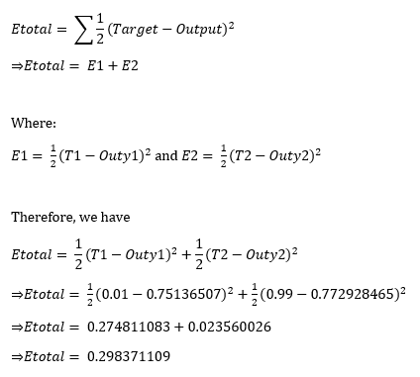
5.2.1 Forward Pass
https://www.youtube.com/watch?v=0e0z28wAWfg
Now, we got the output y1 and y2 and not match with T1 and T2.
We calculate the total Error.
Example:
X1 = 0.05, X2 = 0.10
b1 = 0.35, b2 = 0.60
Initial Weight:
w1 = 0.15, w2 = 0.20, w3 = 0.25, w4 = 0.30
w5 = 0.40, w6 = 0.45, w7 = 0.50, w8 = 0.55
Target values:
T1 = 0.01, T2 = 0.99
X1
H1
w5
y1
w1
w6
w2
w3
H2
w7
y2
X2
w8
w4
b1
b2

Slide 7
5.2.2 Backward Pass
Peter H. Chen

Slide 8



5.2.2 Backward Pass
https://www.youtube.com/watch?v=0e0z28wAWfg
Now, we have the total Error. We are going to back propagate the minimized error and update w1, w2, …, and etc.
Consider the error at w5:
Backend Pass:
To update weights, consider w5:
Example:
X1 = 0.05, X2 = 0.10
b1 = 0.35, b2 = 0.60
Initial Weight:
w1 = 0.15, w2 = 0.20, w3 = 0.25, w4 = 0.30
w5 = 0.40, w6 = 0.45, w7 = 0.50, w8 = 0.55
Target values:
T1 = 0.01, T2 = 0.99
X1
H1
w5
y1
Where:
w1
w6
w2
w3
H2
w7
y2
X2
w8
w4
b1
b2

Slide 9
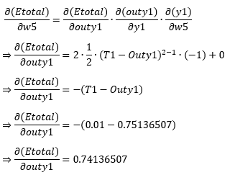
5.2.2 Backward Pass
https://www.youtube.com/watch?v=0e0z28wAWfg
Now, we have the total Error. We are going to back propagate the minimized error and update w1, w2, …, and etc.
Consider the error at w5:
Since:
Example:
X1 = 0.05, X2 = 0.10
b1 = 0.35, b2 = 0.60
Initial Weight:
w1 = 0.15, w2 = 0.20, w3 = 0.25, w4 = 0.30
w5 = 0.40, w6 = 0.45, w7 = 0.50, w8 = 0.55
Target values:
T1 = 0.01, T2 = 0.99
We have:
X1
H1
w5
y1
w1
w6
w2
w3
H2
w7
y2
X2
w8
w4
b1
b2

Slide 10
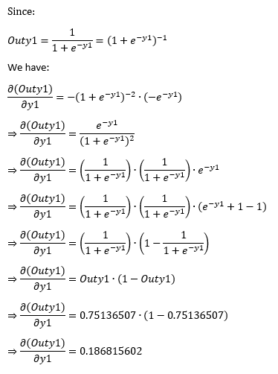
5.2.2 Backward Pass
https://www.youtube.com/watch?v=0e0z28wAWfg
Now, we have the total Error. We are going to back propagate the minimized error and update w1, w2, …, and etc.
Consider the error at w5:
Example:
X1 = 0.05, X2 = 0.10
b1 = 0.35, b2 = 0.60
Initial Weight:
w1 = 0.15, w2 = 0.20, w3 = 0.25, w4 = 0.30
w5 = 0.40, w6 = 0.45, w7 = 0.50, w8 = 0.55
Target values:
T1 = 0.01, T2 = 0.99
X1
H1
w5
y1
w1
w6
w2
w3
H2
w7
y2
X2
w8
w4
b1
b2

Slide 11
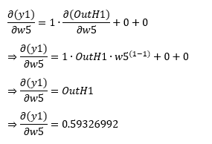
5.2.2 Backward Pass
https://www.youtube.com/watch?v=0e0z28wAWfg
Now, we have the total Error. We are going to back propagate the minimized error and update w1, w2, …, and etc.
Consider the error at w5:
From:
Example:
X1 = 0.05, X2 = 0.10
b1 = 0.35, b2 = 0.60
Initial Weight:
w1 = 0.15, w2 = 0.20, w3 = 0.25, w4 = 0.30
w5 = 0.40, w6 = 0.45, w7 = 0.50, w8 = 0.55
Target values:
T1 = 0.01, T2 = 0.99
y1 = w5 * OutH1 + w6 * H1 + b2
We have:
X1
H1
w5
y1
w1
w6
w2
w3
H2
w7
y2
X2
w8
w4
b1
b2

Slide 12
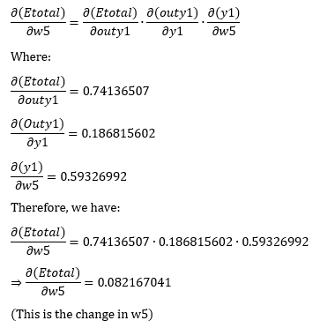
5.2.2 Backward Pass
https://www.youtube.com/watch?v=0e0z28wAWfg
Summary the above calculation:
Example:
X1 = 0.05, X2 = 0.10
b1 = 0.35, b2 = 0.60
Initial Weight:
w1 = 0.15, w2 = 0.20, w3 = 0.25, w4 = 0.30
w5 = 0.40, w6 = 0.45, w7 = 0.50, w8 = 0.55
Target values:
T1 = 0.01, T2 = 0.99
X1
H1
w5
y1
w1
w6
w2
w3
H2
w7
y2
X2
w8
w4
b1
b2

Slide 13
5.2.2 Backward Pass
https://www.youtube.com/watch?v=0e0z28wAWfg
Summary the above calculation:
Example:
X1 = 0.05, X2 = 0.10
b1 = 0.35, b2 = 0.60
Initial Weight:
w1 = 0.15, w2 = 0.20, w3 = 0.25, w4 = 0.30
w5 = 0.40, w6 = 0.45, w7 = 0.50, w8 = 0.55
Target values:
T1 = 0.01, T2 = 0.99
X1
H1
w5
y1
w1
w6
w2
w3
H2
w7
y2
X2
w8
w4
b1
b2

Slide 14
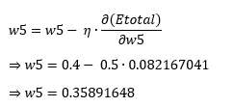
5.2.2 Backward Pass
https://www.youtube.com/watch?v=0e0z28wAWfg
Update w5 value:
Example:
X1 = 0.05, X2 = 0.10
b1 = 0.35, b2 = 0.60
Initial Weight:
w1 = 0.15, w2 = 0.20, w3 = 0.25, w4 = 0.30
w5 = 0.40, w6 = 0.45, w7 = 0.50, w8 = 0.55
Target values:
T1 = 0.01, T2 = 0.99
X1
H1
w5
y1
w1
w6
w2
w3
H2
w7
y2
X2
w8
w4
b1
b2

Slide 15
5.2.2 Backward Pass
https://www.youtube.com/watch?v=0e0z28wAWfg
w5 = 0.35891648
In the same way, we update W6, W7, and W8.
w6 = 0.408666186
w7 = 0.511201270
w8 = 0.561370121
These w5, w6, w6, w7, 28 are the new updated weights.
X1
H1
w5
y1
w1
w6
w2
w3
H2
w7
y2
X2
w8
w4
b1
b2

Slide 16
5.2.2 Backward Pass
https://www.youtube.com/watch?v=0e0z28wAWfg
We update W1, W2, W3, and W4.
X1
H1
w5
y1
w1
w6
w2
w3
H2
w7
y2
X2
w8
w4
b1
b2

Slide 17



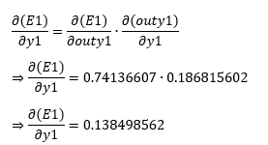
5.2.2 Backward Pass
https://www.youtube.com/watch?v=0e0z28wAWfg
Now, at hidden layer. Update W1, W2, W3, and W4.
X1
H1
w5
y1
w1
w6
w2
w3
H2
w7
y2
X2
w8
w4
b1
b2

Slide 18



5.2.2 Backward Pass
https://www.youtube.com/watch?v=0e0z28wAWfg
Now, at hidden layer. Update W1, W2, W3, and W4.
X1
H1
w5
y1
w1
w6
w2
w3
H2
w7
y2
X2
w8
w4
b1
b2

Slide 19


5.2.2 Backward Pass
https://www.youtube.com/watch?v=0e0z28wAWfg
Now, at hidden layer. Update W1, W2, W3, and W4.
X1
H1
w5
y1
w1
w6
w2
w3
H2
w7
y2
X2
w8
w4
b1
b2

Slide 20
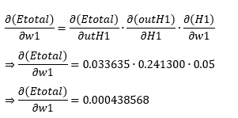
5.2.2 Backward Pass
https://www.youtube.com/watch?v=0e0z28wAWfg
Now, at hidden layer. Update W1, W2, W3, and W4.
X1
H1
w5
y1
w1
w6
w2
w3
H2
w7
y2
X2
w8
w4
b1
b2

Slide 21
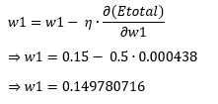
5.2.2 Backward Pass
https://www.youtube.com/watch?v=0e0z28wAWfg
Update the w1.
Update the same way, we have w2 = 0.19956143, w3 = 0.24975114, w4 = 0.29950229.
X1
H1
w5
y1
w1
w6
w2
w3
H2
w7
y2
X2
w8
w4
b1
b2

Slide 22
5.2.2 Backward Pass
https://www.youtube.com/watch?v=0e0z28wAWfg
So, we have update the W1, W2, W3, and W4.
X1
H1
w5
y1
w1
w6
w2
w3
H2
w7
y2
X2
w8
w4
b1
b2

Slide 23
5.2.2 Backward Pass
https://www.youtube.com/watch?v=0e0z28wAWfg
So, from y1 and y2, we updated w5-w8. From H1 and H2, swe updated W1-W4.
Again, we forward propagate to calculate output y1 value and y2 value and compare to target values T1 and T2.
Then we calculate the Error values and then we back propagate to update W1 to W8 until the output Etotal satisfy our specification.
X1
H1
w5
y1
w1
w6
w2
w3
H2
w7
y2
X2
w8
w4
b1
b2

Slide 24
End of Chapter

