Slide 1

5.2 Multi-Layer Perceptron: Entropy, Cross-Entropy, and KL-Divergence
Peter H. Chen

Slide 2
5.2 Entropy, Cross-Entropy, and KL-Divergence
https://www.tensorflow.org/tutorials/
KL divergence versus cross-entropy
This document explain the Entropy, Cross-Entropy, and KL Divergence.
The first link is probably the most succinct, and I included the other links because they provide some additional information (though their answers to the question seem less direct): 1) https://ai.stackexchange.com/questions/3065/why-has-cross-entropy-become-the-classification-standard-loss-function-and-not-k 2) https://stats.stackexchange.com/questions/265966/why-do-we-use-kullback-leibler-divergence-rather-than-cross-entropy-in-the-t-sne/265989 3) https://stats.stackexchange.com/questions/357963/what-is-the-difference-cross-entropy-and-kl-divergence 4) https://www.reddit.com/r/MachineLearning/comments/4mebvf/why_train_with_crossentropy_instead_of_kl/ 5) https://stats.stackexchange.com/questions/188903/intuition-on-the-kullback-leibler-kl-divergence

Slide 3
5.2.1 Information Theory

Slide 4
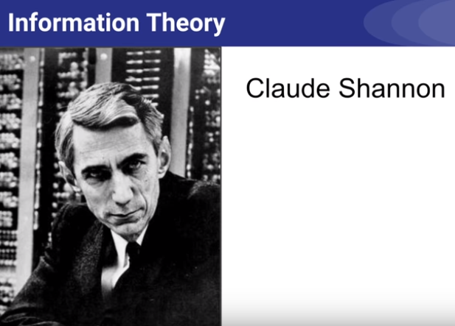
5.2.1 Information Theory
https://www.youtube.com/watch?v=ErfnhcEV1O8
Information Theory (1):
In machine learning, cross-entry is very commonly used as a cost function when training classifiers.
We will see why that is.
Those concepts come from Claude Shannon’s information theory.
Claude Shannon is an American mathematician, electrical engineer, and cryptographer (encoding/encoding engineer).

Slide 5
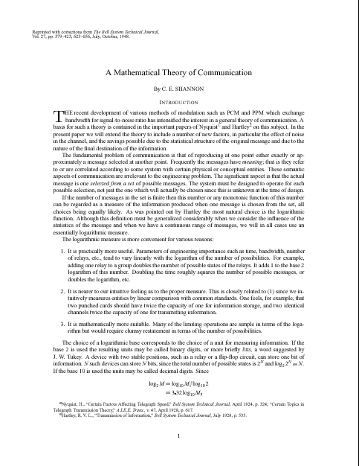
5.2.1 Information Theory
https://www.youtube.com/watch?v=ErfnhcEV1O8
Information Theory (2):
In Claude Shannon 1948 paper, “A Mathematical Theory of Communication”, he founded what is now known as Information Theory.
The goal is to reliably and efficiently transmit a message from a sender to a recipient.

Slide 6
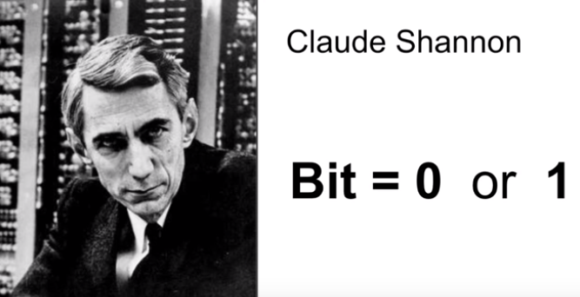
5.2.1 Information Theory
https://www.youtube.com/watch?v=ErfnhcEV1O8
Information Theory (3):
In our digital age, messages are composed of bits.
Of course, you know that a bit is a number that is either equal to 0 or 1. Bit not all bits are useful: some of them are redundant, some of them are errors, and so on.
So when we communicate a message we want as much useful information as possible to get through.

Slide 7
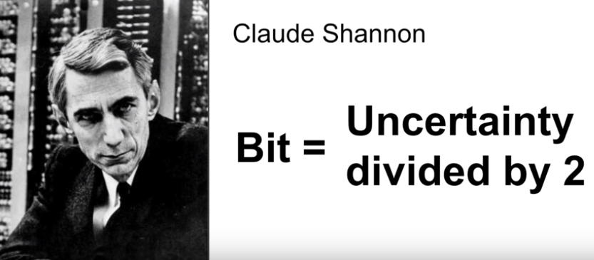
5 Multi-Layer Perceptrons (2)
https://www.youtube.com/watch?v=ErfnhcEV1O8
Information Theory (4):
In Shannon’s theory, to transmit one bit of information means to reduce the recipient’s uncertainty by a factor of 2.

Slide 8
5.2.2 What is a bit?

Slide 9
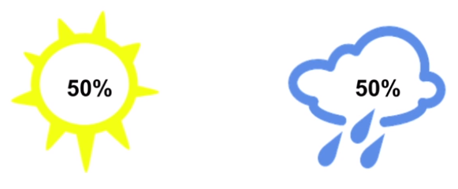
5.2.2 What is a bit?
https://www.youtube.com/watch?v=ErfnhcEV1O8
What is a bit (1)?
For example, say that the weather is completely random, with 50/50 chance of being either sunny or rainy every day.

Slide 10


5.2.2 What is a bit?
https://www.youtube.com/watch?v=ErfnhcEV1O8
What is a bit (2)?
If the weather station tells you that is going to be rainy tomorrow, then they says have actually reduce your uncertainty by a factor of two. There were two equally likely options, now, there is just one.

Slide 11

5.2.2 What is a bit?
https://www.youtube.com/watch?v=ErfnhcEV1O8
What is a bit (3)?
So the weather channel actually send you a single bit of useful information.
And this is true no matter how they encoded this information.
1 bit

Slide 12
5.2.2 What is a bit?
https://www.youtube.com/watch?v=ErfnhcEV1O8
What is a bit (4)?
If they encoded it as a string with 5 characters (“Rainy”), each encoded on 1 byte, then they actually send you a 40 bits message, but they still only communicated 1 bit of useful information.
“Rainy”
1 bit

Slide 13
5.2.3 Measure Information

Slide 14
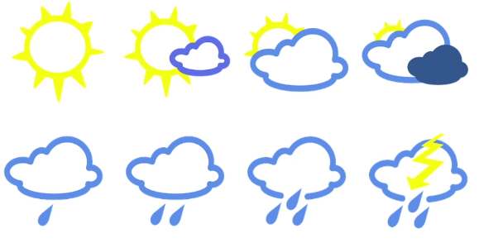
5.2.3 Measure Information
https://www.youtube.com/watch?v=ErfnhcEV1O8
Measure Information (1):
Now, suppose the weather has 8 possible states, all equally likely.

Slide 15



5.2.3 Measure Information
https://www.youtube.com/watch?v=ErfnhcEV1O8
Measure Information (2):
Now, when the weather station gives you tomorrow’s weather, they are dividing your uncertainty by a factor of 8, which is 2 to the power of 3. So they send you 3 bits of useful information.
3 bits

Slide 16
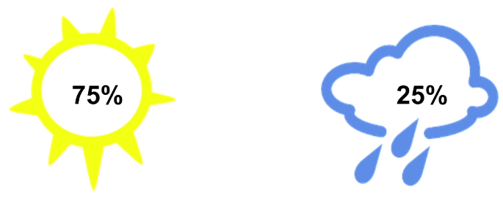
5.2.3 Measure Information
https://www.youtube.com/watch?v=ErfnhcEV1O8
Measure Information (3):
But what is the possibilities are not equally likely?
Say 75% chance sunny and 25% rainy.

Slide 17

5.2.3 Measure Information
https://www.youtube.com/watch?v=ErfnhcEV1O8
Measure Information (4):
If the weather station tells you it is going to be rainy tomorrow, then your uncertainty is has dropped by a factor of 4, which is 2 bits of information.
The uncertainty reduction is just the inverse of the event’s probability, in this case, the inverse of 25% is 4.
2 bits

Slide 18

5.2.3 Measure Information
https://www.youtube.com/watch?v=ErfnhcEV1O8
Measure Information (5):
Now the log of (1/x) is equal to -log (x), so the equation to compute the number of bits simplifies to - binary log of probability, 25%.
2 bits

Slide 19


5.2.3 Measure Information
https://www.youtube.com/watch?v=ErfnhcEV1O8
Measure Information (6):
Now, if the weather station tell you it is going to be sunny tomorrow, then your uncertainty has not dropped much. In fact, you get just over 0.41 bits of information.
0.41 bits

Slide 20

5.2.3 Measure Information
https://www.youtube.com/watch?v=ErfnhcEV1O8
Measure Information (7):
How much of information you are going to get from the weather station, on average?
Well, there is a 75% chance that it will be sunny tomorrow, so that is what the weather station would tell you and that is 0.41 bits of information.
Then, there is 25% chance that is will be rainy, in which case the weather station will tell you so, and this will give you 2 bits of information.
?

Slide 21

5.2.3 Measure Information
https://www.youtube.com/watch?v=ErfnhcEV1O8
Measure Information (8):
So, on the average, you will get 0.81 bits of information from the weather station, every data.
So what we computed is called the Entropy.
It is a nice measure of how uncertain the events are.
0.81 bits

Slide 22
5.2.4 Entropy

Slide 23

5.2.4 Entropy
https://www.youtube.com/watch?v=ErfnhcEV1O8
Entropy (1):
Hopefully, the Entropy’s equation should now make complete sense: it measure the average amount of information that you get when you learn the weather each day, ore more generally, the average amount of information that you get from one sample drawn from a given probability distribution p.
It tells you how unpredictable that probability distribution is.

Slide 24
5.2.4 Entropy
https://www.youtube.com/watch?v=ErfnhcEV1O8
Entropy (2):
If you live in the middle of a desert where it is sunny every day.
On average, you wont’s get much information the weather station, the entropy will be close to zero.
Conversely, if the weather varied a lot, the entropy will be much larger.

Slide 25
5.2.5 Cross-Entropy

Slide 26
5.2.5 Cross-Entropy
https://www.youtube.com/watch?v=ErfnhcEV1O8
Cross-Entropy (1):
OK, now, let’s talk about cross-entropy.
It is really quite simple: It is just the average message length.

Slide 27
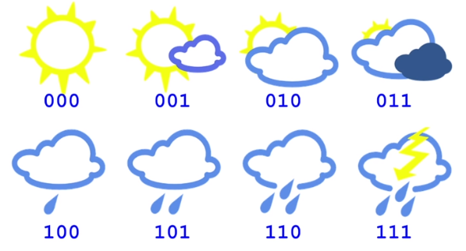

5.2.5 Cross-Entropy
https://www.youtube.com/watch?v=ErfnhcEV1O8
Cross-Entropy (2):
For example, if the weather station encodes each of the 8 possible options using a 3-bits code like this. Then every message will have 3 bits. So the average message length, will of course be 3 bits, that is the cross-entropy.

Slide 28
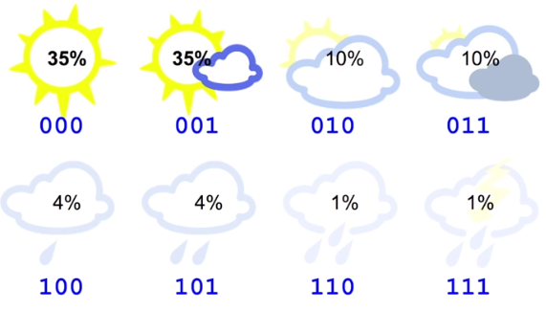

5.2.5 Cross-Entropy
https://www.youtube.com/watch?v=ErfnhcEV1O8
Cross-Entropy (3):
But now, suppose you live in a sunny region and the weather’s probability distribution looks like this.
Each day, there is a 35% chance of being sunny, and 1% chance of thunderstorm.
You can compute the entropy of probability distribution, and you will find that it is 2.23 bits.
Cross-Entropy
=2.23 bits

Slide 29
5.2.5 Cross-Entropy
https://www.youtube.com/watch?v=ErfnhcEV1O8
Cross-Entropy (4):
So, it is shame the weather station send 3 bits per message on average when the weather’s entropy is just 2.23 bits.
In other words, on average we send 3 bits, but the recipient entropy is just 2.23 useful bits. We can do better.
Count how many bits we used
= 35% x 3 + 35% x 3 +10% x 3 + 10% x 3 + 4% x 3 + 4% x 3 + 1% x 3 + 1% x 3
= 3 bits
Cross-Entropy
=2.23 bits

Slide 30
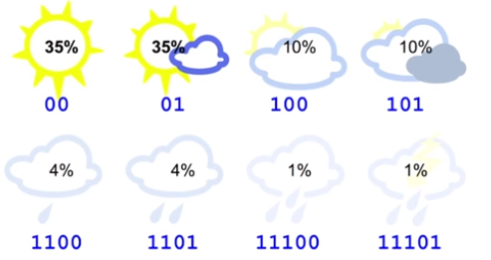
5.2.5 Cross-Entropy
https://www.youtube.com/watch?v=ErfnhcEV1O8
Cross-Entropy (5):
We are now just using 2-bit messages for the sunny or partially sunny weather, 3 bits for cloudy and most cloudy, 4 bits for light and medium rain, and 5 bits for heavy rainis and thunderstorm.
Note that our code is unambiguous: If you chain multiple messages, there is only one way to interpret the sequence of bits.
For example, 011100 can only mean partially sunny followed by light rain.

Slide 31
5.2.5 Cross-Entropy
https://www.youtube.com/watch?v=ErfnhcEV1O8
Cross-Entropy (6):
OK, so if you compute the average number of bits that we send every day, you get 2.42 bits.
That is our new and improve cross-entry!
35% x 2 + 35% x 2 + 10% x 3 + 10% x 3 + 4% x 4 + 4% x 4 + 1% x 5 + 1% x 5
= 2.42 bits

Slide 32
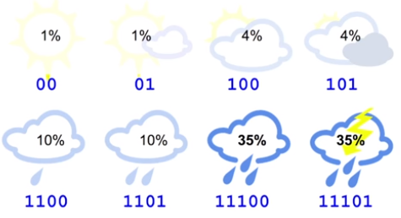
5.2.5 Cross-Entropy
https://www.youtube.com/watch?v=ErfnhcEV1O8
Cross-Entropy (7):
Now, it you compute the cross-entropy, you will find that is euqla to 4.58 bits.
Wow, that is really bad, it is roughly twice the entropy.
In other words, on average, we use send 4.58 bits but only 2.23 bits will really be useful to the recipient.
1% x 2 + 1% x 2 + 4% x 3 + 4% x 3
+ 10% x 4 + 10% x 4 + 35% x 5 + 35% x 5
= 4.58 bits

Slide 33
5.2.5 Cross-Entropy
https://www.youtube.com/watch?v=ErfnhcEV1O8
Cross-Entropy (8):
We are sending twice as much information per message as is necessary.
This is because the code we are sending make some implicit assumption about the weather distribution.
1% x 2 + 1% x 2 + 4% x 3 + 4% x 3
+ 10% x 4 + 10% x 4 + 35% x 5 + 35% x 5
= 4.58 bits

Slide 34
5.2.5 Cross-Entropy
https://www.youtube.com/watch?v=ErfnhcEV1O8
Cross-Entropy (9):
For example, when we us a 2-bit message for sunny weather, we are implicitly assuming that it will be sunny every 4 days (2 to the power of 2), at least on average.
In other words, by using this code, we are implicitly predicting a probability of 25% for sunny weather, or else our code will not be optimal.

Slide 35
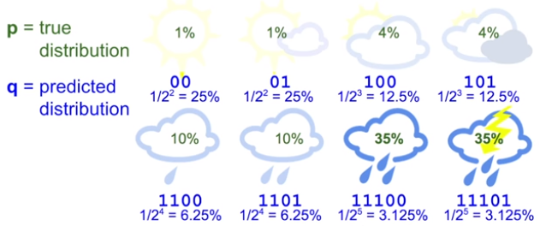
5.2.5 Cross-Entropy
https://www.youtube.com/watch?v=ErfnhcEV1O8
Cross-Entropy (10):
So, now it is pretty obvious that the predicted distribution q is quite different from the true distribution p.
Note that our code does not use messages starting with 1111. So that is why if you add up all the predicted probabilities in this example, they do not add up to 100%.

Slide 36

5 Multi-Layer Perceptrons (2)
https://www.youtube.com/watch?v=ErfnhcEV1O8
Cross-Entropy (11):
Anyway, now we can express cross-entropy as a function of both true probability distribution p and predicted probability distribution q.
As you can see, it looks pretty similar with the equation for the Entropy, but instead of computing the log of the true probability, we use the log of the predicted probability, which is equal to the message length.
Cross-Entropy:

Slide 37
5.2.5 Cross-Entropy
https://www.youtube.com/watch?v=ErfnhcEV1O8
Cross-Entropy (12):
If our predictions are perfect, then the cross-entropy is simply equals to the entropy.
But if the distribution differ, then the cross-entropy will be greater than the entropy by some number of bits.
The amount by which the cross-entropy exceeds the entropy is called the relative entropy, or more commonly, the Kullback-Leibler Divergence (or KL Divergence).
Cross-Entropy:

Slide 38
5.2.6 KL-Divergence

Slide 39
5.2.6 KL -Divergence
https://www.youtube.com/watch?v=ErfnhcEV1O8
KL-Divergence (1):
So, in short: Cross-entropy is equals to the entropy plus the KL divergence.
Cross-Entropy
= Entropy + KL Divergence
Or H(p)
= H(p, q) + D_{KL}(p||q)

Slide 40
5.2.6 KL -Divergence
https://www.youtube.com/watch?v=ErfnhcEV1O8
KL-Divergence (2):
Or, equivalently, the KL Divergence, which is D_{KL}(p||q) is equals to cross-entropy H(p, q) minus the entropy H (p).
KL Divergence:
D_{KL}(p||q) = H(p, q) – H(p)

Slide 41
5.2.6 KL -Divergence
https://www.youtube.com/watch?v=ErfnhcEV1O8
KL-Divergence (3):
In this particular example, the cross entropy is 4.58 bits, and the entropy is 2.23 bits.
So the KL divergence is 2.35 bits.
KL Divergence:
D_{KL}(p||q) = H(p, q) – H(p)

Slide 42
5.2.7 Cross-Entropy as a Cost Function

Slide 43

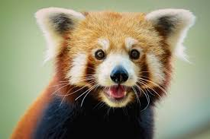
5.2.7 Cross-Entropy as a Cost Function
https://www.youtube.com/watch?v=ErfnhcEV1O8
Cross-Entry as a Cost Function (1):
OK. Now let’s use cross-entropy in machine learning!
Say, we want to train an image classifier that will detect some animal.
For each of the 7 possible classes, the classifier outputs an estimate probability.
Classifier

Slide 44
5.2.7 Cross-Entropy as a Cost Function
https://www.youtube.com/watch?v=ErfnhcEV1O8
Cross-Entry as a Cost Function (2):
This is the predicted probability distribution.
Now, this is a supervised learning problem, so we know the true distribution:
In this example, we know that this is an image of the cute red panda, so the probability is 100% for red panda and 0% for the rest.
Classifier

Slide 45


5.2.7 Cross-Entropy as a Cost Function
https://www.youtube.com/watch?v=ErfnhcEV1O8
Cross-Entry as a Cost Function (3):
We can use the cross-entropy between these two distribution as a cost function. This is called the cross-entropy loss, or simply the log loss, and it is just the equation we saw earlier except it usually uses the natural logarithm rather than the binary logarithm.
This does not change much for training, since the binary log od x is just equal to the natural log of x divided by a constant (the natural log of 2).
Classifier
Cross-Entropy Loss:

Slide 46
5.2.7 Cross-Entropy as a Cost Function)
https://www.youtube.com/watch?v=ErfnhcEV1O8
Cross-Entry as a Cost Function (4):
So when the labels are one-hot vectors, meaning one class has a probability of 100% and the rests are 0, as is the case in this example, then the cross-entropy is just negative log of the estimate probability for the true.
Classifier
Cross-Entropy Loss:
= - ln(025) =1.386

Slide 47
5.2.7 Cross-Entropy as a Cost Function
https://www.youtube.com/watch?v=ErfnhcEV1O8
Cross-Entry as a Cost Function (5):
You can see the cost will grow very large if the predicted probability for the true class is close to 0.
But if the predicted probability is close to 1, then the cost will be close to true distribution’s entropy which in this case, is equal to 0 since it is a one-hot vector.
This is the Entropy, Cross-Entropy, and KL diversgence.
Classifier
Cross-Entropy Loss:
= - ln(025) =1.386

Slide 48
End of Chapter

