Slide 1

3 Introduction to TensorFlow (1)
Peter H. Chen

Slide 2
3 Introduction to TensorFlow (1)
https://www.tensorflow.org/tutorials/
List of Topics
TensorFlow Buffers
TF eager execution
Adding TF nodes
TF methods (for constants)
TF methods (for sequences)
TF methods (for Python lists)

Slide 3
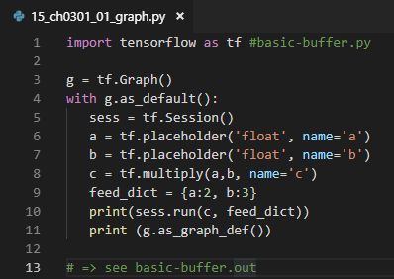
3 Introduction to TensorFlow (1)
https://www.tensorflow.org/tutorials/
TensorFlow Graphs and Buffers
import tensorflow as tf #basic-buffer.py
g = tf.Graph()
with g.as_default():
sess = tf.Session()
a = tf.placeholder('float', name='a')
b = tf.placeholder('float', name='b')
c = tf.multiply(a,b, name='c')
feed_dict = {a:2, b:3}
print(sess.run(c, feed_dict))
print (g.as_graph_def())
# => see basic-buffer.out

Slide 4
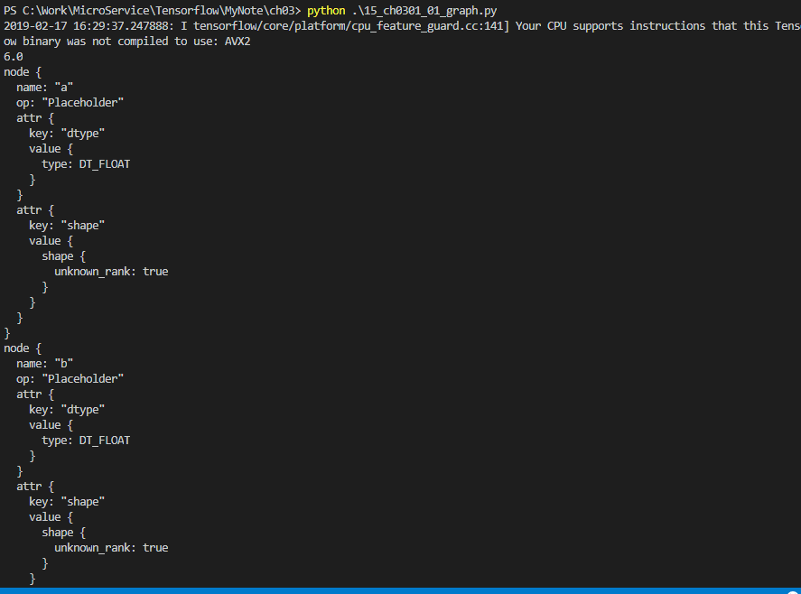
3 Introduction to TensorFlow (1)
https://www.tensorflow.org/tutorials/
TensorFlow Graphs and Buffers
python 25_ch0301_graph.py
. . .
node {
name: "c"
op: "Mul"
input: "a"
input: "b"
attr {
key: "T"
value {
type: DT_FLOAT
}
}

Slide 5
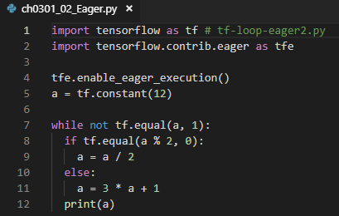
3 Introduction to TensorFlow (1)
https://www.tensorflow.org/tutorials/
TF Loops and Eager Execution
import tensorflow as tf # tf-loop-eager2.py
import tensorflow.contrib.eager as tfe
tfe.enable_eager_execution()
a = tf.constant(12)
while not tf.equal(a, 1):
if tf.equal(a % 2, 0):
a = a / 2
else:
a = 3 * a + 1
print(a)

Slide 6
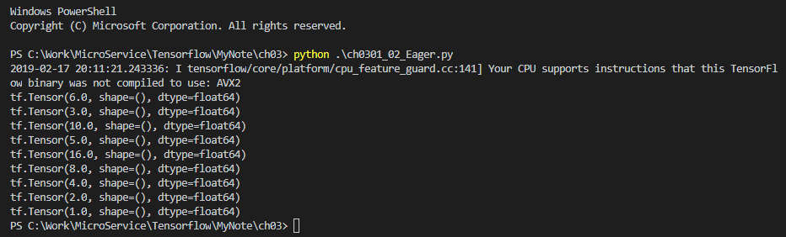
3 Introduction to TensorFlow (1)
https://www.tensorflow.org/tutorials/
TF Loops and Eager Execution
> python .\ch0301_02_Eager.py
tf.Tensor(6.0, shape=(), dtype=float64)
tf.Tensor(3.0, shape=(), dtype=float64)
tf.Tensor(10.0, shape=(), dtype=float64)
tf.Tensor(5.0, shape=(), dtype=float64)
tf.Tensor(16.0, shape=(), dtype=float64)
tf.Tensor(8.0, shape=(), dtype=float64)
tf.Tensor(4.0, shape=(), dtype=float64)
tf.Tensor(2.0, shape=(), dtype=float64)
tf.Tensor(1.0, shape=(), dtype=float64)

Slide 7
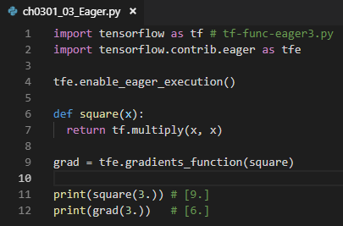
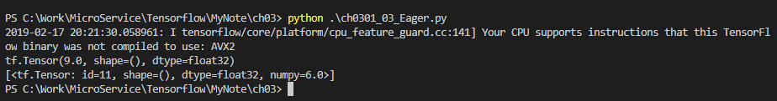
3 Introduction to TensorFlow (1)
https://www.tensorflow.org/tutorials/
TF Loops and Eager Execution
import tensorflow as tf # tf-func-eager3.py
import tensorflow.contrib.eager as tfe
tfe.enable_eager_execution()
def square(x):
return tf.multiply(x, x)
grad = tfe.gradients_function(square)
print(square(3.)) # [9.]
print(grad(3.)) # [6.]

Slide 8
3 Introduction to TensorFlow (1)
https://www.tensorflow.org/tutorials/
TF Tensor Operations
TF supports many operations on tensors
Adding pairs of tensors
Multiplying tensors
Dividing tensors
Subtracting tensors
=> Operations are element-by-element

Slide 9
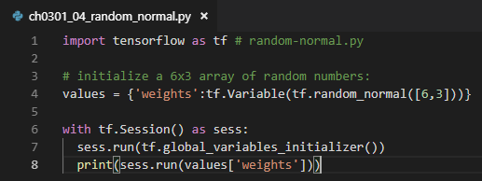
3 Introduction to TensorFlow (1)
https://www.tensorflow.org/tutorials/
TensorFlow method: random_normal()
import tensorflow as tf # random-normal.py
# initialize a 6x3 array of random numbers:
values = {'weights':tf.Variable(tf.random_normal([6,3]))}
with tf.Session() as sess:
sess.run(tf.global_variables_initializer())
print(sess.run(values['weights']))

Slide 10
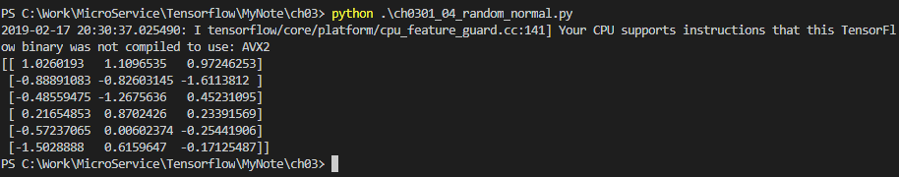
3 Introduction to TensorFlow (1)
https://www.tensorflow.org/tutorials/
TensorFlow method: random_normal()
# sample output (6 rows x 3 columns):
[[ 0.83530873 1.00292623 -0.11506019]
[-0.82566637 0.45110381 -1.09818149]
[-0.26840609 -0.4434818 0.48984894]
[ 0.48618484 -1.55438101 1.38592315]
[ 0.23166555 -0.37035158 0.10339094]
[-0.58803022 -0.17280568 -0.96742302] ]

Slide 11
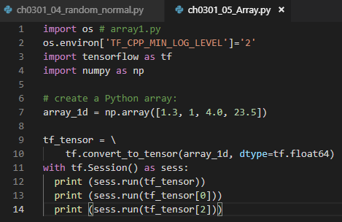
3 Introduction to TensorFlow (1)
https://www.tensorflow.org/tutorials/
TensorFlow Arrays
import os # array1.py
os.environ['TF_CPP_MIN_LOG_LEVEL']='2'
import tensorflow as tf
import numpy as np
# create a Python array:
array_1d = np.array([1.3, 1, 4.0, 23.5])
tf_tensor = \
tf.convert_to_tensor(array_1d, dtype=tf.float64)
with tf.Session() as sess:
print (sess.run(tf_tensor))
print (sess.run(tf_tensor[0]))
print (sess.run(tf_tensor[2]))

Slide 12

3 Introduction to TensorFlow (1)
https://www.tensorflow.org/tutorials/
TensorFlow Arrays
> Python ch0301_05_Array.py
[ 1.3 1. 4. 23.5]
1.3
4.0

Slide 13
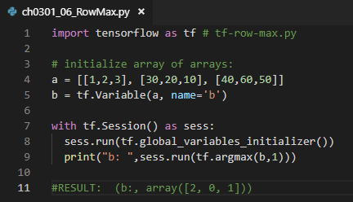

3 Introduction to TensorFlow (1)
https://www.tensorflow.org/tutorials/
TensorFlow Arrays
import tensorflow as tf # tf-row-max.py
# initialize array of arrays:
a = [[1,2,3], [30,20,10], [40,60,50]]
b = tf.Variable(a, name='b')
with tf.Session() as sess:
sess.run(tf.global_variables_initializer())
print("b: ",sess.run(tf.argmax(b,1)))
#RESULT: (b:, array([2, 0, 1]))
Index of Max value in row = [2, 0, 1]

Slide 14
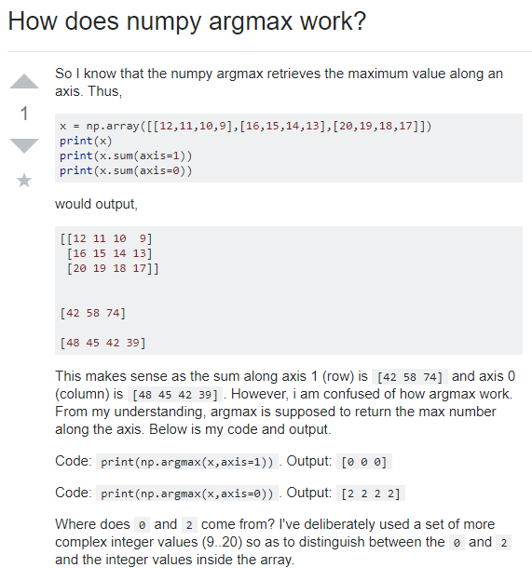
3 Introduction to TensorFlow (1)
https://www.tensorflow.org/tutorials/
What is Axis?
Axis = 1: row
Axis = 0: column
argmax (arry_2d, axis = 1)
# pick up the max from each row
argmax (array_2d, axis = 0)
# pick up the max from each column

Slide 15
3 Introduction to TensorFlow (1)
https://www.tensorflow.org/tutorials/
TensorFlow range() API
=> Similar to np.linspace() API
tf.range(start,limit,delta=1,dtype=None,name='range')
# EXAMPLE:
tf.range(3,18,3)
=> [3, 6, 9, 12, 15]
=> similar to a for loop:
for(x=3; x<18; x+=3)

Slide 16
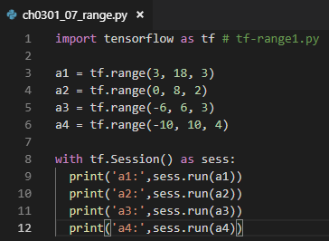
3 Introduction to TensorFlow (1)
https://www.tensorflow.org/tutorials/
TensorFlow range() API
import tensorflow as tf # tf-range1.py
a1 = tf.range(3, 18, 3)
a2 = tf.range(0, 8, 2)
a3 = tf.range(-6, 6, 3)
a4 = tf.range(-10, 10, 4)
with tf.Session() as sess:
print('a1:',sess.run(a1))
print('a2:',sess.run(a2))
print('a3:',sess.run(a3))
print('a4:',sess.run(a4))

Slide 17
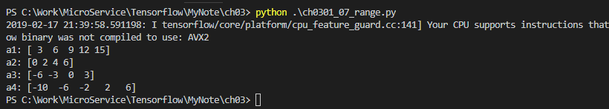
3 Introduction to TensorFlow (1)
https://www.tensorflow.org/tutorials/
TensorFlow range() API
Output from tf-range1.py:
('a1:', array([3, 6, 9, 12, 15], dtype=int32))
('a2:', array([0, 2, 4, 6], dtype=int32))
('a3:', array([-6, -3, 0, 3], dtype=int32))
('a4:', array([-10, -6, -2, 2, 6], dtype=int32))

Slide 18
3 Introduction to TensorFlow (1)
https://www.tensorflow.org/tutorials/
TF and Python Lists
Output from tf-range1.py:
('a1:', array([3, 6, 9, 12, 15], dtype=int32))
('a2:', array([0, 2, 4, 6], dtype=int32))
('a3:', array([-6, -3, 0, 3], dtype=int32))
('a4:', array([-10, -6, -2, 2, 6], dtype=int32))

Slide 19
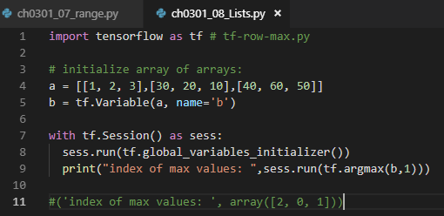

3 Introduction to TensorFlow (1)
https://www.tensorflow.org/tutorials/
TF and Python Lists
import tensorflow as tf # tf-row-max.py
# initialize array of arrays:
a = [[1, 2, 3],[30, 20, 10],[40, 60, 50]]
b = tf.Variable(a, name='b')
with tf.Session() as sess:
sess.run(tf.global_variables_initializer())
print("index of max values: ",sess.run(tf.argmax(b,1)))
#('index of max values: ', array([2, 0, 1]))
1. Argmax (b, axis=1), axis =1, flag select row
2. Max values of each row is 3, 30, 60
3. The corresponding Index of Max values of each row is [2, 0, 1]

Slide 20
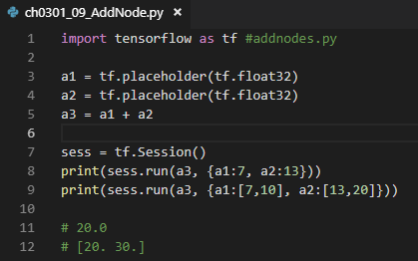
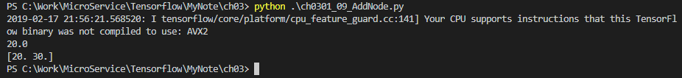
3 Introduction to TensorFlow (1)
https://www.tensorflow.org/tutorials/
Adding TF Nodes
import tensorflow as tf #addnodes.py
a1 = tf.placeholder(tf.float32)
a2 = tf.placeholder(tf.float32)
a3 = a1 + a2
sess = tf.Session()
print(sess.run(a3, {a1:7, a2:13}))
print(sess.run(a3, {a1:[7,10], a2:[13,20]}))
# 20.0
# [20. 30.]
a1 = 7, a2= 13 => a3 = a1 + a2 = 20
a1 = [7, 10], a2 = [13, 20] => a3 = a1 + a2 = [20 30]

Slide 21
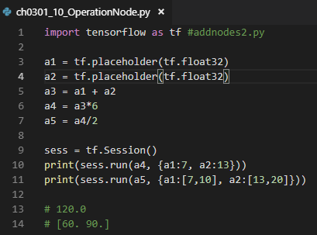
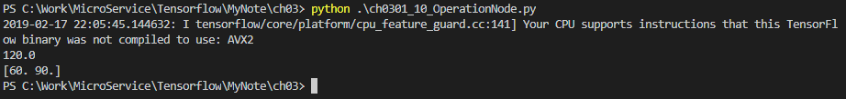
3 Introduction to TensorFlow (1)
https://www.tensorflow.org/tutorials/
Operations with TF Nodes
import tensorflow as tf #addnodes2.py a1 = tf.placeholder(tf.float32)
a2 = tf.placeholder(tf.float32)
a3 = a1 + a2
a4 = a3*6
a5 = a4/2 sess = tf.Session()
print(sess.run(a4, {a1:7, a2:13}))
print(sess.run(a5, {a1:[7,10], a2:[13,20]})) # 120.0
# [60. 90.]
a1 = 7, a2= 13 => a3 = a1 + a2 = 20, a4 = a3 * 6 = 120
a1 = [7, 10], a2 = [13, 20] => a3 = a1 + a2 = [20 30] , a4 = a3 * 6 = [120, 180], a5 = a4/2 = [60, 90]

Slide 22
3 Introduction to TensorFlow (1)
https://www.tensorflow.org/tutorials/
Operations with TF Nodes
import tensorflow as tf #addnodes3.py
a1 = tf.placeholder(tf.float32)
a2 = tf.placeholder(tf.float32)
a3 = a1 + a2
a4 = a3*6
a5 = a4/2 with tf.Session() as sess: #addnodes3.py
print(sess.run(a4, {a1:7, a2:13}))
print(sess.run(a5, {a1:[7,10], a2:[13,20]}))
# print('a4: ',sess.run(a4))
# print('a5: ',sess.run(a5))
# b1 = tf.add_n([a4, a5], name="b1")
# print('b1: ',sess.run(b1))
# b2 = tf.multiply(a4, a5, name="b2")
# print('b2: ',sess.run(b2))
# b3 = tf.multiply(tf.pow(a4,2),tf.pow(a5,2), name="b3")
# print('b3: ',sess.run(b3))

Slide 23
3 Introduction to TensorFlow (1)
https://www.tensorflow.org/tutorials/
Summary of Session (1)
TensorFlow Buffers (JSON data)
TF loops [ while not tf.equal(a, 1): ]
“if” logic [ if tf.equal(a % 2, 0): ]
TF functions (a la Python):
def square(x):
return tf.multiply(x, x)

Slide 24
3 Introduction to TensorFlow (1)
https://www.tensorflow.org/tutorials/
Summary of Session (2)
TF functions (a la Python):
def abs(x):
return x if x > 0. else –x
TF operations on tensors:
Add/subtract/multiply/divide tensors
TF tf.random_normal() method:
values = {'weights':tf.Variable(tf.random_normal([6,3]))}

Slide 25
3 Introduction to TensorFlow (1)
https://www.tensorflow.org/tutorials/
Summary of Session (3)
TF tf.argmax() method:
a = [[1,2,3], [30,20,10], [40,60,50]]
b = tf.Variable(a, name='b’)
print("b: ",sess.run(tf.argmax(b,1)))
TF sum and prod array methods:
m_prod = tf.matmul(matrix1, matrix2)
m_sum = tf.add(matrix1,matrix2)

Slide 26
End of Chapter

