Slide 1

3 Introduction to TensorFlow (2)
Peter H. Chen

Slide 2
3 Introduction to TensorFlow (2)
https://www.tensorflow.org/tutorials/
List of Topics (TF Method) (1)
eval()
rank()
reduce_sum()
reduce_mean()
random_normal()
truncated_normal()
reshape()
range()
List of Topics (TF Method) (2)
equal()
argmax()
argmin()
one_hot()
name_scope()
summary.scalar()
TF activation functions
TF loss functions
TF optimizers
TF from the Python REPL

Slide 3
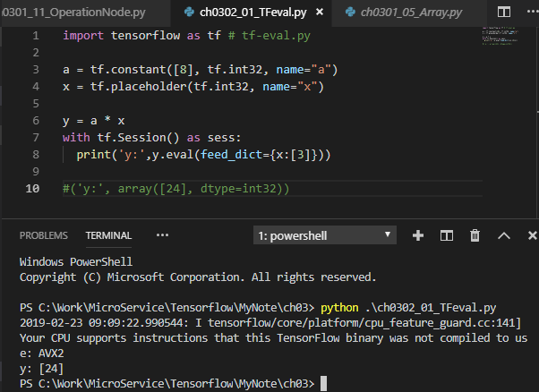
3 Introduction to TensorFlow (2)
https://www.tensorflow.org/tutorials/
TF and eval()
import tensorflow as tf # tf-eval.py
a = tf.constant([8], tf.int32, name="a")
x = tf.placeholder(tf.int32, name="x")
y = a * x
with tf.Session() as sess:
print('y:',y.eval(feed_dict={x:[3]}))
#('y:', array([24], dtype=int32))

Slide 4
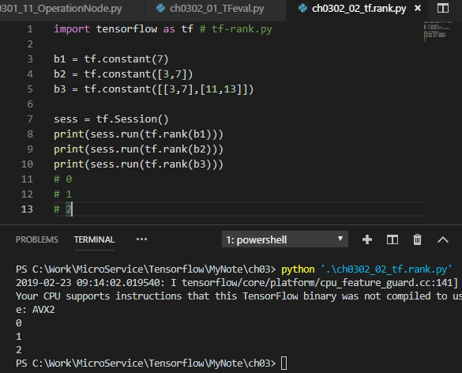
3 Introduction to TensorFlow (2)
https://www.tensorflow.org/tutorials/
tf.rank()
import tensorflow as tf # tf-rank.py
b1 = tf.constant(7)
b2 = tf.constant([3,7])
b3 = tf.constant([[3,7],[11,13]])
sess = tf.Session()
print(sess.run(tf.rank(b1)))
print(sess.run(tf.rank(b2)))
print(sess.run(tf.rank(b3)))
# 0
# 1
# 2

Slide 5
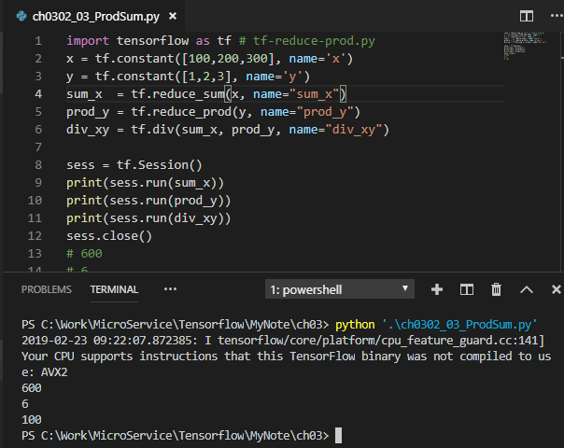
3 Introduction to TensorFlow (2)
https://www.tensorflow.org/tutorials/
tf.reduce_prod() and tf.reduce_sum()
import tensorflow as tf # tf-reduce-prod.py
x = tf.constant([100,200,300], name='x')
y = tf.constant([1,2,3], name='y’)
sum_x = tf.reduce_sum(x, name="sum_x")
prod_y = tf.reduce_prod(y, name="prod_y")
div_xy = tf.div(sum_x, prod_y, name="div_xy")
sess = tf.Session()
print(sess.run(sum_x))
print(sess.run(prod_y))
print(sess.run(div_xy))
sess.close()
# 600
# 6
# 100

Slide 6
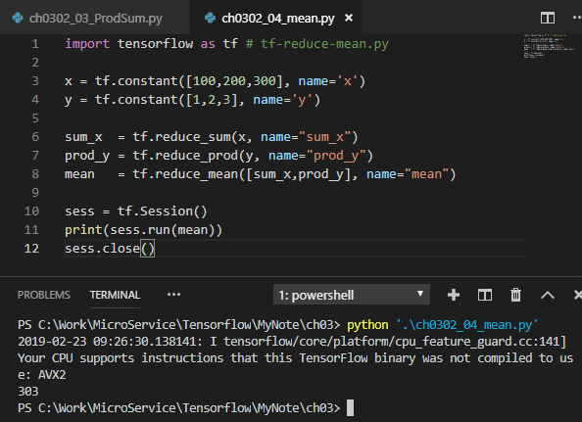
3 Introduction to TensorFlow (2)
https://www.tensorflow.org/tutorials/
tf.reduce_mean()
import tensorflow as tf # tf-reduce-mean.py
x = tf.constant([100,200,300], name='x')
y = tf.constant([1,2,3], name='y')
sum_x = tf.reduce_sum(x, name="sum_x")
prod_y = tf.reduce_prod(y, name="prod_y")
mean = tf.reduce_mean([sum_x,prod_y], name="mean")
sess = tf.Session()
print(sess.run(mean))
sess.close()
# 303

Slide 7
3 Introduction to TensorFlow (2)
https://www.tensorflow.org/tutorials/
tf.random_normal()
random values from a normal distribution
random numbers from a normal distribution
mean is close to 0
the values can be farther apart:
Ex: -2 to 2
Can lead to saturation for sigmoid/tanh

Slide 8
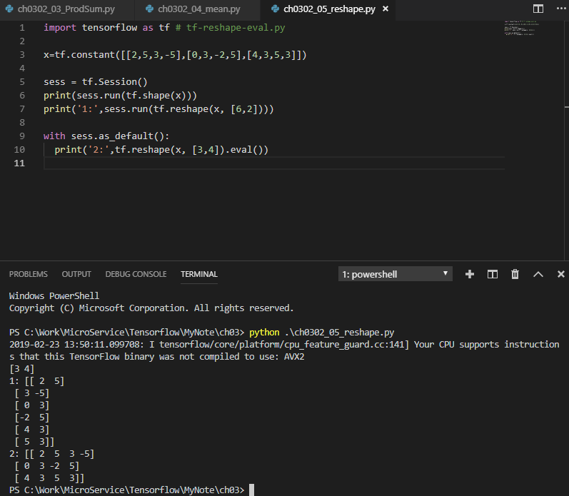
3 Introduction to TensorFlow (2)
https://www.tensorflow.org/tutorials/
tf.reshape()
import tensorflow as tf # tf-reshape-eval.py
x=tf.constant([[2,5,3,-5],[0,3,-2,5],[4,3,5,3]])
sess = tf.Session()
print(sess.run(tf.shape(x)))
print('1:',sess.run(tf.reshape(x, [6,2])))
with sess.as_default():
print('2:',tf.reshape(x, [3,4]).eval())
#
('1:', array([[ 2, 5],
[ 3, -5],
[ 0, 3],
[-2, 5],
[ 4, 3],
[ 5, 3]], dtype=int32))
('2:', array([
[ 2, 5, 3, -5],
[ 0, 3, -2, 5],
[ 4, 3, 5, 3]], dtype=int32))

Slide 9
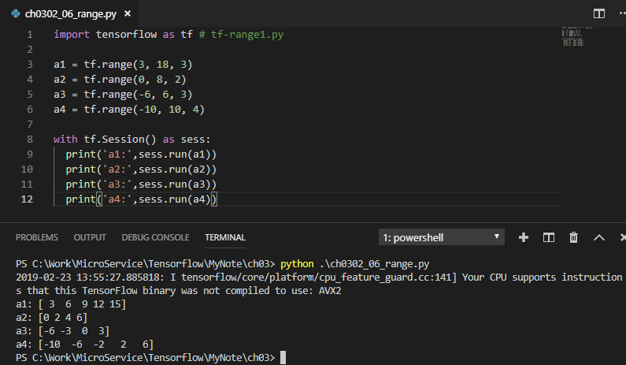
3 Introduction to TensorFlow (2)
https://www.tensorflow.org/tutorials/
tf.range()
import tensorflow as tf # tf-range1.py
a1 = tf.range(3, 18, 3)
a2 = tf.range(0, 8, 2)
a3 = tf.range(-6, 6, 3)
a4 = tf.range(-10, 10, 4)
with tf.Session() as sess:
print('a1:',sess.run(a1))
print('a2:',sess.run(a2))
print('a3:',sess.run(a3))
print('a4:',sess.run(a4))

Slide 10
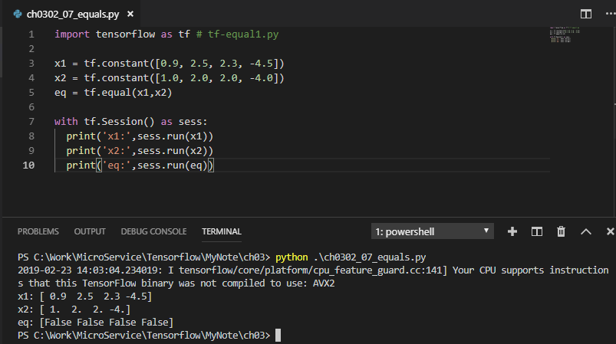
3 Introduction to TensorFlow (2)
https://www.tensorflow.org/tutorials/
TF tf.equal() [A]
import tensorflow as tf # tf-equal1.py
x1 = tf.constant([0.9, 2.5, 2.3, -4.5])
x2 = tf.constant([1.0, 2.0, 2.0, -4.0])
eq = tf.equal(x1,x2)
with tf.Session() as sess:
print('x1:',sess.run(x1))
print('x2:',sess.run(x2))
print('eq:',sess.run(eq))
#('x1:’,array([0.9,2.5,2.3, -4.5], dtype=float32))
#('x2:’,array([1., 2., 2., -4.], dtype=float32))
#('eq:’,array([False, False, False, False]))

Slide 11
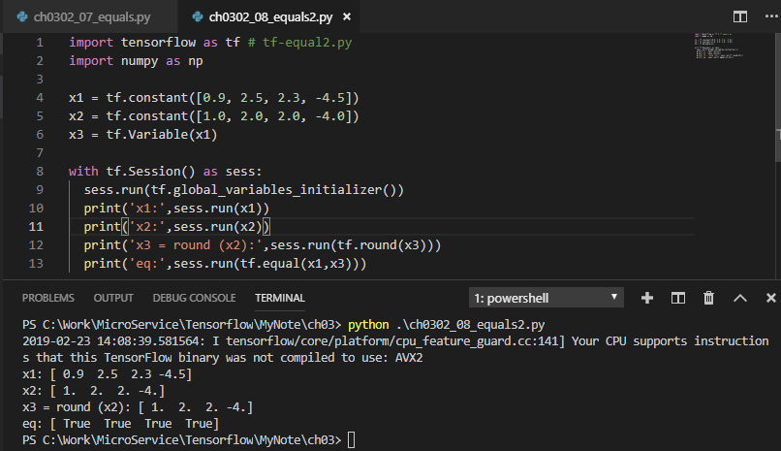
3 Introduction to TensorFlow (2)
https://www.tensorflow.org/tutorials/
TF tf.equal() [B]
import tensorflow as tf # tf-equal2.py
import numpy as np
x1 = tf.constant([0.9, 2.5, 2.3, -4.5])
x2 = tf.constant([1.0, 2.0, 2.0, -4.0])
x3 = tf.Variable(x1)
with tf.Session() as sess:
sess.run(tf.global_variables_initializer())
print('x1:',sess.run(x1))
print('x2:',sess.run(x2))
print('x3 = round (x2):',sess.run(tf.round(x3)))
print('eq:',sess.run(tf.equal(x1,x3)))
#('x1:',array([0.9, 2.5, 2.3, -4.5], dtype=float32))
#('x2:',array([1., 2., 2., -4.], dtype=float32))
#('r3:',array([1., 2., 2., -4.], dtype=float32))
#('eq:',array([True,True,True,True]))

Slide 12
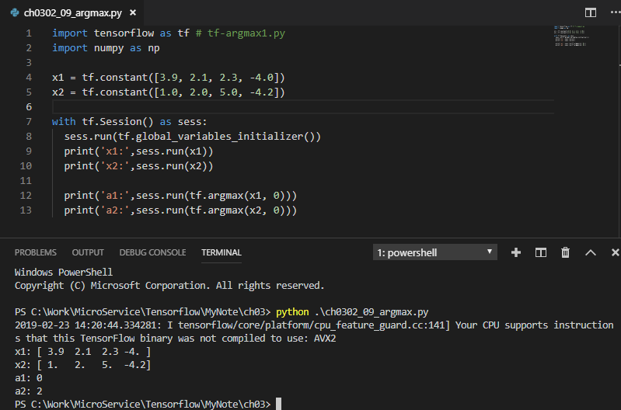
3 Introduction to TensorFlow (2)
https://www.tensorflow.org/tutorials/
TF tf.argmax() [A]
import tensorflow as tf # tf-argmax1.py
import numpy as np
x1 = tf.constant([3.9, 2.1, 2.3, -4.0])
x2 = tf.constant([1.0, 2.0, 5.0, -4.2])
with tf.Session() as sess:
sess.run(tf.global_variables_initializer())
print('x1:',sess.run(x1))
print('x2:',sess.run(x2))
print('a1:',sess.run(tf.argmax(x1, 0)))
print('a2:',sess.run(tf.argmax(x2, 0)))
#('x1:',array([3.9,2.1,2.3,-4.],dtype=float32))
#('x2:',array([1.,2.,5., -4.2],dtype=float32))
#('a1:',0)
#('a2:',2)

Slide 13
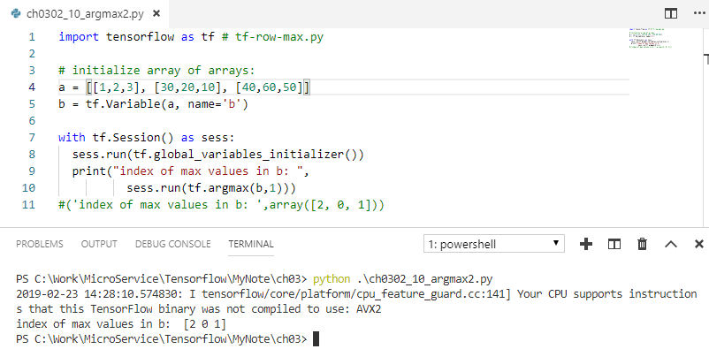
3 Introduction to TensorFlow (2)
https://www.tensorflow.org/tutorials/
TF tf.argmax() [B]
import tensorflow as tf # tf-row-max.py
# initialize array of arrays:
a = [[1,2,3], [30,20,10], [40,60,50]]
b = tf.Variable(a, name='b')
with tf.Session() as sess:
sess.run(tf.global_variables_initializer())
print("index of max values in b: ",
sess.run(tf.argmax(b,1)))
#('index of max values in b: ',array([2, 0, 1]))

Slide 14
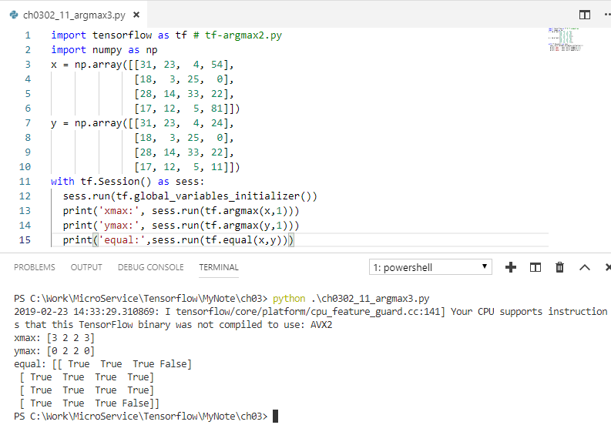
3 Introduction to TensorFlow (2)
https://www.tensorflow.org/tutorials/
TF tf.argmax() [B]
import tensorflow as tf # tf-argmax2.py
import numpy as np
x = np.array([[31, 23, 4, 54],
[18, 3, 25, 0],
[28, 14, 33, 22],
[17, 12, 5, 81]])
y = np.array([[31, 23, 4, 24],
[18, 3, 25, 0],
[28, 14, 33, 22],
[17, 12, 5, 11]])
with tf.Session() as sess:
sess.run(tf.global_variables_initializer())
print('xmax:', sess.run(tf.argmax(x,1)))
print('ymax:', sess.run(tf.argmax(y,1)))
print('equal:',sess.run(tf.equal(x,y)))
#('xmax:', array([3, 2, 2, 0]))
#('ymax:', array([0, 2, 2, 3]))
#('equal:',
# array([[True,True,True,False],
# [True,True,True,True],
# [True,True,True,True],
# [True,True,True,False]]))

Slide 15
3 Introduction to TensorFlow (2)
https://www.tensorflow.org/tutorials/
TF tf.one_hot()
For variables with non-numeric values
possible values often in a fixed set.
Called categorical or nominal data
=> Convert each value to a vector with a unique 1
EXAMPLE: a color variable: red, green, or blue
SOLUTION: a 3x3 identity matrix
red, green, blue
1, 0, 0
0, 1, 0
0, 0, 1

Slide 16
3 Introduction to TensorFlow (2)
https://www.tensorflow.org/tutorials/
TF tf.name_scope()
Conceptually similar to namespaces in other languages (ex: Java and C#)
useful for two variables with same name but in different operations
“groups” variables in TensorBoard (week4/hour1)
see namescope1.py:
with tf.name_scope("scope_b1"):
b1 = tf.add_n([a4, a5], name="b1”)

Slide 17
3 Introduction to TensorFlow (2)
https://www.tensorflow.org/tutorials/
TF tf.summary.scalar()
Generates a tensor with a scalar value
Invoked from TF code
updates the TF graph
visible in TensorBoard
Examples:
tf.summary.scalar('stddev', stddev)
tf.summary.scalar('max', tf.reduce_max(var))
tf.summary.scalar('min', tf.reduce_min(var))

Slide 18
3 Introduction to TensorFlow (2)
https://www.tensorflow.org/tutorials/
TF tf.nn: activation functions
tf.nn.relu
tf.nn.relu6
tf.nn.crelu
tf.nn.elu
tf.nn.selu
tf.nn.softplus
tf.nn.softsign
tf.nn.dropout
tf.nn.bias_add
tf.sigmoid
tf.tanh

Slide 19
3 Introduction to TensorFlow (2)
https://www.tensorflow.org/tutorials/
TF Loss Functions
tf.train.GradientDescentOptimizer(): original gradient descent method
tf.train.AdagradOptimizer(): adapts the learning rate
tf.train.AdadeltaOptimizer(): modified Adagrad

Slide 20
3 Introduction to TensorFlow (2)
https://www.tensorflow.org/tutorials/
TensorFlow Optimizers
subclasses of Optimizer base class
with methods to compute gradients for a loss
methods to apply gradients to variables.
subclasses implement classic optimization algorithms
ex: GradientDescent and Adagrad
=> instantiate one of the subclasses of Optimizer

Slide 21
3 Introduction to TensorFlow (2)
https://www.tensorflow.org/tutorials/
TensorFlow Optimizers
tf.train.Optimizer
tf.train.GradientDescentOptimizer
tf.train.AdadeltaOptimizer
tf.train.AdagradOptimizer
tf.train.AdagradDAOptimizer
tf.train.MomentumOptimizer
tf.train.AdamOptimizer
tf.train.FtrlOptimizer
tf.train.ProximalGradientDescentOptimizer
tf.train.ProximalAdagradOptimizer
tf.train.RMSPropOptimizer

Slide 22
3 Introduction to TensorFlow (2)
https://www.tensorflow.org/tutorials/
TF and the Python REPL
Open a command shell
Type “python” at the command prompt
Enter the following statements (in blue):
>>> sess = tf.Session()
>>> hello = tf.constant("Hello, TensorFlow!")
>>> sess.run(hello)
'Hello, TensorFlow!'

Slide 23
3 Introduction to TensorFlow (2)
https://www.tensorflow.org/tutorials/
Summary of Session (1)
eval()
rank()
reduce_sum()
reduce_mean()
random_normal()
truncated_normal()
reshape()
range()
Summary of Session (2)
equal()
argmax()
argmin()
one_hot()
name_scope()
scalar_summary()
histogram_summary()
TF activation functions
TF loss functions
TF optimizers
TF from the Python REPL

Slide 24
End of Chapter

