Slide 1

3 Introduction to TensorFlow (3)
Peter H. Chen

Slide 2
3 Introduction to TensorFlow (3)
https://www.tensorflow.org/tutorials/
List of Topics
Google Colaboratory
TensorFlow Serving
Tensor2Tensor
TensorFlow Model Analysis (TFMA)
Properties of Images
TensorFlow and Images
Rotate/crop image
Checkpoints

Slide 3
3 Introduction to TensorFlow (3)
https://www.tensorflow.org/tutorials/
Google Colaboratory (1)
An online environment for TensorFlow
Provides Jupyter notebooks
Create/upload/download notebooks/Python
Install “Google Drive” to access local files
=> Up to 12 GPU hours per day (free)
Google Colaboratory (2)
no set-up steps are required
runs entirely in the cloud
suitable for training simple models
good for testing ideas quickly
connect Colab to Jupyter on your laptop

Slide 4
3 Introduction to TensorFlow (3)
https://www.tensorflow.org/tutorials/
Google Colaboratory (3)
TensorFlow execution with GPUs
visualization using Matplotlib
save a copy of your Colab notebook to Github:
File > Save a copy to GitHub
load any .ipynb on GitHub (add path to URL):
colab.research.google.com/github
see the main website for more details
Google Colaboratory (4)
Main page:
https://colab.research.google.com/notebooks/welcome.ipynb
Overview page:
https://colab.research.google.com/notebooks/basic_features_overview.ipynb
Some tips:
https://www.kdnuggets.com/2018/02/essential-google-colaboratory-tips-tricks.html

Slide 5
3 Introduction to TensorFlow (3)
https://www.tensorflow.org/tutorials/
Google Colaboratory (5)
How to connect to a server:
1) To go Colab “welcome” page
2) Click on “CONNECT” button
How to upload local Jupyter notebook:
1) click on “File”
2) click on “Upload notebook…” 3)select a notebook and wait a few moments
How to select a GPU:
1) upload a Jupyter notebook
2) Edit > Notebook Settings > Hardware selector
3) Select “GPU”0
Google Colaboratory (6): Sample Notebooks
NN with California housing dataset:
https://colab.research.google.com/notebooks/mlcc/first_steps_with_tensor_flow.ipynb
Intro to Pandas page:
https://colab.research.google.com/notebooks/mlcc/intro_to_pandas.ipynb
Logistic regression:
https://colab.research.google.com/notebooks/mlcc/logistic_regression.ipynb?hl=en

Slide 6
3 Introduction to TensorFlow (3)
https://www.tensorflow.org/tutorials/
What is Tensorflow Serving? (1)
a high-performance serving system for ML models
designed for production environments
easy to deploy new algorithms and experiments
with the same server architecture and APIs
provides integration with TensorFlow models
easily extended to serve other models and data
=> https://www.tensorflow.org/serving/

Slide 7
3 Introduction to TensorFlow (3)
https://www.tensorflow.org/tutorials/
What is Tensorflow Serving? (2)
# Download TF Serving Docker image+repo:
docker pull tensorflow/serving
git clone https://github.com/tensorflow/serving
# Location of demo models:
TESTDATA="$(pwd)/serving/tensorflow_serving/servables/tensorflow/testdata“
# Start TF Serving container and open the REST API port:
docker run -t --rm -p 8501:8501 \
-v "$TESTDATA/saved_model_half_plus_two_cpu:/models/half_plus_two” -e MODEL_NAME=half_plus_two \
tensorflow/serving &

Slide 8
3 Introduction to TensorFlow (3)
https://www.tensorflow.org/tutorials/
What is Tensorflow Serving? (3)
# Query the model using the predict API:
curl -d '{"instances": [1.0, 2.0, 5.0]}’ \
-X POST http://localhost:8501/v1/models/half_plus_two:predict
# Returns this result:
#=> { "predictions": [2.5, 3.0, 4.5] }

Slide 9
3 Introduction to TensorFlow (3)
https://www.tensorflow.org/tutorials/
What is Tensor2Tensor?
#a library of DL models and datasets
makes DL more accessible/accelerate ML research
actively used by the Google Brain team
provides downloadable datasets / pre-trained models
you can also create/train your own models
Colab notebook with intro to tensor2tensor:
https://colab.research.google.com/github/tensorflow/tensor2tensor/blob/master/tensor2tensor/notebooks/hello_t2t.ipynb

Slide 10
3 Introduction to TensorFlow (3)
https://www.tensorflow.org/tutorials/
What is TensorFlow Model Analysis?
a library for evaluating TensorFlow models
you can evaluate models on large amounts of data
https://github.com/tensorflow/model-analysis
=> TFMA requires Apache Beam:
pip install apache-beam
https://beam.apache.org/
https://beam.apache.org/get-started/downloads/

Slide 11
3 Introduction to TensorFlow (3)
https://www.tensorflow.org/tutorials/
Pixels and Colors
One pixel = one “sprite”
Each pixel has a color value
Color value = (R,G,B) triple
Grayscale: (R,G,B) values are equal
(TR, G, B) Triples
(R,G,B) = (Red, Green, Blue)
value between 0 and 255 (or 0 and 1)
(255,0,0): RED
(0,255,0): GREEN
(0,0,255): BLUE
(255,255,0): YELLOW
(255,200,0): ORANGE
(255,255,255): WHITE
(0,0,0): BLACK

Slide 12
3 Introduction to TensorFlow (3)
https://www.tensorflow.org/tutorials/
TensorFlow and Images (1)
Grayscale images:
one channel
0 = black
255 = white
Tensors are (w,h,c=1) where:
w = width
h = height
c = channels
TensorFlow and Images (2)
Color images with three channels:
red, green, blue
Color images with four channels:
red, green, blue, alpha (=“opacity”)
Tensors are (w,h,c) where:
w = width
h = height
c = channels

Slide 13
3 Introduction to TensorFlow (3)
https://www.tensorflow.org/tutorials/
Thumbnail Images and Channels
MNIST: 28 x 28 image size (= 784 pixels)
CIFAR-10: 32 x 32 image size (=1,024 pixels)
Split color image into 3 channels:
Red channel (28x28)
Green channel (28x28)
Blue channel (28x28)
MNIST image: TF tensor (28,28,3)
CIFAR10 image: TF tensor (32,32,3)

Slide 14
3 Introduction to TensorFlow (3)
https://www.tensorflow.org/tutorials/
Working with Lists of Image
One image: a TF tensor [W,H,C]
Ex: (28,28,3) is a 28x28 image (3 channels)
An image list as a TF tensor [N,W,H,C] where:
N = # images, W = width, H = height, C = channels
Ex: [10,32,32,3] is 10 images 32x32 (3 channels)
=> CNNS involve lists of images

Slide 15
3 Introduction to TensorFlow (3)
https://www.tensorflow.org/tutorials/
TensorFlow Image APIs (1)
TF APIs for manipulating images:
Rotating images
Cropping/slicing images
Scaling images
Skewing images

Slide 16
3 Introduction to TensorFlow (3)
https://www.tensorflow.org/tutorials/
TensorFlow Image APIs (2): Rotate
# "swap" width + height (first two axes):
tf.transpose(x, perm=[1,0,2])
# simpler API: "swap" width + height:
tf.image.transpose_image(x)
Example: tf-images1.py

Slide 17
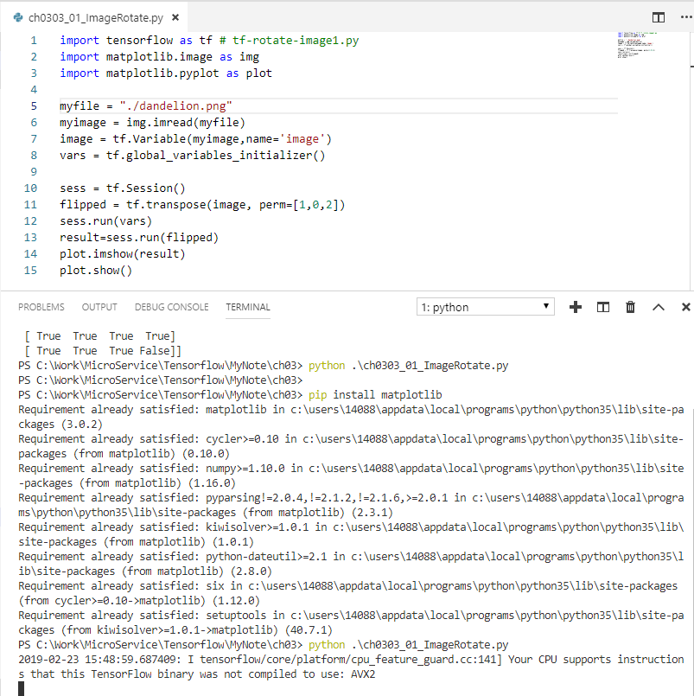
3 Introduction to TensorFlow (3)
https://www.tensorflow.org/tutorials/
TensorFlow Image APIs (3): Rotate
import tensorflow as tf # tf-rotate-image1.py
import matplotlib.image as img
import matplotlib.pyplot as plot
myfile = "dandelion.png"
myimage = img.imread(myfile)
image = tf.Variable(myimage,name='image')
vars = tf.global_variables_initializer()
sess = tf.Session()
flipped = tf.transpose(image, perm=[1,0,2])
# perm=[1, 0, 2] means
# [0, 1, 2] -> [1, 0, 2]
# dim_0 -> dime_1, dim_1 -> dim_0, dim_2 -> dim_2
sess.run(vars)
result=sess.run(flipped)
plot.imshow(result)
plot.show()

Slide 18
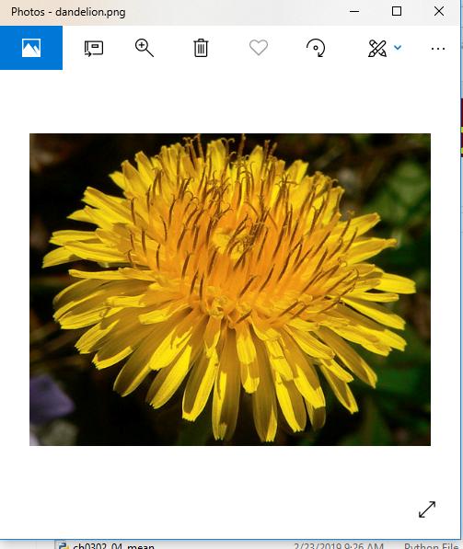
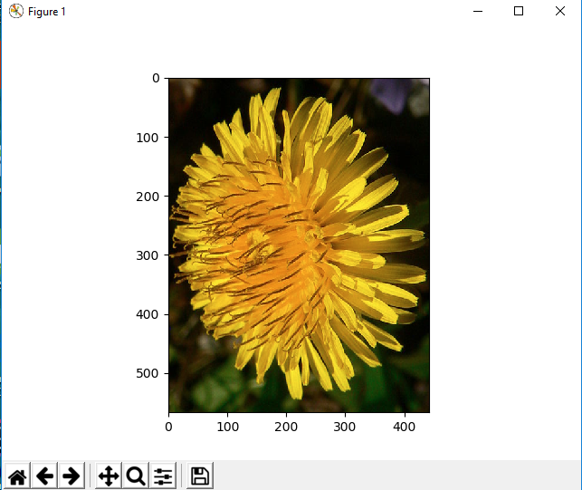
3 Introduction to TensorFlow (3)
https://www.tensorflow.org/tutorials/
TensorFlow Image APIs (3): Rotate
# Rotate Image:

Slide 19
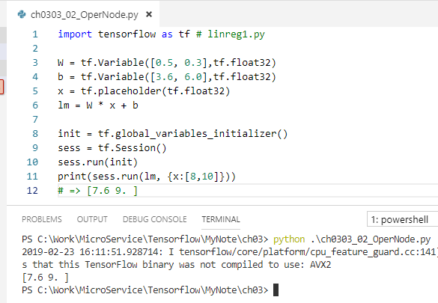

3 Introduction to TensorFlow (3)
https://www.tensorflow.org/tutorials/
Operations with TF Nodes (1)
import tensorflow as tf # linreg1.py
W = tf.Variable([0.5, 0.3],tf.float32)
b = tf.Variable([3.6, 6.0],tf.float32)
x = tf.placeholder(tf.float32)
lm = W * x + b
init = tf.global_variables_initializer()
sess = tf.Session()
sess.run(init)
print(sess.run(lm, {x:[8,10]}))
=> [7.6 9. ]

Slide 20
3 Introduction to TensorFlow (3)
https://www.tensorflow.org/tutorials/
Saving TF Variables (1)
TF saves variables in binary checkpoint files
TF map variable names to tensor values
tf.train.Saver constructor adds save and restore ops
Saver object provides methods to run these ops,
specifies paths for checkpoint files to read/write
Saver restores all variables defined in your model

Slide 21
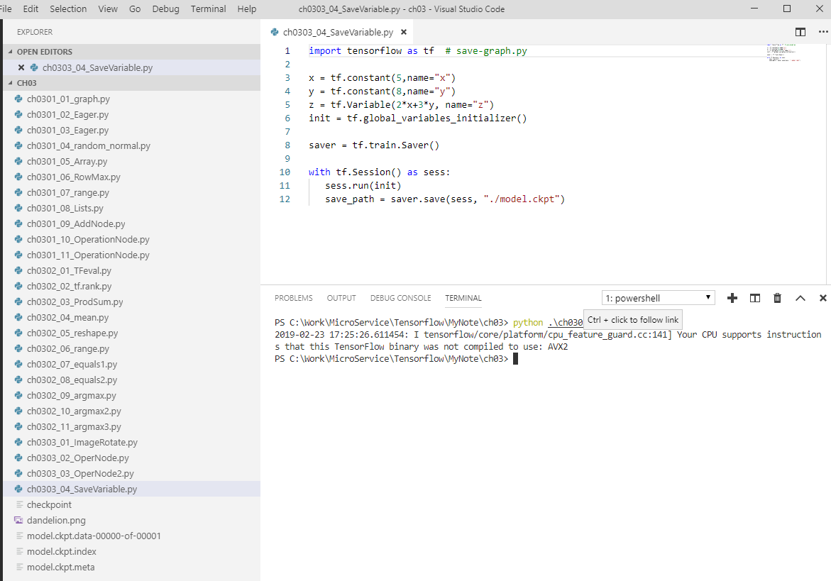
3 Introduction to TensorFlow (3)
https://www.tensorflow.org/tutorials/
Saving TF Variables (2)
import tensorflow as tf # save-graph.py
x = tf.constant(5,name="x")
y = tf.constant(8,name="y")
z = tf.Variable(2*x+3*y, name="z")
init = tf.global_variables_initializer()
saver = tf.train.Saver()
with tf.Session() as sess:
sess.run(init)
save_path = saver.save(sess, "./model.ckpt")

Slide 22
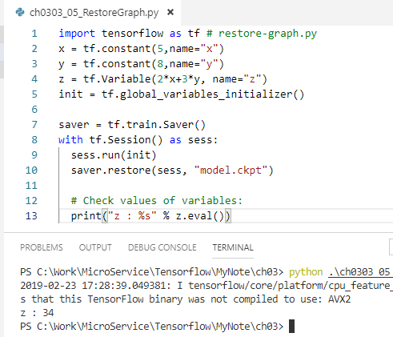
3 Introduction to TensorFlow (3)
https://www.tensorflow.org/tutorials/
Restoring TF Graphs
import tensorflow as tf # restore-graph.py
x = tf.constant(5,name="x")
y = tf.constant(8,name="y")
z = tf.Variable(2*x+3*y, name="z")
init = tf.global_variables_initializer()
saver = tf.train.Saver()
with tf.Session() as sess:
sess.run(init)
saver.restore(sess, "model.ckpt")
# Check values of variables:
print("z : %s" % z.eval())
#34

Slide 23
3 Introduction to TensorFlow (3)
https://www.tensorflow.org/tutorials/
TF Checkpoint
The string model.ckpt is NOT a file
it's prefix of filenames for the checkpoint
Users interact with the prefix (not files)

Slide 24
3 Introduction to TensorFlow (3)
https://www.tensorflow.org/tutorials/
TensorFlow Method: Constants
tf.zeroes(...):
initialize a tensor with all zeroes
tf.ones(...):
initialize a tensor with all ones
tf.fill(...):
initialize a tensor with a specified value
tf.constant(...):
initialize a tensor with a constant

Slide 25
3 Introduction to TensorFlow (3)
https://www.tensorflow.org/tutorials/
A laptop with TF, CPU, and GPU
tf.zeroes(...):
initialize a tensor with all zeroes
tf.ones(...):
initialize a tensor with all ones
tf.fill(...):
initialize a tensor with a specified value
tf.constant(...):
initialize a tensor with a constant

Slide 26
3 Introduction to TensorFlow (3)
https://www.tensorflow.org/tutorials/
tf.shape() and tf.size()
tf.shape(): the shape of input
Ex:
t = tf.constant([[[1,1,1],[2,2,2]],[[3,3,3],[4,4,4]]])
tf.shape(t) # [2, 2, 3]
tf.size(): the # of elements in input
Ex:
t = tf.constant([[[1,1,1],[2,2,2]],[[3,3,3],[4,4,4]]])
tf.size(t) # 12

Slide 27
3 Introduction to TensorFlow (3)
https://www.tensorflow.org/tutorials/
tf.rank()
tf.rank(): # of indices required to uniquely select each element of the tensor
Ex:
# shape of tensor 't' is [2, 2, 3]
t=tf.constant([[[1,1,1],[2,2,2]],[[3,3,3],[4,4,4]]])
tf.rank(t) # 3
NB: The rank of a tensor != the rank of a matrix
Rank is aka "order", "degree", or "ndims”

Slide 28
3 Introduction to TensorFlow (3)
https://www.tensorflow.org/tutorials/
tf.rank()
[[[1,1,1],[2,2,2]],[[3,3,3],[4,4,4]]]
The previous is the same as:
[
[[1,1,1],
[2,2,2]],
[[3,3,3],
[4,4,4]]
]

Slide 29
3 Introduction to TensorFlow (3)
https://www.tensorflow.org/tutorials/
TensorFlow Sequence Utilities
Sequence utilities include methods:
argmin: the minimum value of a dimension
argmax: the maximum value of a dimension
listdiff: the complement of intersection of lists
where(): the index of the true values on a tensor
unique(): showing unique values on a list

Slide 30
3 Introduction to TensorFlow (3)
https://www.tensorflow.org/tutorials/
Summary of Session (1)
Rotate image APIs:
# "swap" width + height:
tf.transpose(x, perm=[1,0,2])
# simpler API: "swap" width + height:
tf.image.transpose_image(x)
Linear Regression:
W = tf.Variable([0.5, 0.3],tf.float32)
b = tf.Variable([3.6, 6.0],tf.float32)
x = tf.placeholder(tf.float32)
lm = W * x + b
Summary of Session (2)
Save (snippet):
saver = tf.train.Saver()
with tf.Session() as sess:
sess.run(init)
save_path = saver.save(sess, "model.ckpt")
Restore (snippet):
saver = tf.train.Saver()
with tf.Session() as sess:
sess.run(init)
saver.restore(sess, "model.ckpt")

Slide 31
3 Introduction to TensorFlow (3)
https://www.tensorflow.org/tutorials/
Summary of Session (3)
tf.zeroes(...):
initialize a tensor with all zeroes
tf.ones(...):
initialize a tensor with all ones
tf.fill(...):
initialize a tensor with a specified value
tf.constant(...):
initialize a tensor with a constant

Slide 32
End of Chapter

