Slide 1

6 Convolutional Neural Network (1)
Peter H. Chen

Slide 2
6 Convolutional Neural Network (1)
https://www.tensorflow.org/tutorials/
Highlights/Overview
activation/cost functions
gradient descent
back propagation
hyper-parameters
what are CNNs
CNN pseudocode

Slide 3
6 Convolutional Neural Network (1)
https://www.tensorflow.org/tutorials/
Classify versus Detect (1)
object classification:
the process of categorization
classify an image: cat, dog, apple, etc
object detection:
the process of identification
based on a previously defined classes or types
=> after an object is detected, other properties (location, count, etc) are relevant to classification

Slide 4
6 Convolutional Neural Network (1)
https://www.tensorflow.org/tutorials/
Classify versus Detect (2)
Classify or detect: which is harder?
The level of difficulty depends on:
the properties being studied
the error margins
accuracy rates
and other factors

Slide 5
6 Convolutional Neural Network (1)
https://www.tensorflow.org/tutorials/
Classify versus Detect (3)
Problems often involve both techniques:
1) perform object detection on a given image
2) identify the associated/relevant region
3) apply classification to predict its class

Slide 6
6 Convolutional Neural Network (1)
https://www.tensorflow.org/tutorials/
Classify versus Detect (4)
object detection:
"Is the object detected?" (Y/N)
image recognition:
ex: face recognition (not face classification)
object classification:
cat, dog, mouse, bird, ...

Slide 7
6 Convolutional Neural Network (1)
https://www.tensorflow.org/tutorials/
Classify versus Detect (5)
Difficult problems to solve:
1) detecting overlapping images
2) distinguishing between overlapping images
3) inferring properties of occluded images
=> Capsule Networks have decent success
https://github.com/OlafenwaMoses/ImageAI
https://towardsdatascience.com/object-detection-with-10-lines-of-code-d6cb4d86f606

Slide 8
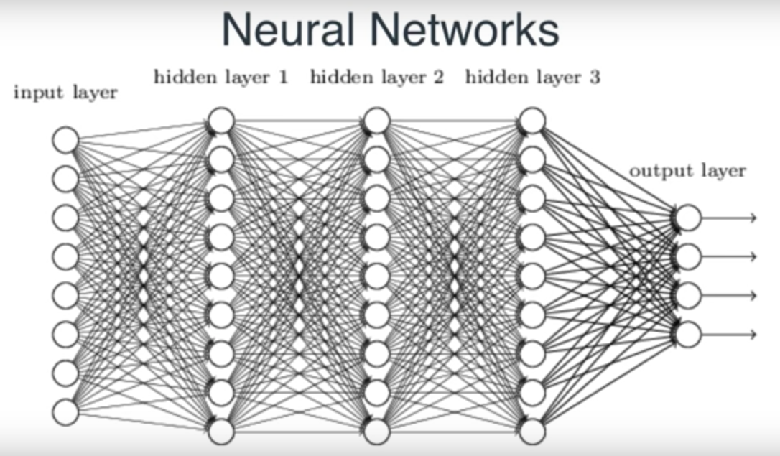
6 Convolutional Neural Network (1)
https://www.tensorflow.org/tutorials/
Neural Network with 3 Hidden Layers

Slide 9
6 Convolutional Neural Network (1)
https://www.tensorflow.org/tutorials/
Neural Network (General)
Multiple hidden layers:
Layer composition is your decision
Activation functions: sigmoid, tanh, RELU
https://en.wikipedia.org/wiki/Activation_function
Back propagation (1980s)
https://en.wikipedia.org/wiki/Backpropagation
=> Initial weights: small random numbers

Slide 10
6 Convolutional Neural Network (1)
https://www.tensorflow.org/tutorials/
CNN (General Structure)
1) An input layer (image data)
2) Convolutions (aka filters)
3) Activation function: RELU
4) Max pooling layer
5) repeat steps 2, 3, and 4
6) add FC (fully connected) layer
7) use softmax activation function
Also involves back propagation

Slide 11
6 Convolutional Neural Network (1)
https://www.tensorflow.org/tutorials/
Why Use Max Pooling? (1)
Two main objectives:
Reason 1: Reduce the computational cost
reduce the size of the previous layer
without any additional parameters
shrink data without any training cost

Slide 12
6 Convolutional Neural Network (1)
https://www.tensorflow.org/tutorials/
Why Use Max Pooling? (2): What is Max Pooling?
https://www.quora.com/What-is-max-pooling-in-convolutional-neural-networks
Max pooling is a sample-based discretization process. The objective is to down-sample an input representation (image, hidden-layer output matrix, etc.), reducing its dimensionality and allowing for assumptions to be made about features contained in the sub-regions binned.
This is done to in part to help over-fitting by providing an abstracted form of the representation. As well, it reduces the computational cost by reducing the number of parameters to learn and provides basic translation invariance to the internal representation.
Max pooling is done by applying a max filter to (usually) non-overlapping subregions of the initial representation.
Let's say we have a 4x4 matrix representing our initial input. Let's say, as well, that we have a 2x2 filter that we'll run over our input. We'll have a stride of 2 (meaning the (dx, dy) for stepping over our input will be (2, 2)) and won't overlap regions.

Slide 13
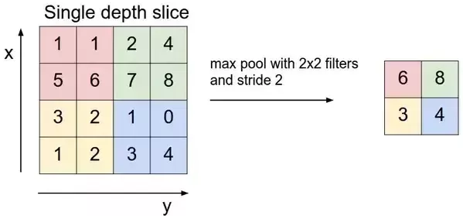
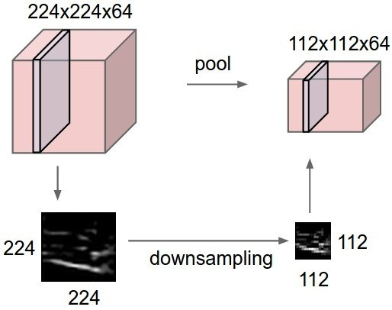
6 Convolutional Neural Network (1)
https://www.tensorflow.org/tutorials/
Why Use Max Pooling? (3): What is Max Pooling?
For each of the regions represented by the filter, we will take the max of that region and create a new, output matrix where each element is the max of a region in the original input.

Slide 14
6 Convolutional Neural Network (1)
https://www.tensorflow.org/tutorials/
Why Use Max Pooling? (4): What is Max Pooling?
For a real example (note that the z dimension, the number of layers, remains unchanged in the pooling operation):.

Slide 15
6 Convolutional Neural Network (1)
https://www.tensorflow.org/tutorials/
Why Use Max Pooling? (5)
2x2 pooling layers (very common size)
useful to reduce the size of the previous step
especially if you plan to try different convolutions
at the same time over the same previous layer
without pooling the # of parameters is too large

Slide 16
6 Convolutional Neural Network (1)
https://www.tensorflow.org/tutorials/
Why Use Max Pooling? (6)
Reason 2: Make the network more generic
Pooling helps the layer generalize
it combines several values into one
this decreases the chance of overfitting

Slide 17
6 Convolutional Neural Network (1)
https://www.tensorflow.org/tutorials/
What are Capsule Networks?
“modified” CNNs
they do not use max pooling
Whole/part detection
Better for detecting overlapping images
Less prone to GANs
More complex to train
Still early stage (11/2017)

Slide 18
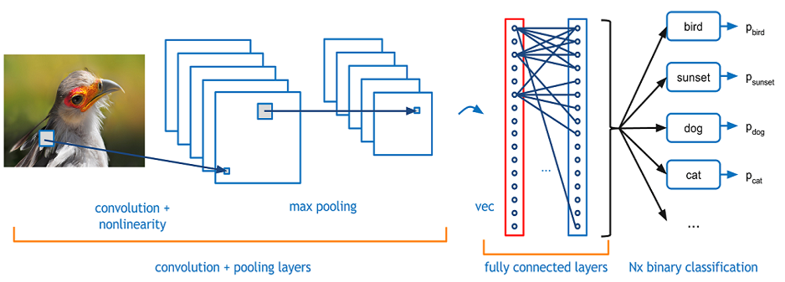
6 Convolutional Neural Network (1)
https://www.tensorflow.org/tutorials/
CNNs: convolution and pooling

Slide 19
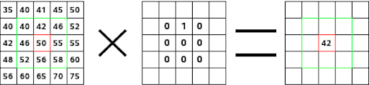
6 Convolutional Neural Network (1)
https://www.tensorflow.org/tutorials/
CNNs: Convolution Calculations
https://docs.gimp.org/en/plug-in-convmatrix.html (Not found)

Slide 20
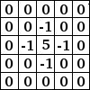
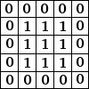
6 Convolutional Neural Network (1)
https://www.tensorflow.org/tutorials/
CNNs: Convolution Matrices (examples) (1)
Sharpen:
Blur:

Slide 21
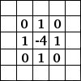
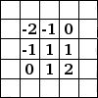
6 Convolutional Neural Network (1)
https://www.tensorflow.org/tutorials/
CNNs: Convolution Matrices (examples) (2)
Edge Detect:
Emboss (carve, stamp):

Slide 22
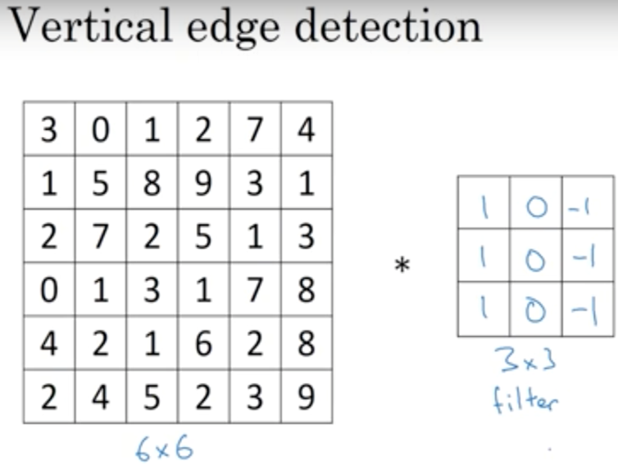
6 Convolutional Neural Network (1)
https://www.tensorflow.org/tutorials/
CNNs: Convolution Matrices (examples) (3)

Slide 23
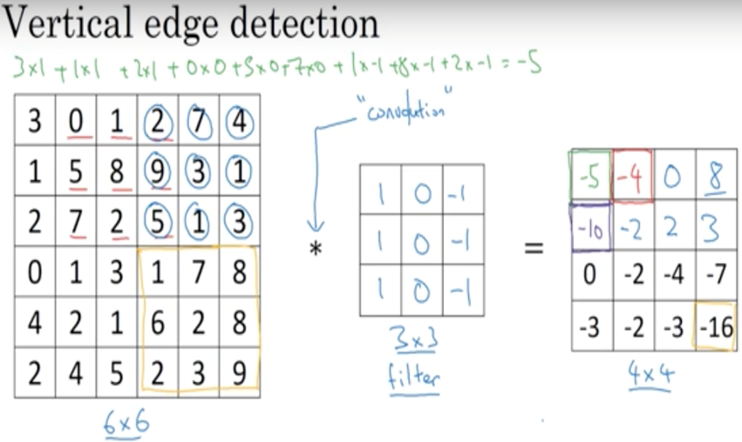
6 Convolutional Neural Network (1)
https://www.tensorflow.org/tutorials/
CNNs: Convolution Matrices (examples) (4)

Slide 24
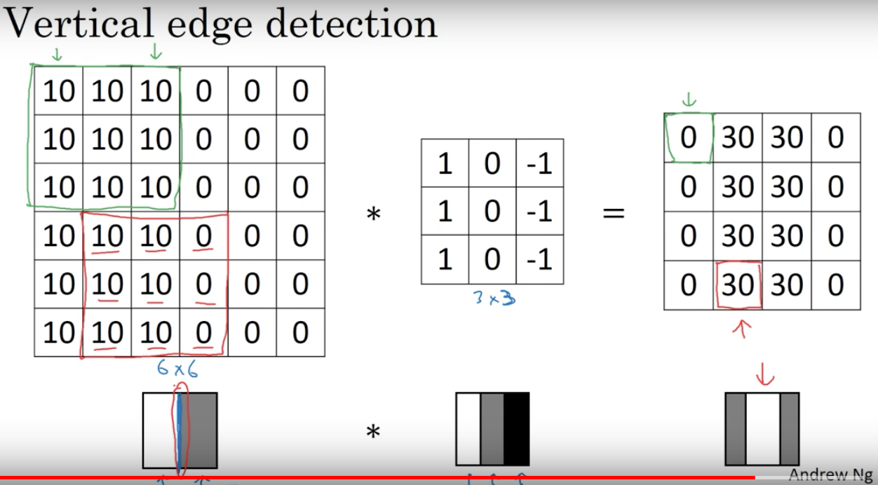
6 Convolutional Neural Network (1)
https://www.tensorflow.org/tutorials/
CNNs: Convolution Matrices (examples) (5)

Slide 25
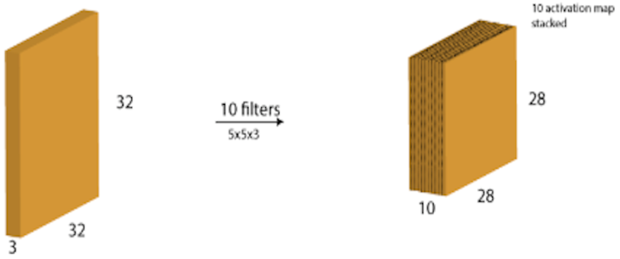
6 Convolutional Neural Network (1)
https://www.tensorflow.org/tutorials/
CNNs: Feature Maps

Slide 26

6 Convolutional Neural Network (1)
https://www.tensorflow.org/tutorials/
CNNs: Max Pooling Example

Slide 27
6 Convolutional Neural Network (1)
https://www.tensorflow.org/tutorials/
Activation Functions in Python
import numpy as np
...
# Python sigmoid example:
z = 1/(1 + np.exp(-np.dot(W, x)))
...
# Python tanh example:
z = np.tanh(np.dot(W,x));
# Python ReLU example:
z = np.maximum(0, np.dot(W, x))

Slide 28
6 Convolutional Neural Network (1)
https://www.tensorflow.org/tutorials/
What’s the “Best” Activation Function?
Initially: sigmoid was popular
Then: tanh became popular
Now: RELU is preferred (better results)
Softmax: for FC (fully connected) layers
NB: sigmoid and tanh are used in LSTMs

Slide 29
6 Convolutional Neural Network (1)
https://www.tensorflow.org/tutorials/
How to Select a Cost Function?
mean-squared error (MSE):
for a regression problem
binary cross-entropy (or MSE):
for a two-class classification problem
categorical cross-entropy:
for a many-class classification problem

Slide 30
6 Convolutional Neural Network (1)
https://www.tensorflow.org/tutorials/
GD versus SGD
SGD (Stochastic Gradient Descent)
Randomly selected training sample
Minibatch Stochastic Gradient Descent
+ involves a SUBSET of the dataset
GD (Gradient Descent):
+ involves the ENTIRE dataset
More details:
http://cs229.stanford.edu/notes/cs229-notes1.pdf

Slide 31
6 Convolutional Neural Network (1)
https://www.tensorflow.org/tutorials/
Set up Data and Model and train
load/read dataset
create TF model
train model
evaluate model

Slide 32
6 Convolutional Neural Network (1)
https://www.tensorflow.org/tutorials/
Some CNN Terminology (1)
A filter: another term is a kernel
A feature map:
1) the result of “applying” a filter to an image
2) pixel values might be < 0 and/or > 255
Drop-out rate: the % of randomly selected neurons to “ignore” during each forward pass (different for each pass)
the drop-out value is specified as a decimal: 0.1, 0.2, etc
some metrics that are available:
accuracy, precision, and so forth
https://www.tensorflow.org/api_docs/python/tf/metrics

Slide 33
6 Convolutional Neural Network (1)
https://www.tensorflow.org/tutorials/
Some CNN Terminology (2)
Stride:
how many units you “shift” the filter (1/2/3/etc)
Padding:
makes feature map same size as image
Kernel size:
the dimensions of the filter (1x1, 3x3, 5x5, etc)

Slide 34
6 Convolutional Neural Network (1)
https://www.tensorflow.org/tutorials/
Components of a CNN
1) Specify the input layer
2) Add a convolution to create feature maps
3) Perform RELU on the feature maps
4) repeat 1) and 2)
5) add a FC (fully connected layer)
6) connect FC to output layer via softmax

Slide 35
6 Convolutional Neural Network (1)
https://www.tensorflow.org/tutorials/
CNN pseudocode
Specify an optimizer
specify a cost function
specify a learning rate
Specify desired metrics (accuracy/precision/etc)
specify # of batch runs in a training epoch
For each epoch:
For each batch:
Extract the batch data
Run the optimiser + cross-entropy operations
Add to the average cost
Calculate the current test accuracy
Print out some results
Calculate the final test accuracy and print

Slide 36
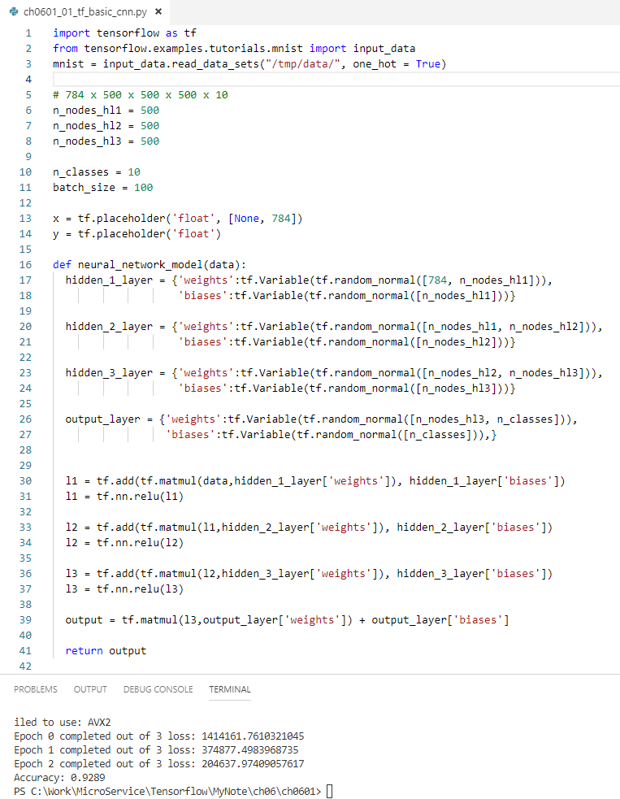
6 Convolutional Neural Network (1)
https://www.tensorflow.org/tutorials/
CNN TensorFlow Code Samples (1)
https://github.com/aymericdamien/TensorFlow-Examples/blob/master/examples/3_NeuralNetworks/convolutional_network_raw.py
tf-tutorial-basic-cnn.py <= in class

Slide 37
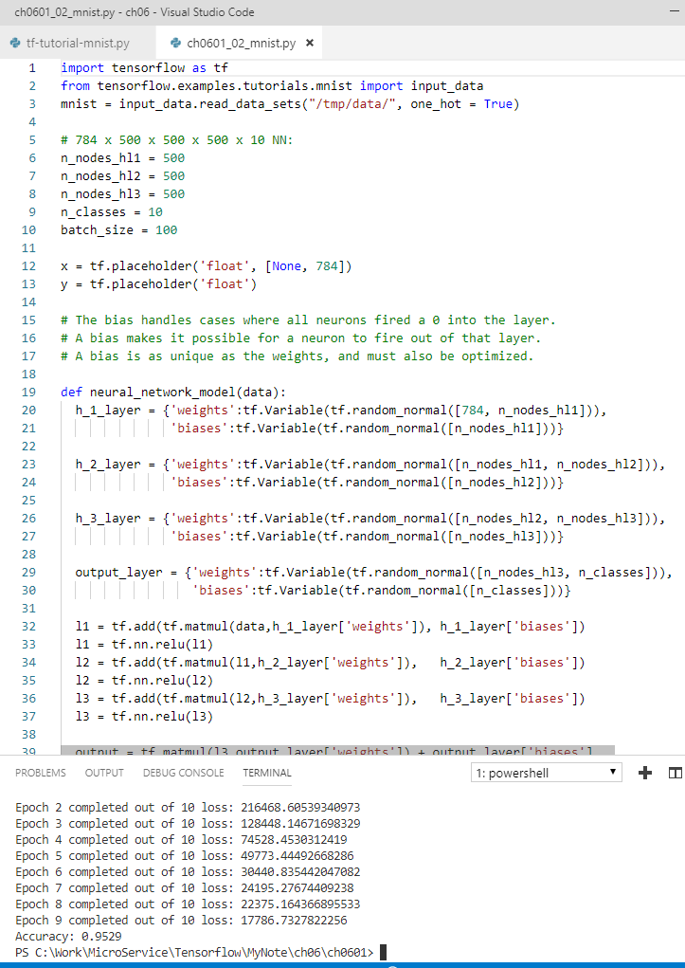
6 Convolutional Neural Network (1)
https://www.tensorflow.org/tutorials/
CNN TensorFlow Code Samples (2)
tf-tutorial-mnist.py

Slide 38
End of Chapter

