Slide 1

6 Convolutional Neural Network (2)
Peter H. Chen

Slide 2
6 Convolutional Neural Network (2)
https://www.tensorflow.org/tutorials/
List of Session Topic
TF and MNIST Images
TF APIs for CNNs
TF and CNN layers
TF and CNN models

Slide 3
6 Convolutional Neural Network (2)
https://www.tensorflow.org/tutorials/
TF and MNIST Images (1)
import tensorflow as tf # tf-show-mnist-images.py
import matplotlib.pyplot as plt
from tensorflow.examples.tutorials.mnist import input_data
mnist = input_data.read_data_sets("/tmp/data/", one_hot=True)
#1) color version of image #1:
plt.imshow(mnist.train.images[0].reshape((28, 28), order='C'), interpolation='nearest')
#2) b&w version of image #1:
#plt.imshow(mnist.train.images[0].reshape((28, 28), order='C'), cmap='Greys', interpolation='nearest')
plt.show()

Slide 4
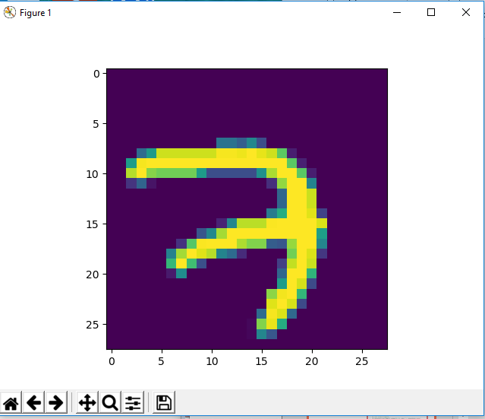
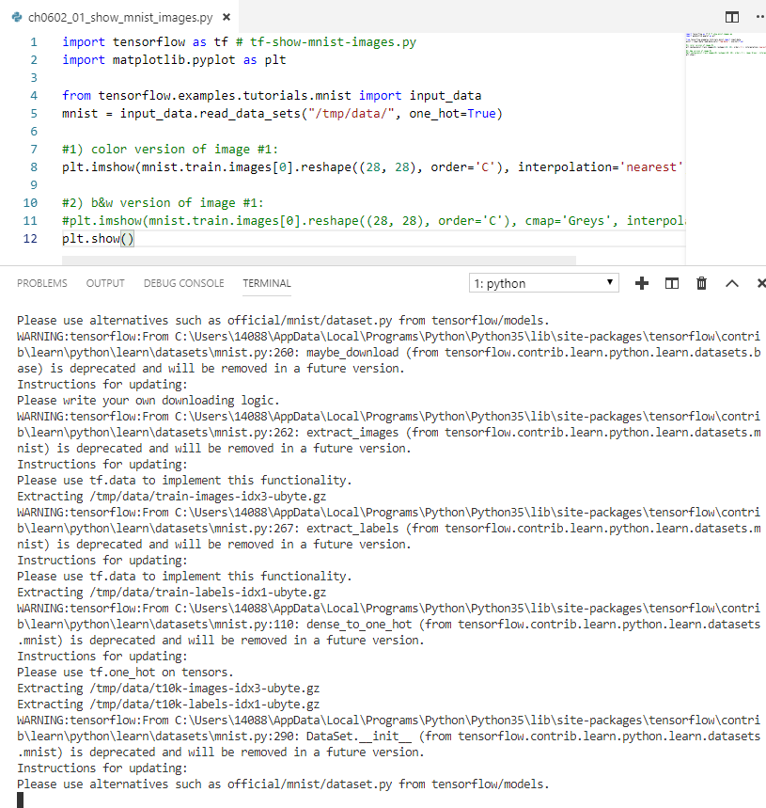
6 Convolutional Neural Network (2)
https://www.tensorflow.org/tutorials/
TF and MNIST Images (2)

Slide 5
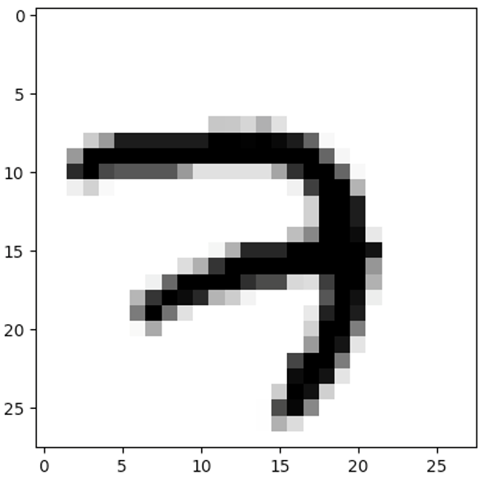
6 Convolutional Neural Network (2)
https://www.tensorflow.org/tutorials/
TF and MNIST Images (3)

Slide 6
6 Convolutional Neural Network (2)
https://www.tensorflow.org/tutorials/
Plotting a Grid of MNIST Images (1)
import matplotlib.pyplot as plt # show-grid-images.py
from tensorflow.examples.tutorials.mnist import input_data
mnist = input_data.read_data_sets('MNIST_data', one_hot = True)
batch_xs, batch_ys = mnist.train.next_batch(100)
rows = 3
cols = 5
count = rows*cols
fig, ax = plt.subplots(nrows=rows, ncols=cols, sharex=True, sharey=True,)
ax = ax.flatten()
for i in range(count):
img = batch_xs[i].reshape(28, 28)
ax[i].imshow(img, interpolation='nearest')
ax[0].set_xticks([])
ax[0].set_yticks([])
plt.tight_layout()
# plt.savefig('mnist_figures.png', dpi=300)
plt.show()

Slide 7
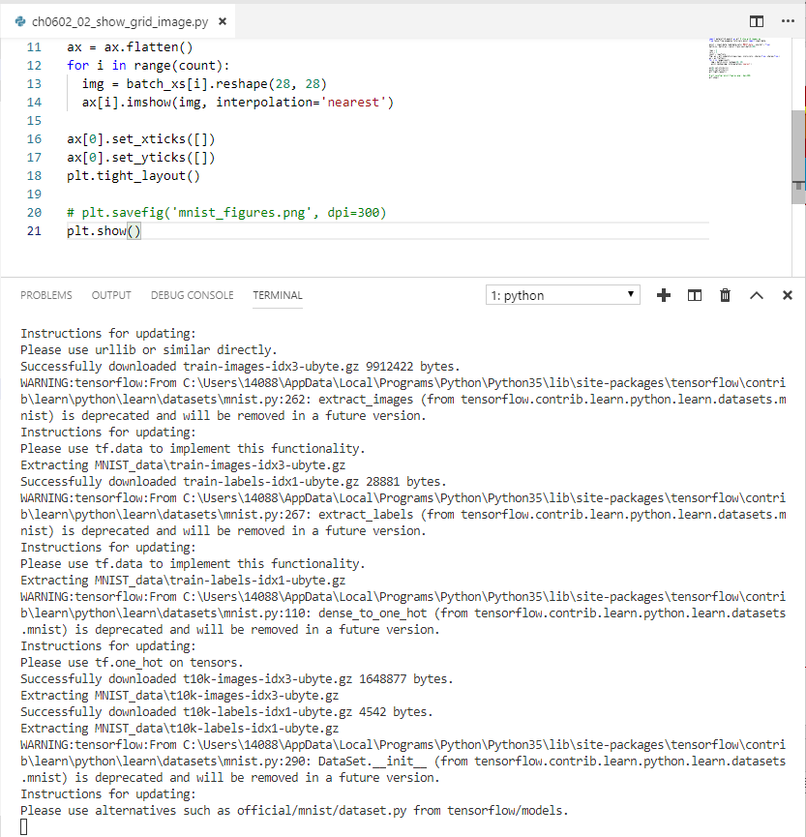
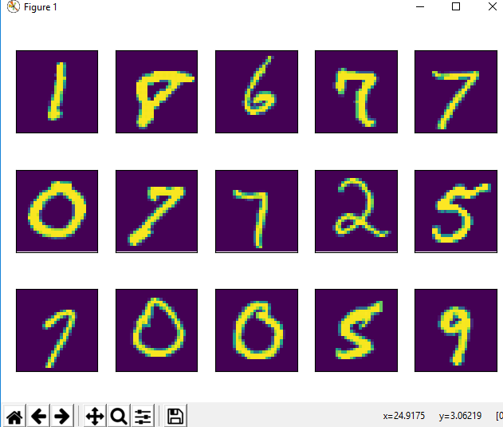
6 Convolutional Neural Network (2)
https://www.tensorflow.org/tutorials/
Plotting a Grid of MNIST Images (2)

Slide 8
6 Convolutional Neural Network (2)
https://www.tensorflow.org/tutorials/
TF Methods for CNNs
1) TF convolution methods:
Perform feature extraction
2) TF ReLU (activation function):
make values non-negative
3) TF Max Pooling Methods:
reduce size of feature map
4) TF softmax Method:
connect final layer to outputs

Slide 9
6 Convolutional Neural Network (2)
https://www.tensorflow.org/tutorials/
TF Convolution Methods for CNNs
Most useful/important convolution:
tf.nn.conv2d()
Some common/useful parameters:
Input
Filter
Strides
padding

Slide 10
6 Convolutional Neural Network (2)
https://www.tensorflow.org/tutorials/
TF and CNN layers
A convolutional layer:
+ concatenates a convolution
+ adds a bias parameter sum
+ returns activation function (ReLU)
A convolutional layer in Python:
def conv_layer(x_in, weights, bias, strides=1):
x = tf.nn.conv2d(x,weights,strides=[1,strides,strides,1],padding='SAME’)
x = tf.nn.bias_add(x_in, bias)
return tf.nn.relu(x)

Slide 11
6 Convolutional Neural Network (2)
https://www.tensorflow.org/tutorials/
TF and CNN layers
A max pooling layer in Python:
def maxpool2d(x, k=2):
return tf.nn.max_pool(x, ksize=[1, k, k, 1], strides=[1, k, k, 1], padding='SAME')

Slide 12
6 Convolutional Neural Network (2)
https://www.tensorflow.org/tutorials/
TF Pooling Methods for CNNs
tf.nn.max_pool() <= use this one
tf.nn.avg_pool()
tf.nn.avg_pool3d()
tf.nn.max_pool3d()

Slide 13
6 Convolutional Neural Network (2)
https://www.tensorflow.org/tutorials/
TensorFlow APIs for CNNs
1) TF 2d convolution API:
tf.layers.conv2d(...)
2) TF ReLU API:
tf.nn.relu(...)
3) TF Max Pooling API:
tf.layers.max_pooling2d(...)

Slide 14
6 Convolutional Neural Network (2)
https://www.tensorflow.org/tutorials/
Creating a Simple/Basic CNN
1) create the first convolutional layer:tf.nn.conv2d(...) plus ReLU
2) create the second convolutional layer:
tf.nn.conv2d(...) plus ReLU
3) create fully connected (FC) layer
4) apply softmax activation function

Slide 15
6 Convolutional Neural Network (2)
https://www.tensorflow.org/tutorials/
Other TF APIs and CNNs
Other code details:
dense layer
dropout rate
Predictions
calculate loss
specify metrics
Complete code listing for TF CNN:
https://www.tensorflow.org/tutorials/layers

Slide 16
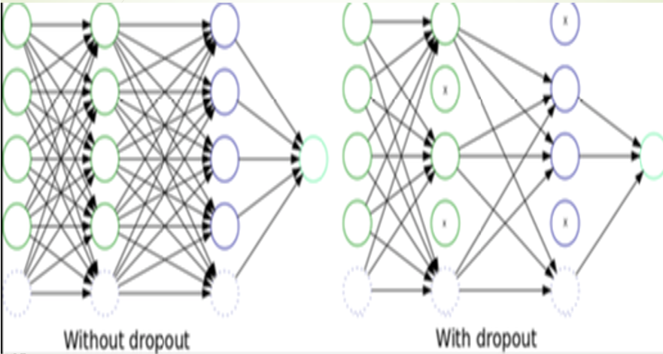
6 Convolutional Neural Network (2)
https://www.tensorflow.org/tutorials/
TF Dropout for CNNs

Slide 17
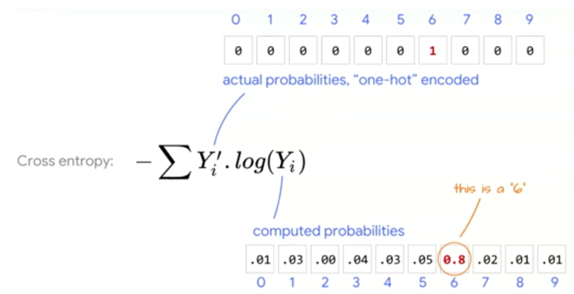
6 Convolutional Neural Network (2)
https://www.tensorflow.org/tutorials/
MNIST: Predicted Digits

Slide 18
6 Convolutional Neural Network (2)
https://www.tensorflow.org/tutorials/
Review tf.argmax() and tf.equal()
1) tf.argmax(pred,1):
Returns the index with the largest value (per row) of pred
2) tf.argmax(Y, 1)):
Returns the index with the largest value (per row) of Y
3) tf.equal(tf.argmax(pred,1), tf.argmax(Y, 1)):
returns the element-wise truth value array (pred == Y)
=> Assign the result in step #3 to correct_pred
4) tf.cast(correct_pred, tf.float32):
Converts true to 1 and false to 0
5) tf.reduce_mean(tf.cast(correct_pred, tf.float32)):
Calculates the average # of correct values

Slide 19
6 Convolutional Neural Network (2)
https://www.tensorflow.org/tutorials/
tf.argmax() and tf.equal() example
SEE argmax-equal.py code sample
pred = np.array([[31, 23, 4, 24, 27, 34],
[18, 3, 25, 0, 6, 35],
[28, 14, 33, 22, 20, 8],
[13, 30, 21, 19, 7, 9],
[16, 1, 26, 32, 2, 29],
[17, 12, 5, 11, 10, 15]])
y = np.array([[31, 23, 4, 24, 27, 11],
[18, 3, 25, 0, 6, 35],
[28, 14, 33, 22, 20, 8],
[13, 30, 21, 19, 7, 9],
[16, 1, 26, 32, 2, 29],
[17, 12, 5, 11, 10, 15]])

Slide 20
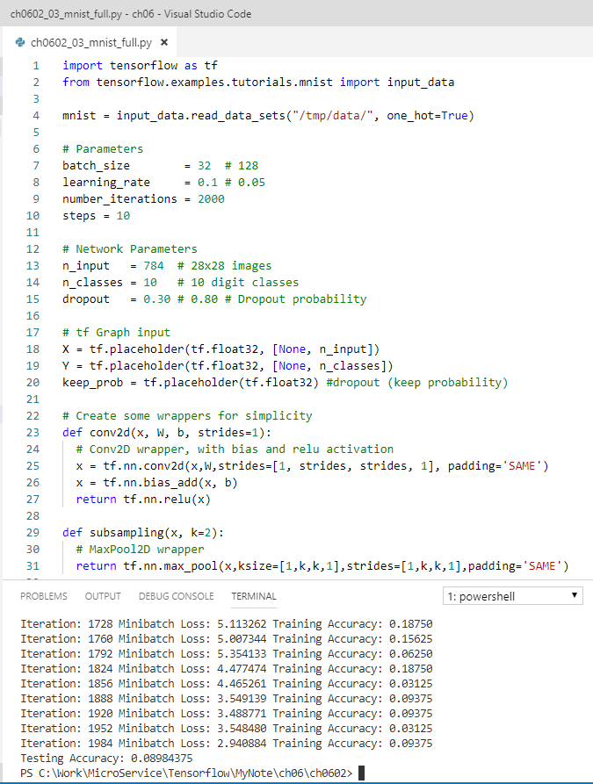
6 Convolutional Neural Network (2)
https://www.tensorflow.org/tutorials/
Evaluating a Model
Code sample: tf-mnist-full.py
# Evaluate model (explanation in earlier slides):
# array of boolean (true/false) values:
correct_pred = tf.equal(tf.argmax(pred,1), tf.argmax(Y, 1))
#decimal value (multiply by 100 to get % accuracy):
accuracy = tf.reduce_mean(tf.cast(correct_pred, tf.float32))

Slide 21
End of Chapter

