Slide 1

10 Number Guesser
Peter H. Chen

Slide 2
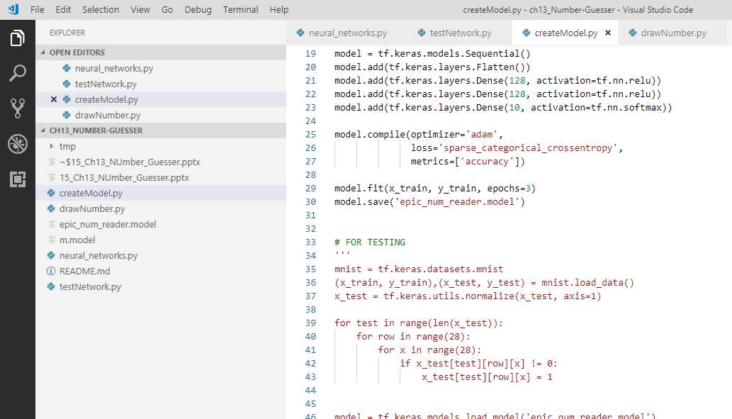
10 Number Guesser
https://www.youtube.com/watch?v=jNW97izstLg&t=10s
In the folder, we have the python files: createModel.py, drawNumber.py, neural_network.py, and testNetwok.py.
They are written in tensorflow for deep learning.

Slide 3
10.1 ch1001_createModel.py
Peter H. Chen

Slide 4
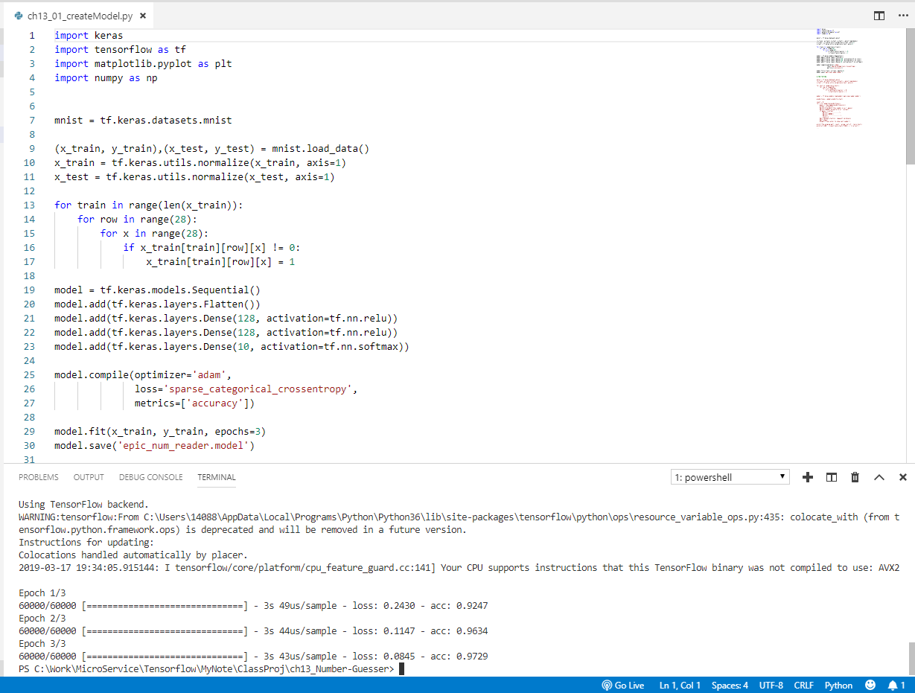
10.1 ch1001_createModel.py
https://www.youtube.com/watch?v=jNW97izstLg&t=10s
ch1001_createModel.py is used to create the model.
> python ch1001_createModel.py

Slide 5
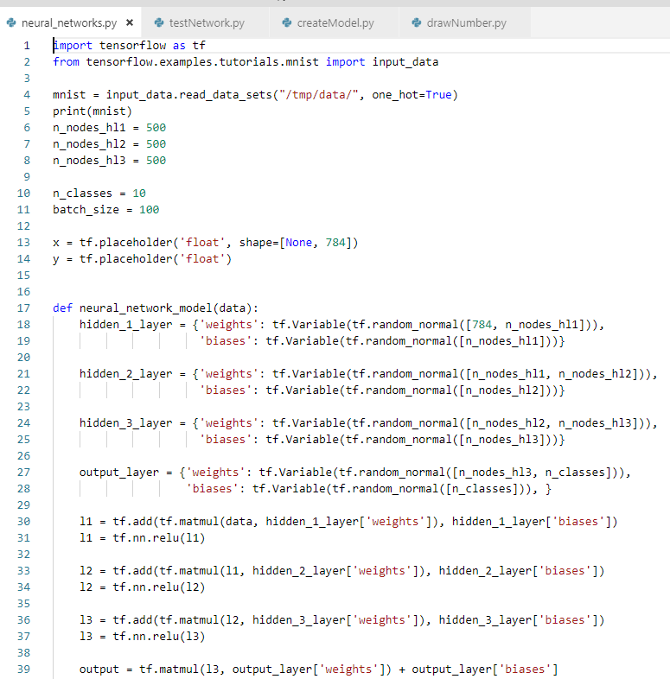
10 Number Guesser
https://www.youtube.com/watch?v=jNW97izstLg&t=10s
Neural_network.py

Slide 6
10.2 ch1002_testNetwork.py
Peter H. Chen

Slide 7
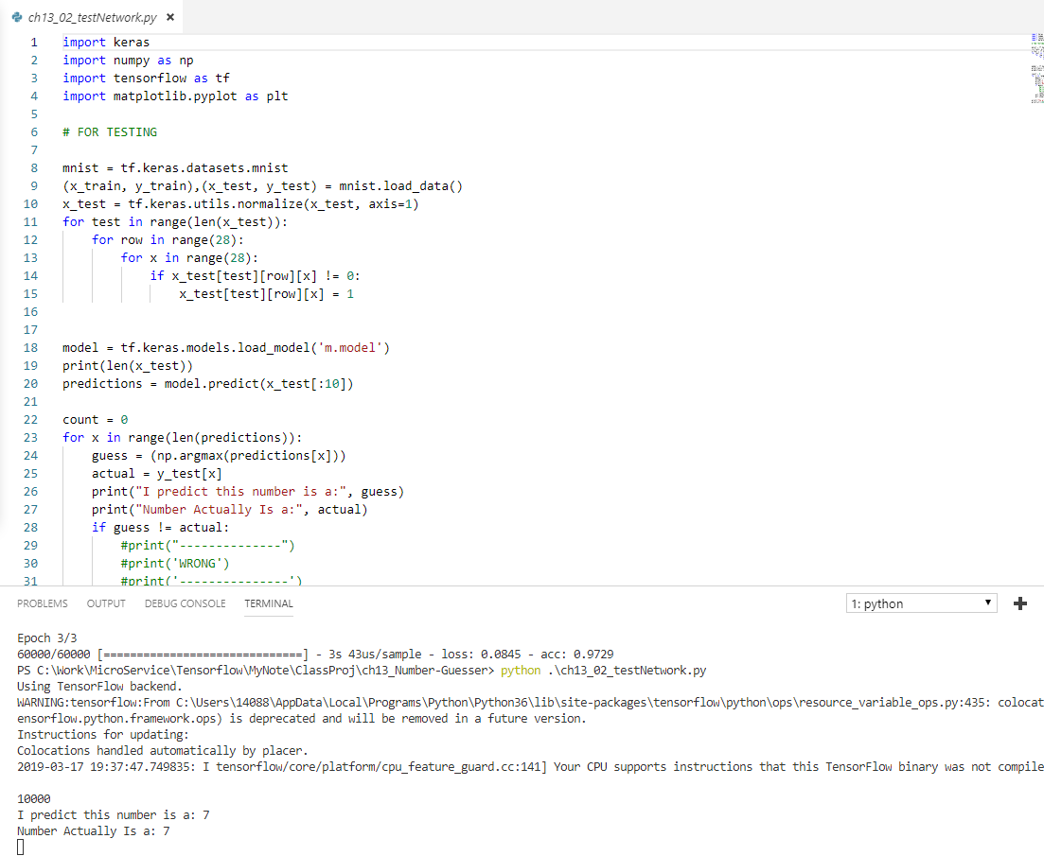
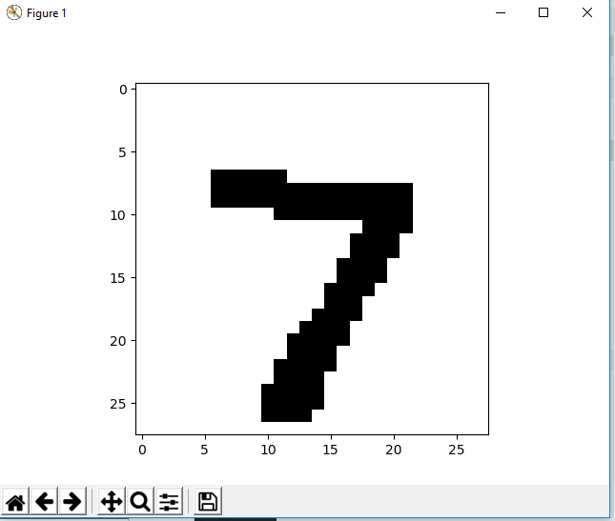
10.2 ch1002_testNetwork.py
https://www.youtube.com/watch?v=jNW97izstLg&t=10s
> python testNetwork.py
Display the first number 7 and predict 7.
Click x to close and display the next number.

Slide 8
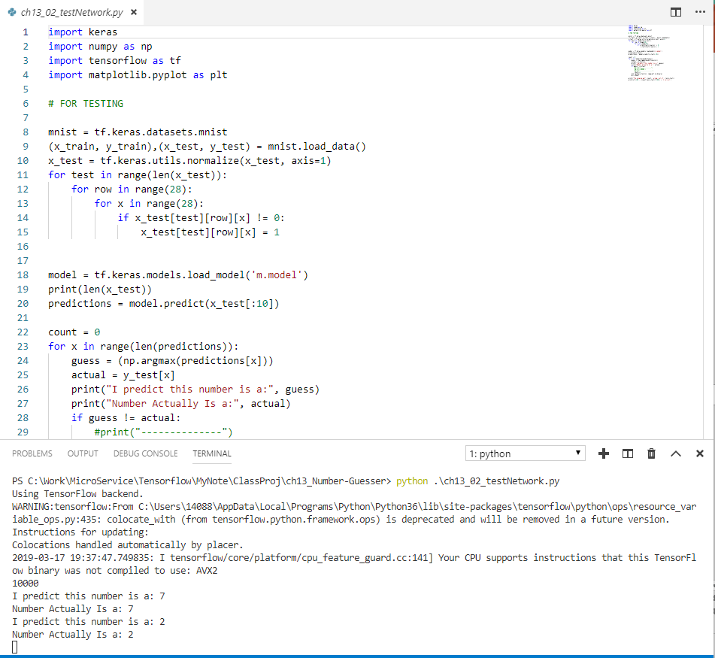
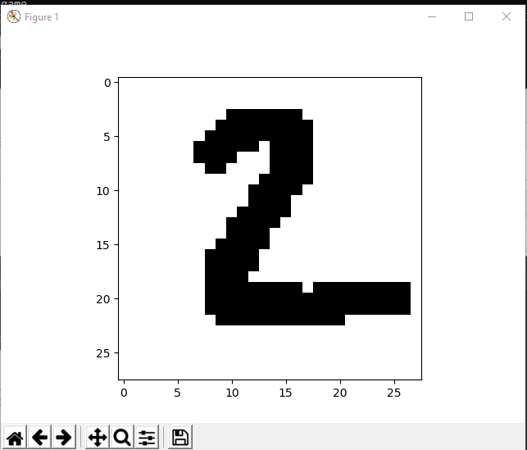
10.1 TestNetwork.py
https://www.youtube.com/watch?v=jNW97izstLg&t=10s
Close the first number 7 and
Continue display the second number 2 and predict the number 2.

Slide 9
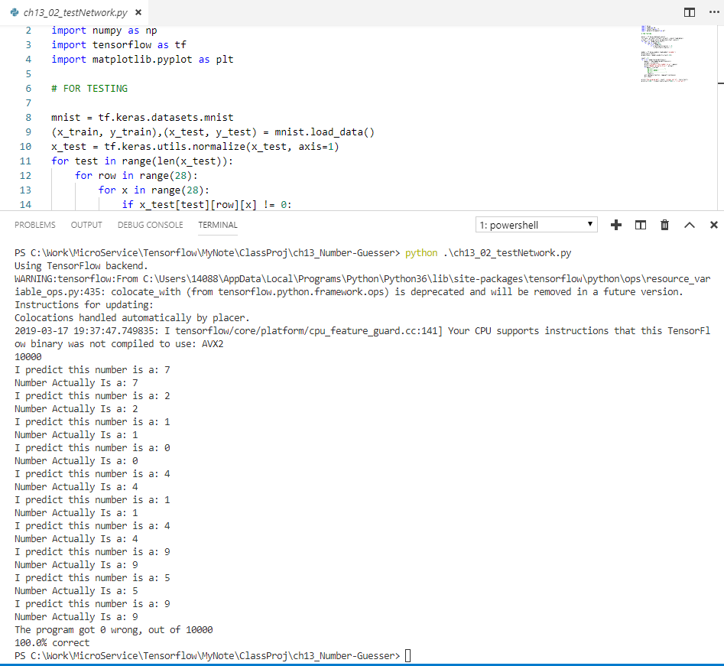
10.1 TestNetwork.py
https://www.youtube.com/watch?v=jNW97izstLg&t=10s
Keep on going.
There are totally 10 digits for guessing.
We are lucky to have 100% guessing correct.

Slide 10
10.3 ch1003_drawNumber.py
Peter H. Chen

Slide 11
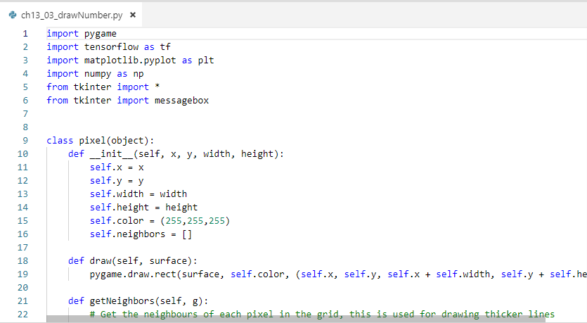
10 Number Guesser
https://www.youtube.com/watch?v=jNW97izstLg&t=10s
> pip3 install pygame

Slide 12
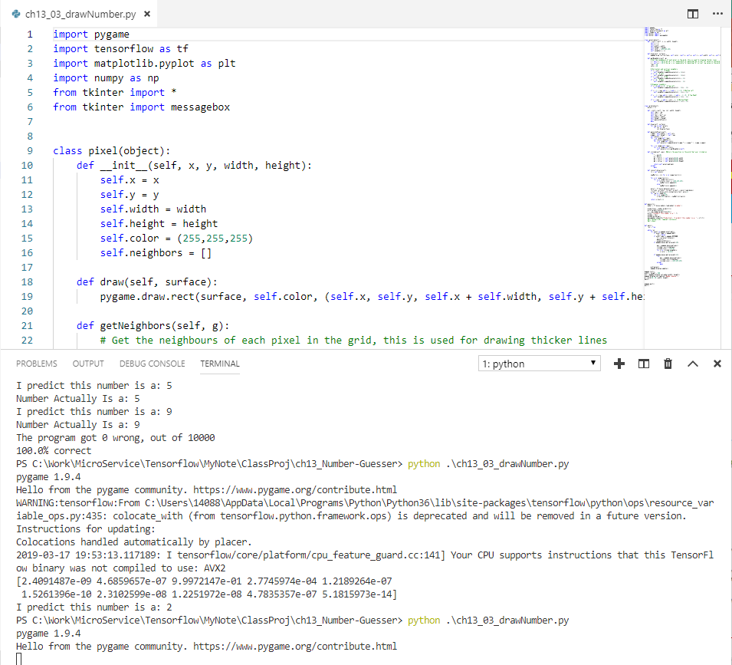
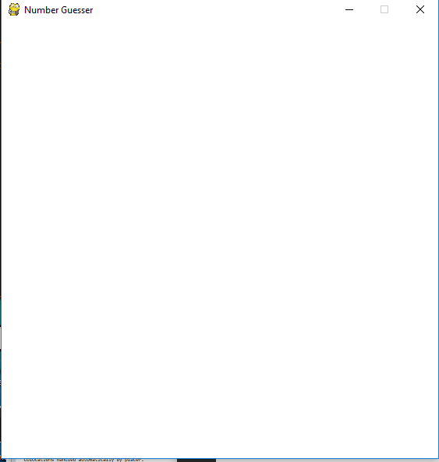
10.3 ch1003_drawNumber.py
https://www.youtube.com/watch?v=jNW97izstLg&t=10s
> python ch1003_drawNumber.py
Display the empty screen.

Slide 13
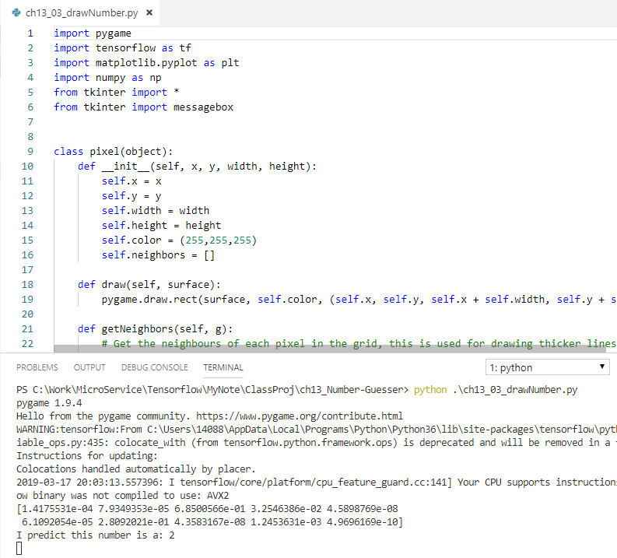
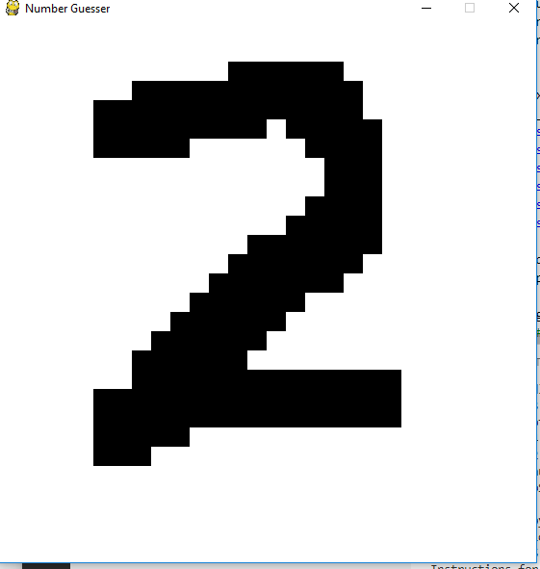
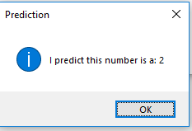
10.3 ch1003_drawNumber.py
https://www.youtube.com/watch?v=jNW97izstLg&t=10s
Draw a digit
Enter Space bar to predict.

Slide 14
10.3 ch1003_drawNumber.py
https://www.youtube.com/watch?v=jNW97izstLg&t=10s
This program is not hard code but sometimes get incorrect prediction.

Slide 15
10.4 ch1004_neuralNetwork.py
Peter H. Chen

Slide 16
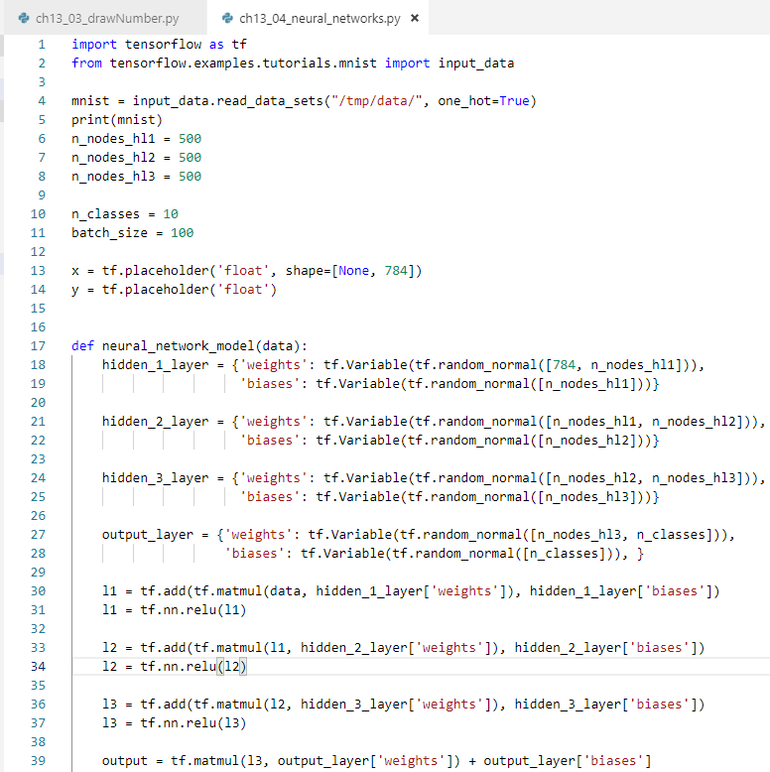
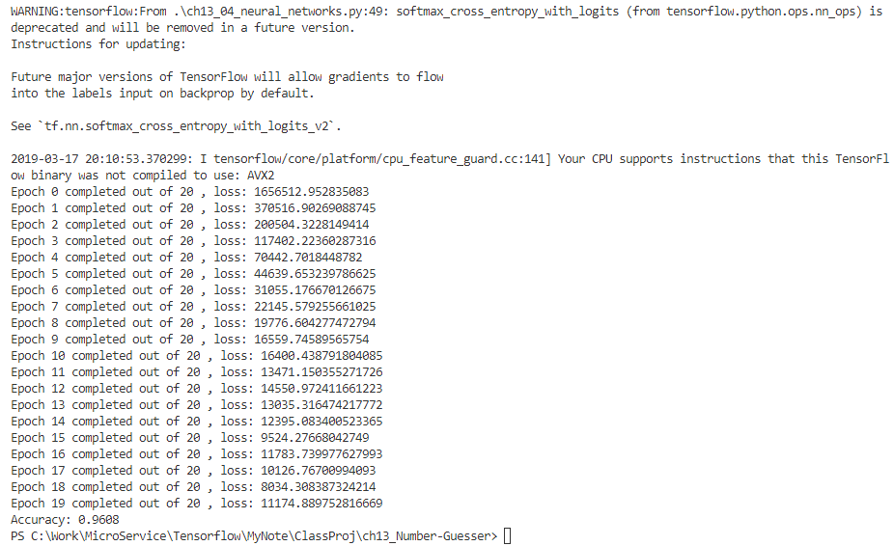
10.4 ch1004_nerualNetwork.py
https://www.youtube.com/watch?v=jNW97izstLg&t=10s
This program uses tensorflow for three layers of neural network

Slide 17
10.5 Summary
Peter H. Chen

Slide 18
10.4 ch1004_nerualNetwork.py
https://www.youtube.com/watch?v=jNW97izstLg&t=10s
This section shows write model data, digit predict, hand writing prediction, and tensorflow neural network.

Slide 19
End of Chapter

