Slide 1

9 Monte Carlo Technique (3)
Peter H. Chen

Slide 2
9 Monte Carlo Technique (3)
https://www.tensorflow.org/tutorials/
List of Topics
Model-free predictions
Value function approximation
Policy gradient methods
What is Monte Carlo?
The Monte Carlo tree search algorithm
Minimax and game trees
The Monte Carlo Tree Search
MCMC (Markov Chain Monte Carlo)

Slide 3
9 Monte Carlo Technique (3)
https://www.tensorflow.org/tutorials/
Policy Gradients
can provide a strong learning signal to improve a parameterized policy
computing the expected return involves averaging over plausible trajectories induced by the current policy parameterization
This averaging requires either deterministic approximations (e.g., linearization) or stochastic approximations via sampling
Deterministic approximations can only be applied in a model-based setting where a model of the underlying transition dynamics is available

Slide 4
9 Monte Carlo Technique (3)
https://www.tensorflow.org/tutorials/
Model-free RL (Reinforcement Learning)
a Monte Carlo estimate of the expected return is determined
For gradient-based learning, this Monte Carlo approximation poses a challenge since gradients cannot pass through these samples of a stochastic function.
Therefore, we turn to an estimator of the gradient, known in RL as the REINFORCE rule
elsewhere known as the score function or likelihood-ratio estimator

Slide 5
9 Monte Carlo Technique (3)
https://www.tensorflow.org/tutorials/
Hidden Markov Models (HMMs) (1)
a statistical Markov model
the system being modeled is a Markov process
with unobserved (i.e. hidden) states
can be represented as a dynamic Bayesian network

Slide 6
9 Monte Carlo Technique (3)
https://www.tensorflow.org/tutorials/
Hidden Markov Models (HMMs) (2)
the state is not directly visible
the output is visible
a generalization of a mixture model
hidden variables are related through a Markov process

Slide 7
9 Monte Carlo Technique (3)
https://www.tensorflow.org/tutorials/
Hidden Markov Models (HMMs) (3)
Resemble NDFAs (non-deterministic finite automata):
The outgoing edges have probabilities
For any state: the sum of probabilities of the outgoing edges of that state (node) equals one

Slide 8
9 Monte Carlo Technique (3)
https://www.tensorflow.org/tutorials/
Hidden Markov Models (HMMs) Use Cases
Cryptanalysis
Speech recognition (including Siri)
Speech synthesis
Machine translation
Gene prediction
Handwriting recognition
Alignment of bio-sequences
Time series analysis
Protein folding
Metamorphic virus detection

Slide 9
9 Monte Carlo Technique (3)
https://www.tensorflow.org/tutorials/
Actor-critic Methods
the "actor" is the policy
the "critic" is the value
The "actor" learns by using feedback from the "critic"
these methods trade off variance reduction of policy gradients with bias introduction from value function methods

Slide 10
9 Monte Carlo Technique (3)
https://www.tensorflow.org/tutorials/
Monte Carlo Tree Search (MCTS)
1. Selection
Starting at root node R, recursively select optimal child nodes (explained below) until a leaf node L is reached.
2. Expansion
If L is a not a terminal node (i.e. it does not end the game) then create one or more child nodes and select one C.
3. Simulation
Run a simulated playout from C until a result is achieved.
4. Backpropagation
Update the current move sequence with the simulation result.

Slide 11
9 Monte Carlo Technique (3)
https://www.tensorflow.org/tutorials/
Monto Carlo Tree Search (MCTS) Advantages (1)
1) A heuristic
does not require any strategic or tactical knowledge about the given domain to make reasonable decisions.
functions effectively with no knowledge of a game
Only requires legal moves and end conditions
Hence a single MCTS implementation can be reused for a number of games with little modification
MCTS is a potential boon for general game playing
2) Asymmetric:
performs asymmetric tree growth
adapts to the topology of the search space
algorithm visits more interesting nodes more often
focusses its search time in more relevant parts of the tree

Slide 12
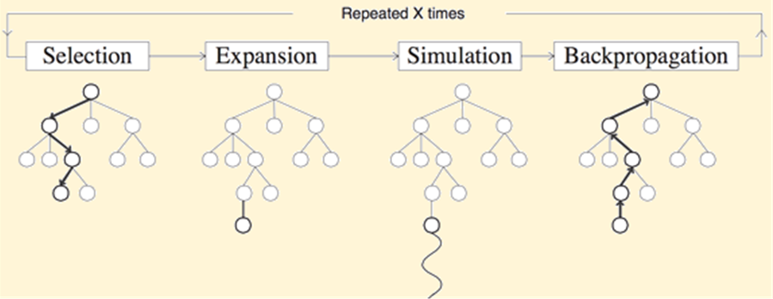
9 Monte Carlo Technique (3)
https://www.tensorflow.org/tutorials/
Monto Carlo Tree Search (MCTS)

Slide 13
9 Monte Carlo Technique (3)
https://www.tensorflow.org/tutorials/
Monto Carlo Estimates
estimates the eventual success of our actions
play the entire episode with our current policy
until we reach "success" or "failure"
use that result to update our value estimates for each traversed state
this propagates values efficiently once at the end of an episode instead of every time we make a move
this introduces noise to our estimates because we attribute very distant rewards to them

Slide 14
9 Monte Carlo Technique (3)
https://www.tensorflow.org/tutorials/
Alpha Go and MCTS
AlphaGo used MCTS for two reasons:
1) MCTS can significantly improve the learned policy via a form of lookahead search
2) MCTS was already found to work effectively for Go programs

Slide 15
9 Monte Carlo Technique (3)
https://www.tensorflow.org/tutorials/
How Alpha Go uses MCTS (1)
The essence of MCTS: run enough simulations from the current state, playing the game until the end, so that you have a very good idea of what’s the best action to make from the current state.
Start from the current state 𝑠0, which initially is the only node in the search tree.
At any given iteration, there are "expanded" states that are part of the tree and unexplored states that are not.
Every expanded state has a counter for its mean expected return (based on your simulations) and its visit count (how many times you’ve traversed this node).
Always start at s0 for each iteration, and select subsequent, expanded states to traverse.

Slide 16
9 Monte Carlo Technique (3)
https://www.tensorflow.org/tutorials/
How Alpha Go uses MCTS (2)
Although you can select the next state uniformly at random, it's highly inefficient for a game like Go that has huge branching factors
Instead: select the next state by trading off between its mean return and visit count to balance between exploration and exploitation
Whenever you reach a leaf node 𝑠𝐿, expand that node, adding its child nodes to the tree

Slide 17
9 Monte Carlo Technique (3)
https://www.tensorflow.org/tutorials/
How Alpha Go uses MCTS (3)
Afterwards, you simulate the rest of the game starting from 𝑠𝐿, going down nodes that haven’t yet been added to the tree according to some policy, until the game is finished at timestep 𝑇 and the output 𝑧𝐿=𝑟(𝑠𝑇) is attained
This output 𝑧𝐿 is backed-up to all expanded nodes on the search path to update their mean returns
=> The select, expand, simulate, and backup steps are key to MCTS
https://www.quora.com/Why-did-AlphaGo-decide-to-use-the-Monte-Carlo-tree-search-algorithm-for-the-Go-game/answer/Jerry-Liu-10?__nsrc__=4&__snid3__=2048665924

Slide 18
9 Monte Carlo Technique (3)
https://www.tensorflow.org/tutorials/
Alpha Go Zero
https://en.wikipedia.org/wiki/AlphaGo_Zero
https://www.datasciencecentral.com/profiles/blogs/deep-learning-alphago-zero-explained-in-one-picture
http://tim.hibal.org/blog/alpha-zero-how-and-why-it-works/

Slide 19
9 Monte Carlo Technique (3)
https://www.tensorflow.org/tutorials/
Minimax/alpha-beta pruning
most games are too large for minimax to construct a full search tree
alpha-beta pruning helps, but it still struggles in games with high branching factors
you can’t as easily cut off search in the middle to replace with a value function

Slide 20
9 Monte Carlo Technique (3)
https://www.tensorflow.org/tutorials/
Off-Policy vs On-Policy Learning
Off-policy methods: we can generate data with any strategy(using epsilon greedy for example) and learn from it.
On-policy methods: can only learn from actions that were taken following our policy (remember, a policy is the method we use to determine which actions to take).
This constrains our learning process, as we have to have an exploration strategy that is built in to the policy itself, but allows us to tie results directly to our reasoning, and enables us to learn more efficiently.

Slide 21


End of Chapter

