Slide 1

9 Markov Decision Process (4)
Peter H. Chen

Slide 2
9 Markov Decision Process (4)
https://www.tensorflow.org/tutorials/
List of Topics
Optimal value functions
Optimal Policy
Finding an Optimal Policy
Policy improvement
Extensions of MDPs
Stochastic Matrices
Cat and Mouse Game

Slide 3
9 Markov Decision Process (4)
https://www.tensorflow.org/tutorials/
Sum of Geometric Series
Sk = 1 + r + r^2 + ... + r^k
r*Sk = r + r^2 + ... + r^k + r^(k+1)
Sk-r*Sk = 1 - r^(k+1)
Sk*(1-r) = 1 - r^(k+1)
1 - r^(k+1)
Sk = -----------
1 – r
Sk -> 1/(1-r) as r -> ∞ because |r| < 1

Slide 4
9 Markov Decision Process (4)
https://www.tensorflow.org/tutorials/
Optimal Value Function for MDPs
The optimal state-value function Vp(s) is the maximum state-value function over all policies:
V*(s) = max { Vp(s) } over all policies p
The optimal action-value function Qp(s,a) is the maximum action-value function over all policies:
Q*(s,a) = max { Qp(s,a) } over all policies p
=> the optimal value function specifies the best possible performance in the MDP
=> an MDP is “solved” when we find that optimal function

Slide 5
9 Markov Decision Process (4)
https://www.tensorflow.org/tutorials/
Optimal Policy for MDPs
Partial ordering over policies:
p1 >= p2 if Vp1(s) >= Vp2(s) for all states s
there exists an optimal policy p* for any MDP
=> multiple optimal policies can exist
All optimal policies achieve the optimal state-value function: Vp*(s) = V*(s)
All optimal policies achieve the optimal action-value function: Qp*(s, q) = Q*(s,a)

Slide 6
9 Markov Decision Process (4)
https://www.tensorflow.org/tutorials/
Policy Improvement
Maximize over q*(s,a):
P*(a|s) = 1 if a = argmax { q*(s,a) } for all a in A
P*(a|s) = 0 otherwise
=> there is always a deterministic optimal policy for ANY MDP

Slide 7
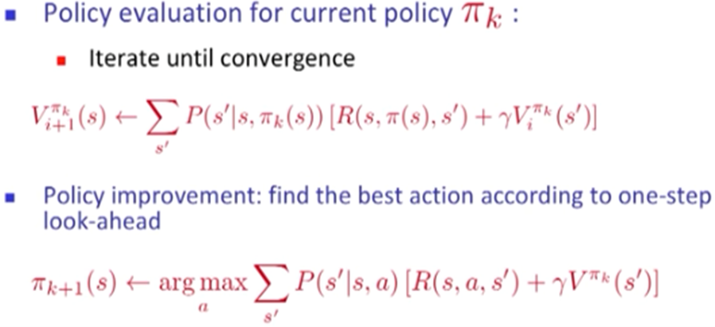
9 Markov Decision Process (4)
https://www.tensorflow.org/tutorials/
Finding an Optimal Policy for MDPs

Slide 8
9 Markov Decision Process (4)
https://www.tensorflow.org/tutorials/
Bellman Optimality Equation
It’s a non-linear equation
No general closed form solution
Iterative solutions include:
1) Value iteration
2) Policy iteration
3) Q-learning
4) SARSA

Slide 9
9 Markov Decision Process (4)
https://www.tensorflow.org/tutorials/
The core problem of MDPs (1)
1) find a "policy" for the decision maker
2) policy is a function π : S -> A
3) it specifies the action π(s) that the decision maker will choose when in state s
r: the discount factor where 0 ≤ r < 1
=> Infinite sum of discounted rewards: 1/[1-r]

Slide 10
9 Markov Decision Process (4)
https://www.tensorflow.org/tutorials/
The core problem of MDPs (2)
When an MDP is combined with a policy, the action for each state and the resulting combination behaves like a Markov chain
The goal is to choose a policy π that maximizes some cumulative function of the random rewards, typically the expected discounted sum
=> If the probabilities or rewards are unknown, the problem is Reinforcement Learning

Slide 11
9 Markov Decision Process (4)
https://www.tensorflow.org/tutorials/
Extensions of MDPs
Infinite and continuous MDPs
Partially observable MDPs (POMDPs)
Undiscounted, average reward MDPs

Slide 12
9 Markov Decision Process (4)
https://www.tensorflow.org/tutorials/
RL obeys the Markov Property
only the current state affects the next state
previous states are irrelevant
decisions made at s(t) are based solely on s(t−1)
this assumption is true in most RL algorithms
this assumption is also somewhat unrealistic
=> all states must be fully observable

Slide 13
9 Markov Decision Process (4)
https://www.tensorflow.org/tutorials/
MDP Toolbox (1)
A Python toolkit for MDPs
Fast array manipulation using NumPy
Full sparse matrix support via SciPy's sparse package
Optional linear programming support using cvxopt
https://pymdptoolbox.readthedocs.io/en/latest/index.html
https://pymdptoolbox.readthedocs.io/en/latest/api/mdp.html

Slide 14
9 Markov Decision Process (4)
https://www.tensorflow.org/tutorials/
MDP Toolbox (2)
A) Installation step:
pip install pymdptoolbox
B) Installation step (if step A) fails):
git clone https://github.com/sawcordwell/pymdptoolbox.git
cd pymdptoolbox/
python setup.py install

Slide 15
9 Markov Decision Process (4)
https://www.tensorflow.org/tutorials/
MDP Toolbox (3)
import mdptoolbox.example # mdptoolbox1.py
P, R = mdptoolbox.example.forest()
vi = mdptoolbox.mdp.ValueIteration(P, R, 0.9)
vi.run()
policy = vi.policy # result is (0, 0, 0)
print("policy:",policy)

Slide 16
9 Markov Decision Process (4)
https://www.tensorflow.org/tutorials/
MDP Toolbox (4)
import mdptoolbox, mdptoolbox.example #mdptoolbox2.py
P, R = mdptoolbox.example.forest()
fh = mdptoolbox.mdp.FiniteHorizon(P, R, 0.9, 3)
fh.run()
print("array values:")
print(fh.V)
policy = fh.policy
print("policy:")
print(policy)

Slide 17
9 Markov Decision Process (4)
https://www.tensorflow.org/tutorials/
Stochastic Matrices (1)
The following are the same:
stochastic matrix
probability matrix
transition matrix
substitution matrix
Markov matrix
=> developed by Andrew Markov

Slide 18
9 Markov Decision Process (4)
https://www.tensorflow.org/tutorials/
Stochastic Matrices (2)
Used in various fields:
probability theory
statistics
mathematical finance
linear algebra
population genetics
computer science

Slide 19
9 Markov Decision Process (4)
https://www.tensorflow.org/tutorials/
Stochastic Matrices (3)
it's a square matrix
It describes the transitions of a Markov chain
each entry is represents a probability
A right stochastic matrix:
a real square matrix whose rows sum to 1
A left stochastic matrix:
a real square matrix whose columns sum to 1
A doubly stochastic matrix:
a real square matrix whose rows & columns sum to 1

Slide 20
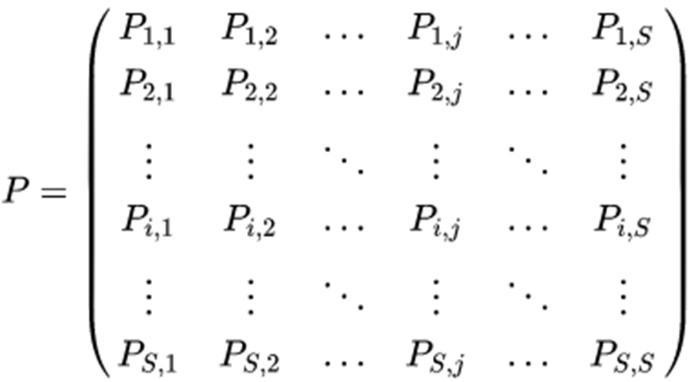
9 Markov Decision Process (4)
https://www.tensorflow.org/tutorials/
General Stochastic Matrix

Slide 21
9 Markov Decision Process (4)
https://www.tensorflow.org/tutorials/
Stochastic Vectors
also called probability vector
a vector of nonnegative real numbers
the vector values sum to 1
=> each row of a right stochastic matrix (or column of a left stochastic matrix) is a stochastic vector
Convention: use row vectors of probabilities and right stochastic matrices rather than column vectors of probabilities and left stochastic matrices

Slide 22
9 Markov Decision Process (4)
https://www.tensorflow.org/tutorials/
Cat and Mouse Game (1)
Given five contiguous boxes
Cat can jump one box (left or right)
Mouse can jump one box (left or right)
Game over when both are in the same box
https://en.wikipedia.org/wiki/Stochastic_matrix

Slide 23
9 Markov Decision Process (4)
https://www.tensorflow.org/tutorials/
Cat and Mouse Game (2)
https://en.wikipedia.org/wiki/Stochastic_matrix
Suppose there are a timer and a row of five adjacent boxes, with a cat in the first box and a mouse in the fifth box at time zero. The cat and the mouse both jump to a random adjacent box when the timer advances.
E.g. if the cat is in the second box and the mouse in the fourth one, the probability is one fourth that the cat will be in the first box and the mouse in the fifth after the timer advances.
If the cat is in the first box and the mouse in the fifth one, the probability is one that the cat will be in box two and the mouse will be in box four after the timer advances. The cat eats the mouse if both end up in the same box, at which time the game ends. The random variable K gives the number of time steps the mouse stays in the game.
The Markov chain that represents this game contains the following five states specified by the combination of positions (cat,mouse). Note that while a naive enumeration of states would list 25 states, many are impossible either because the mouse can never have a lower index than the cat (as that would mean the mouse occupied the cat's box and survived to move past it), or because the sum of the two indices will always have even parity. In addition, the 3 possible states that lead to the mouse's death are combined into one.

Slide 24
9 Markov Decision Process (4)
https://www.tensorflow.org/tutorials/
Markov Chain for Cat & Mouse Game
Five states of positions (cat, mouse):
State 1: (1,3)
State 2: (1,5)
State 3: (2,4)
State 4: (3,5)
State 5: (game over): (2,2), (3,3) & (4,4)

Slide 25
9 Markov Decision Process (4)
https://www.tensorflow.org/tutorials/
Stochastic Matrix for Cat & Mouse Game (1)
P(1,1) = 0 (impossible)
P(2,2) = 0 (impossible)
P(3,3) = 0 (impossible)
P(4,4) = 0 (impossible)
P(5,5) = 0 (impossible)
P(1,3) ≠ 0
P(1,5) ≠ 0
=> regardless of the initial state, the cat will eventually catch the mouse (with probability 1)
the stationary state π = (0,0,0,0,1) is the limit

Slide 26
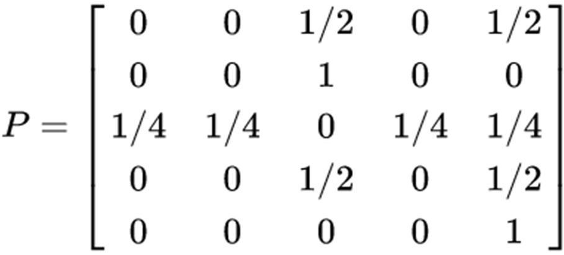
9 Markov Decision Process (4)
https://www.tensorflow.org/tutorials/
Stochastic Matrix for Cat & Mouse Game (2)

Slide 27
9 Markov Decision Process (4)
https://www.tensorflow.org/tutorials/
Markov Models (links)
https://towardsdatascience.com/markov-models-and-trump-tweets-91b0d3f0f1eb
https://github.com/3mi1y/Markov_Trump_Tweets
https://raw.githubusercontent.com/3mi1y/Markov_Trump_Tweets/master/server/trumpTweets.csv
http://ai.berkeley.edu/home.html
https://www.quora.com/What-is-the-difference-between-Markov-Chain-Bayesian-Network-Dynamic-Bayesian-Network

Slide 28
End of Chapter

