Slide 1

9 Introduction to Markov Chain (1)
Peter H. Chen

Slide 2
9 Introduction to Markov Chain (1)
https://www.tensorflow.org/tutorials/
List of Topics
What is a DFA
What is an NDFA
Markov Chains
Markov Models
Markov Reward Process
MDP (Markov Decision Process)

Slide 3
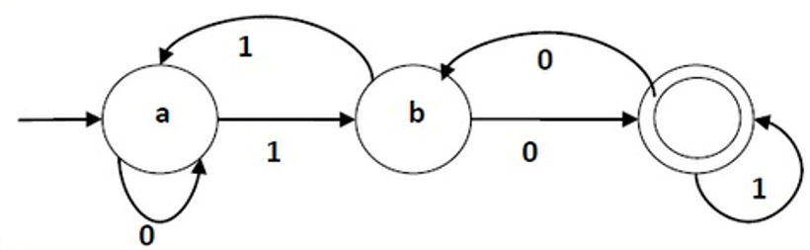
9 Introduction to Markov Chain (1)
https://www.tensorflow.org/tutorials/
A DFA (Deterministic Finite Automata)

Slide 4
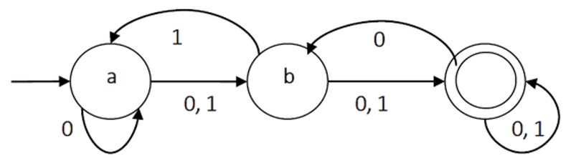
9 Introduction to Markov Chain (1)
https://www.tensorflow.org/tutorials/
An NDFA (Non-Deterministic FA)

Slide 5
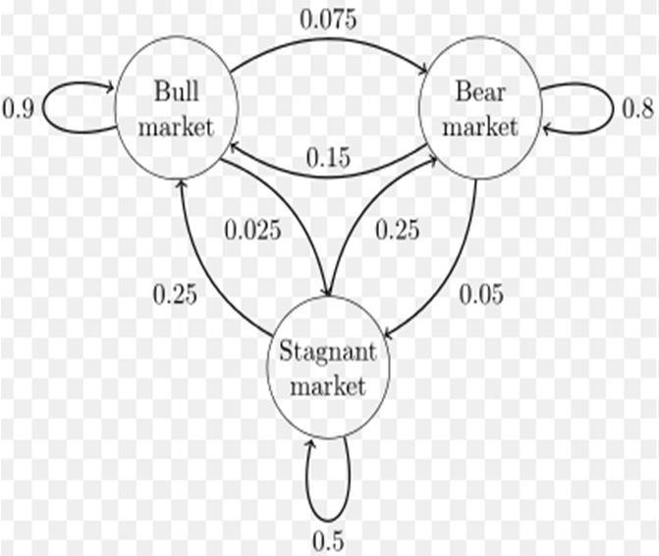
9 Introduction to Markov Chain (1)
https://www.tensorflow.org/tutorials/
A Basic Markov Chain

Slide 6
9 Introduction to Markov Chain (1)
https://www.tensorflow.org/tutorials/
Markov Chains / Models
Markov Chain:
1) a model describing a sequence of possible events
2) the probability of each event depends only on the state in the previous event
Markov Models:
the state is directly visible to the observer
the state transition probabilities are the only parameters

Slide 7
9 Introduction to Markov Chain (1)
https://www.tensorflow.org/tutorials/
Markov Chains (1)
A Markov chain is a sequence of states such that the (n+1)th state is independent of all previous states if the nth state is known
You can predict the distribution of the next state if I tell you the current state, without telling how I got to the current state
The canonical example of a Markov chain is random walk — suppose a person starts at position X= 0, and at each timestep, takes either a step forward or a step backwards, with equal probability

Slide 8
9 Introduction to Markov Chain (1)
https://www.tensorflow.org/tutorials/
Markov Chains (2)
If the state is defined as the current position of the person, then, given just the current position of the person, you can infer the distribution of the next state
You don’t need to know all the steps the person took so far
An example of a process that is not Markovian would be to draw cards from a deck without replacement
If the state is defined as the current card drawn, then you cannot infer the distribution of the next card without knowing all the cards have been drawn so far

Slide 9
9 Introduction to Markov Chain (1)
https://www.tensorflow.org/tutorials/
What is a Random Walk?
a path based on a sequence of random steps
Some examples of random walks:
the path of a molecule moving in a liquid/gas
the search path of a foraging animal
the price of a fluctuating stock
the financial status of a gambler
NB: they may not be truly random
=> a Markov chain is a random walk in a graph

Slide 10
9 Introduction to Markov Chain (1)
https://www.tensorflow.org/tutorials/
Markov Reward Process (1)
An MRP (Markov Reward Process) is a MC (Markov Chain) with values
An MRP is a tuple (S, P, R, g) where:
S is a finite set of states
P is a state transition probability matrix:
P(s,s’) = P[S(t+1) = s’ | S(t) = s]
R is a reward function:
R(s) = E[R(t+1) | S(t) = s]
g is a discount factor ( 0 <= g < 1)

Slide 11
9 Introduction to Markov Chain (1)
https://www.tensorflow.org/tutorials/
Markov Reward Process (2)
An MRP is discounted because:
Avoids infinite returns in cyclic Markov processes
Uncertainty about the future
Immediate financial rewards might earn more
Human behavior prefers immediate reward
NB: g = 1 is valid if all sequences are finite

Slide 12
9 Introduction to Markov Chain (1)
https://www.tensorflow.org/tutorials/
MRP Value Function V(s)
V(s) = the long-term total value of state s
V(s) = the expected return starting from state s
Let G(t) be a random sample in the MRP
Return G(t) = total discount reward from time t
V(s) = E[G(t) | S(t) = s]

Slide 13
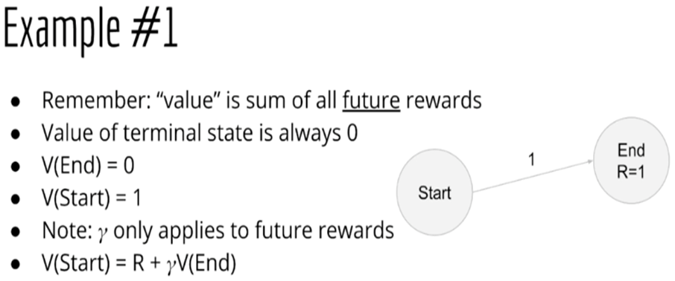
9 Introduction to Markov Chain (1)
https://www.tensorflow.org/tutorials/
Calculating Rewards (1)

Slide 14
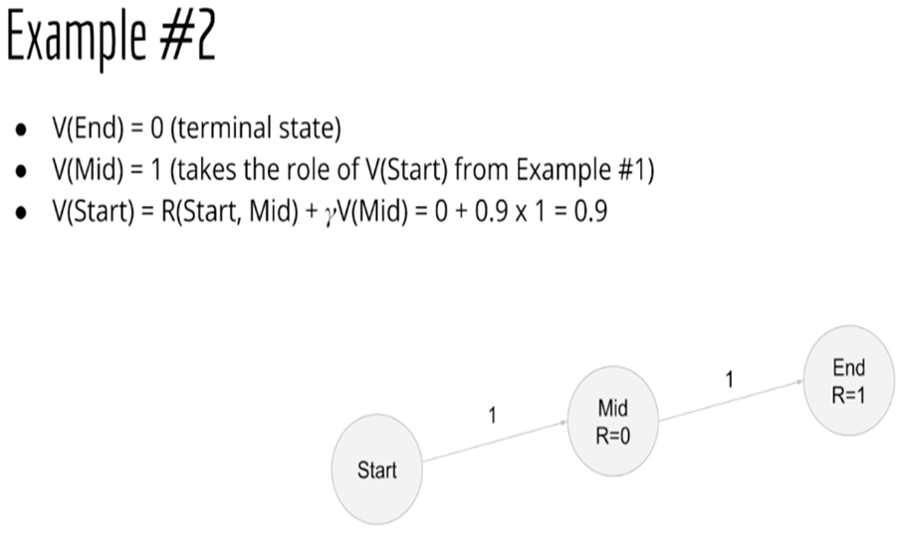
9 Introduction to Markov Chain (1)
https://www.tensorflow.org/tutorials/
Calculating Rewards (2)

Slide 15
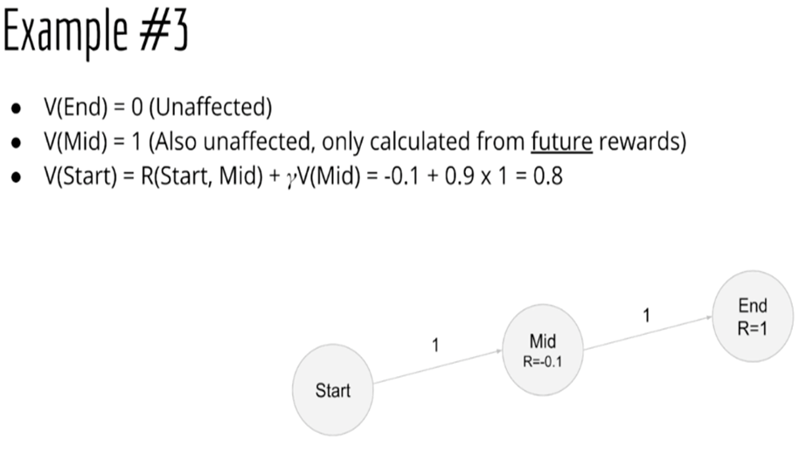
9 Introduction to Markov Chain (1)
https://www.tensorflow.org/tutorials/
Calculating Rewards (3)

Slide 16
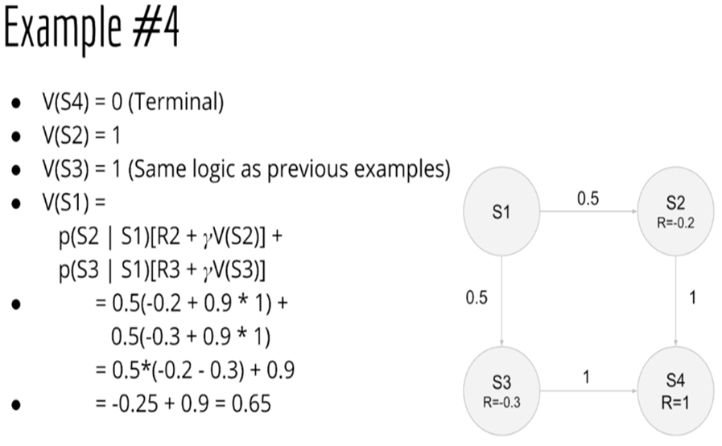
9 Introduction to Markov Chain (1)
https://www.tensorflow.org/tutorials/
Calculating Rewards (4)

Slide 17
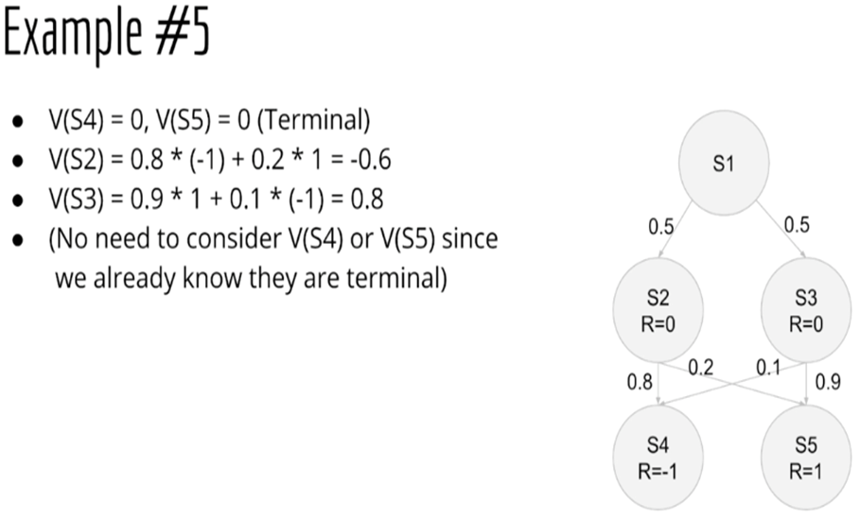
9 Introduction to Markov Chain (1)
https://www.tensorflow.org/tutorials/
Calculating Rewards (5)

Slide 18
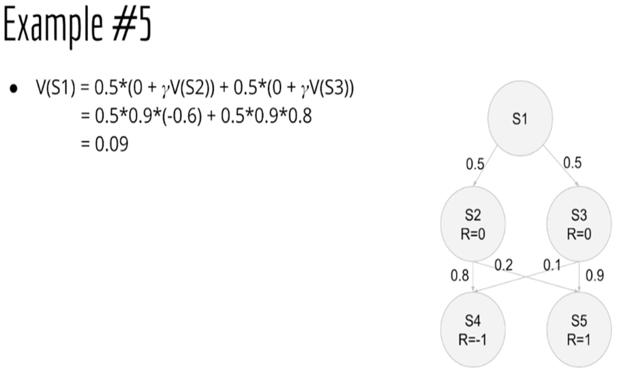
9 Introduction to Markov Chain (1)
https://www.tensorflow.org/tutorials/
Calculating Rewards (6)

Slide 19
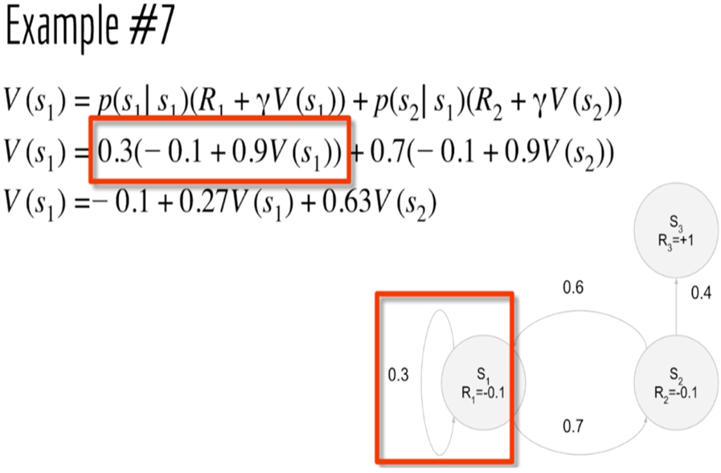
9 Introduction to Markov Chain (1)
https://www.tensorflow.org/tutorials/
Calculating Rewards (7)

Slide 20
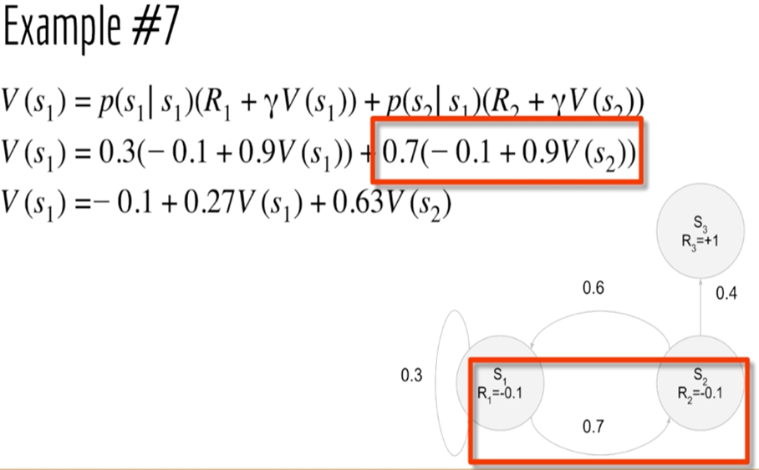
9 Introduction to Markov Chain (1)
https://www.tensorflow.org/tutorials/
Calculating Rewards (8)

Slide 21
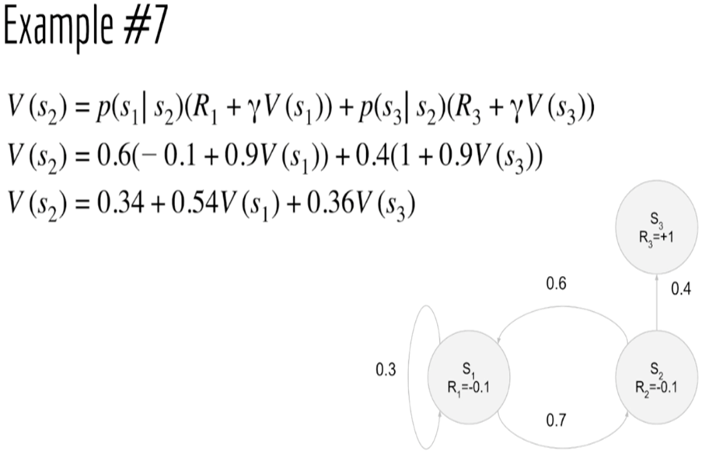
9 Introduction to Markov Chain (1)
https://www.tensorflow.org/tutorials/
Calculating Rewards (9)

Slide 22
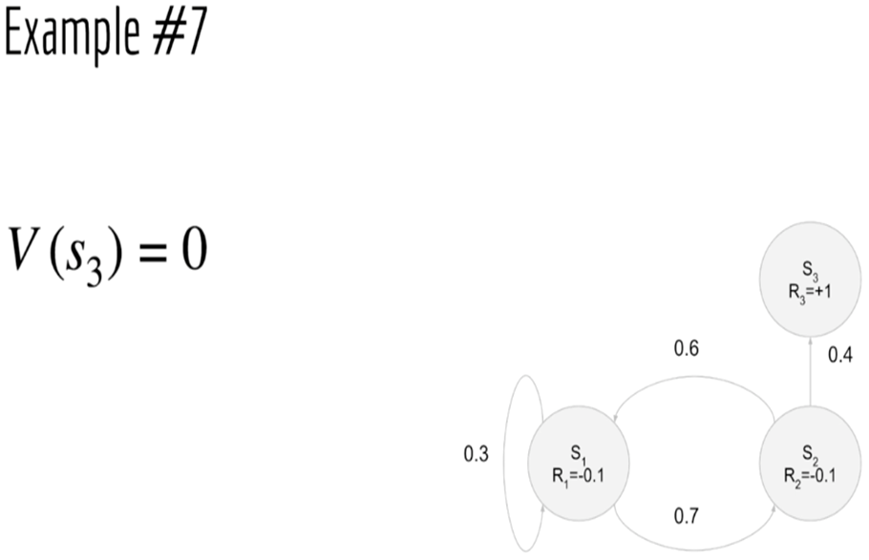
9 Introduction to Markov Chain (1)
https://www.tensorflow.org/tutorials/
Calculating Rewards (10)

Slide 23
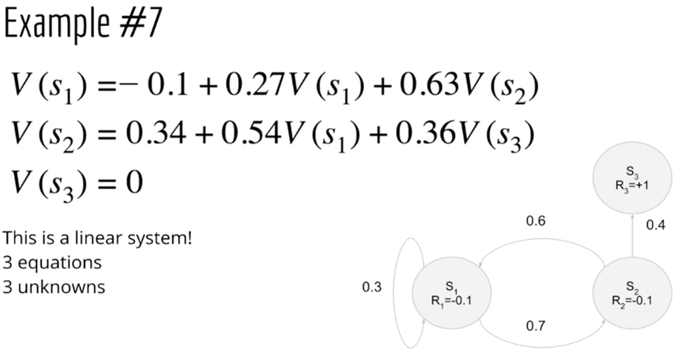
9 Introduction to Markov Chain (1)
https://www.tensorflow.org/tutorials/
Calculating Rewards (11)

Slide 24
9 Introduction to Markov Chain (1)
https://www.tensorflow.org/tutorials/
Bellman Equation for MRPs
Direct solution is possible for small MRPs
iterative techniques for large MRPs:
1)dynamic programming
2)Monte-Carlo evaluation
3)Temporal-Difference Learning

Slide 25
9 Introduction to Markov Chain (1)
https://www.tensorflow.org/tutorials/
What is an MDP (Markov Decision Process)?
An acronym for Markov Decision Process
A mathematical framework for modeling decision making
useful for studying a wide range of optimization problems
MDPs formally describe environments for MDPs
Almost all RL problems can be formulated as MDPs

Slide 26
9 Introduction to Markov Chain (1)
https://www.tensorflow.org/tutorials/
An MDP is a 5-tuple (1)
An MDP is a 5-tuple (S, A, P(a), R(a), r) where:
S is a finite set of states
A is a finite set of actions
A(s) is the finite set of actions available from state s

Slide 27
9 Introduction to Markov Chain (1)
https://www.tensorflow.org/tutorials/
Components of MDPs (1)
A set of states S and a set of actions A
A transition function T(a, s, s’)
A reward function R(s, a, s’)
A start state and an optional terminal state

Slide 28
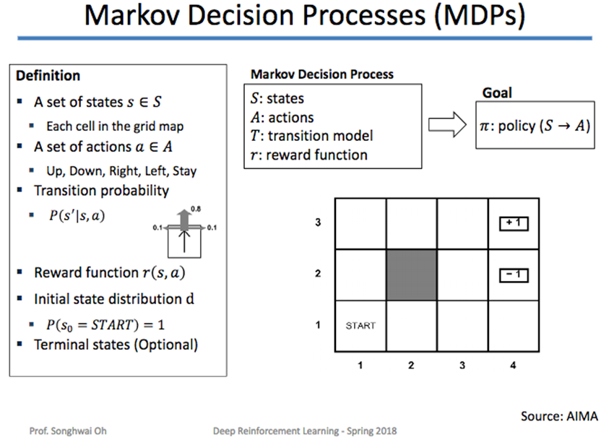
9 Introduction to Markov Chain (1)
https://www.tensorflow.org/tutorials/
Components of MDPs (2)

Slide 29
9 Introduction to Markov Chain (1)
https://www.tensorflow.org/tutorials/
MDP (Markov Decision Process) (1)
solved via dynamic programming and RL (Reinforcement Learning)
MDPs are non-deterministic search problems
outcomes are partly random and partly under control
Optimal control: usually involves continuous MDPs
Partially observable problems are actually MDPs
One-armed bandit: an MDP with one state
K-armed bandit: an MDP with one state

Slide 30
9 Introduction to Markov Chain (1)
https://www.tensorflow.org/tutorials/
MDP (Markov Decision Process) (2)
Markov decision process (MDP): the set of states and actions, coupled with the rules for transitioning from one state to another
One episode of this process (e.g., a single game) produces a finite sequence of states, actions, and rewards.
We need to define:
1) a return (a total discounted reward)
2) a policy: agent’s behavior (deterministic or stochastic)
3) the expected return starting from a particular state (state-value function, action-value function)

Slide 31
9 Introduction to Markov Chain (1)
https://www.tensorflow.org/tutorials/
Properties of MDPs
=> the Markov property: history doesn’t matter
MDPs always have an optimal deterministic policy (*)
=> true even if the MDP is nondeterministic
(*) see next slide . . .

Slide 32
9 Introduction to Markov Chain (1)
https://www.tensorflow.org/tutorials/
What is a Policy?
A policy is a path in an MDP
Policy P = {S0, S1, S2, S3, . . . , Sk} where k <= n
an optimal policy has the highest reward
There is at least one optimal policy
=> Even if the MDP is non-deterministic

Slide 33
9 Introduction to Markov Chain (1)
https://www.tensorflow.org/tutorials/
Two Policy Types
A deterministic policy:
A deterministic mapping from state to action
A stochastic policy:
A mapping from state to a distribution of actions

Slide 34
9 Introduction to Markov Chain (1)
https://www.tensorflow.org/tutorials/
States in MDPs
"The future is independent of the past given the present":
H1:t → St → Ht+1 : ∞
Once the state is known, the history may be discarded
=> the state is a sufficient statistic of the future
A state St is Markov if and only if:
P[S(t+1) | St ] = P[S(t+1) | S1, ..., St ]

Slide 35
9 Introduction to Markov Chain (1)
https://www.tensorflow.org/tutorials/
Value Functions in MDPs
Vp(s) is the state-value function of an MDP
Vp(s) of an MDP is the expected return starting from state s AND following policy p
Vp(s) = Ep[ G(t) | S(t) = s ]
Qp(a) is the action-value function of an MDP
Qp(s,a) of an MDP is the expected return starting from state s AND action a AND following policy p
Qp(s,a) = Ep[ G(t) | S(t) = s, A(t) = a ]

Slide 36
9 Introduction to Markov Chain (1)
https://www.tensorflow.org/tutorials/
Optimal Control (1)
Given an MDP: find the optimal (*) policy p
Two exact methods for doing so:
1) value iteration (finds optimal value function V*)
2) policy iteration
(*) a policy that maximizes the expected reward

Slide 37
9 Introduction to Markov Chain (1)
https://www.tensorflow.org/tutorials/
Optimal Control (2)
Given an MDP: find the optimal (*) policy p
Limitations:
1) Requires small/discrete state-action space
2) Update equations must know P(s’ | s,a)
Overcoming these limitations:
1) sampling-based approximations
2) Q/V function fitting

Slide 38
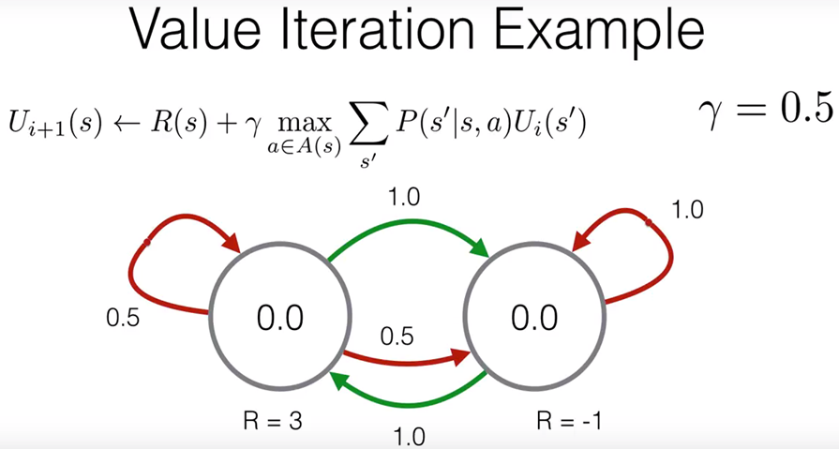
9 Introduction to Markov Chain (1)
https://www.tensorflow.org/tutorials/
Ex: Two States and Many Actions

Slide 39
9 Introduction to Markov Chain (1)
https://www.tensorflow.org/tutorials/
RL (Reinforcement Learning) and Bellman’s Equation
Calculations involve (state, action) pairs
=> an action can have multiple outgoing edges
EXAMPLE (see states in the previous slide):
1) left-side state:
“red” action has two outgoing red edges
“green” action has one outgoing green edge
2) right-side state:
“red” action has one outgoing red edges
“green” action has one outgoing green edge
=> see concrete example in the next slide

Slide 40
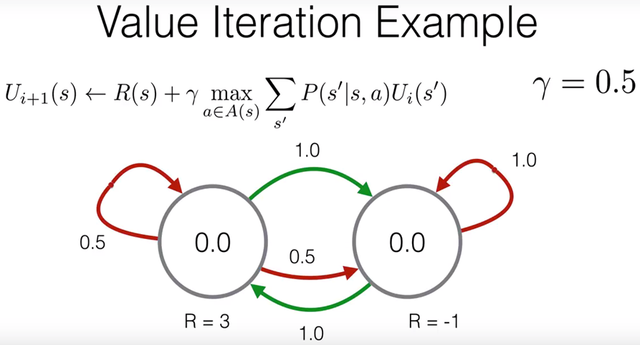
9 Introduction to Markov Chain (1)
https://www.tensorflow.org/tutorials/
Calculating the Reward (1)

Slide 41
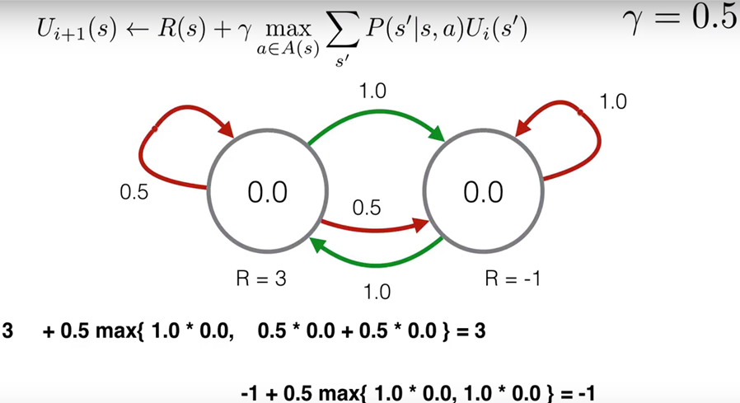
9 Introduction to Markov Chain (1)
https://www.tensorflow.org/tutorials/
Calculating the Reward (2)

Slide 42
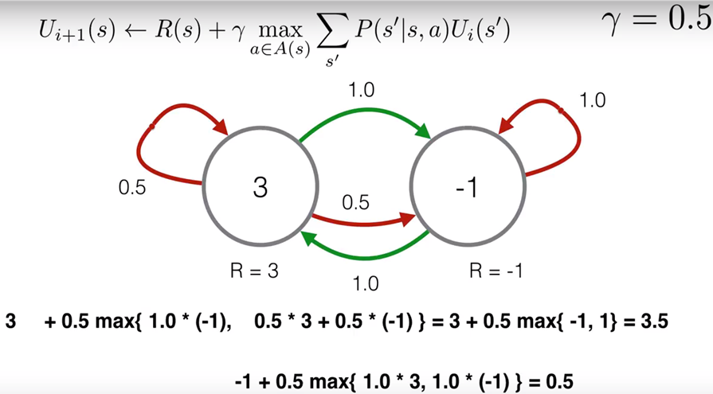
9 Introduction to Markov Chain (1)
https://www.tensorflow.org/tutorials/
Calculating the Reward (3)

Slide 43
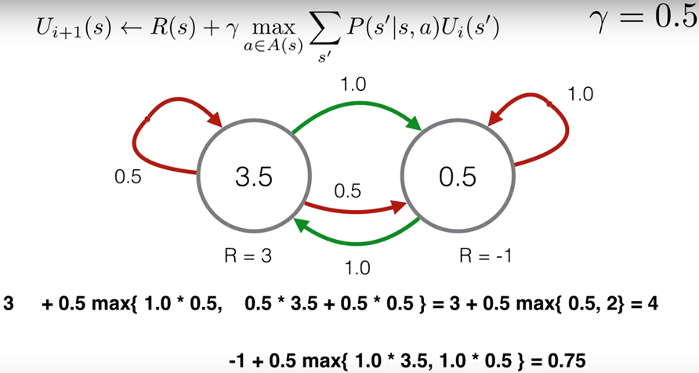
9 Introduction to Markov Chain (1)
https://www.tensorflow.org/tutorials/
Calculating the Reward (4)

Slide 44
9 Introduction to Markov Chain (1)
https://www.tensorflow.org/tutorials/
Summary
DFAs and NDFAs
Markov Chains
Markov Models
Markov Reward Process
MDP (Markov Decision Process)
What is a value function
What is a policy
Bellman Equation
Calculating Rewards

Slide 45
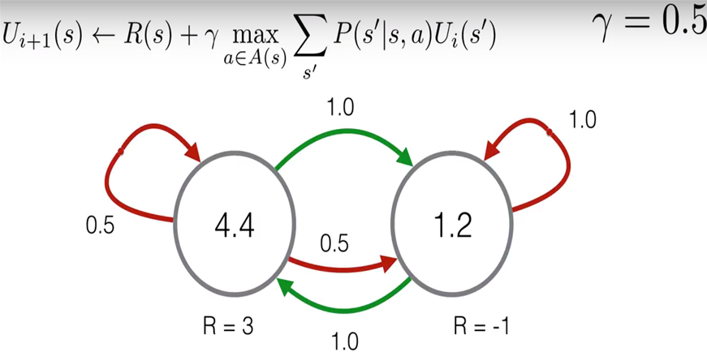
9 Introduction to Markov Chain (1)
https://www.tensorflow.org/tutorials/
Calculating the Reward (5)

Slide 46
End of Chapter

