Slide 1

10 Data Analysis and Models (2)
Peter H. Chen

Slide 2
10 Data Analysis and Models (2)
https://www.tensorflow.org/tutorials/
List of Topics
Data analysis
Evaluating models
Common data models
Mapping data to features

Slide 3
10 Data Analysis and Models (2)
https://www.tensorflow.org/tutorials/
Outlier vs Anomaly
Outlier:
An observation with an “extreme” value as compared to the other observations in the data
Can be due to experimental error
Not necessarily an anomaly
Anomaly:
An unusual value (and also an outlier)
Can be indicative of an issue/problem
Very difficult to decide based on a single event
Important for fraud detection

Slide 4
10 Data Analysis and Models (2)
https://www.tensorflow.org/tutorials/
Multicollinearity
Independent variables that are highly correlated to each other
Many regression techniques assume multicollinearity is not present in the dataset
It causes problems in ranking variables based on their importance
It's more difficult to select the most important independent variable

Slide 5
10 Data Analysis and Models (2)
https://www.tensorflow.org/tutorials/
Data Analysis
Heteroscedasticity:
occurs when a dependent variable's variability is not equal across values of an independent variable
Homoscedasticity:
Occurs when all random variables have the same finite variance

Slide 6
10 Data Analysis and Models (2)
https://www.tensorflow.org/tutorials/
Data Analysis
Heteroscedasticity:
occurs when a dependent variable's variability is not equal across values of an independent variable
Homoscedasticity:
Occurs when all random variables have the same finite variance

Slide 7
10 Data Analysis and Models (2)
https://www.tensorflow.org/tutorials/
Overfitting vs Underfitting
Overfitting:
Unnecessary variables can lead to overfitting
an algorithm works well on the training set but has a significantly lower accuracy on a test set
Underfitting:
Can occur if dataset is smaller than # of features
consider using an SVM instead of a CNN

Slide 8
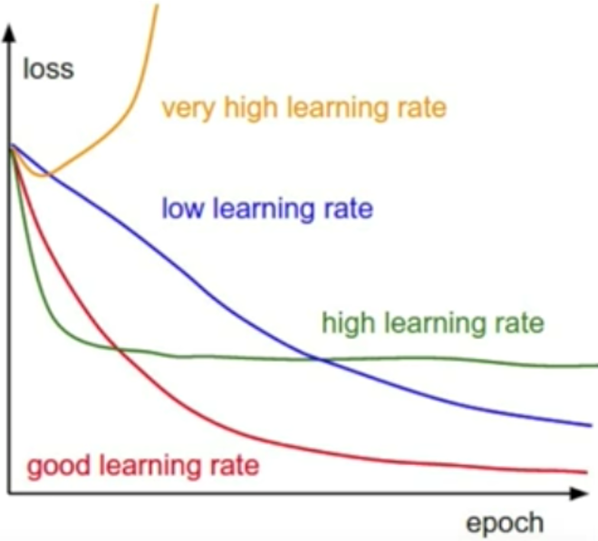
10 Data Analysis and Models (2)
https://www.tensorflow.org/tutorials/
Overfitting vs Underfitting

Slide 9
10 Data Analysis and Models (2)
https://www.tensorflow.org/tutorials/
Overfitting
occurs when a model fit the training data so closely that it does not generalize well to new data
reduces our predictive ability for new data
How to reduce overfitting:
- dropout rate
- BN (batch normalization)
https://developers.google.com/machine-learning/crash-course/generalization/peril-of-overfitting

Slide 10
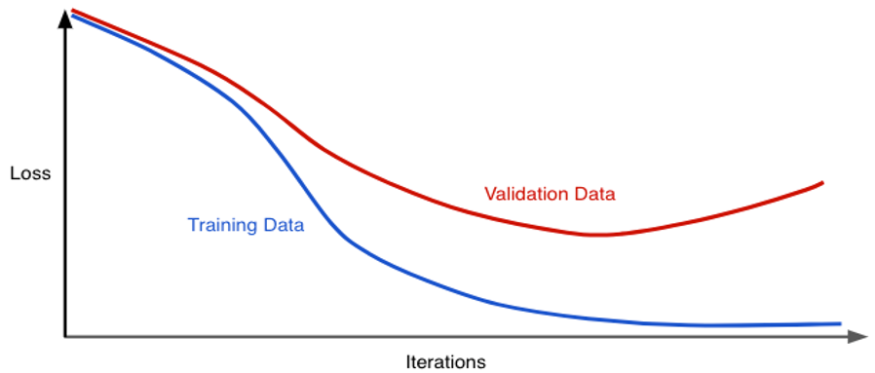
10 Data Analysis and Models (2)
https://www.tensorflow.org/tutorials/
Overfitting: Generalization Curve

Slide 11
10 Data Analysis and Models (2)
https://www.tensorflow.org/tutorials/
Mini-Batch Size and Gradient Descent
Recall the following two points:
A) smaller batches => less accurate gradient updates
B) larger batches => larger variance
Two factors regarding mini-batch size:
1) time efficiency for training
2) ”noisiness” of the gradient estimate
Gradient training: approximately linear in batch size
More details here:
https://www.quora.com/Intuitively-how-does-mini-batch-size-affect-the-performance-of-stochastic-gradient-descent/answer/Brian-Wong-21

Slide 12
10 Data Analysis and Models (2)
https://www.tensorflow.org/tutorials/
Mini-Batch Size and Gradient Descent
Example: Given a set of 100,000 training samples
Suppose Minibatch size #1 is 100
Suppose Minibatch size #2 is 10,000
Then the following is true:
1) MB #2 takes 100 times longer than MB #1
2) MB #2 makes 1 update while MB #1 makes 100
=> MB #1 might be 10x more productive which reduces training time

Slide 13
10 Data Analysis and Models (2)
https://www.tensorflow.org/tutorials/
Batch Normalization
Key idea: normalize each batch by both mean and variance
handles distributions whose features vary across the training and test data (which breaks the IID assumption)
normalizing the input in an NN enables gradient descent to reduce the oscillations when approaching the minimum point
can reduce the impact of previous layers by keeping the mean and variance fixed
in some way this makes the layers independent with each other
hence faster convergence
"imposes" regularization when using mini-batch size
can lead to higher overall accuracy
NB: the regularization effects decrease with larger batch size
https://www.dlology.com/blog/one-simple-trick-to-train-keras-model-faster-with-batch-normalization/

Slide 14
10 Data Analysis and Models (2)
https://www.tensorflow.org/tutorials/
Dropout Regularization
dropout is useful for neural networks
randomly "dropping out" unit activations in a network for one gradient step
The more you drop out, the stronger the regularization:
+ 0.0 = No dropout regularization
+ 1.0 = Drop out everything (but model learns nothing)
+ values between 0.0 and 1.0 = more useful

Slide 15
10 Data Analysis and Models (2)
https://www.tensorflow.org/tutorials/
Dropout vs Batch Normalization
=> Both methods are 'Regularization by Training' methods
Dropout:
mostly a technique for regularization
regularizes the NN
Batch normalization:
mostly a technique for improving optimization
stabilizes the NN
inputs are dynamically normalized (on a mini-batch basis)
=> happens to introduce some noise into the network, so it can regularize the model a little bit

Slide 16
10 Data Analysis and Models (2)
https://www.tensorflow.org/tutorials/
Hyperparameter Tuning
Four main strategies available:
Trial & Error
Grid Search
Random Search
Bayesian Optimization
Details here:
https://blog.floydhub.com/guide-to-hyperparameters-search-for-deep-learning-models/

Slide 17
10 Data Analysis and Models (2)
https://www.tensorflow.org/tutorials/
Hyperparameter Tuning
Tune the values for the following:
Batch size (favor mini-batch)
# of epochs (initially smaller)
learning rate
# of hidden layers
# of neurons per layer
=> no order of importance for these hyperparams
Consider external services for tuning purposes

Slide 18
10 Data Analysis and Models (2)
https://www.tensorflow.org/tutorials/
Optimizers with Adaptive Learning Rates
For the following optimizers:
Adadelta
Adam
RMSprop
Keep the following points in mind
1) it’s safe to use the recommended values
2) focus on tuning other hyperparameters

Slide 19
10 Data Analysis and Models (2)
https://www.tensorflow.org/tutorials/
Evaluating Models
Some useful concepts include:
confusion matrix
R and R^2 values
accuracy
precision
Recall
F1 score
p-value
=> discussed briefly in subsequent slides

Slide 20
10 Data Analysis and Models (2)
https://www.tensorflow.org/tutorials/
Confusion Matrix
Also called an error matrix
=> also a type of contingency table
A 2x2 set of tabular values:
TP: True Positive
FP: False Positive
TN: True Negative
FN: False Negative
https://en.wikipedia.org/wiki/Confusion_matrix

Slide 21
10 Data Analysis and Models (2)
https://www.tensorflow.org/tutorials/
R and R^2 Values
Computes a scaled measure based on MSE
Measure of correlation between actual and predicted value
R: coefficient of correlation
R^2: coefficient of determination
http://www.statisticshowto.com/probability-and-statistics/coefficient-of-determination-r-squared/

Slide 22
10 Data Analysis and Models (2)
https://www.tensorflow.org/tutorials/
Accuracy vs Precision vs Recall
P = # of real positive cases
N = # of real negative cases
accuracy = (TP + TN)/[P + N]
precision = TP/[TN + FP]
recall = TP/[TP + FN]

Slide 23
10 Data Analysis and Models (2)
https://www.tensorflow.org/tutorials/
What is an F1 Score?
A measure of a test’s accuracy
Harmonic mean of precision and recall
Best value: 1 worst value: 0
https://en.wikipedia.org/wiki/F1_score

Slide 24
10 Data Analysis and Models (2)
https://www.tensorflow.org/tutorials/
What is a p-value?
Used in null hypothesis testing
Smaller p-value => higher significance
Threshold value for p: 5% or 1%
https://en.wikipedia.org/wiki/P-value

Slide 25
10 Data Analysis and Models (2)
https://www.tensorflow.org/tutorials/
Prediction Bias (factors)
Incomplete feature set
Noisy data set
Buggy pipeline
Biased training sample
Overly strong regularization

Slide 26
10 Data Analysis and Models (2)
https://www.tensorflow.org/tutorials/
Training versus test data
training set: a subset to train a model
test set: a subset to test the trained model
ensure the following for a test set:
1) it's large enough to yield statistically meaningful results
2) it's representative of the data set as a whole
3) Never train on test data
https://developers.google.com/machine-learning/crash-course/training-and-test-sets/playground-exercise

Slide 27
10 Data Analysis and Models (2)
https://www.tensorflow.org/tutorials/
Mapping Data to Features
Mapping string values (two steps):
1)define a vocabulary of all the feature's string values
2)use this vocabulary to create a one-hot encoding that
represents a given string value as a binary vector, where:
a) one element in the vector (the given string value) is 1
b) all other elements are set to 0
c) the vector length equals the size of the vocabulary

Slide 28
10 Data Analysis and Models (2)
https://www.tensorflow.org/tutorials/
Mapping Data to Features
Categorical (enumerated) values:
A smallish set of values (ex: drop-down lists)
1) Categorical variables (independent values):
The 50 US states
A set of political parties
Day of week
2) Categorical variables (hierarchical values):
Pay grades
Developer level

Slide 29
10 Data Analysis and Models (2)
https://www.tensorflow.org/tutorials/
Mapping Data to Features
Mapping categorical values:
A) A set of scalar values
Example:
Days of week: {0=“Sunday”,1,2,3,4,5,6=“Saturday”}
Example: Gender: {0=“Male”, 1=“Female”}
Example: developer levels
{1=Intern,4=Entry,7=Intermediate,10=Senior,. . .}

Slide 30
10 Data Analysis and Models (2)
https://www.tensorflow.org/tutorials/
Mapping Data to Features
Mapping categorical values:
B) A set of vector values
Example: {French, Italian, German, Other}
Nationality C1 C2 C3
French 0 0 0
Italian 1 0 0
German 0 1 0
Other 0 0 1
=> essentially a one-hot encoding

Slide 31
10 Data Analysis and Models (2)
https://www.tensorflow.org/tutorials/
Handling Vanishing/Exploding Gradient
1) Proper initialization of weights:
Use Xavier or He technique instead of random values
2) Use non-saturating activation function:
ELU (exponential linear unit) or Leaky ReLU
3) Batch normalization [ N(0,1) ]:
Scale values and shift around zero
4) Gradient clipping (specify max gradient)
5) Truncated BPTT: drop distant layers (or use LSTM cells)

Slide 32
10 Data Analysis and Models (2)
https://www.tensorflow.org/tutorials/
Common datasets
Alexnet
Resnet
IRIS
Vgg16 / Vgg19
CIFAR10
STL-10

Slide 33
10 Data Analysis and Models (2)
https://www.tensorflow.org/tutorials/
Common datasets: AlexNet
a Convolutional Neural Network
Originally written to run with GPU support
Won the 2012 INLSVRC challenge
10.8% higher accuracy than runner-up
Alex Krizhenvsky, Geoffrey Hinton, Ilya Sutskever

Slide 34
10 Data Analysis and Models (2)
https://www.tensorflow.org/tutorials/
Common datasets: ResNet
An Artificial Neural Network
“skip connections” skip over layers
Also called “short cuts”
Similar in concept to some brain structures
https://en.wikipedia.org/wiki/Residual_neural_network

Slide 35
10 Data Analysis and Models (2)
https://www.tensorflow.org/tutorials/
Common datasets: IRIS
A dataset for flowers
50 samples from each of three species
Also a multivariate dataset
Typical test case for machine learning
https://en.wikipedia.org/wiki/Iris_flower_data_set

Slide 36
10 Data Analysis and Models (2)
https://www.tensorflow.org/tutorials/
Common datasets: vgg16
a Convolutional Neural Network
trained on ImageNet Large Scale Visual Recognition Competition (ILSVRC) data
16 layers and 138 millions parameters
can classify 1000 different objects with high accuracy

Slide 37
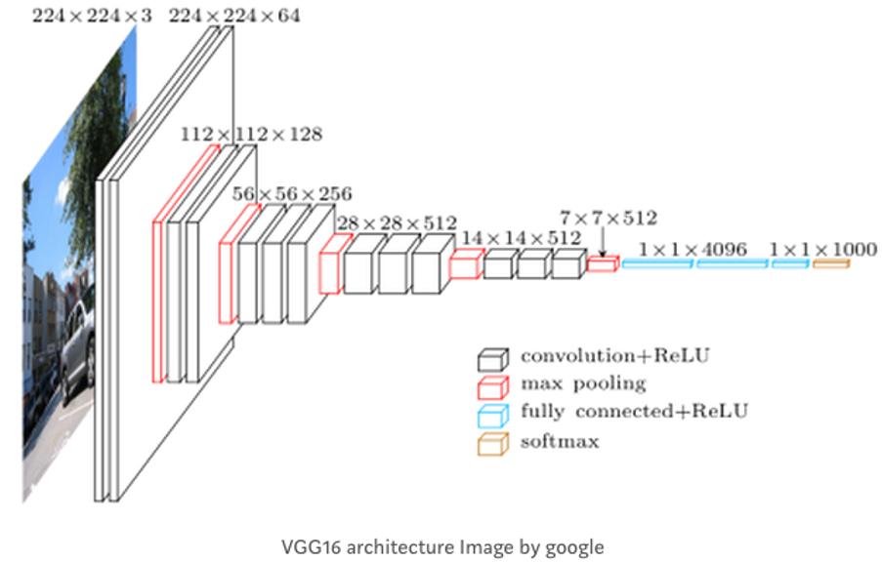
10 Data Analysis and Models (2)
https://www.tensorflow.org/tutorials/
Common datasets: vgg16

Slide 38
10 Data Analysis and Models (2)
https://www.tensorflow.org/tutorials/
Discriminative vs Generative Models
Examples of discriminative models:
Logistic regression
SVMs (support vector machines)
Neural networks
Conditional random fields
Maximum-entropy Markov models
Examples of generative Models:
GANs (Generative Adversarial Networks)
https://en.wikipedia.org/wiki/Generative_model

Slide 39
10 Data Analysis and Models (2)
https://www.tensorflow.org/tutorials/
Things to Remember…
Gradient descent is an algorithm for minimizing error over multiple steps
Autodiff is a calculus trick for finding the gradients in gradient descent
Softmax is a function for choosing the most probable classification given several input values

Slide 40
10 Data Analysis and Models (2)
https://www.tensorflow.org/tutorials/
What’s Faster than Gradient Descent?
Momentum Optimization:
 Introduces a momentum term to the descent, so it slows down as things start to flatten and speeds up as the slope is steep
Nesterov Accelerated Gradient:
 A small tweak on momentum optimization – computes momentum based on the gradient slightly ahead of you, not where you are

Slide 41
10 Data Analysis and Models (2)
https://www.tensorflow.org/tutorials/
What’s Faster than Gradient Descent?
RMSProp:
 Adaptive learning rate to help point toward the minimum
Adam:
 Adaptive moment estimation – momentum + RMSProp combined  Popular choice, easy to use

Slide 42
10 Data Analysis and Models (2)
https://www.tensorflow.org/tutorials/
Miscellaneous Terms
1) Correlated but independent:
https://en.wikipedia.org/wiki/Correlation_and_dependence
2) Time series:
https://en.wikipedia.org/wiki/Time_series
3) Kurtosis (“tailedness” of a probability distribution):
https://en.wikipedia.org/wiki/Categorical_variable

Slide 43
10 Data Analysis and Models (2)
https://www.tensorflow.org/tutorials/
Cloud-based Solutions
AWS (Amazon)
Microsoft (Azure)
GCP (Google)
IBM (IDE for models)
Build your own machine

Slide 44
10 Data Analysis and Models (2)
https://www.tensorflow.org/tutorials/
Some Challenges
1) How to handle too much data (exceeds RAM):
Split the data into smaller datasets
Try to generalize/infer patterns that you see
2) How to handle insufficient data:
Generate more data
use SVM or kMeans instead of CNN
3) Data size and choice of algorithms:
If you select an algorithm that requires an in-memory dataset but it’s too large then what can you do?

Slide 45
End of Chapter

