Slide 1

10 Miscellaneous Topics (3)
Peter H. Chen

Slide 2
10 Miscellaneous Topics (3)
https://www.tensorflow.org/tutorials/
List of Topics
Probabilistic Models
PGMs (Probabilistic Graphical Models)
What are Bayesian Networks?
What are Mixture Models?
GMMs (Gaussian Mixture Models)
Bernoulli Distribution
Dirichlet distribution
Markov chains / models
Hidden Markov Models
GANs
Unsupervised Learning
Reinforcement Learning
Bayesian Inference
Bayes Theorem
NLP (Natural Language Processing)
TensorFlow layers and estimators

Slide 3
10 Miscellaneous Topics (3)
https://www.tensorflow.org/tutorials/
What are Probabilistic Models?
they incorporate random variables and probability distributions into the model of an event or phenomenon
probabilistic models give a probability distribution as a solution
=> deterministic models give a single possible outcome for an event
https://www.quora.com/What-is-the-difference-between-probabilistic-and-deterministic-models

Slide 4
10 Miscellaneous Topics (3)
https://www.tensorflow.org/tutorials/
PGMs (Probabilistic Graphical Models)
a PGM is a probabilistic model
its graph expresses the conditional dependence structure between random variables
PGMs are commonly used in:
probability theory
statistics (esp Bayesian statistics)
machine learning

Slide 5
10 Miscellaneous Topics (3)
https://www.tensorflow.org/tutorials/
What are Bayesian Networks?
They are PGMs
represents a set of variables and their conditional dependencies
via a directed acyclic graph (DAG)
https://commons.wikimedia.org/w/index.php?curid=19734596

Slide 6
10 Miscellaneous Topics (3)
https://www.tensorflow.org/tutorials/
What are Bayesian Networks?
Example:
the probabilistic relationships between diseases and symptoms
Given symptoms, the network can be used to compute the probabilities of the presence of various diseases
Attribution for image in next slide:
https://en.wikipedia.org/wiki/Bayesian_network

Slide 7
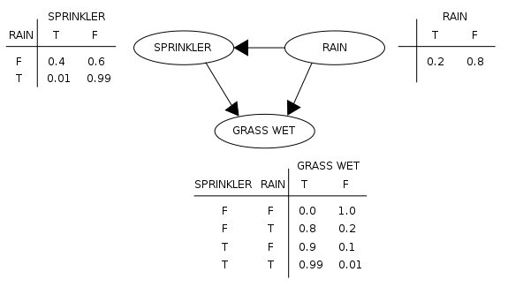
10 Miscellaneous Topics (3)
https://www.tensorflow.org/tutorials/
What are Bayesian Networks?

Slide 8
10 Miscellaneous Topics (3)
https://www.tensorflow.org/tutorials/
What are Mixture Models?
probabilistic models with subpopulations
they contain multiple distributions
they used for making statistical inferences about the subpopulations
based on observations on the pooled population
Use cases for Mixture Models:
Financial models
House prices
Topics in a document
Handwriting recognition

Slide 9
10 Miscellaneous Topics (3)
https://www.tensorflow.org/tutorials/
GMMs (Gaussian Mixture Models)
Multiple overlapping Gaussian distributions
a probabilistic model
data points are from a mixture of Gaussian distributions
the distributions have unknown parameters
=> mixture models generalize k-means clustering to incorporate information about the covariance structure of the data as well as the centers of the latent Gaussians
https://en.wikipedia.org/wiki/Mixture_model

Slide 10
10 Miscellaneous Topics (3)
https://www.tensorflow.org/tutorials/
Bernoulli Distribution
a discrete probability distribution of a random variable
takes the value 1 with probability p
takes the value 0 with probability q=1-p
can be used to represent a coin toss
1 and 0 represent "head" and "tail" (or vice versa)
=> a special case of the binomial distribution where a single experiment/trial is conducted (n=1)
=> a special case of the two-point distribution, for which the outcome need not be a bit, i.e., the two possible outcomes need not be 0 and 1

Slide 11
10 Miscellaneous Topics (3)
https://www.tensorflow.org/tutorials/
Dirichlet Distribution
a family of continuous multivariate probability distributions
parameterized by a vector of positive reals
a multivariate generalization of the beta distribution.
commonly used as prior distributions in Bayesian statistics
the Dirichlet distribution is the conjugate prior of the categorical distribution and multinomial distribution
the infinite-dimensional generalization of the Dirichlet distribution is the Dirichlet process
https://www.quora.com/What-is-an-intuitive-explanation-of-the-Dirichlet-distribution
https://en.wikipedia.org/wiki/Dirichlet_distribution

Slide 12
10 Miscellaneous Topics (3)
https://www.tensorflow.org/tutorials/
Markov Chains / Models
Markov Chain:
1) a model describing a sequence of possible events
2) the probability of each event depends only on the state in the previous event
Markov Models:
the state is directly visible to the observer
the state transition probabilities are the only parameters

Slide 13
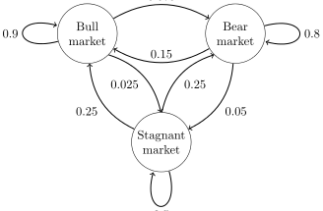
10 Miscellaneous Topics (3)
https://www.tensorflow.org/tutorials/
Markov Chain (example)

Slide 14
10 Miscellaneous Topics (3)
https://www.tensorflow.org/tutorials/
Hidden Markov Models (HMMs)
a statistical Markov model
the system being modeled is a Markov process
with unobserved (i.e. hidden) states
can be represented as a dynamic Bayesian network
the state is not directly visible
the output is visible
a generalization of a mixture model
hidden variables are related through a Markov process
Resemble NDFAs (non-deterministic finite automatas):
The outgoing edges have probabilities
For any state: the sum of probabilities of the outgoing edges of that state (node) equals one

Slide 15
10 Miscellaneous Topics (3)
https://www.tensorflow.org/tutorials/
HMM Use Cases
Cryptanalysis
Speech recognition (including Siri)
Speech synthesis
Machine translation
Gene prediction
Handwriting recognition
Alignment of bio-sequences
Time series analysis
Protein folding
Metamorphic virus detection

Slide 16
10 Miscellaneous Topics (3)
https://www.tensorflow.org/tutorials/
GANs: Generative Adversarial Networks
Make imperceptible changes to images
Can consistently defeat all NNs
Can have extremely high error rate
Some images create optical illusions
https://www.quora.com/What-are-the-pros-and-cons-of-using-generative-adversarial-networks-a-type-of-neural-network

Slide 17
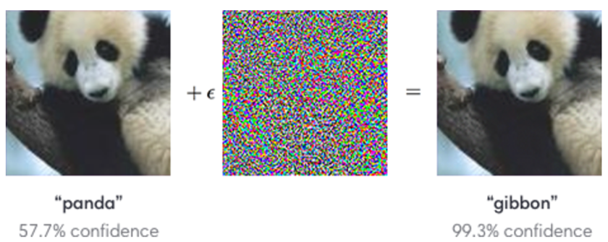
10 Miscellaneous Topics (3)
https://www.tensorflow.org/tutorials/
What are GANs?

Slide 18
10 Miscellaneous Topics (3)
https://www.tensorflow.org/tutorials/
Deep Learning Playground
TF playground home page:
http://playground.tensorflow.org
Demo #1:
https://github.com/tadashi-aikawa/typescript-playground
=> preceding converts playground to TypeScript

Slide 19
10 Miscellaneous Topics (3)
https://www.tensorflow.org/tutorials/
Unsupervised Learning
the dataset is unlabeled
=> note: there is no loss function
The goal: reconstruct the input data using a representation or embedding
=> Clustering algorithms: unsupervised learning

Slide 20
10 Miscellaneous Topics (3)
https://www.tensorflow.org/tutorials/
Reinforcement Learning (RL)
RL involves the concepts of:
Agents
Environments
States
actions and rewards
Agent: something that takes actions
Action (A): A is the set of possible moves an agent can make
Discount factor: it’s multiplied with future rewards as discovered by the agent in order to dampen their effect on the agent’s choice of action.
Environment: The world through which the agent moves

Slide 21
10 Miscellaneous Topics (3)
https://www.tensorflow.org/tutorials/
Reinforcement Learning (RL)
State (S): A state is a concrete and immediate situation in which the agent finds itself
Reward (R): A reward is the feedback by which we measure the success or failure of an agent’s actions.
Policy (π): The policy is the strategy that the agent employs to determine the next action based on the current state. It maps states to actions, the actions that promise the highest reward.
Value (V): The expected long-term return with discount, as opposed to the short-term reward R
Q-value or action-value (Q): Q-value is similar to Value, except that it takes an extra parameter, the current action a
Qπ(s, a) refers to the long-term return of the current state s, taking action a under policy π.
Q maps state-action pairs to rewards. Note the difference between Q and policy.
Trajectory: A sequence of states and actions that influence those states. From the Latin "to throw across."

Slide 22
10 Miscellaneous Topics (3)
https://www.tensorflow.org/tutorials/
Bayesian Inference
a method of statistical inference
uses Bayes' theorem to update the probability for a hypothesis as more information becomes available
an important technique in statistics
important in dynamic analysis of sequential data
closely related to subjective probability
often called "Bayesian probability”
https://en.wikipedia.org/wiki/Bayesian_inference

Slide 23
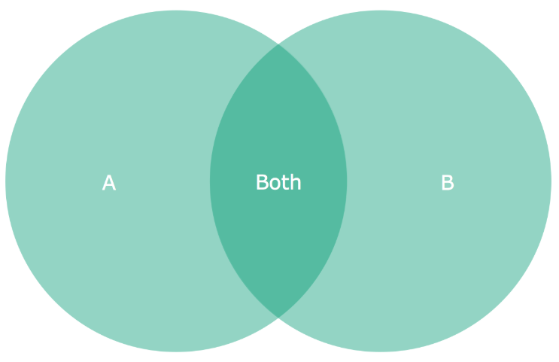
10 Miscellaneous Topics (3)
https://www.tensorflow.org/tutorials/
Bayes Theorem

Slide 24
10 Miscellaneous Topics (3)
https://www.tensorflow.org/tutorials/
Bayes Theorem
P(A) = probability of being in set A
P(B) = probability of being in set B
P(Both) = probability of being in A intersect B
P(A|B) = probability of being in A (given you’re in B)
P(B|A) = probability of being in B (given you’re in A)

Slide 25
10 Miscellaneous Topics (3)
https://www.tensorflow.org/tutorials/
Bayes Theorem
P(A|B) = P(Both)/P(B)
Hence: P(B)*P(A|B) = P(Both) (#1)
P(B|A) = P(Both)/P(A)
Hence: P(A)*P(A|B) = P(Both) (#2)
Combine #1 and #2 to get:
P(B)*P(A|B) = P(A)*P(B|A) (#3)
Divide both sides of (#3) by P(B):
P(A|B) = P(A)*P(A|B)/P(B) (#4)

Slide 26
10 Miscellaneous Topics (3)
https://www.tensorflow.org/tutorials/
NLP (Natural Language Processing)
Several techniques in NLP:
Bag of Words (BoW)
TF-IDF
Word2vec

Slide 27
10 Miscellaneous Topics (3)
https://www.tensorflow.org/tutorials/
Bag of Words (BoW)
an algorithm that counts how many times a word appears in a document
Those word counts allow us to compare documents and gauge their similarities
Used in applications like search, document classification and topic modeling
BoW is a method for preparing text for input in a deep-learning net

Slide 28
10 Miscellaneous Topics (3)
https://www.tensorflow.org/tutorials/
What is TF-IDF?
Term Frequency-Inverse Document Frequency
a way to judge the topic of an article by the words it contains
words are given weights
TF-IDF measures relevance (not frequency)
Word counts are replaced with TF-IDF scores across the entire dataset
TF (term frequency): measures the number of times that words appear in a given document
Document frequency: how often a word occurs in an entire set of documents, i.e., all of Wikipedia or every web page
IDF (inverse-document frequency): the more documents a word appears in, the less valuable that word becomes
the TF-IDF relevance of each word is a normalized data format that also adds up to 1
=> words such as "and" or "the" are ignored

Slide 29
10 Miscellaneous Topics (3)
https://www.tensorflow.org/tutorials/
What is TF-IDF?
We actually use the log of the IDF, since word frequencies are distributed exponentially
It’s a better weighting of a words overall popularity
TF-IDF assumes a document is just a "bag of words”
Parsing documents into a bag of words can be most of the work
Representing words as a hash value (number) for efficiency
What about synonyms? Various tenses? Abbreviations? Capitalizations? Misspellings?
A simple search algorithm:
1) Compute TF-IDF for every word in a corpus
2) For a given search word, sort the documents by their TF-IDF score for that word
3) Display the results

Slide 30
10 Miscellaneous Topics (3)
https://www.tensorflow.org/tutorials/
What is Word2vec?
a two-layer neural net that processes text
Word2vec is not a deep neural network
input is a text corpus
output is a set of vectors: feature vectors for words in that corpus
Word2vec use cases:
A) genes, code, likes, playlists, social media graphs
B) other verbal or symbolic series in which patterns may be discerned
Word2vec groups the vectors of similar words together in a vector space
it detects similarities mathematically
creates vectors that are distributed numerical representations of word features
features such as the context of individual words
Word2vec does not require human intervention

Slide 31
10 Miscellaneous Topics (3)
https://www.tensorflow.org/tutorials/
Matrices, Eigenvectors, and Eigenvalues
Given an nxn matrix A of real numbers
Given a 1xn vector x of real numbers
=> Suppose that A*x = a*x for some number a
then x is called an eigenvector
a is called an eigenvalue
NB: eigenvectors are not necessarily orthogonal

Slide 32
10 Miscellaneous Topics (3)
https://www.tensorflow.org/tutorials/
Eigenvectors and Eigenvalues
Given an nxn matrix A of real numbers
Given a set {v1,v2,…,vn} of eigenvectors of A
Given a set {a1,a2,…,an} of eigenvalues of A
Let Q = matrix of the eigenvectors of A
Let V = diagonal matrix of the eigenvalues of A
Let Qinv = the inverse of matrix Q
Then A can be expressed as this product:
A = Q * V * Qinv

Slide 33
10 Miscellaneous Topics (3)
https://www.tensorflow.org/tutorials/
Extremely Large Datasets
Neither of these solutions works for large datasets:
A) Processing a large dataset
split it into N partitions
train N separate models
combine the models at the end
=> each partition learns nothing from the data that it didn't train
B) splitting the model:
split a model into components
train components with all the data
=> how do you split the model?

Slide 34
10 Miscellaneous Topics (3)
https://www.tensorflow.org/tutorials/
Distributed TensorFlow
DistBelief handles very large datasets
the default distributed training with TensorFlow
solution involves data parallelism
every node trains on a subset of the data
they maintain state consistency:
they send and receive parameter updates
handled via a centralized parameter server
The underlying algorithm for DistBelief:
asynchronous stochastic gradient descent
individual nodes can send updates at different frequencies without waiting on all the other nodes
Partially solves the “stale gradient” problem
More details in this article:
https://www.quora.com/Is-distributed-deep-learning-mostly-solved-by-DL-frameworks-like-TensorFlow

Slide 35
10 Miscellaneous Topics (3)
https://www.tensorflow.org/tutorials/
Gram Schmidt Orthogonalization Theorem
Given a set of vectors V in vector space R(n)
Then there is a set of orthogonal unit vectors V2 in R(n) that spans the same subspace as V
Example:
V = {(1,1,0), (2,1,0), (-1,4,0)}
V2 = {(1,0,0), (0,1,0)}

Slide 36
10 Miscellaneous Topics (3)
https://www.tensorflow.org/tutorials/
TensorFlow tf.layers
Functions in tf.layers are "wrappers" for their counterpart in tf.nn
many MNIST CNN examples use tf.nn.droput: keep_prop as a parameter
In nn.dropout, keep_prob is the probability that each element is kept
In layers.dropout, rate=0.1 would drop out 10% of input units
So keep_prob = 1 - rate, and layers.dropout allows training parameter
tf.nn.dropout scales the weights by 1./keep prob during training phase
tf.layers.dropout scales the weights by 1./(1-rate)
TF code sample with tf.layers:
tf-layer-cnn-mnist.py

Slide 37
10 Miscellaneous Topics (3)
https://www.tensorflow.org/tutorials/
TensorFlow tf.estimator
linear classification outline in tf.estimator:
import tensorflow as tf
# Set up a linear classifier:
classifier = tf.estimator.LinearClassifier()
# Train the model on some example data:
classifier.train(input_fn=train_input_fn, steps=2000)
# Use it to predict:
predictions = classifier.predict(input_fn=predict_input_fn)
TF code sample with tf.estimator:
tf-estimator.py
https://www.tensorflow.org/get_started/custom_estimators

Slide 38
10 Miscellaneous Topics (3)
https://www.tensorflow.org/tutorials/
Some Theorems
Universal Approximation Theorem (UAT)
Hahn-Banach theorem
the Riesz Representation theorem
=> involves some Fourier analysis

Slide 39
10 Miscellaneous Topics (3)
https://www.tensorflow.org/tutorials/
Bipolar Sigmoidal Function
Binary Sigmoidal Function:
values range between 0 and 1
F(x) = sigm(x) = 1/[1+exp(−x)]
Bipolar Sigmoidal Function:
based on the sigmoid function
values range between -1 and 1
F(x) = 2/[1+exp(−x)] − 1
= [1−exp(x)]/[1+exp(x)]

Slide 40
End of Chapter

