Slide 1

1 Introduction to Deep Learning (2)
Peter H. Chen

Slide 2
1 Introduction to Deep Learning (2)
https://www.tensorflow.org/tutorials/
Highlights/Overview
intro to AI/ML/DL/NNs
Hidden layers
Initialization values
Neurons per layer
Activation function
cost function
gradient descent
learning rate
Dropout rate
what are CNNs

Slide 3
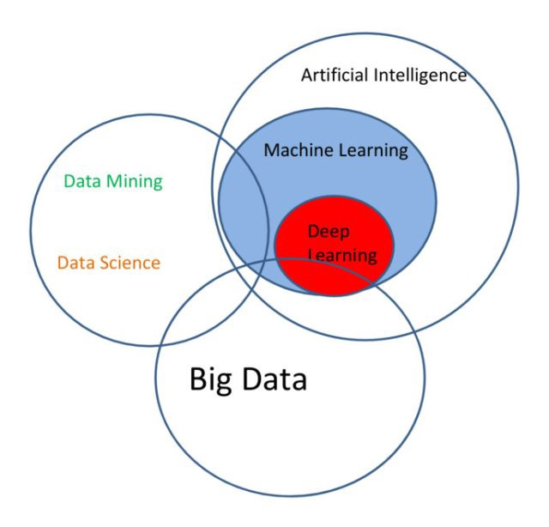
1 Introduction to Deep Learning (2)
https://www.tensorflow.org/tutorials/
The Data/AI Landscape:
Artificial Intelligence, Machine Learning, Deep Learning, Data Mining/Data Science, and Big Data.

Slide 4
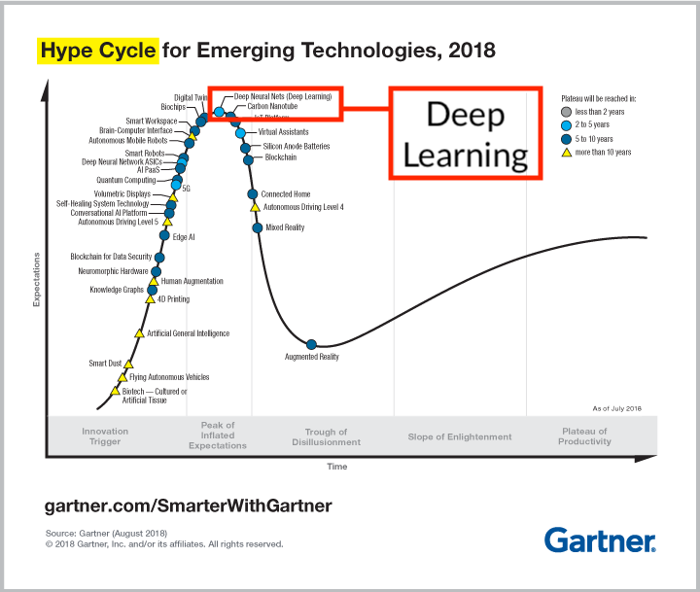
1 Introduction to Deep Learning (2)
https://www.tensorflow.org/tutorials/
Gartner 2017: Deep Learning

Slide 5
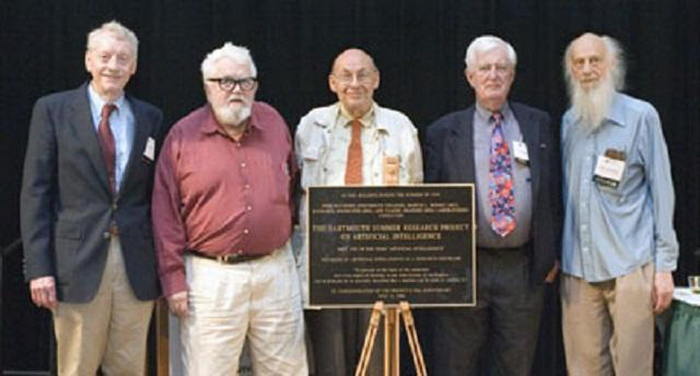
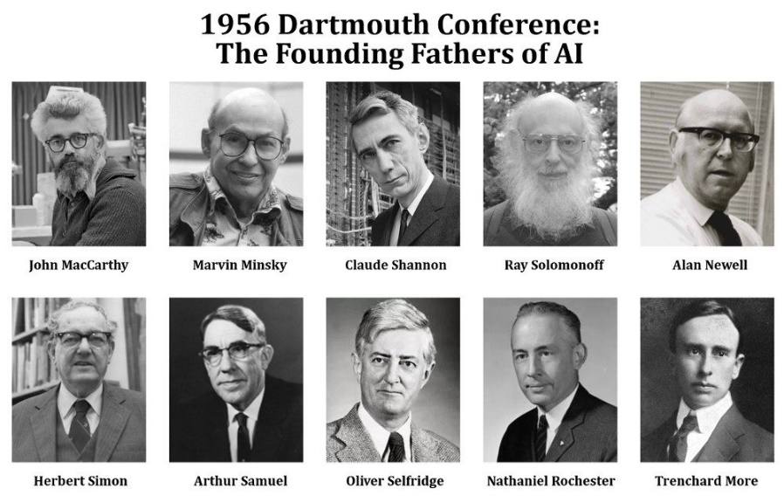
1 Introduction to Deep Learning (2)
https://www.tensorflow.org/tutorials/
The Official Start of AI (1956)
https://www.forbes.com/sites/gilpress/2016/08/28/artificial-intelligence-defined-as-a-new-research-discipline-this-week-in-tech-history/#4bc3e0db6dd1
Five of the attendees of the 1956 Dartmouth Summer Research Project on Artificial Intelligence reunited at the July 2006 AI@50 conference.
From left: Trenchard More, John McCarthy, Marvin Minsky, Oliver Selfridge, and Ray Solomonoff. (Photo by Joseph Mehling)

Slide 6
1 Introduction to Deep Learning (2)
https://www.tensorflow.org/tutorials/
What is Deep Learning?
A subset of machine learning
usually requires significant data
Usually outperforms traditional ML
Advantages of AI
Fewer Errors
Apps (Siri, Cortana, and etc.)
Impartiality (equal treatment of all rivals; fairness)
Digital Assistants
Medical Apps
Utilities (self-Driving cars)
Disadvantages of AI
High Costs (software/hardware): Cost money to build up.
Unemployment: Robot replace job market.
No cause/effect capability: Robots do not consider cause/effect.
lack of empathy: Robot can supercede humans.

Slide 7
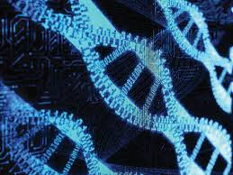


1 Introduction to Deep Learning (2)
https://www.tensorflow.org/tutorials/
Use Cases for Deep Learning
Computer Vision
Speech Recognition
Image Processing
Bioinformatics
Social Network Filtering
Drug Design
CRM (Customer relationship Management)
Recommendation systems
Mobile Advertising
Many others

Slide 8
1 Introduction to Deep Learning (2)
https://www.tensorflow.org/tutorials/
What is a Deep Neural Network?
input layer, multiple hidden layers, and output layer
nonlinear processing via activation functions
perform transformation and feature extraction
gradient descent algorithm with back propagation
each layer receives the output from previous layer
results are comparable/superior to human experts

Slide 9
1 Introduction to Deep Learning (2)
https://www.tensorflow.org/tutorials/
Types of Deep Learning:
Supervised learning (you know the answer)
unsupervised learning (you don’t know the answer)
Semi-supervised learning (mixed dataset)
Reinforcement learning (such as, games)
Types of algorithms:
Classifiers (detect spam, fraud, and etc.)
Regression (predict stock price, housing price, and etc.)
Clustering (unsupervised classifiers)
Deep Learning Architectures
Unsupervised Pre-trained Networks (UPNs)
Convolutional Neural Networks (CNNs)
Recurrent Neural Networks (LSTMs, Long-Short Term Memory)
The most popular architectures:
CNNs (and capsule networks) for images
LSTMs for NLP and audio

Slide 10
1 Introduction to Deep Learning (2)
https://www.tensorflow.org/tutorials/
RNN (Recurrent Neural Networks)
Robot control
Time series predictions
Music composition
Grammar learning
Handwriting recognition
Human action recognition

Slide 11
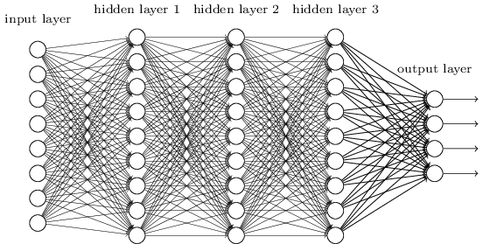
1 Introduction to Deep Learning (2)
https://www.tensorflow.org/tutorials/
Neural Network: 3 Hidden Layers

Slide 12
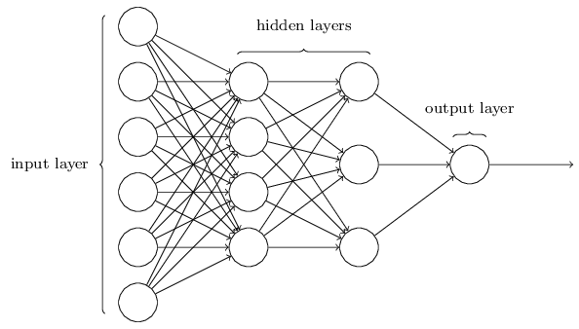
1 Introduction to Deep Learning (2)
https://www.tensorflow.org/tutorials/
Neural Network: 2 Hidden Layers (Regression)

Slide 13
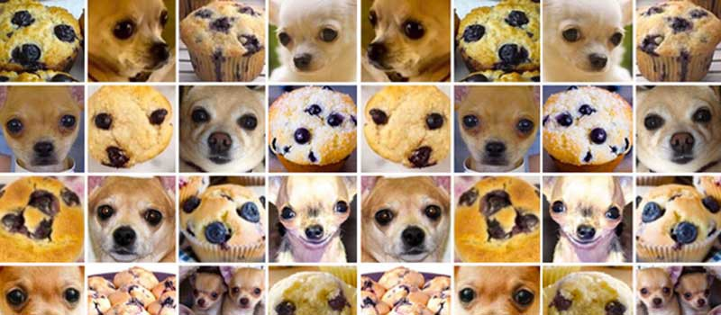
1 Introduction to Deep Learning (2)
https://www.tensorflow.org/tutorials/
Classification and Deep Learning

Slide 14
1 Introduction to Deep Learning (2)
https://www.tensorflow.org/tutorials/
A Basic Model in Machine Learning
Let’s perform the following steps:
Start with a simple model (2 variables)
Generalize that model (n variables)
See how it might apply to a NN
Linear Regression
One of the simplest models in ML
Fits a line (y = m*x + b) to data in 2D
Finds best line by minimizing MSE (Mean Squared Error):
m = average of x values (“mean”)
b also has a closed form solution

Slide 15
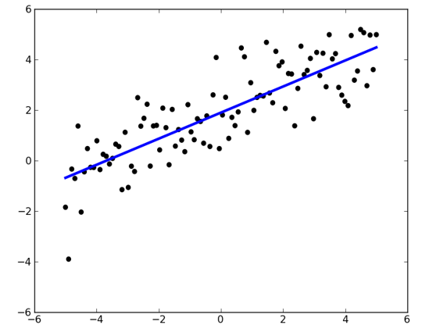
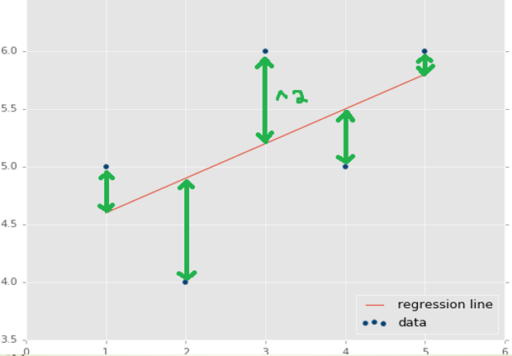
1 Introduction to Deep Learning (2)
https://www.tensorflow.org/tutorials/
Linear Regression in 2D: example

Slide 16
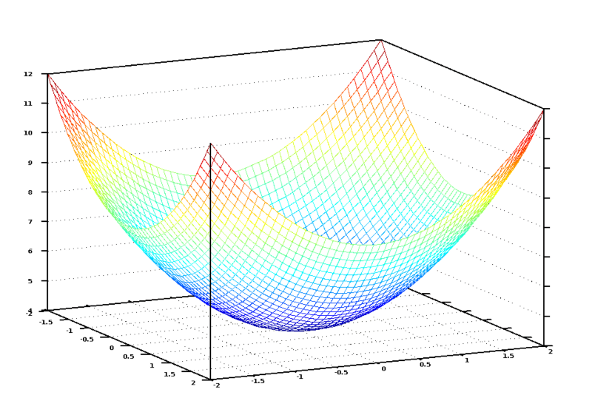
1 Introduction to Deep Learning (2)
https://www.tensorflow.org/tutorials/
Sample Cost Function #1 (MSE)

Slide 17
1 Introduction to Deep Learning (2)
https://www.tensorflow.org/tutorials/
Linear Regression: example #1
One feature (independent variable):
X = number of square feet
Predicted value (dependent variable):
Y = cost of a house
A very “coarse grained” model
We can devise a much better model
Linear Regression: example #2
Multiple features:
X1 = # of square feet
X2 = # of bedrooms
X3 = # of bathrooms (dependency?)
X4 = age of house
X5 = cost of nearby houses
X6 = corner lot (or not): Boolean
a much better model (6 features)

Slide 18
1 Introduction to Deep Learning (2)
https://www.tensorflow.org/tutorials/
Linear Multivariate Analysis
General form of multivariate equation:
Y = w1*x1 + w2*x2 + . . . + wn*xn + b
w1, w2, . . . , wn are numeric values
x1, x2, . . . , xn are variables (features)
Properties of variables:
Can be independent (Naïve Bayes)
weak/strong dependencies can exist

Slide 19
1 Introduction to Deep Learning (2)
https://www.tensorflow.org/tutorials/
Neural Network with 3 Hidden Layers

Slide 20
1 Introduction to Deep Learning (2)
https://www.tensorflow.org/tutorials/
Neural Networks: Matrices
From inputs to first hidden layer:
Y1 = W1*X + B1 (where X, Y1, and B1 are vectors; W1: matrix)
From first to second hidden layers:
Y2 = W2*X + B2 (where X, Y2, and B2 are vectors; W2: matrix)
From second to third hidden layers:
Y3 = W3*X + B3 (where X, Y3, B3 are vectors; W3: matrix)
➔ Apply an “activation function” to y values
Neural Networks (general)
Multiple hidden layers:
Layer composition is your decision
Activation functions: sigmoid, tanh, RELU: https://en.wikipedia.org/wiki/Activation_function
Back propagation (1980s): https://en.wikipedia.org/wiki/Backpropagation
=> Initial weights: small random numbers

Slide 21
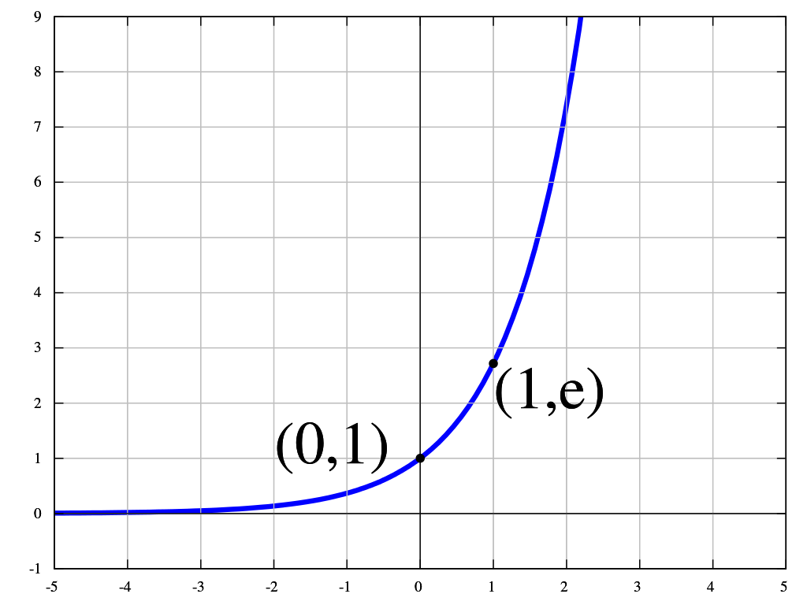
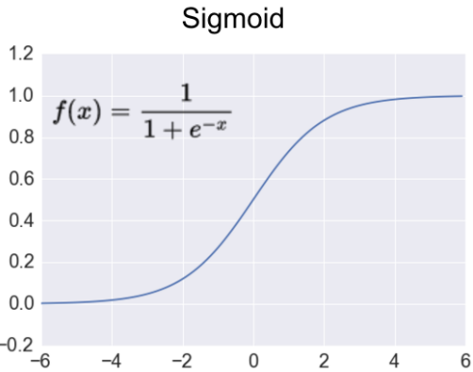
1 Introduction to Deep Learning (2)
https://www.tensorflow.org/tutorials/
Euler’s Function (e = 2.71828…)
The sigmoid Activation Function

Slide 22
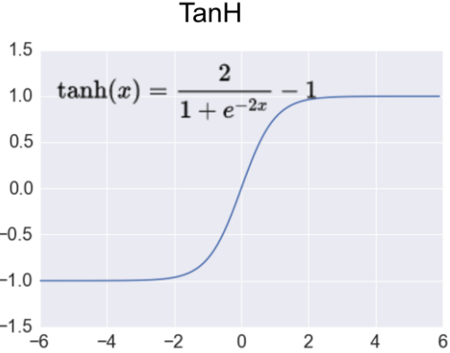
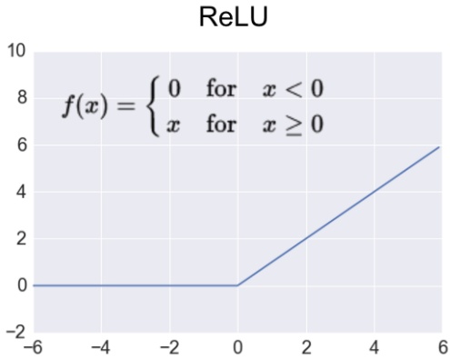
1 Introduction to Deep Learning (2)
https://www.tensorflow.org/tutorials/
The tanh Activation Function
The ReLU (Rectified Linear Unit) Activation Function

Slide 23

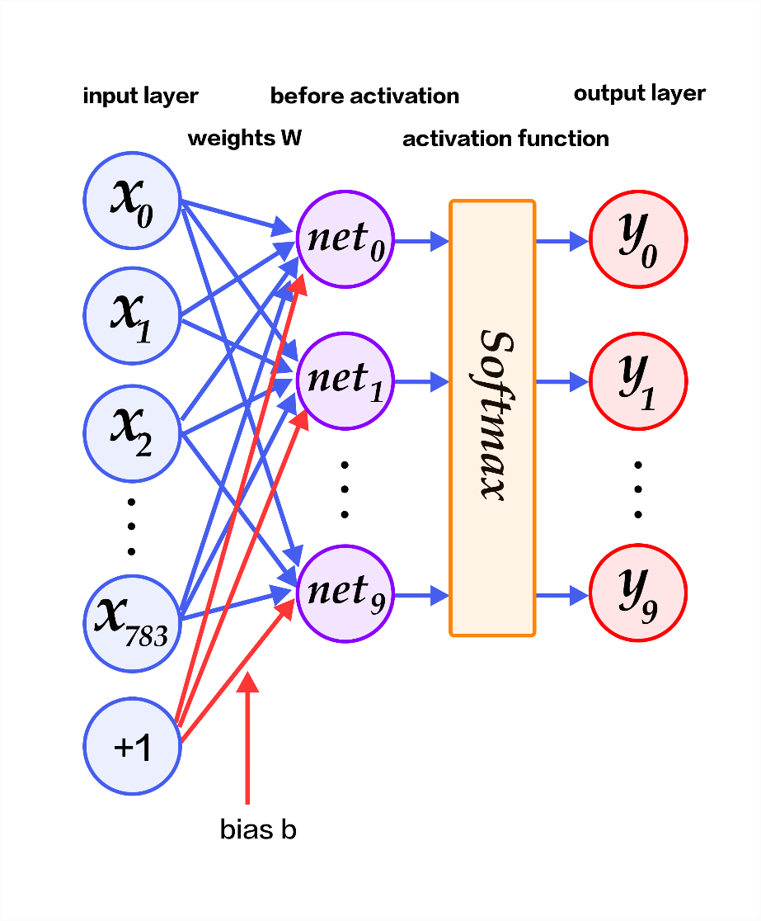
1 Introduction to Deep Learning (2)
https://www.tensorflow.org/tutorials/
The softmax Activation Function

Slide 24
1 Introduction to Deep Learning (2)
https://www.tensorflow.org/tutorials/
Activation Functions in Python
import numpy as np
...
# Python sigmoid example:
z = 1/(1 + np.exp(-np.dot(W, x)))
. . .
# Python tanh example:
z = np.tanh(np.dot(W,x));
. . .
# Python ReLU example:
z = np.maximum(0, np.dot(W, x))
What’s the “Best” Activation Function?
Initially: sigmoid was popular
Then: tanh became popular
Now: RELU is preferred (better results)
Softmax: for FC (fully connected) layers
Note: sigmoid and tanh are used in LSTMs (Long Short-Term Memory)

Slide 25
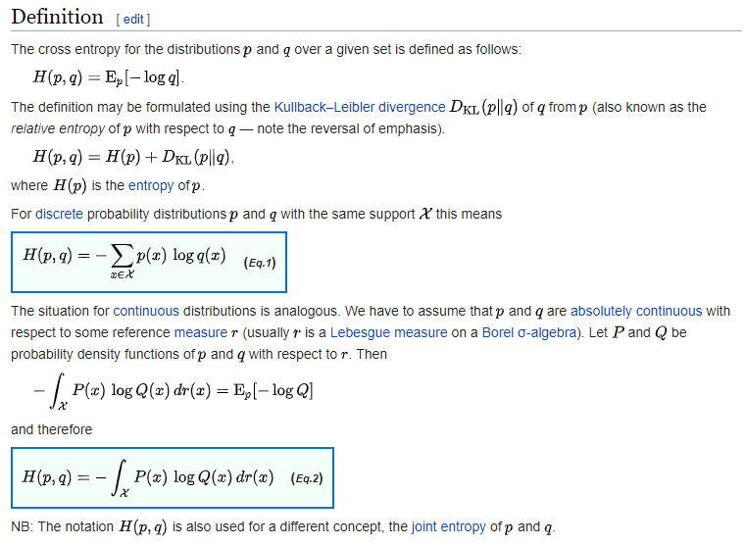
1 Introduction to Deep Learning (2)
https://www.tensorflow.org/tutorials/
Types of Cost/Error Functions
MSE (Mean-Squared Error)
Cross-entropy
Various others

Slide 26
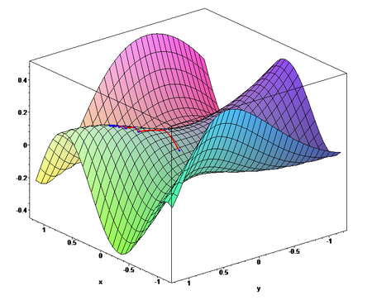
1 Introduction to Deep Learning (2)
https://www.tensorflow.org/tutorials/
Sample Cost Function #1 (MSE)
Sample Cost Function #2)

Slide 27
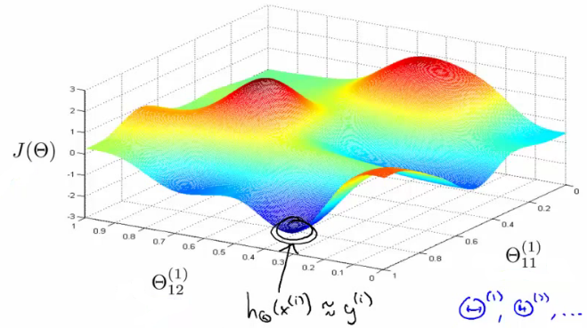
1 Introduction to Deep Learning (2)
https://www.tensorflow.org/tutorials/
Sample Cost Function #3

Slide 28
1 Introduction to Deep Learning (2)
https://www.tensorflow.org/tutorials/
GD versus SGD
SGD (Stochastic Gradient Descent): involves one row of the dataset
Mini batch: involves a SUBSET of the dataset
GD (Gradient Descent): involves the ENTIRE dataset
More details: http://cs229.stanford.edu/notes/cs229-notes1.pdf
What is Imbalanced Data?
Scenario: train a NN to predict whether or not someone in a video is holding a lethal weapon
Suppose your training data consists of:
only 50 videos of people holding weapons
1000 videos of people without weapons
=> If you train your network with this data, your model will be highly biased towards predicting that no one ever has a weapon
Note:
For example, suppose you have two classes — A and B.
Class A is 90% of your data-set and class B is the other 10%, but you are most interested in identifying instances of class B.
You can reach an accuracy of 90% by simply predicting class A every time, but this provides a useless classifier for your intended use case.

Slide 29
1 Introduction to Deep Learning (2)
https://www.tensorflow.org/tutorials/
Handling Imbalanced Data
Use class weights in the loss function, so the under-represented classes receive higher weights in the loss function, and any miss-classifications for that particular class will lead to a very high error in the loss function.
Over-sample: Repeating some of the training examples that contain the under-represented class helps even-out the distribution. This works best if the available data is small.
Under-sample: You can simply skip some training examples that contain the over-represented class. This works best if the available data is very large.
Data augmentation for the minority class: synthetically create more training examples for the under-represented class.
EX: with the example of detecting lethal weapons, you can change some of the colors and lighting of the videos that belong to the class having lethal weapons.

Slide 30
1 Introduction to Deep Learning (2)
https://www.tensorflow.org/tutorials/
Data Augmentation for Images
Rotate/flip the images horizontally and vertically
Alter the brightness and colors of the images
Randomly blur the images
Randomly crop patches from the images
=> perform any alteration that would change the look of the image, but not the overall content
you can make a picture of a dog blue, but the dog is still recognizable

Slide 31
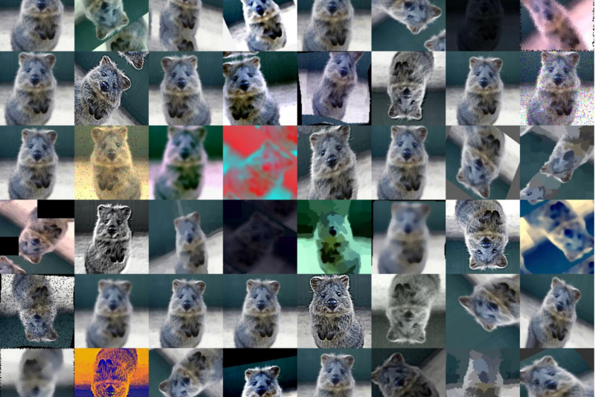
1 Introduction to Deep Learning (2)
https://www.tensorflow.org/tutorials/
Data Augmentation for Images

Slide 32
1 Introduction to Deep Learning (2)
https://www.tensorflow.org/tutorials/
What is Transfer Learning?
start with a network that was previously trained on many images (ex: ResNet pre-trained on ImageNet)
fine-tune the ResNet model by only re-training the last few layers
thus we are taking the info (image features) that ResNet learned and . . .
fine-tuning and applying it to a different task
possible because the feature information of images across domains is often quite similar
but the analysis of these features can be different depending on the application

Slide 33
1 Introduction to Deep Learning (2)
https://www.tensorflow.org/tutorials/
Hyper Parameters (examples)
# of hidden layers in a neural network
the learning rate (in many models)
the dropout rate
# of leaves or depth of a tree
# of latent factors in a matrix factorization
# of clusters in a k-means clustering
Note:
In machine learning, a hyper parameter is a parameter whose value is set before the learning process begins.
By contrast, the values of other parameters are derived via training.
Different model training algorithms require different hyperparameters, some simple algorithms (such as ordinary least squares regression) require none.
Given these hyper parameters, the training algorithm learns the parameters from the data.

Slide 34
1 Introduction to Deep Learning (2)
https://www.tensorflow.org/tutorials/
Hyper Parameter: dropout rate
"dropout" refers to dropping out units (both hidden and visible) in a neural network
a regularization technique for reducing overfitting in neural networks
prevents complex co-adaptations on training data
a very efficient way of performing model averaging with neural networks
How Many Layers in a DNN (Dynamic Neural Network)?
Algorithm #1 (from Geoffrey Hinton):
add layers until you start overfitting your training set
now add dropout or some another regularization method
Algorithm #2 (Yoshua Bengio):
"Add layers until the test error does not improve anymore.”

Slide 35
1 Introduction to Deep Learning (2)
https://www.tensorflow.org/tutorials/
How Many Hidden Nodes in a DNN?
Based on a relationship between:
# of input and # of output nodes
Amount of training data available
Complexity of the cost function
The training algorithm
TF playground home page: http://playground.tensorflow.org
CNNs versus RNNs
CNNs (Convolutional NNs): Good for image processing
CNNs were invented in 1980s, CNNs breakthrough in 2000s by GPUs.
CNNs processed 10-20% of all checks
=> Approximately 60% of all NNs
RNNs (Recurrent NNs):
Good for NLP (Natural Language Processing) and audio

Slide 36
1 Introduction to Deep Learning (2)
https://www.tensorflow.org/tutorials/
What are CNNs?
“Core” layers:
Convolution (3x3, 5x5, and 1x1 filters)
ReLU (replace negative values with zero)
Max Pooling (or capsule networks)
Other layers:
Softmax activation (with output layer)
translation invariance
Fewer connections

Slide 37
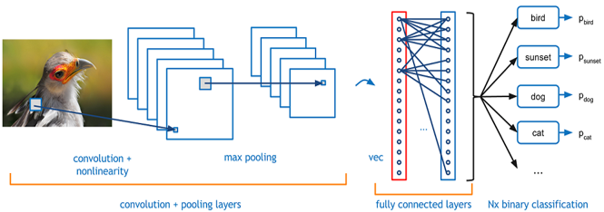
1 Introduction to Deep Learning (2)
https://www.tensorflow.org/tutorials/
CNNs: Convolution, ReLU, and Max Pooling

Slide 38
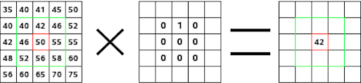
1 Introduction to Deep Learning (2)
https://www.tensorflow.org/tutorials/
CNNs: Convolution Calculations
https://docs.gimp.org/en/plug-in-convmatrix.html

Slide 39
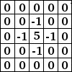
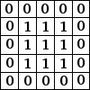
1 Introduction to Deep Learning (2)
https://www.tensorflow.org/tutorials/
CNNs: Convolution Matrices (examples)
Sharpen:
Blur:

Slide 40
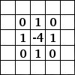
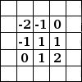
1 Introduction to Deep Learning (2)
https://www.tensorflow.org/tutorials/
CNNs: Convolution Matrices (examples)
Edge detect:
Emboss (mold):

Slide 41
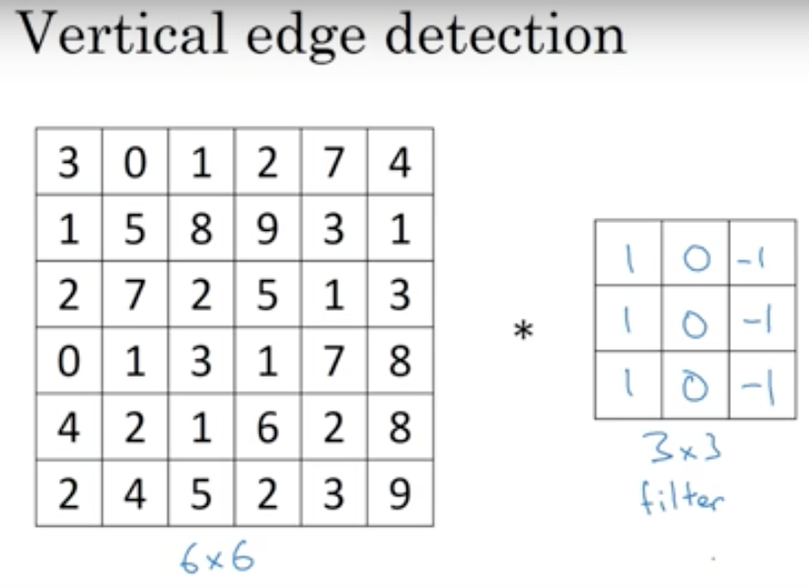
1 Introduction to Deep Learning (2)
https://www.tensorflow.org/tutorials/
CNNs: Convolution Matrices (examples)

Slide 42
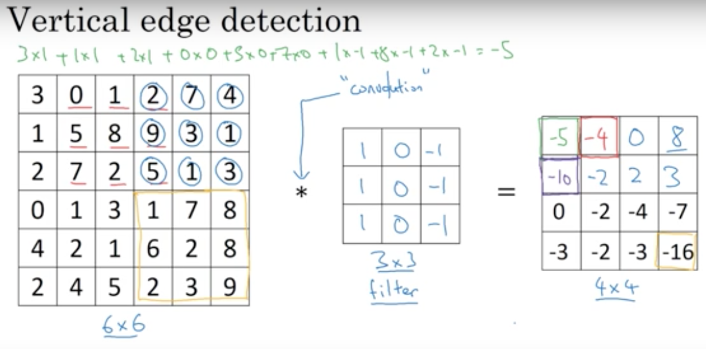
1 Introduction to Deep Learning (2)
https://www.tensorflow.org/tutorials/
CNNs: Convolution Matrices (examples)

Slide 43
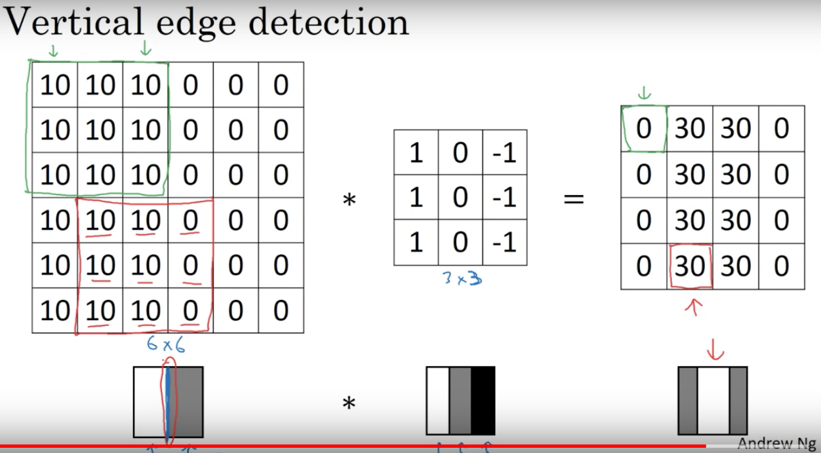
1 Introduction to Deep Learning (2)
https://www.tensorflow.org/tutorials/
CNNs: Convolution Matrices (examples)

Slide 44
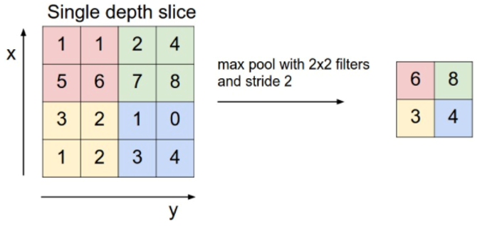
1 Introduction to Deep Learning (2)
https://www.tensorflow.org/tutorials/
CNNs: Max Pooling Example

Slide 45
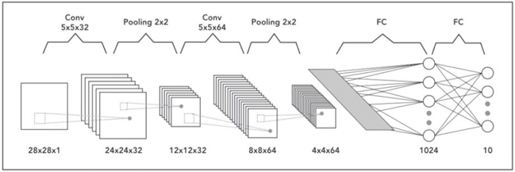
1 Introduction to Deep Learning (2)
https://www.tensorflow.org/tutorials/
CNN Architecture

Slide 46
1 Introduction to Deep Learning (2)
https://www.tensorflow.org/tutorials/
Deep Learning and Art/”Stuff”
“Convolutional Blending” images:
=> 19-layer Convolutional Neural Network
www.deepart.io
Bots created their own language:
https://www.recode.net/2017/3/23/14962182/ai-learning-language-open-ai-research
https://www.fastcodesign.com/90124942/this-google-engineer-taught-an-algorithm-to-make-train-footage-and-its-hypnotic

Slide 47
1 Introduction to Deep Learning (2)
https://www.tensorflow.org/tutorials/
Summary
Properties of CNNs:
Activation functions
Cost functions
Back propagation
Convolution, ReLU, Max Pooling
Softmax and back propagation
Filters and feature maps

Slide 48
End of Chapter

