Slide 1

1 Introduction to Deep Learning (3)
Peter H. Chen

Slide 2
1 Introduction to Deep Learning (3)
https://www.tensorflow.org/tutorials/
List of Topics:
What is TensorFlow?
What is a Tensor?
TF (TensorFlow) Graphs
TF Constants
TF Placeholders
TF Variables
TF Arithmetic
TF Arrays
TensorFlow Operations
TensorFlow Eager Execution
Saving Graphs for TensorFlow

Slide 3
1 Introduction to Deep Learning (3)
https://www.tensorflow.org/tutorials/
What is TensorFlow? (1)
An open source framework for ML (Machine Learning) and DL (Deep Learning)
Apache license
Created by Google (released 11/2015)
Evolved from Google Brain
TF: https://www.tensorflow.org/
Support for Python, Java, C++
Desktop, server, mobile device (TF Lite)
CPU/GPU/TPU support
Linux and Mac OS X support
Linux VM (Virtual Machine) for Windows
Installation: pip install tensorflow
Involves a “computation” graph
Numerical computation and data flow graph
“everything is a graph”
Visualization via TensorBoard
Can be embedded in Python scripts

Slide 4
1 Introduction to Deep Learning (3)
https://www.tensorflow.org/tutorials/
What is TensorFlow? (2)
TF consists of two components:
a graph protocol buffer
a runtime to execute (distributed) graph
analogous to Python code and the Python interpreter
It's not specific to neural networks
More generally an architecture for executing a graph of numerical operations
TF can optimize the processing of that graph, and distribute its processing across a network
Can also distribute work across GPUs
Can handle massive scale
Runs on about anything
Highly efficient C++ code with easy to use Python APIs

Slide 5
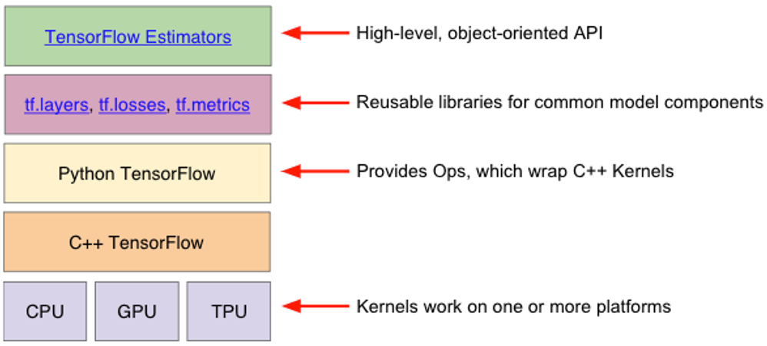
1 Introduction to Deep Learning (3)
https://www.tensorflow.org/tutorials/
What is TensorFlow? (3)

Slide 6
1 Introduction to Deep Learning (3)
https://www.tensorflow.org/tutorials/
What is TensorFlow? (4)
TensorFlow Use Cases (Generic)
Image recognition
Computer vision
Voice/sound recognition
Time series analysis
Language detection
Language translation
Text-based processing
Handwriting Recognition

Slide 7
1 Introduction to Deep Learning (3)
https://www.tensorflow.org/tutorials/
What is TensorFlow? (5)
Graph: graph of operations [DAG (Directed Acyclic Graph)]
Sessions: contains Graph(s)
lazy execution (default)
operations in parallel (default)
Nodes: operators/variables/constants
Edges: tensors
=> graphs are split into subgraphs and executed in parallel (or multiple CPUs)

Slide 8
1 Introduction to Deep Learning (3)
https://www.tensorflow.org/tutorials/
TensorFlow Graph Execution
Execute statements in a tf.Session() object
Invoke the “run” method of that object
“eager” execution is also available
TensorFlow Advantages
Distributed:
Runs on a cluster of machines
Or multiple CPUs/GPUs on same machine
Suite of software:
TensorFlow
TensorFlow Lite (mobile)
TensorBoard (visualization)
TensorFlow Server (hosting)
Tensorflow.js (browser)

Slide 9
1 Introduction to Deep Learning (3)
https://www.tensorflow.org/tutorials/
TensorFlow Uses
Distributed computation
R/D for developing new ML algorithms
A REPL (Read-Eval-Print-Loop) environment
Take models from training to production
Large-scale distributed models
TF graph computed on different machines
Models for mobile
TensorFlow Strengths
Support for Python (easy to use)
Runs well on small systems
Efficient/performant
Strong support from Google

Slide 10
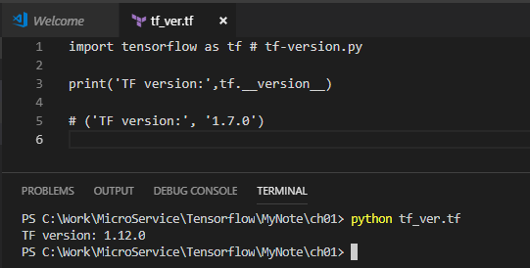
1 Introduction to Deep Learning (3)
https://www.tensorflow.org/tutorials/
TensorFlow Challenges
Distributed support not fully developed
Libraries are under development
New versions are not backward compatible
TensorFlow (Installed) Version
import tensorflow as tf # tf-version.py
print('TF version:',tf.__version__)
# ('TF version:', '1.7.0')

Slide 11
1 Introduction to Deep Learning (3)
https://www.tensorflow.org/tutorials/
Disabling h5py Message
If you see the following message:
“FutureWarning: Conversion of the second argument of issubdtype from `float` to `np.floating` is deprecated. . .”
You can upgrade h5py:
> sudo pip3 install h5py==2.8.0rc1

Slide 12
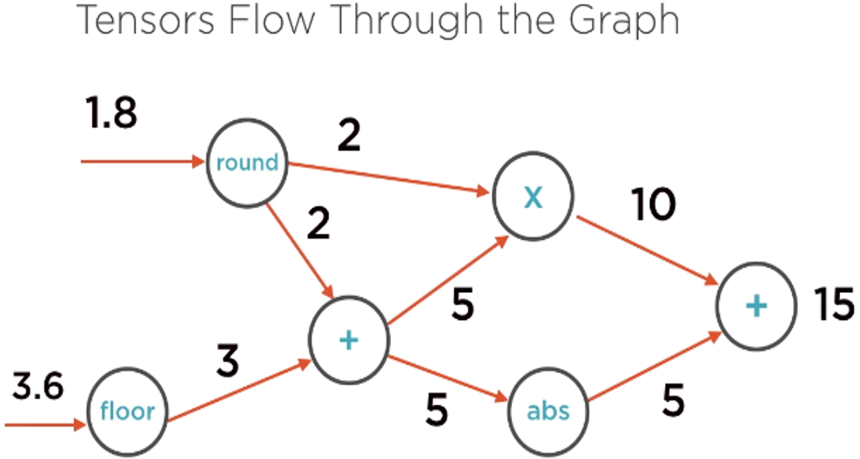
1 Introduction to Deep Learning (3)
https://www.tensorflow.org/tutorials/
TensorFlow Graph (example)

Slide 13
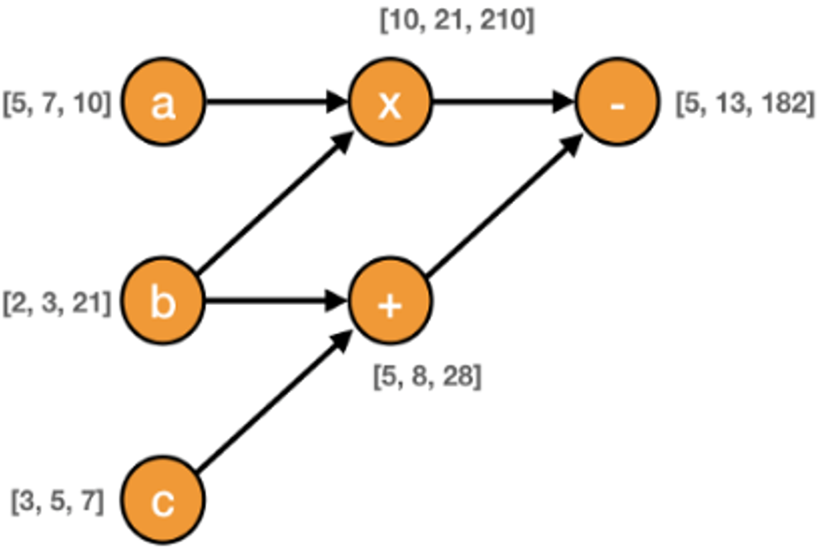
1 Introduction to Deep Learning (3)
https://www.tensorflow.org/tutorials/
TensorFlow Graph (example)

Slide 14
1 Introduction to Deep Learning (3)
https://www.tensorflow.org/tutorials/
What is a Tensor?
TF tensors are n-dimensional arrays
TF tensors are very similar to numpy ndarrays
scalar number: a zeroth-order tensor
vector: a first-order tensor
matrix: a second-order tensor
3-dimensional array: a 3rd order tensor
https://dzone.com/articles/tensorflow-simplified-examples

Slide 15
1 Introduction to Deep Learning (3)
https://www.tensorflow.org/tutorials/
TensorFlow Basics
TF Graphs
TF Constants
TF Variables
TF Placeholders
TensorFlow Constants
Initialized during its definition
Cannot change its value (“immutable”)
Can specify its name (optional)
Examples:
a = tf.constant(“3“, name=“a“)
b = tf.constant([5,5,5], tf.float32)

Slide 16
1 Introduction to Deep Learning (3)
https://www.tensorflow.org/tutorials/
TensorFlow Placeholders (function) (1)
=> initial value is optional
type is required (ex; tf.float32)
Initial or assigned value (can use feed_dict)
Examples:
a = tf.placeholder("float")
b = tf.placeholder(tf.int32, name='b’)
c = tf.placeholder(tf.float32, shape=[3])

Slide 17
1 Introduction to Deep Learning (3)
https://www.tensorflow.org/tutorials/
TensorFlow Placeholders (function) (2)
# Unconstrained shape
w = tf.placeholder(tf.float32)
# Matrix of unconstrained size
x = tf.placeholder(tf.float32, shape=[None, None])
# Matrix with 32 columns
y = tf.placeholder(tf.float32, shape=[None, 32])
# 128x32-element matrix
z = tf.placeholder(tf.float32, shape=[128, 32])

Slide 18
1 Introduction to Deep Learning (3)
https://www.tensorflow.org/tutorials/
TensorFlow Placeholders (function) (3)
# placeholder without shape:
x = tf.placeholder(tf.float32,(3,4))
# placeholder X with unspecified number of rows of shape (128, 128, 3) of type float32:
x = tf.placeholder(tf.float32, shape=[None, 128, 128, 3], name="X")
only allocates memory for future use
can have variable size
for inputting data "external" to graph
placeholder is a function
good for unknown data size

Slide 19
1 Introduction to Deep Learning (3)
https://www.tensorflow.org/tutorials/
TensorFlow Variables (class) (1)
initial value is optional
must be initialized before graph execution
updated during training
constantly recomputed
Ex: they hold values for weights and biases
in-memory buffer (saved/restored from disk)
Examples:
b = tf.Variable(3, name=‘b’)
x = tf.Variable(2, name='x’)
z = tf.Variable(5*x, name="z")
W = tf.Variable(20)
lm = tf.Variable(W*x + b, name=“lm”)

Slide 20
1 Introduction to Deep Learning (3)
https://www.tensorflow.org/tutorials/
TensorFlow Variables (class) (2)
a tensor that's updateable via operations
like a "regular" variable
requires an initial value (Tensor)
holds the learned model parameters
variables can be shared (or non-trainable)
used for storing/maintaining state
Internally stores a persistent tensor
modifications are visible across multiple tf.Sessions
you can read/modify the values of the tensor
multiple workers see the same values for tf.Variables
the best way to represent shared, persistent state manipulated by your program

Slide 21
1 Introduction to Deep Learning (3)
https://www.tensorflow.org/tutorials/
TF Constants vs TF Variables (1)
TF Variables:
values can be modified in the future
use tf.assign() to modify values
can be used any place a Tensor can
maintain their state across multiple calls to run()
variable's value updateable by back propagation
can also be saved, restored, and so forth
tf.global_variables_initializer():
initializes all variables in your code
it works in asynchronous mode
Tf.Variable: trainable variables
tf.placeholder: allocates space for data
More details/discussion here:
https://stackoverflow.com/questions/36693740/whats-the-difference-between-tf-placeholder-and-tf-variable

Slide 22
1 Introduction to Deep Learning (3)
https://www.tensorflow.org/tutorials/
TF Constants vs TF Variables (2)
=> variables represent your model's trainable parameters (ex: weights and biases of a NN)
=> Tensors represents the data fed into your model and the intermediate representations of that data as it passes through your model

Slide 23
1 Introduction to Deep Learning (3)
https://www.tensorflow.org/tutorials/
TensorFlow Graph Execution
Build (define) a TF graph
Initialize a tf.Session()
Initialize variables (if any)
Feed data into the graph
Execute the graph
get output

Slide 24
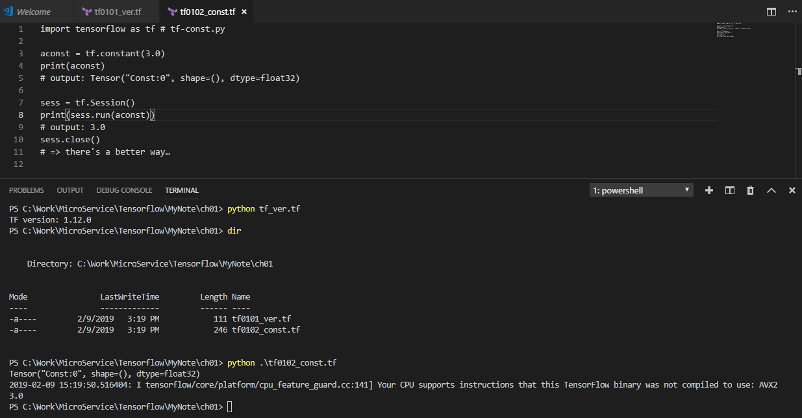
1 Introduction to Deep Learning (3)
https://www.tensorflow.org/tutorials/
TensorFlow Constants (sample #1)
import tensorflow as tf # tf-const.py
aconst = tf.constant(3.0)
print(aconst)
# output: Tensor("Const:0", shape=(), dtype=float32)
sess = tf.Session()
print(sess.run(aconst))
# output: 3.0
sess.close()
# => there's a better way…

Slide 25
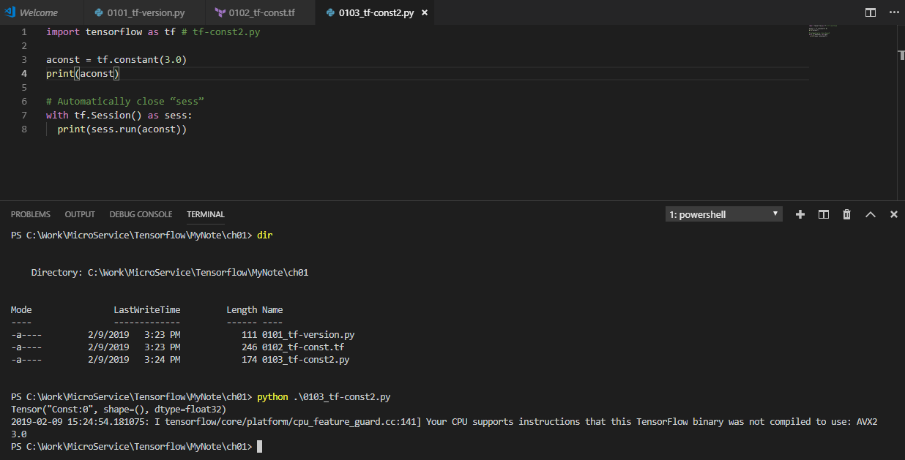
1 Introduction to Deep Learning (3)
https://www.tensorflow.org/tutorials/
TensorFlow Constants (sample #2)
import tensorflow as tf # tf-const2.py
aconst = tf.constant(3.0)
print(aconst)
# Automatically close “sess”
with tf.Session() as sess:
print(sess.run(aconst))

Slide 26
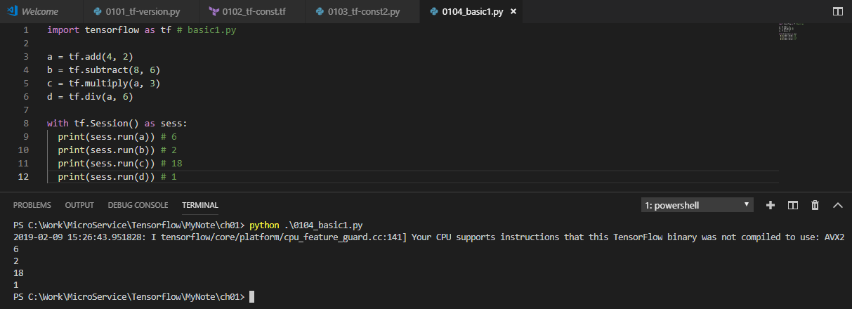
1 Introduction to Deep Learning (3)
https://www.tensorflow.org/tutorials/
TensorFlow Arithmetic
import tensorflow as tf # basic1.py
a = tf.add(4, 2)
b = tf.subtract(8, 6)
c = tf.multiply(a, 3)
d = tf.div(a, 6)
with tf.Session() as sess:
print(sess.run(a)) # 6
print(sess.run(b)) # 2
print(sess.run(c)) # 18
print(sess.run(d)) # 1

Slide 27
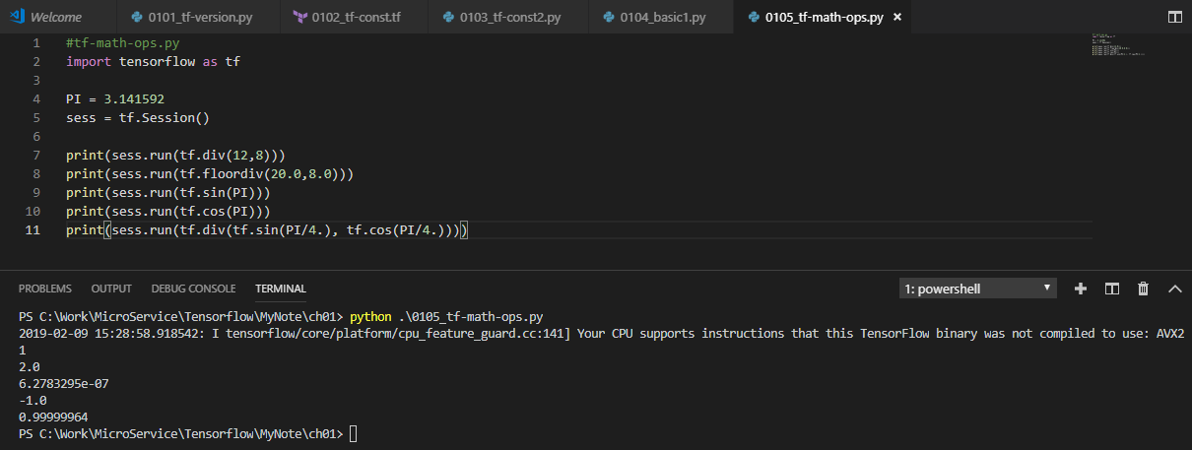
1 Introduction to Deep Learning (3)
https://www.tensorflow.org/tutorials/
TensorFlow Arithmetic Methods (1)
#tf-math-ops.py
import tensorflow as tf
PI = 3.141592
sess = tf.Session()
print(sess.run(tf.div(12,8)))
print(sess.run(tf.floordiv(20.0,8.0)))
print(sess.run(tf.sin(PI)))
print(sess.run(tf.cos(PI)))
print(sess.run(tf.div(tf.sin(PI/4.), tf.cos(PI/4.))))
Output from tf-math-ops.py:
1
2.0
6.27833e-07
-1.0
1.0

Slide 28
1 Introduction to Deep Learning (3)
https://www.tensorflow.org/tutorials/
TensorFlow Arithmetic Methods (2)
#tf-math-ops-pi.py
import tensorflow as tf
import math as m
PI = tf.constant(m.pi)
sess = tf.Session()
print(sess.run(tf.div(12,8)))
print(sess.run(tf.floordiv(20.0,8.0)))
print(sess.run(tf.sin(PI)))
print(sess.run(tf.cos(PI)))
print(sess.run(tf.div(tf.sin(PI/4.), tf.cos(PI/4.))))
Output from tf-math-ops.py:
Output from tf-math-ops-pi.py:
1
2.0
#OLD: 6.27833e-07
-8.742278e-08
-1.0
1.0

Slide 29
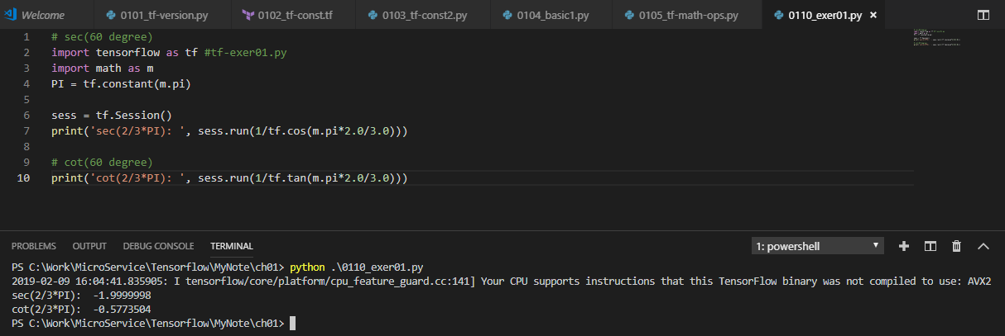
1 Introduction to Deep Learning (3)
https://www.tensorflow.org/tutorials/
Exercise #1: Trig Values in TF
#1) in TensorFlow calculate:
sec(60 degrees)
#2) in TensorFlow calculate:
cot(60 degrees)
HINTS:
A) use an earlier code sample
B) sec() = 1.0/cos()
C) use the TF tan() function

Slide 30
1 Introduction to Deep Learning (3)
https://www.tensorflow.org/tutorials/
TensorFlow Trig Values
# trig-values.py
import tensorflow as tf
import numpy as np
import math as m
PI = tf.constant(m.pi)
a = tf.cos(PI/3.)
b = tf.sin(PI/3.)
c = 1.0/a # sec(60)
d = 1.0/tf.tan(PI/3.) # cot(60)
with tf.Session() as sess:
print('a:', sess.run(a))
print('b:', sess.run(b))
print('c:', sess.run(c))
print('d:', sess.run(d))

Slide 31
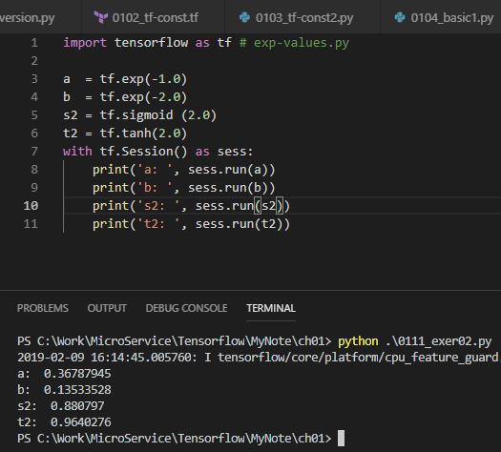
1 Introduction to Deep Learning (3)
https://www.tensorflow.org/tutorials/
Exercise #2: Exponential Values in TF (1)
#1) in TensorFlow calculate:
exp(-1.0)
exp(-2.0)
sigmoid(2.0)
tanh(2.0)
HINTS:
A) “exp” is the exponential function
B) find the definition of sigmoid
C) find the definition of tanh

Slide 32
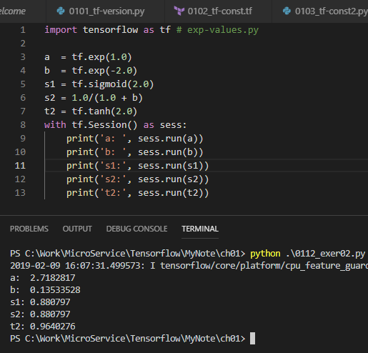
1 Introduction to Deep Learning (3)
https://www.tensorflow.org/tutorials/
Exercise #2: Exponential Values in TF (2)
import tensorflow as tf # exp-values.py
a = tf.exp(1.0)
b = tf.exp(-2.0)
s1 = tf.sigmoid(2.0)
s2 = 1.0/(1.0 + b)
t2 = tf.tanh(2.0)
with tf.Session() as sess:
print(‘a: ‘, sess.run(a))
print(‘b: ‘, sess.run(b))
print(‘s1: ‘, sess.run(s1))
print(‘s2: ‘, sess.run(s2))
print(‘t2: ‘, sess.run(t2))

Slide 33
1 Introduction to Deep Learning (3)
https://www.tensorflow.org/tutorials/
TensorFlow Data Types
tf.float32
tf.float64
tf.int8
tf.int16
tf.int32
tf.int64
tf.uint8
tf.string
tf.bool

Slide 34
1 Introduction to Deep Learning (3)
https://www.tensorflow.org/tutorials/
TensorFlow Arrays
TF supports multi-dimensional tensors
Indexes start with the value 0 (not 1)
TF supports arrays “slicing”
extract sub-ranges of tensors

Slide 35
1 Introduction to Deep Learning (3)
https://www.tensorflow.org/tutorials/
Array Dimensions and Operations
If A = (m,n) array and B = (n,p) array:
A*B is an (m,p) array
A(t) is (n,m) and B(t) is (p,n)
A+B and A-B => both are (m,n) arrays
B*A is undefined unless B=(p,n) & A=(n,m)

Slide 36
1 Introduction to Deep Learning (3)
https://www.tensorflow.org/tutorials/
TensorFlow Arrays (1)
# tensor-elem1.py
import tensorflow as tf
sess = tf.Session()
arr1 = tf.constant([1,2])
print 'arr1: ',sess.run(arr1)
print '[0]: ',sess.run(arr1)[0]
print '[1]: ',sess.run(arr1)[1]
# arr1: [1 2]
# [0]: 1
# [1]: 2

Slide 37
1 Introduction to Deep Learning (3)
https://www.tensorflow.org/tutorials/
TensorFlow Arrays (2)
# tensor-elem2.py
import tensorflow as tf
sess = tf.Session()
arr2 = tf.constant([[1,2],[2,3]])
print 'arr2: ',sess.run(arr2)
print '[1]: ',sess.run(arr2)[1]
print '[1,1]: ',sess.run(arr2)[1,1]
# arr2: [[1 2] [2 3]]
# [1]: [2 3]
# [1,1]: 3

Slide 38
1 Introduction to Deep Learning (3)
https://www.tensorflow.org/tutorials/
TensorFlow Arrays (3)
# tensor-elem3.py
import tensorflow as tf
sess = tf.Session()
arr3 = tf.constant([[[1,2],[2,3]],[[3,4],[5,6]]])
print 'arr3: ',sess.run(arr3)
print '[1]: ',sess.run(arr3)[1]
print '[1,1]: ',sess.run(arr3)[1,1]
print '[1,1,0]:',sess.run(arr3)[1,1,0]
# arr3: [[[1 2] [2 3]] [[3 4] [5 6]]]
# [1]: [[3 4] [5 6]]
# [1,1]: [5 6]
# [1,1,0]: 5

Slide 39
1 Introduction to Deep Learning (3)
https://www.tensorflow.org/tutorials/
Multiply TensorFlow Arrays (CPU)
# tf-cpu.py
import tensorflow as tf
with tf.Session() as sess:
m1 = tf.constant([[3., 3.]]) # 1x2
m2 = tf.constant([[2.],[2.]]) # 2x1
p1 = tf.matmul(m1, m2) # 1x1
print('m1:',sess.run(m1))
print('m2:',sess.run(m2))
print('p1:',sess.run(p1))
# ('m1:', array([[3., 3.]], dtype=float32))
# ('m2:', array([[2.], [2.]],dtype=float32))
# ('p1:', array([[12.]], dtype=float32))

Slide 40
1 Introduction to Deep Learning (3)
https://www.tensorflow.org/tutorials/
Multiply TensorFlow Arrays (GPU)
# tf-gpu.py
import tensorflow as tf
with tf.Session() as sess:
with tf.device("/gpu:1"):
m1 = tf.constant([[3., 3.]]) # 1x2
m2 = tf.constant([[2.],[2.]]) # 2x1
p1 = tf.matmul(m1, m2) # 1x1
print('m1:',sess.run(m1))
print('m2:',sess.run(m2))
print('p1:',sess.run(p1))

Slide 41
1 Introduction to Deep Learning (3)
https://www.tensorflow.org/tutorials/
Convert Python Array to TF Array
# convert-tensors.py
import tensorflow as tf
import numpy as np
x_data = np.array([[1.,2.],[3.,4.]])
x=tf.convert_to_tensor(x_data, dtype=tf.float32)
print ('x1:’,x)
sess = tf.Session()
print('x2:',sess.run(x))
('x1:’,<tf.Tensor 'Const:0' shape=(2, 2) dtype=float32>)
('x2:', array([[1., 2.], [3., 4.]], dtype=float32))

Slide 42
1 Introduction to Deep Learning (3)
https://www.tensorflow.org/tutorials/
Exercise: TensorFlow Arrays
#1) convert to a TF array:
arr = np.array([1, 5.5, 3, 15, 20])
#2) convert to a TF array:
arr = np.array([(1,5,3),(10,20,30),(60,70,80)])
#3) can you add two matrices (tf.add()):
arr1 = np.array([1, 3, 15, 20])
arr2 = np.array([3, 4, 12, -10])

Slide 43
1 Introduction to Deep Learning (3)
https://www.tensorflow.org/tutorials/
TF Placeholders and feed_dict
# tf-var-multiply.py
import tensorflow as tf
a = tf.placeholder("float")
b = tf.placeholder("float")
c = tf.multiply(a,b)
# initialize a and b:
feed_dict = {a:2, b:3}
# multiply a and b:
with tf.Session() as sess:
print(sess.run(c, feed_dict))

Slide 44
1 Introduction to Deep Learning (3)
https://www.tensorflow.org/tutorials/
Saving Graphs for TensorBoard
# tf-save-data.py
import tensorflow as tf
x = tf.constant(5,name="x")
y = tf.constant(8,name="y")
z = tf.Variable(2*x+3*y, name="z”)
model = tf.global_variables_initializer()
with tf.Session() as session:
writer = tf.summary.FileWriter(”./tf_logs",session.graph)
session.run(model)
print 'z = ',session.run(z) # => z = 34
# launch tensorboard: tensorboard –logdir=./tf_logs

Slide 45
1 Introduction to Deep Learning (3)
https://www.tensorflow.org/tutorials/
Summary (1)
Tensorflow tensors: n-dimensional arrays
Tensorflow methods: zeroes, sum, reshape, reduce_sum, get_shape, matmul
Tensorflow Types: tf.constant(), tf.Variable(), tf.placeholder()
Tensorflow sessions:
tf.session()
sess.run(tf.global_variables_initializer())
print('bvar:',sess.run(bvar))
tf.get_default_graph()

Slide 46
1 Introduction to Deep Learning (3)
https://www.tensorflow.org/tutorials/
Summary (2)
TF Arithmetic Operations:
a = tf.add(4, 2)
b = tf.subtract(8, 6)
c = tf.multiply(a, 3)
d = tf.div(a, 6)
tf.div(12,8)
tf.floordiv(20.0,8.0)
tf.sin(PI)
tf.cos(PI)
tf.div(tf.sin(PI/4.), tf.cos(PI/4.))

Slide 47
End of Chapter

