Slide 1

10 Number Guesser
Peter H. Chen

Slide 2
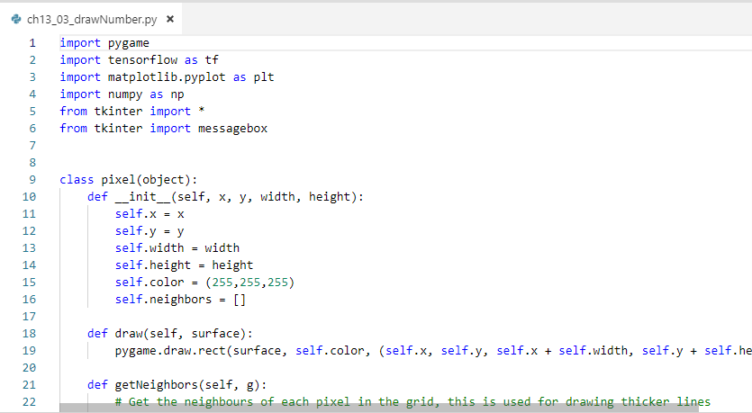
10 Number Guesser
https://www.youtube.com/watch?v=jNW97izstLg&t=10s
> pip3 install pygame

Slide 3
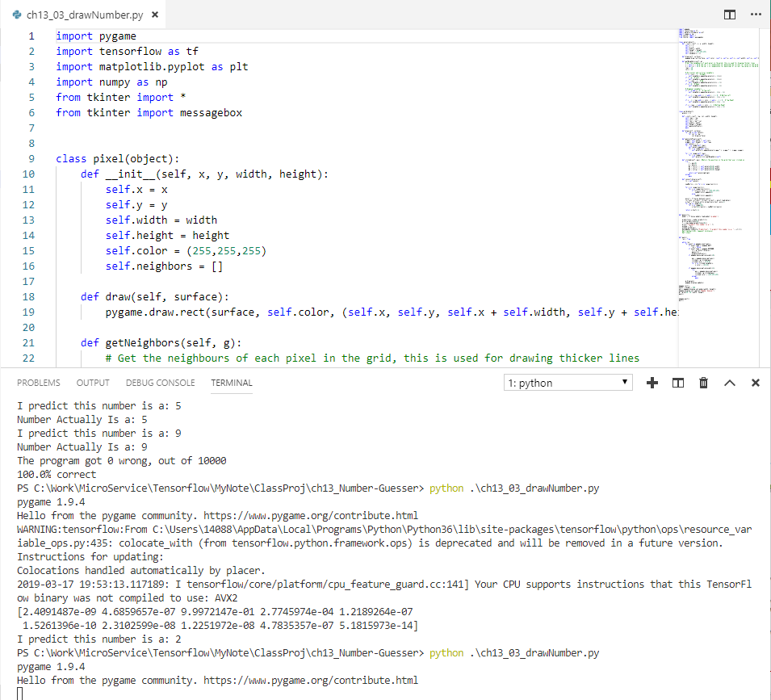
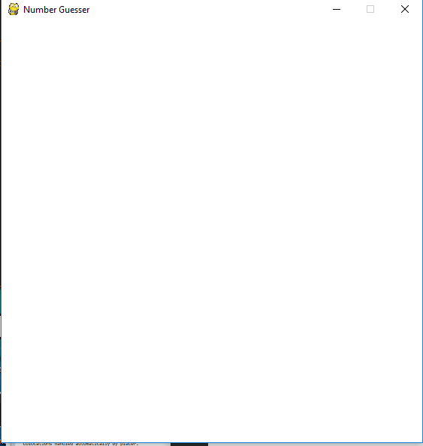
10 Number Guesser
https://www.youtube.com/watch?v=jNW97izstLg&t=10s
> python ch10_03_drawNumber.py
Display the empty screen.

Slide 4
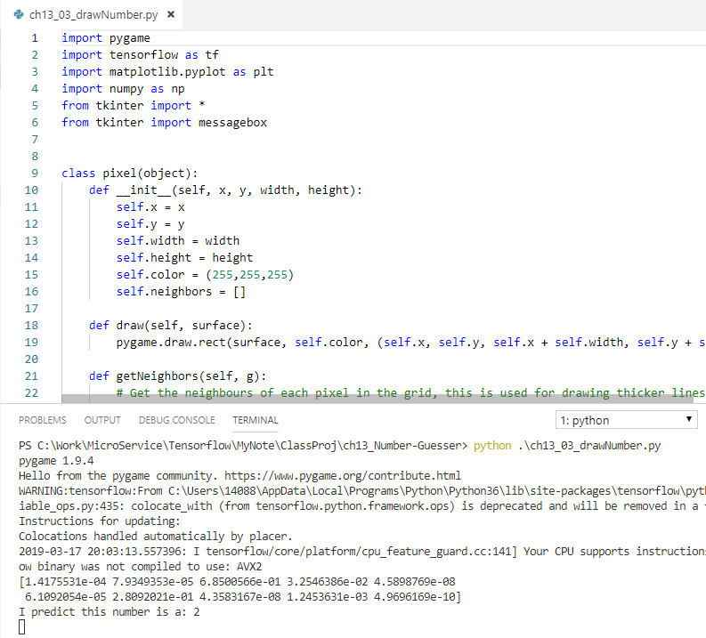
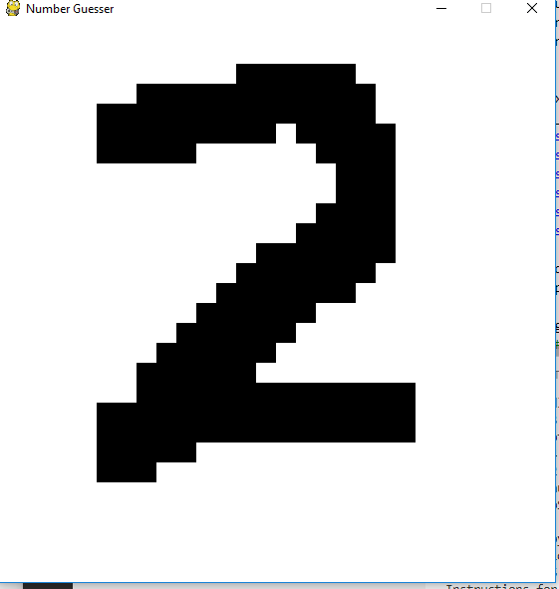
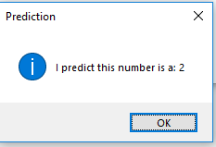
10 Number Guesser
https://www.youtube.com/watch?v=jNW97izstLg&t=10s
Draw a digit
Enter Space bar to predict.

Slide 5
10 Number Guesser
https://www.youtube.com/watch?v=jNW97izstLg&t=10s
This program is modified from Test Network. It is not hard code but sometimes get incorrect prediction.

Slide 6
End of Project

