Slide 1

4 Linear Regression (1)
Peter H. Chen

Slide 2
4 Linear Regression (1)
https://www.tensorflow.org/tutorials/
“MATH” label for topics
one/two minute explanations unavailable
simple explanations probably do not exist
indicates deeper/difficult underlying math
likely requires probability and statistics
"intuitive" explanations require more math
might require knowledge of algorithms

Slide 3
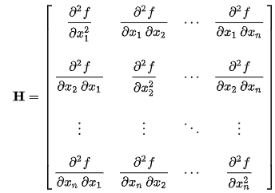
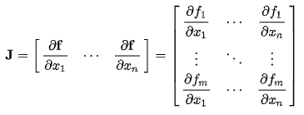
4 Linear Regression (1)
https://www.tensorflow.org/tutorials/
Examples of “MATH” label
[LA] eigenvalues
[LA] eigenvectors
Hessian matrix: is a square matrix of second-order partial derivatives of a scalar-valued function, or scalar field.
Jacobian matrix: is the matrix of all first-order partial derivatives of a vector-valued function.
LA = Linear Algebra
Hessian Matrix
Jacobian Matrix

Slide 4
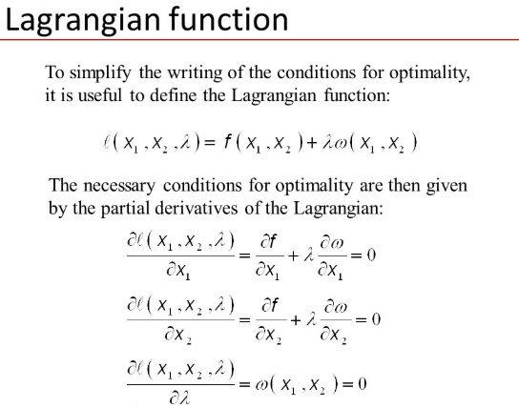
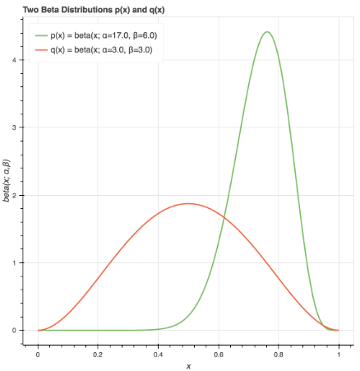
4 Linear Regression (1)
https://www.tensorflow.org/tutorials/
Examples of “MATH” label (2)
Lagrange functions: functions related to the method of Lagrange multipliers, that is used to derive necessary conditions for conditional extrema of functions of several variables or, in a wider setting, of functionals.
Kullback-Leibler divergence (relative entropy) is a measure of how one probability distribution is different from a second, reference probability distribution.
Lagrangian Functions
Kullback-Leibler Divergence

Slide 5
4 Linear Regression (1)
https://www.tensorflow.org/tutorials/
List of Topics
What is Regression Analysis?
Linear Regression
MSE (Mean Squared Error)
Samples of 2D data charts
Sources of Input Data
TF and Linear Regressions

Slide 6
4 Linear Regression (1)
https://www.tensorflow.org/tutorials/
What is Regression Analysis?
It models the relationship between:
1) a dependent variable and
2) one or more independent variables
Regression Analysis involves:
1. Outliers
2. Underfitting and Overfitting
3. Other factors

Slide 7
4 Linear Regression (1)
https://www.tensorflow.org/tutorials/
What is Linear Regression?
Involves fitting the best line to a dataset
Works best with linear-like data
Not good for quadratic/cubic/etc datasets
Overfitting can occur for non-linear datasets
Key Formula: Y = W*X + B (y = m*x + b)

Slide 8
4 Linear Regression (1)
https://www.tensorflow.org/tutorials/
Assumptions of Linear Regression
a linear relation between independent and dependent variables
There should not be any outliers present (really?)
Sample observations should be independent
Error terms should be normally distributed with mean 0 and constant variance

Slide 9
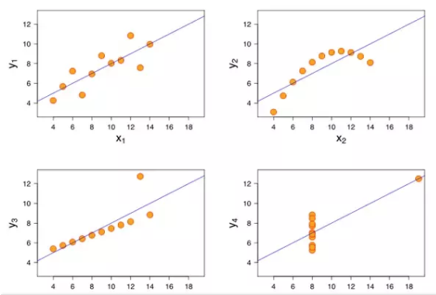
4 Linear Regression (1)
https://www.tensorflow.org/tutorials/
Which one is Good for Linear Regression?

Slide 10
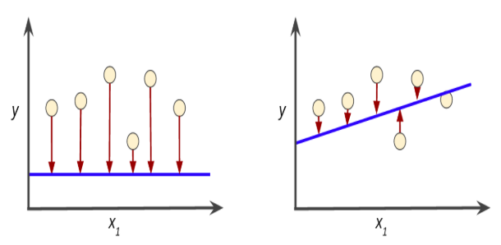
4 Linear Regression (1)
https://www.tensorflow.org/tutorials/
Which Line is a Better Approximation?

Slide 11
4 Linear Regression (1)
https://www.tensorflow.org/tutorials/
Recall: selecting a Cost Function
mean-squared error:
for a regression problem
binary cross-entropy (or mse):
for a two-class classification problem
categorical cross-entropy:
for a many-class classification problem

Slide 12
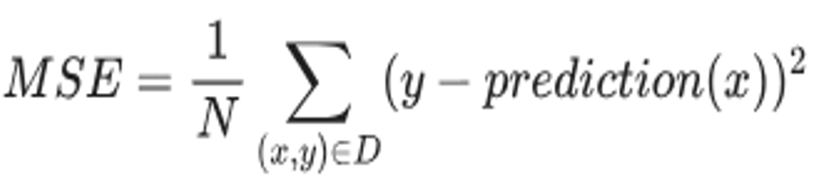
4 Linear Regression (1)
https://www.tensorflow.org/tutorials/
MSE (Mean Squared Error)

Slide 13
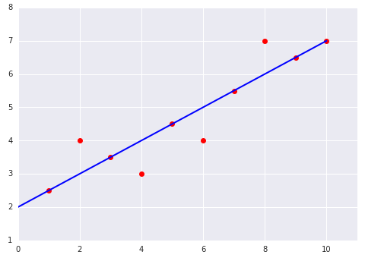
4 Linear Regression (1)
https://www.tensorflow.org/tutorials/
Example #1: MSE = ?

Slide 14
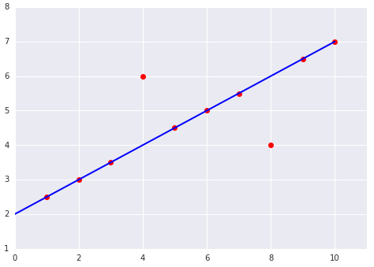
4 Linear Regression (1)
https://www.tensorflow.org/tutorials/
Example #1: MSE = ?

Slide 15
4 Linear Regression (1)
https://www.tensorflow.org/tutorials/
Types of Input Data for LR (Lear Regression)
1) Simplest: arrays of hard-coded numbers:
np.array() or tf.constant()
2) Generate arrays of numbers with:
np.linspace or tf.range()
3) Read data from a dataset:
Use Numpy methods or TF classes

Slide 16
4 Linear Regression (1)
https://www.tensorflow.org/tutorials/
TF and Linear Regression
1) Declare placeholders (x_ph,y_ph) and variables (W, b)
2) Define the initialization operator (init)
3) Declare operations on placeholders and variables: y_pred, loss, train_op
4) Create a session (sess)
5) Run the initialization operator: sess.run(init)
6) Run some graph operations:
sess.run([train_op, loss], feed_dict={x_ph: x, y_ph: y})

Slide 17
4 Linear Regression (1)
https://www.tensorflow.org/tutorials/
TF and Linear Regression
import tensorflow as tf # linear1.py
# W and x are one-d arrays
W = tf.constant([10,20], name='W')
x = tf.placeholder(tf.int32, name='x')
b = tf.placeholder(tf.int32, name='b')
Wx = tf.multiply(W, x, name='Wx')
y = tf.add(Wx, b, name=’y’)

Slide 18
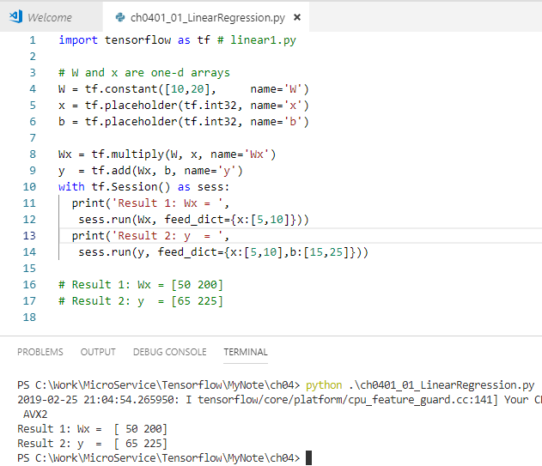
4 Linear Regression (1)
https://www.tensorflow.org/tutorials/
TF and Linear Regression
import tensorflow as tf # linear1.py
# W and x are one-d arrays
W = tf.constant([10,20], name='W')
x = tf.placeholder(tf.int32, name='x')
b = tf.placeholder(tf.int32, name='b')
Wx = tf.multiply(W, x, name='Wx')
y = tf.add(Wx, b, name='y')
with tf.Session() as sess:
print('Result 1: Wx = ‘,
sess.run(Wx, feed_dict={x:[5,10]}))
print('Result 2: y = ‘,
sess.run(y, feed_dict={x:[5,10],b:[15,25]}))
# Result 1: Wx = [50 200]
# Result 2: y = [65 225]

Slide 19
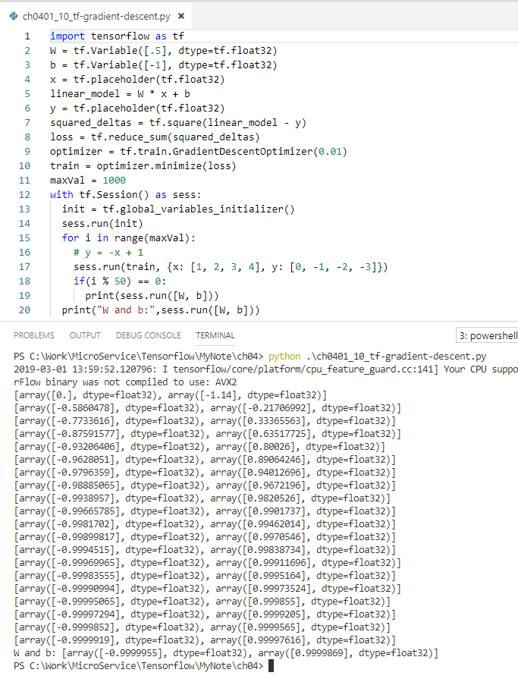
4 Linear Regression (1)
https://www.tensorflow.org/tutorials/
TF and Linear Regression (steps)
1) initialize hyperparameters
2) initialize trainX and trainY (“training” data)
3) initialize X, Y, W, and b
4) yhat = tf.add(tf.multiply(X, W), b)
5) # Mean squared error:
cost = tf.reduce_sum(tf.pow(yhat-Y, 2))/(2*samples)
6) # Gradient descent (minimize() updates W and b):
optimizer = tf.train.GradientDescentOptimizer(lr).minimize(cost)
7) plot results in graph
8) initialize testX and testY
9) calculate values using test data
10) plot results in graph

Slide 20
4 Linear Regression (1)
https://www.tensorflow.org/tutorials/
Digression: what is np.linspace()?
=> Generates evenly-spaced values
import numpy as np # linspace1.py
x1 = np.linspace(0.0, 6.0, 4)
print('x1:',x1)
#('x1:', array([0., 2., 4., 6.]))
x2 = np.linspace(-10.0, 10.0, 21)
print('x2:',x2)
#('x2:’,array([-10., -9., -8., ..., 9.,10.]))

Slide 21
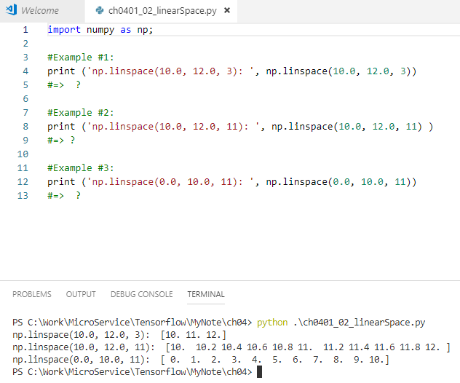
4 Linear Regression (1)
https://www.tensorflow.org/tutorials/
Exercise: np.linspace()
Example #1:
np.linspace(10.0, 12.0, 3)
?
np.linspace(10.0, 12.0, 3): [10. 11. 12.]
Example #2:
np.linspace(10.0, 12.0, 11)
=> ?
np.linspace(10.0, 12.0, 11): [10. 10.2 10.4 10.6 10.8 11. 11.2 11.4 11.6 11.8 12. ]
Example #3:
np.linspace(0.0, 10.0, 11)
?
np.linspace(0.0, 10.0, 11): [ 0. 1. 2. 3. 4. 5. 6. 7. 8. 9. 10.]

Slide 22
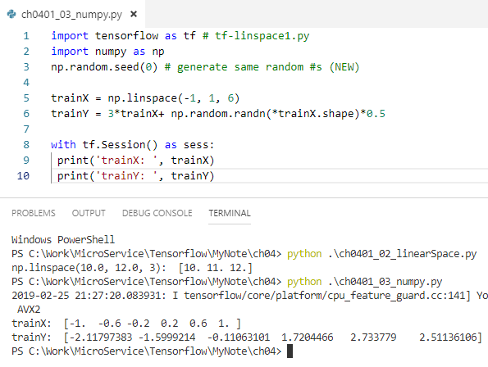
4 Linear Regression (1)
https://www.tensorflow.org/tutorials/
Numpy np.linspace()
import tensorflow as tf # tf-linspace1.py
import numpy as np
np.random.seed(0) # generate same random #s (NEW)
trainX = np.linspace(-1, 1, 6)
trainY = 3*trainX+ np.random.randn(*trainX.shape)*0.5
with tf.Session() as sess:
print("trainX: ”, trainX)
print("trainY: ”, trainY)
# output from tf-linspace1.py
('trainX: ', array([-1., -0.6, -0.2, 0.2, 0.6, 1.]))
('trainY: ',
array([-1.91059547, -1.26147767, -1.16996561,
0.78934524, 1.27834312, 3.77465562]))

Slide 23
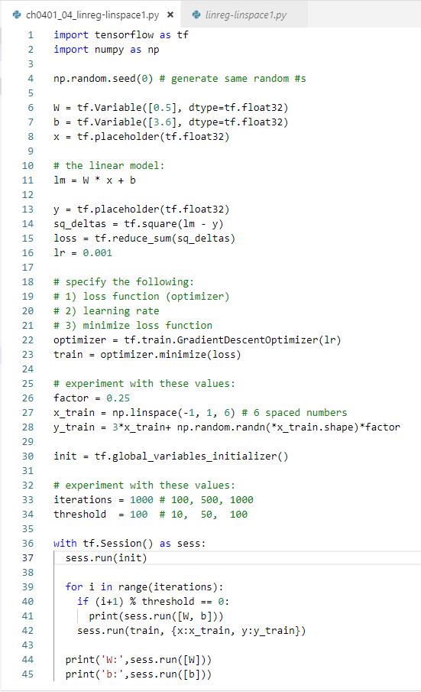
4 Linear Regression (1)
https://www.tensorflow.org/tutorials/
Numpy linspace() (a)
import tensorflow as tf # linreg-linspace1.py
import numpy as np
np.random.seed(0) # generate same random #s (NEW)
W = tf.Variable([0.5], dtype=tf.float32)
b = tf.Variable([3.6], dtype=tf.float32)
x = tf.placeholder(tf.float32)
# the linear model:
lm = W * x + b
y = tf.placeholder(tf.float32)
sq_deltas = tf.square(lm - y)
loss = tf.reduce_sum(sq_deltas)

Slide 24
4 Linear Regression (1)
https://www.tensorflow.org/tutorials/
Numpy linspace() (b)
# 1) loss function (optimizer) and learning rate
optimizer = tf.train.GradientDescentOptimizer(0.01)
# 2) minimize loss function
train = optimizer.minimize(loss)
# experiment with these values:
factor = 0.25
x_train = np.linspace(-1, 1, 6) # 6 spaced numbers
y_train = 3*x_train+ np.random.randn(*x_train.shape)*factor
init = tf.global_variables_initializer()

Slide 25
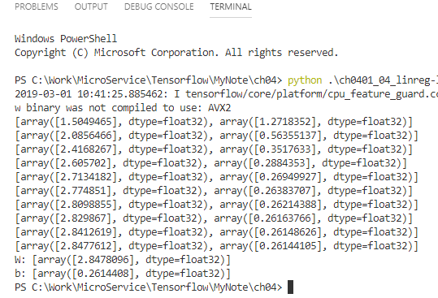
4 Linear Regression (1)
https://www.tensorflow.org/tutorials/
Numpy linspace() (c)
# experiment with these values:
iterations = 1000 # 100, 500, 1000
threshold = 100 # 10, 50, 100
with tf.Session() as sess:
sess.run(init)
for i in range(iterations):
if (i+1) % threshold == 0:
print(sess.run([W, b]))
sess.run(train,{x:x_train,y:y_train})
print('W:',sess.run([W]))
print('b:',sess.run([b]))

Slide 26
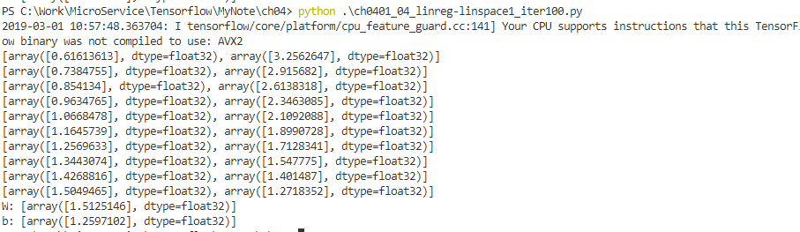
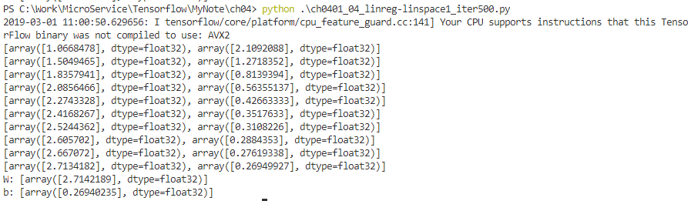

4 Linear Regression (1)
https://www.tensorflow.org/tutorials/
Iteration=100, threshold = 10
Exercise: Numpy linspace()
1) modify linreg-linspace1.py
2) experiment with iteration values (*)
3) experiment with threshold values (*)
4) try to predict the best combination
5) which combination is the best?
6) did the best match your prediction?
7) display the result of your tests
=> experiment with these values:
(*) Iterations: 100, 500, 1000
(*) Threshold: 10, 50, 100
Iteration=500, threshold = 50
Iteration=100, threshold = 100

Slide 27
4 Linear Regression (1)
https://www.tensorflow.org/tutorials/
TensorFlow tf.range()
tf.range(start,limit,delta=1,dtype=None, name='range')
# EX: 'start’/'limit’/'delta' is 3/18/3:
# tf.range(start, limit, delta)
# tf.range(3,18,3):
=> [3, 6, 9, 12, 15]
similar to a for loop:
for(x=3; x<18; x+=3)

Slide 28
4 Linear Regression (1)
https://www.tensorflow.org/tutorials/
TF and Linear Regression
Basic linear regression:
tf-linear_regression.py
Linear regression + eager execution:
tf-linear_regression_eager_api.py

Slide 29
4 Linear Regression (1)
https://www.tensorflow.org/tutorials/
TF tf.argmax() and Python Lists
import tensorflow as tf # tf-row-max.py
# initialize array of arrays:
a = [[1, 2, 3],[30, 20, 10],[40, 60, 50]]
b = tf.Variable(a, name='b')
with tf.Session() as sess:
sess.run(tf.global_variables_initializer())
print("indexes: ",sess.run(tf.argmax(b,1)))
#('indexes: ', array([2, 0, 1]))

Slide 30
4 Linear Regression (1)
https://www.tensorflow.org/tutorials/
Exercises: Python code samples
linear1.py
linreg-linspace1.py <= in class
linspace1.py
tf-linear_regression.py
tf-linear_regression_eager_api.py
tf-linspace1.py
tf-row-max.py

Slide 31
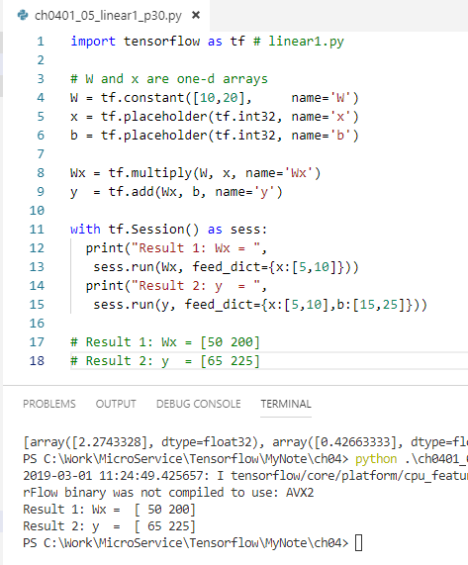
4 Linear Regression (1)
https://www.tensorflow.org/tutorials/
Exercises: Python code samples
linear1.py
linreg-linspace1.py <= in class
linspace1.py
tf-linear_regression.py
tf-linear_regression_eager_api.py
tf-linspace1.py
tf-row-max.py

Slide 32
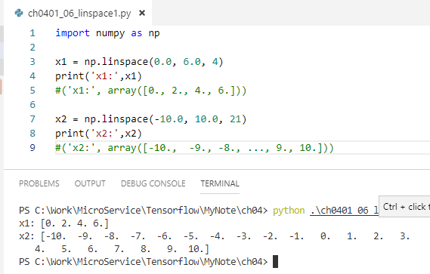
4 Linear Regression (1)
https://www.tensorflow.org/tutorials/
Exercises: Python code samples
linear1.py
linreg-linspace1.py <= in class
linspace1.py
tf-linear_regression.py
tf-linear_regression_eager_api.py
tf-linspace1.py
tf-row-max.py

Slide 33
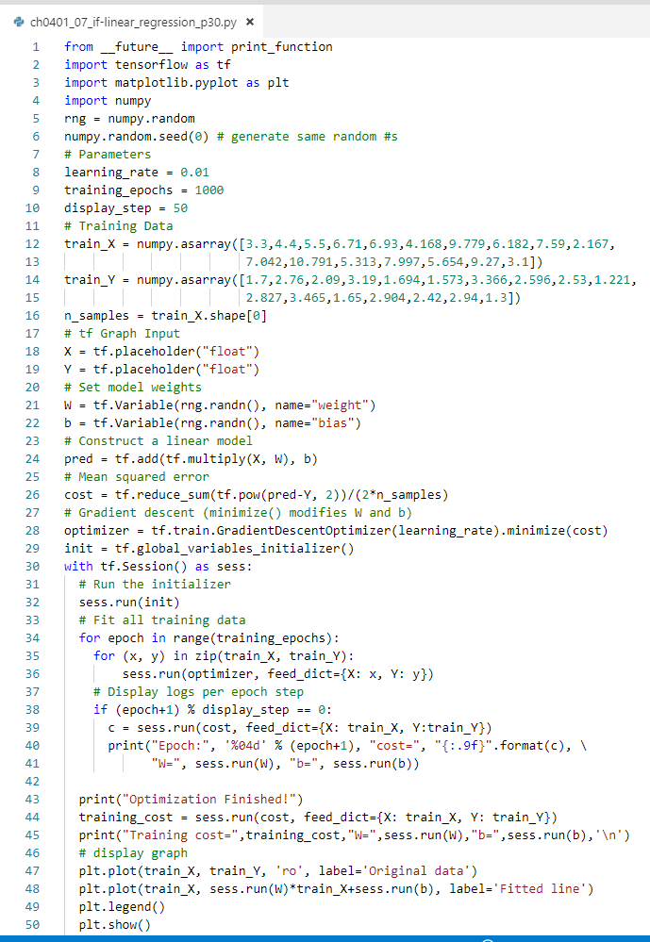
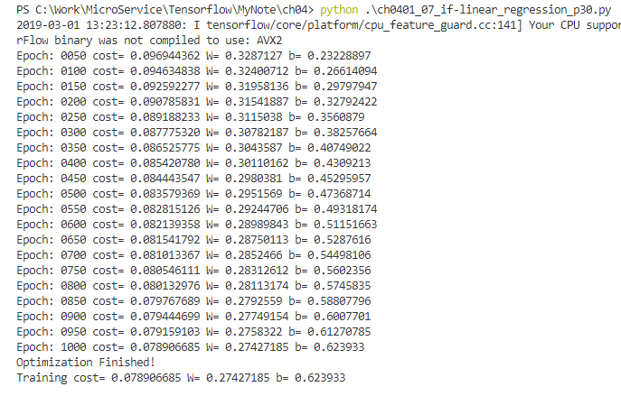
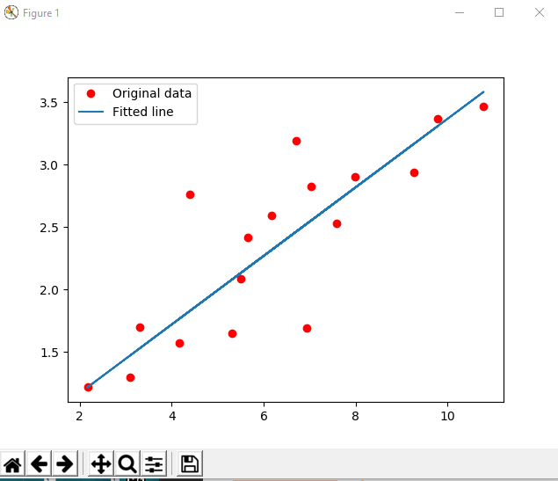
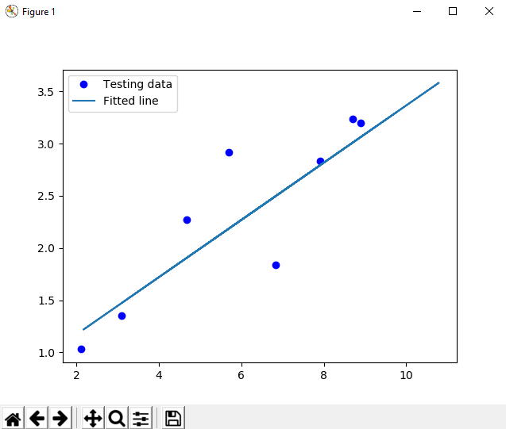
4 Linear Regression (1)
https://www.tensorflow.org/tutorials/
Exercises: Python code samples
linear1.py
linreg-linspace1.py <= in class
linspace1.py
tf-linear_regression.py
tf-linear_regression_eager_api.py
tf-linspace1.py
tf-row-max.py

Slide 34
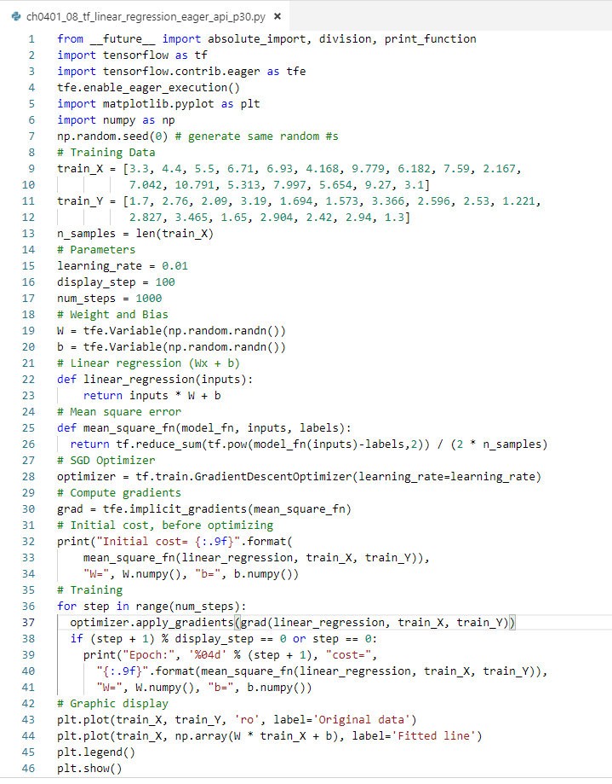
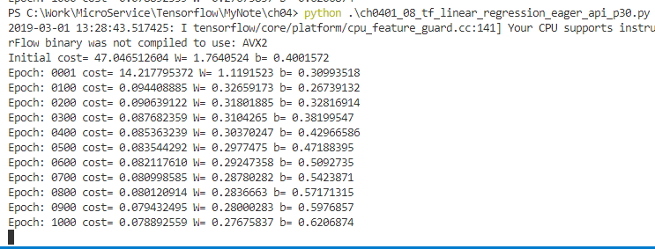
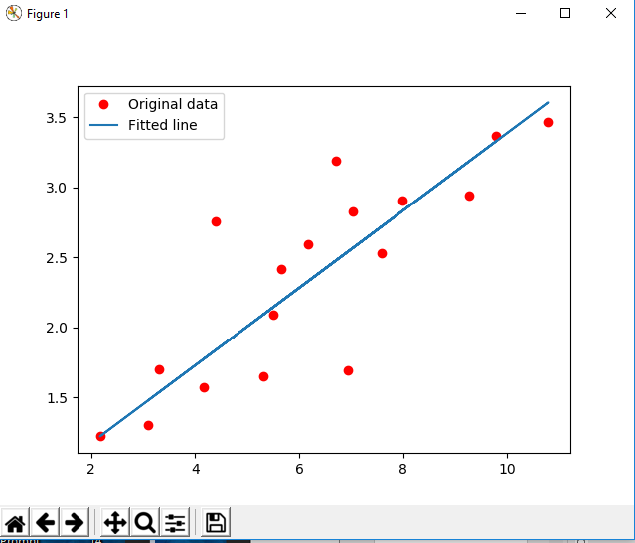
4 Linear Regression (1)
https://www.tensorflow.org/tutorials/
Exercises: Python code samples
linear1.py
linreg-linspace1.py <= in class
linspace1.py
tf-linear_regression.py
tf-linear_regression_eager_api.py
tf-linspace1.py
tf-row-max.py

Slide 35
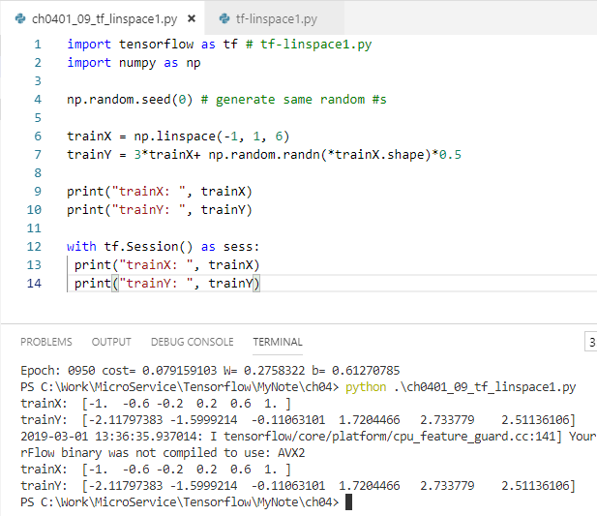
4 Linear Regression (1)
https://www.tensorflow.org/tutorials/
Exercises: Python code samples
linear1.py
linreg-linspace1.py <= in class
linspace1.py
tf-linear_regression.py
tf-linear_regression_eager_api.py
tf-linspace1.py
tf-row-max.py

Slide 36
4 Linear Regression (1)
https://www.tensorflow.org/tutorials/
“full batch” Gradient Descent
a batch: the # of examples to calculate the gradient in one iteration
"full batch": the batch is the entire data set
works for small/medium sized datasets
what about billions (or more) records?
“Stochastic” Gradient Descent
SGD: Stochastic gradient descent
one example (a batch size of 1) per iteration
"stochastic": one example per batch batch is chosen at random
SGD works but is very "noisy"

Slide 37
4 Linear Regression (1)
https://www.tensorflow.org/tutorials/
“Mini batch” SGD Gradient Descent
a compromise between full-batch and SGD
typically between 10 and 1,000 examples
examples are chosen at random
SGD reduces the amount of noise in SGD
still more efficient than full-batch

Slide 38
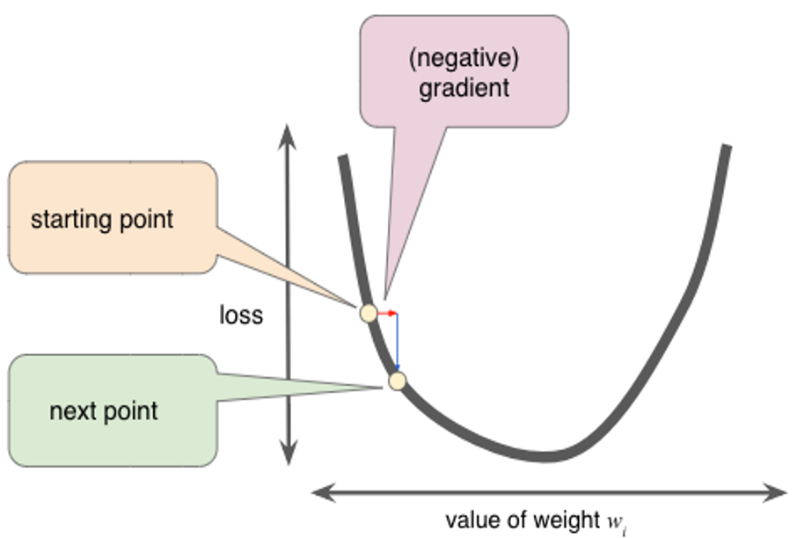
4 Linear Regression (1)
https://www.tensorflow.org/tutorials/
Gradient Descent

Slide 39
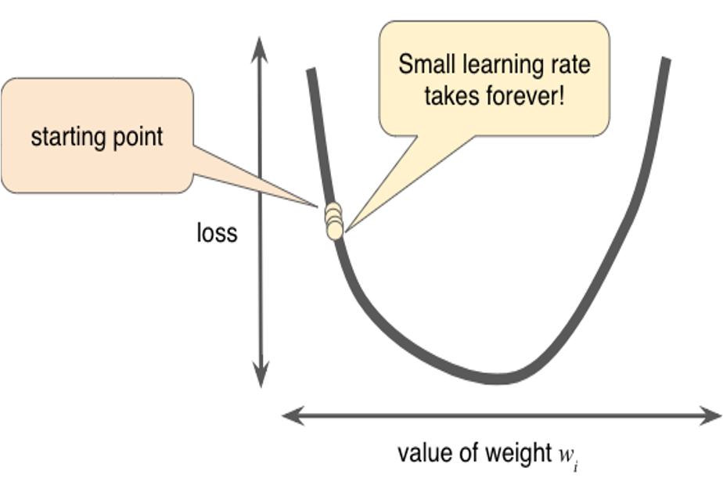
4 Linear Regression (1)
https://www.tensorflow.org/tutorials/
Gradient Descent (too slow)

Slide 40
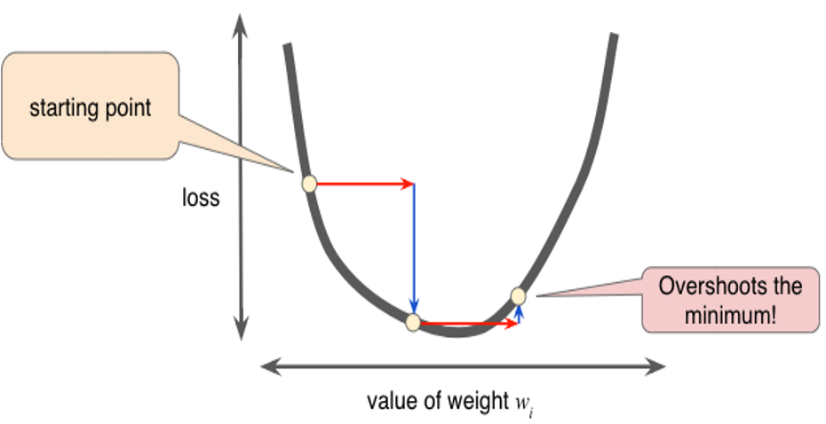
4 Linear Regression (1)
https://www.tensorflow.org/tutorials/
Gradient Descent (too fast)

Slide 41
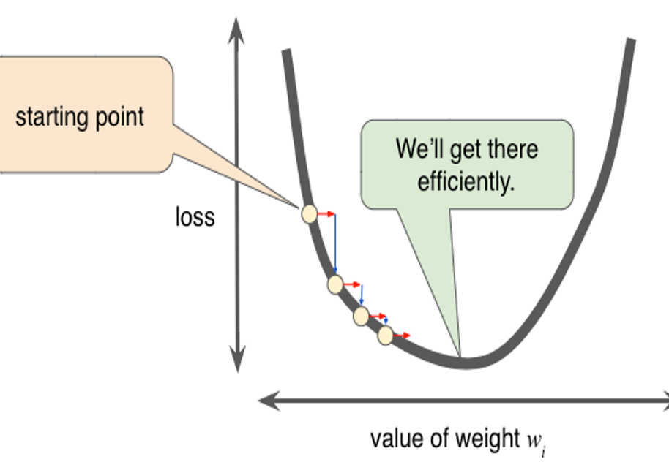
4 Linear Regression (1)
https://www.tensorflow.org/tutorials/
Gradient Descent (Just right :)

Slide 42
4 Linear Regression (1)
https://www.tensorflow.org/tutorials/
Variations on SGD
exponentially increase the learning rate
Use multiple learning rates
Cosine annealing
SGD with “restarts”
https://blog.floydhub.com/ten-techniques-from-fast-ai

Slide 43
4 Linear Regression (1)
https://www.tensorflow.org/tutorials/
Adam Optimization
Aka Adaptive Moment Estimation
works well across a wide range of architectures
highly recommended optimization algorithm
combines gradient descent with momentum and RMSprop algorithms
Advantages of Adam:
Relatively low memory requirements
but higher than gradient descent and gradient descent with momentum)
Can work well even with limited hyperparameter tuning

Slide 44
4 Linear Regression (1)
https://www.tensorflow.org/tutorials/
Adam Optimization
step #1: calculates an exponentially weighted average of past gradients
step #2: calculates an exponentially weighted average of the squares of the past gradients
step #3: updates parameters in a direction based on #1 and #2

Slide 45
4 Linear Regression (1)
https://www.tensorflow.org/tutorials/
Summary of Session (1)
Formula for linear regression (2D):
y = m*x + b (m=slope and b= y-intercept)
Y = W*X + B (matrices and vectors)
np.linspace():
generates a set of evenly spaced numbers
Types of gradient descent:
Mini-batch and stochastic

Slide 46
4 Linear Regression (1)
https://www.tensorflow.org/tutorials/
The Goldilocks Learning Rate
depends on the regression problem
related to the flatness of the loss function
if the gradient of the loss function is small:
=> try a larger learning rate (LR)
NB: a larger LR it compensates for the small gradient and results in a larger step size

Slide 47
End of Chapter

