Slide 1

4 Linear/Logistic Regression (2)
Peter H. Chen

Slide 2
4 Linear/Logistics Regression (2)
https://www.tensorflow.org/tutorials/
List of Topics
Overfitting/Underfitting
Piece Wise Linear Functions
Linear Regression (flaws)
What is Logistic Regression
Regularization (what is it?)
Types of Regularization

Slide 3
4 Linear/Logistics Regression (2)
https://www.tensorflow.org/tutorials/
List of Topics
Overfitting/Underfitting
Piece Wise Linear Functions
Linear Regression (flaws)
What is Logistic Regression
Regularization (what is it?)
Types of Regularization
Selecting Regularization Types
Polynomial regression
Other types of regression
Logistic Regression

Slide 4
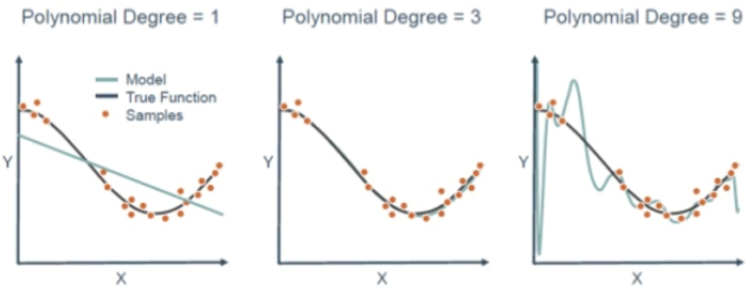
4 Linear/Logistics Regression (2)
https://www.tensorflow.org/tutorials/
What is Model Fitting?

Slide 5
4 Linear/Logistics Regression (2)
https://www.tensorflow.org/tutorials/
What is Overfitting?
1) occurs when a model fits data “too closely”
2) the model treats “noise” as “signal”
3) the model does not work well on new data
Solutions for Overfitting?
1) try regularization
2) higher degree polynomials
3) these can work well for small intervals
4) high deg polys diverge rapidly (+inf or –inf)
5) so model performs “poorly” on test data

Slide 6
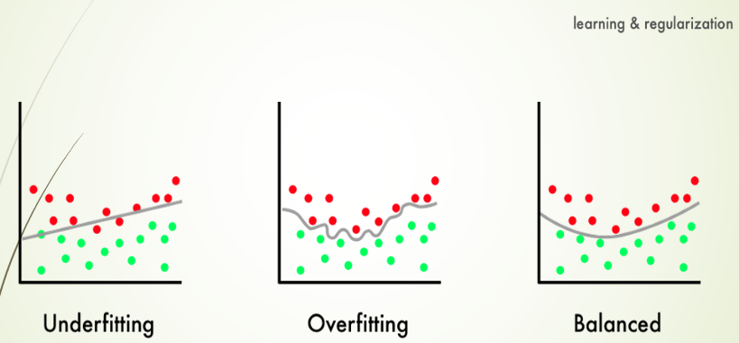
4 Linear/Logistics Regression (2)
https://www.tensorflow.org/tutorials/
What is Underfitting?

Slide 7
4 Linear/Logistics Regression (2)
https://www.tensorflow.org/tutorials/
Piece Wise Linear Functions
1) can approximate higher degree polynomials
2) subdivide horizontal axis into many pieces
3) use line segment to approximate the curve
4) each line segment works on a small dataset

Slide 8
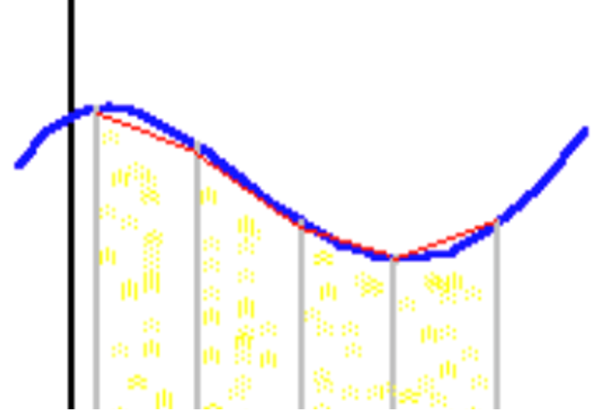
4 Linear/Logistics Regression (2)
https://www.tensorflow.org/tutorials/
Piece Wise Linear Functions (1)
1) can approximate higher degree polynomials
2) subdivide horizontal axis into many pieces
3) use line segment to approximate the curve
4) each line segment works on a small dataset
Piece Wise Linear Functions (2)

Slide 9
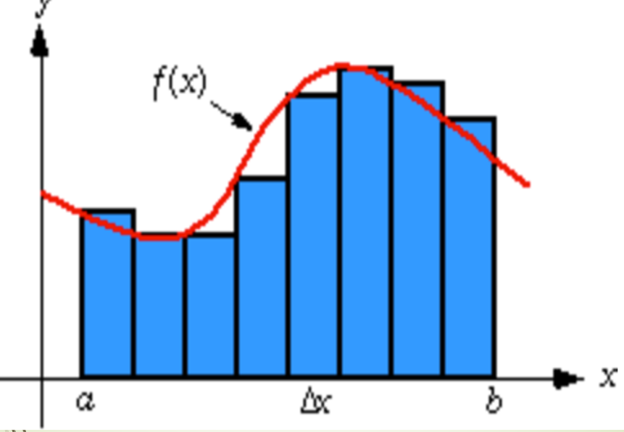
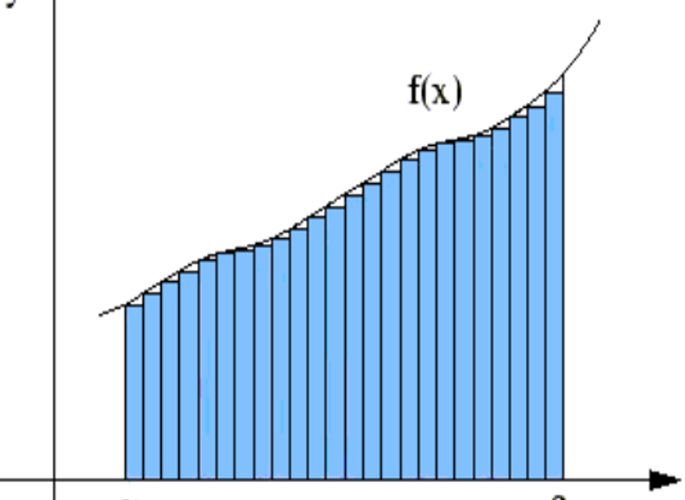
4 Linear/Logistics Regression (2)
https://www.tensorflow.org/tutorials/
Piece Wise Linear Functions (3)
Piece Wise Linear Functions (4)

Slide 10
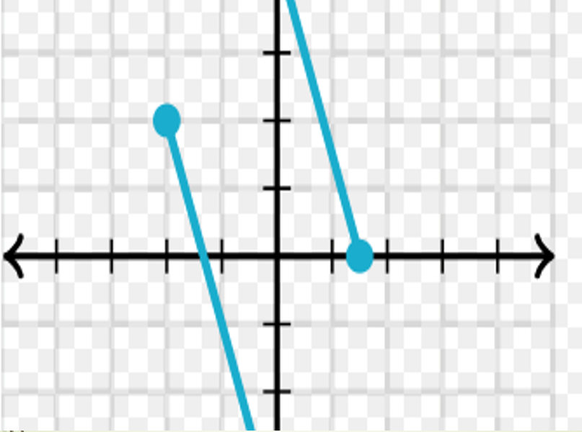
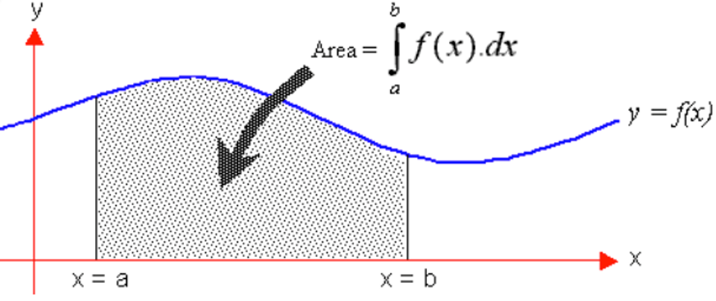
4 Linear/Logistics Regression (2)
https://www.tensorflow.org/tutorials/
Piece Wise Linear Functions (5)
Piece Wise Linear Functions (6)

Slide 11
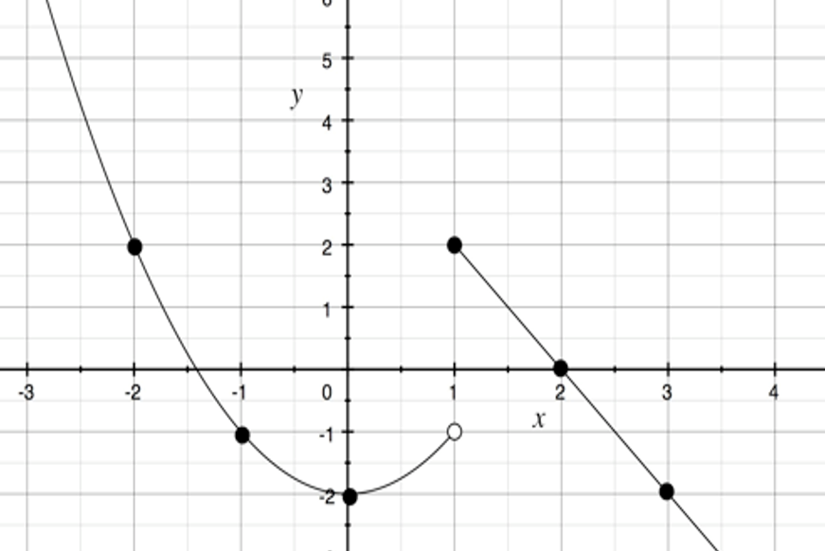
4 Linear/Logistics Regression (2)
https://www.tensorflow.org/tutorials/
Piece Wise Linear Functions (7)

Slide 12
4 Linear/Logistics Regression (2)
https://www.tensorflow.org/tutorials/
Linear Regression flaws
LR suffers from two major flaws:
1) prone to overfit with many input features
[use Regularization to “fix” this]
2) doesn’t easily express non-linear relationships
[use polynomials instead of lines?]

Slide 13
4 Linear/Logistics Regression (2)
https://www.tensorflow.org/tutorials/
What is Logistic Regression?
A classification algorithm (despite its name☺
Useful for binary outcomes (0-or-1 values)
Typically uses the sigmoid function
“apply” the sigmoid to a linear equation
Generate probabilities between 0 and 1

Slide 14
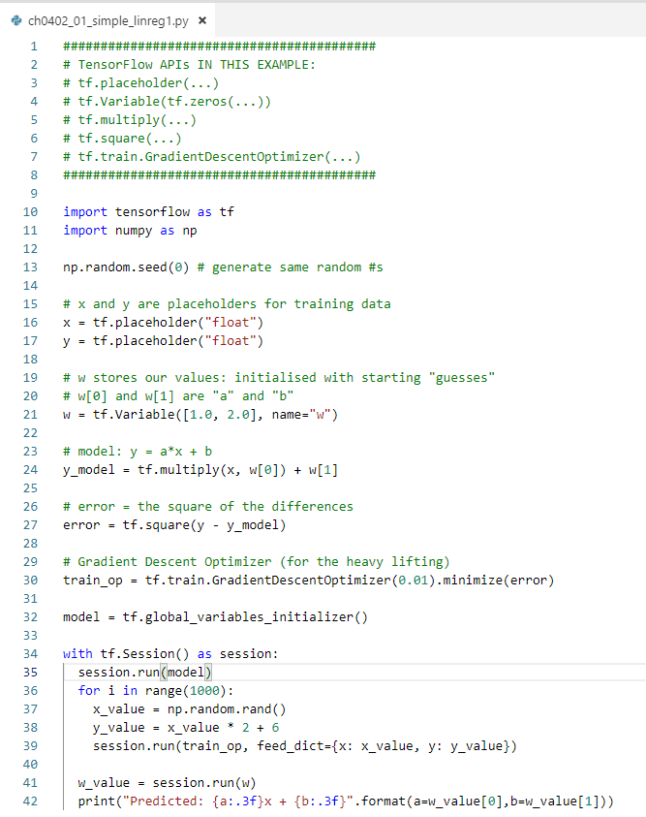

4 Linear/Logistics Regression (2)
https://www.tensorflow.org/tutorials/
Code Samples (mixture)
simple-linreg1.py
plain-linreg2.py
plain-linreg.py <= in class
house-prices.py
tf-sigmoid.py
tf-sigmoid-relu.py
tf-logistic-regression2.py <= in class
tf-logistic-regression1.py <= in class

Slide 15
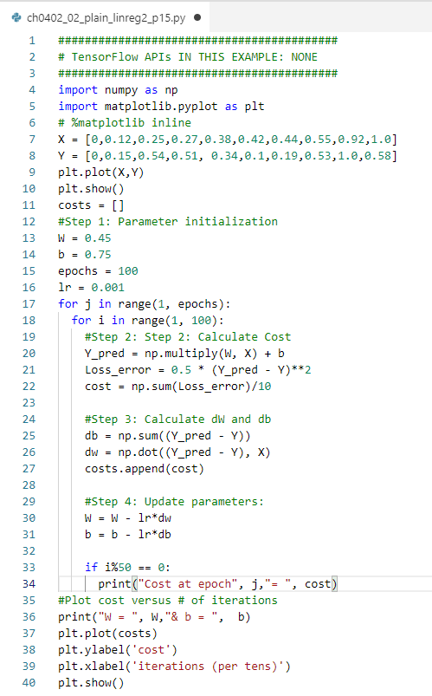
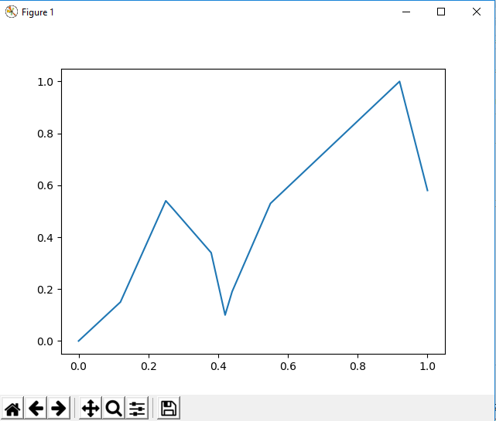
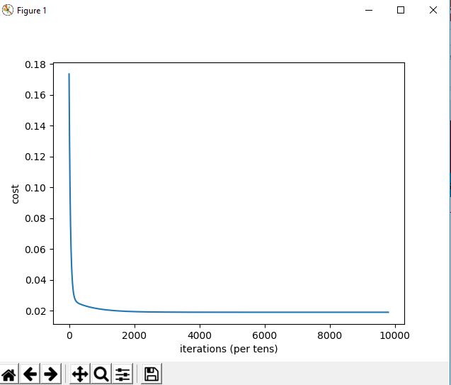
4 Linear/Logistics Regression (2)
https://www.tensorflow.org/tutorials/
Code Samples (mixture)
simple-linreg1.py
plain-linreg2.py
plain-linreg.py <= in class
house-prices.py
tf-sigmoid.py
tf-sigmoid-relu.py
tf-logistic-regression2.py <= in class
tf-logistic-regression1.py <= in class

Slide 16
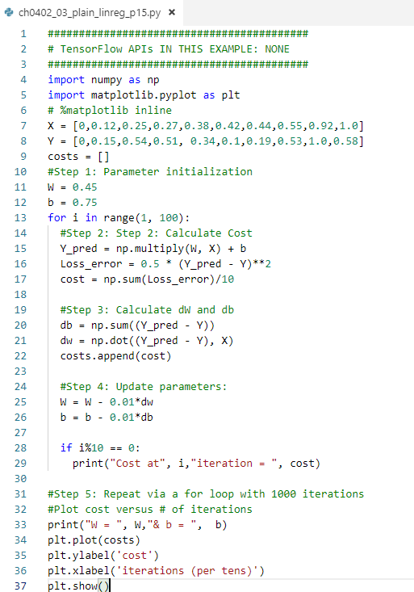
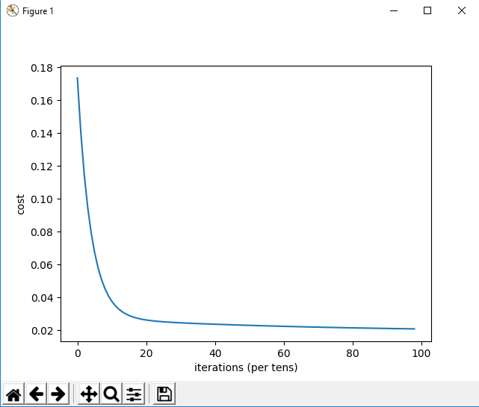
4 Linear/Logistics Regression (2)
https://www.tensorflow.org/tutorials/
Code Samples (mixture)
simple-linreg1.py
plain-linreg2.py
plain-linreg.py <= in class
house-prices.py
tf-sigmoid.py
tf-sigmoid-relu.py
tf-logistic-regression2.py <= in class
tf-logistic-regression1.py <= in class

Slide 17
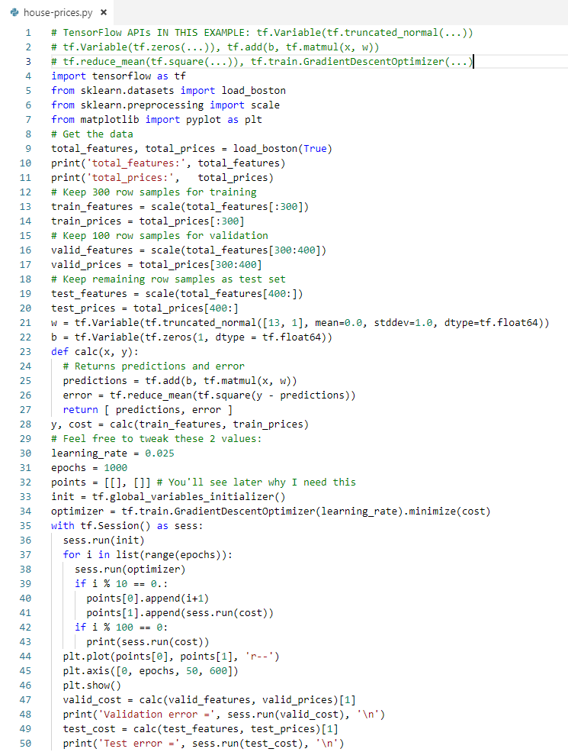
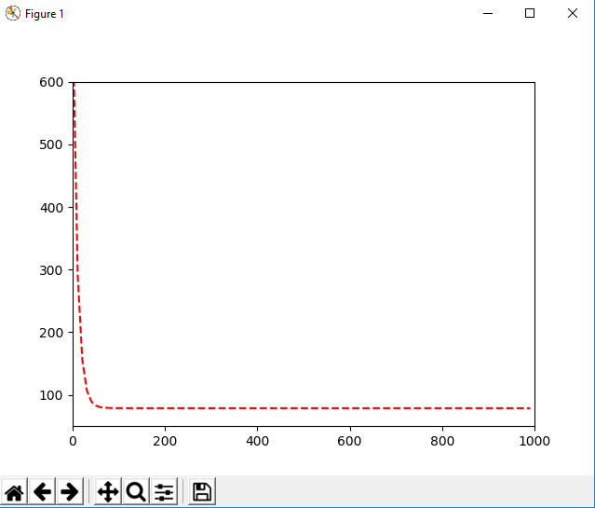
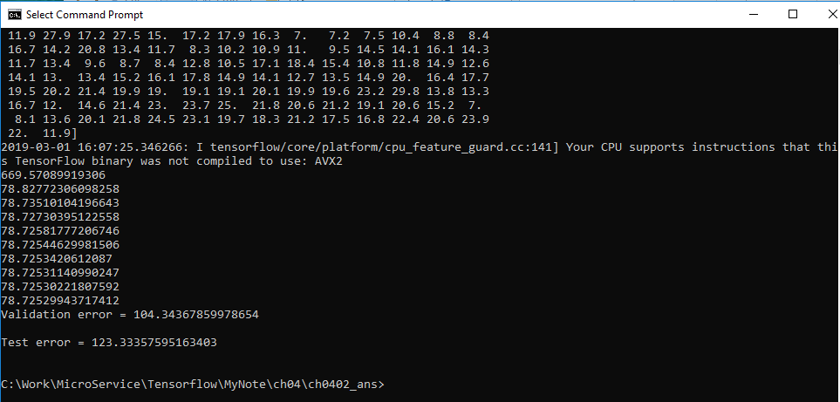
4 Linear/Logistics Regression (2)
https://www.tensorflow.org/tutorials/
Code Samples (mixture)
simple-linreg1.py
plain-linreg2.py
plain-linreg.py <= in class
house-prices.py
tf-sigmoid.py
tf-sigmoid-relu.py
tf-logistic-regression2.py <= in class
tf-logistic-regression1.py <= in class

Slide 18
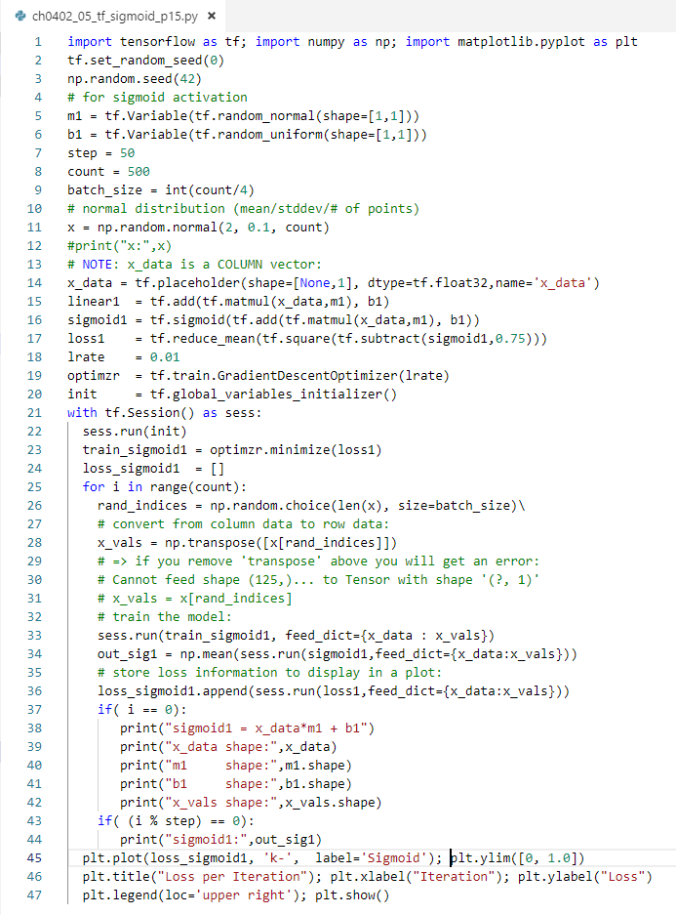
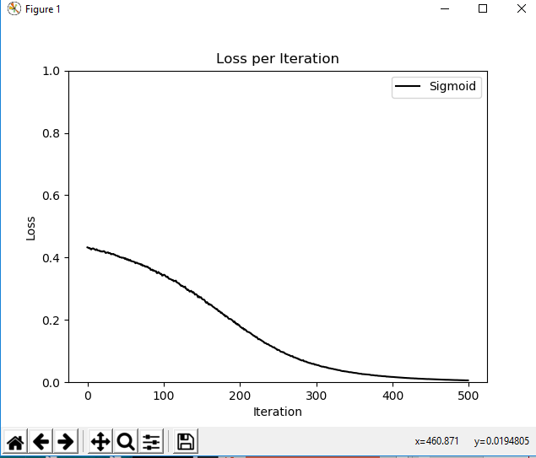
4 Linear/Logistics Regression (2)
https://www.tensorflow.org/tutorials/
Code Samples (mixture)
simple-linreg1.py
plain-linreg2.py
plain-linreg.py <= in class
house-prices.py
tf-sigmoid.py
tf-sigmoid-relu.py
tf-logistic-regression2.py <= in class
tf-logistic-regression1.py <= in class

Slide 19
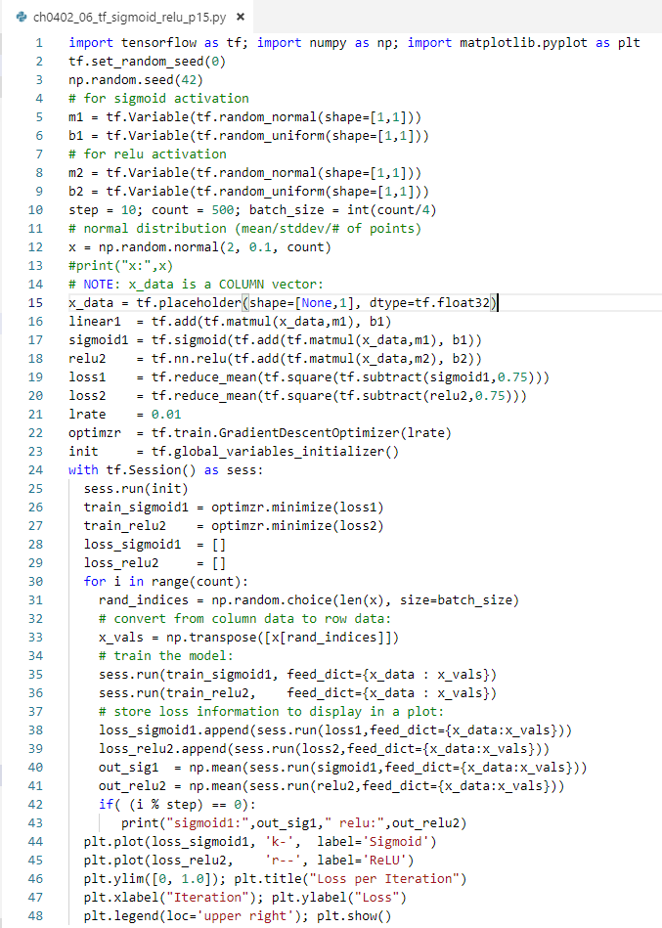
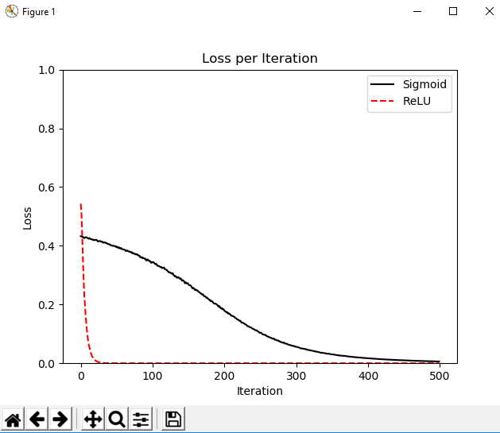
4 Linear/Logistics Regression (2)
https://www.tensorflow.org/tutorials/
Code Samples (mixture)
simple-linreg1.py
plain-linreg2.py
plain-linreg.py <= in class
house-prices.py
tf-sigmoid.py
tf-sigmoid-relu.py
tf-logistic-regression2.py <= in class
tf-logistic-regression1.py <= in class

Slide 20
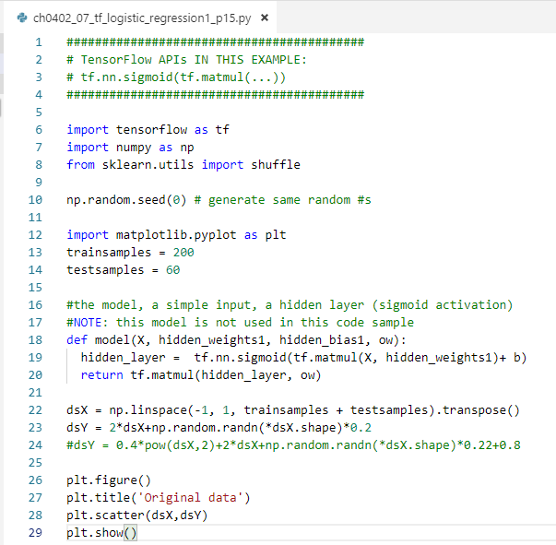
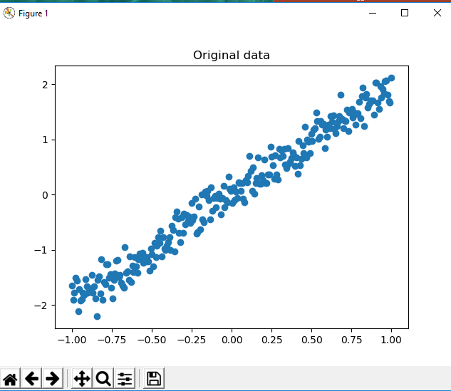
4 Linear/Logistics Regression (2)
https://www.tensorflow.org/tutorials/
Code Samples (mixture)
simple-linreg1.py
plain-linreg2.py
plain-linreg.py <= in class
house-prices.py
tf-sigmoid.py
tf-sigmoid-relu.py
tf-logistic-regression2.py <= in class
tf-logistic-regression1.py <= in class

Slide 21
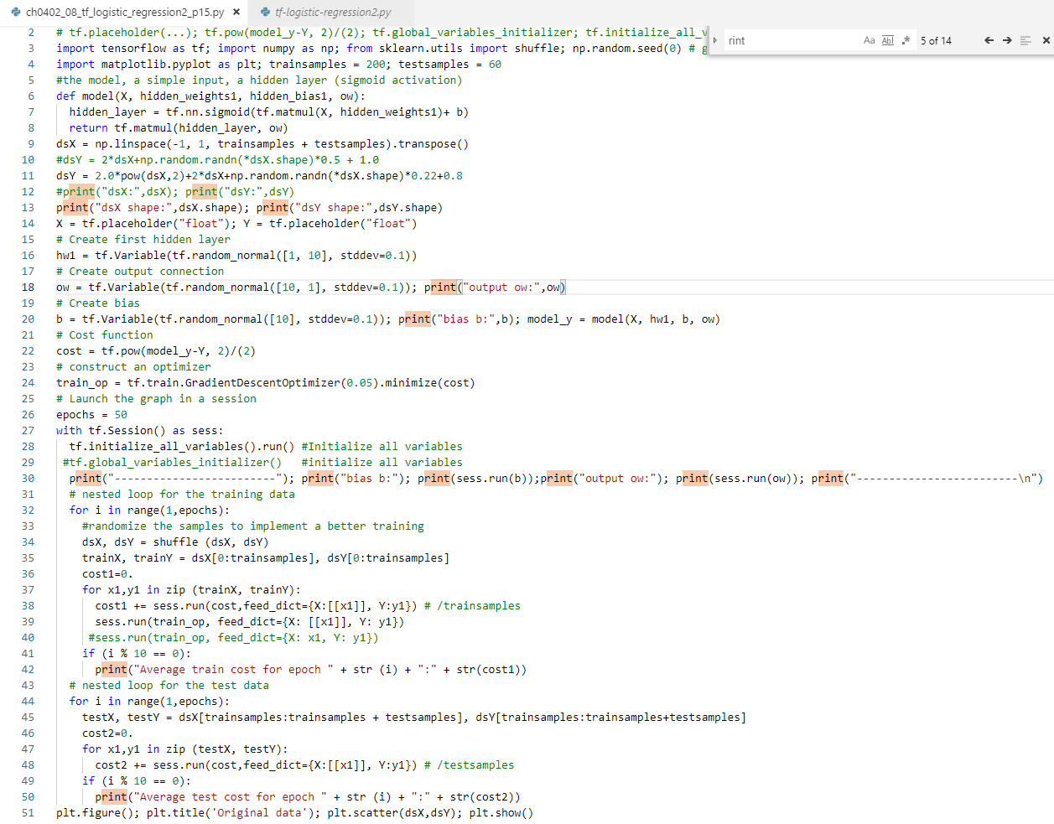
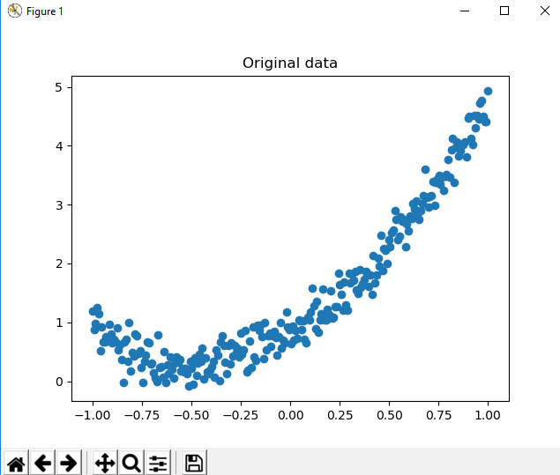
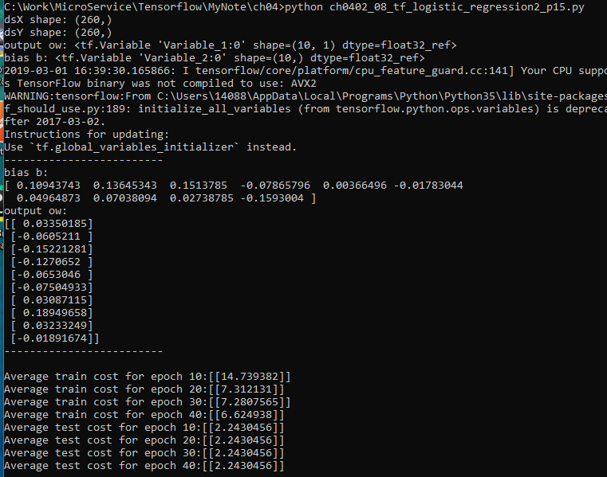
4 Linear/Logistics Regression (2)
https://www.tensorflow.org/tutorials/
Code Samples (mixture)
simple-linreg1.py
plain-linreg2.py
plain-linreg.py <= in class
house-prices.py
tf-sigmoid.py
tf-sigmoid-relu.py
tf-logistic-regression2.py <= in class
tf-logistic-regression1.py <= in class

Slide 22
4 Linear/Logistics Regression (2)
https://www.tensorflow.org/tutorials/
LR: Extreme Example of Overfitting
1) 100 observations in a dataset
2) start with 100 features
3) fit a LR model with the 100 features
the model can "memorize" the dataset:
4) each coefficient memorizes one observation
5) model has perfect accuracy on the dataset
6) performs poorly on unseen data
=> the model hasn't learned the true patterns
=> it has memorized the noise in training data

Slide 23
4 Linear/Logistics Regression (2)
https://www.tensorflow.org/tutorials/
Exercises: Linear Regression
#1: plain-linreg.py
#2: plain-linreg2.py
Experiment with different values for:
A) W, b, and lr (= learning_rate)
B) record your results
C) which combination was the best

Slide 24
4 Linear/Logistics Regression (2)
https://www.tensorflow.org/tutorials/
Exercises: Linear Regression
#1: plain-linreg.py
#2: plain-linreg2.py
Experiment with different values for:
A) W, b, and lr (= learning_rate)
B) record your results
C) which combination was the best

Slide 25
4 Linear/Logistics Regression (2)
https://www.tensorflow.org/tutorials/
What is Regularization? (1)
helps to solve/reduce the overfitting problem
adds a penalty term to the cost function
controls model complexity with penalty term
can remove features (set coefficients to 0)
the "penalty strength" is tunable
What is Regularization? (2)
Regularization is generally useful for:
1) Large number of variables
2) Low ratio of (# observations)/(# of variables)
3) high multi-collinearity

Slide 26
4 Linear/Logistics Regression (2)
https://www.tensorflow.org/tutorials/
Two Types of Regularization
A) L1 Regularization:
1) minimizes the cost function
2) adds a penalty term to a different sum:
3) Uses the sum of absolute values of coefficients
aka "least absolute deviations method”
B) L2 Regularization: uses MSE as cost function
General comparison of L1 versus L2:
1) L2 performs better than L1 regularization
2) L2 is efficient in terms of computation
3) one case where L1 is preferred over L2:
sparse feature sets (L1 has in-built feature selection)

Slide 27
4 Linear/Logistics Regression (2)
https://www.tensorflow.org/tutorials/
Regularized Regression Algorithms (1)
1) “Lasso” Regression:
Least Absolute Shrinkage and Selection Operator
2) Ridge Regression:
aka shrinkage regression
3) Elastic Net:
a compromise between Lasso and Ridge
Regularized Regression Algorithms (2)
1) “Lasso” Regression:
uses L1 regularization in the cost function
Can completely remove features
Offers automatic feature selection
Stronger penalty: “pushes” coefficient to zero

Slide 28
4 Linear/Logistics Regression (2)
https://www.tensorflow.org/tutorials/
Regularized Regression Algorithms (3)
2) Ridge Regression:
uses sum of squares of regression coefficients
Leads to smaller coefficients
Does not force them to 0
Offers “feature shrinkage”
Regularized Regression Algorithms (2)
3) Elastic Net:
a compromise between Lasso and Ridge
penalizes a mix of absolute and squared
tune the ratio of the two penalty types

Slide 29
4 Linear/Logistics Regression (2)
https://www.tensorflow.org/tutorials/
Selecting a Penalty Type
=> No “best” penalty type
Depends on dataset and problem
Try different algorithms
That use different penalty types

Slide 30
4 Linear/Logistics Regression (2)
https://www.tensorflow.org/tutorials/
TF get_shape() API
import tensorflow as tf # tf-getshape.py
c = tf.constant([[1.0,2.0,3.0],
[4.0,5.0,6.0]])
print("c shape:",c.get_shape())
# TensorShape([Dimension(2),Dimension(3)])

Slide 31
4 Linear/Logistics Regression (2)
https://www.tensorflow.org/tutorials/
Exercises: Linear Regression
#3: simple-linreg1.py
#4: house-prices.py
Experiment with different values for:
A) w[0] and w[1] ( "m" and "b”)
B) record your results
C) which combination was the best

Slide 32
4 Linear/Logistics Regression (2)
https://www.tensorflow.org/tutorials/
What is Polynomial Regression?
fitting a polynomial instead of a line
quadratic/cubic/etc
Can result in overfitting

Slide 33
4 Linear/Logistics Regression (2)
https://www.tensorflow.org/tutorials/
Other Types of Regression
Quantile Regression
Principal Component Regression
Partial Least Square Regression
Support Vector Regression
Ordinal Regression
Poisson Regression
Negative Binomial Regression
Quasi-Poisson Regression
Cox Regression

Slide 34
4 Linear/Logistics Regression (2)
https://www.tensorflow.org/tutorials/
Summary of Session (1)
Overfitting/Underfitting
Piece Wise Linear Functions
Linear Regression (flaws)
Regularization (what is it?)
Types of Regularization
Selecting Regularization Types
Polynomial regression
Other types of regression

Slide 35
End of Chapter

