Slide 1

4 Working with TensorBoard (3)
Peter H. Chen

Slide 2
4 Working with TensorBoard (3)
https://www.tensorflow.org/tutorials/
TensorBoard List of Topics
What is TensorBoard?
Launching TensorBoard
TensorBoard APIs:
Summary writer
Adding names/scopes
tf.summary.histogram()
tf.summary.scalar()
tf.summary.merge_all()

Slide 3
4 Working with TensorBoard (3)
https://www.tensorflow.org/tutorials/
What is TensorBoard?
A data visualization tool
Displays entire graph
Charts and graphs of TF code execution
Available in a browser
Part of tensorflow distribution
visualize TensorFlow graphs
plot quantitative metrics about graph execution
show additional data (such as images)
Launch from the command line
tensorboard –logdir=./tf_logs
=> tf_logs contains graph execution files

Slide 4
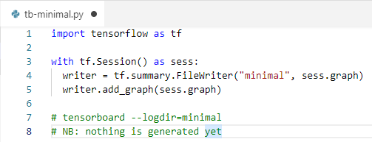
4 Working with TensorBoard (3)
https://www.tensorflow.org/tutorials/
TensorBoard Minimal Example
import tensorflow as tf # tb-minimal.py
with tf.Session() as sess:
writer = tf.summary.FileWriter("minimal", sess.graph)
writer.add_graph(sess.graph)
writer.close()
# tensorboard --logdir=minimal
# NB: nothing is generated yet

Slide 5
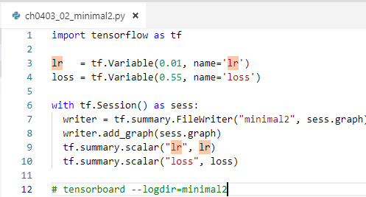
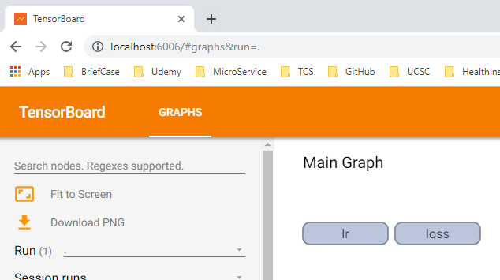
4 Working with TensorBoard (3)
https://www.tensorflow.org/tutorials/
Adding Scalar to TensorBoard
import tensorflow as tf # tb-minimal2.py
lr = tf.Variable(0.01, name='lr')
loss = tf.Variable(0.55, name='loss')
init = tf.global_variables_initializer()
with tf.Session() as sess:
session.run(init)
writer = tf.summary.FileWriter("minimal2”,sess.graph)
writer.add_graph(sess.graph)
tf.summary.scalar("lr", lr)
tf.summary.scalar("loss", loss)
writer.close()
# tensorboard --logdir=minimal2

Slide 6
4 Working with TensorBoard (3)
https://www.tensorflow.org/tutorials/
Graphs for TensorBoard (1)
import tensorflow as tf # tf-save-data.py
x = tf.constant(5,name="x")
y = tf.constant(8,name="y")
z = tf.Variable(2*x+3*y, name="z")
init = tf.global_variables_initializer()
with tf.Session() as session:
writer = tf.summary.FileWriter(”./tf_logs",session.graph)
session.run(init)
print 'z = ',session.run(z) # => z = 34
#launch: tensorboard --logdir=./tf_logs

Slide 7
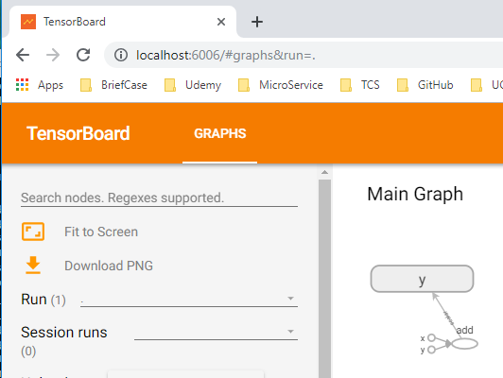
4 Working with TensorBoard (3)
https://www.tensorflow.org/tutorials/
Graphs for TensorBoard (2)
import tensorflow as tf # tb-simple1.py
x = tf.constant(35, name='x')
y = tf.Variable(x + 5, name='y')
with tf.Session() as session:
merged = tf.summary.merge_all()
writer = tf.summary.FileWriter("simple”,session.graph)
init = tf.global_variables_initializer()
session.run(init)
print(session.run(y))
# 1. python tb-simple1.py
# 2. tensorboard –logdir=simple
# 3. open chrome enter “localhost:6006”

Slide 8
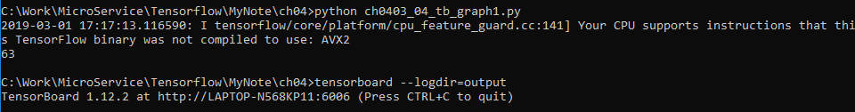
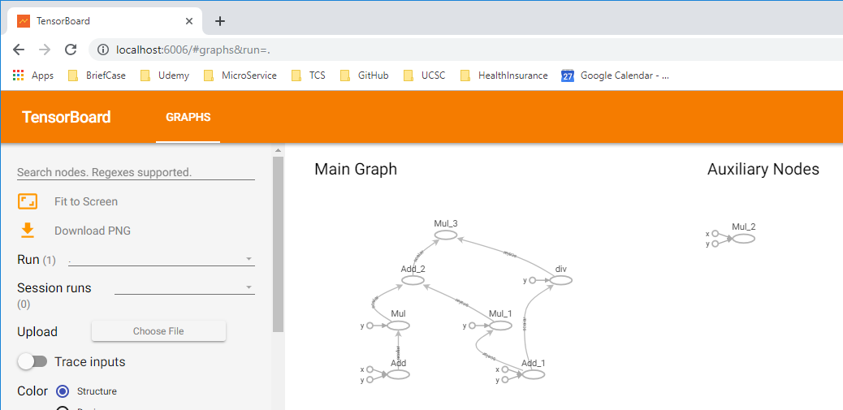
4 Working with TensorBoard (3)
https://www.tensorflow.org/tutorials/
Graphs for TensorBoard (3)
import tensorflow as tf # tb-graph1.py
a = tf.add(1, 2,)
b = tf.multiply(a, 3)
c = tf.add(4, 5,)
d = tf.multiply(c, 6,)
e = tf.multiply(4, 5,)
f = tf.div(c, 6,)
g = tf.add(b, d)
h = tf.multiply(g, f)
with tf.Session() as sess: # tb-graph1.py
print(sess.run(h))
writer = tf.summary.FileWriter("output", sess.graph)
print(sess.run(h))
writer.close()
# 1. python tb-graph1.py
# 2. tensorboard –logdir=output
# 3. open chrome enter “localhost:6006”

Slide 9
4 Working with TensorBoard (3)
https://www.tensorflow.org/tutorials/
Graphs for TensorBoard (4)
import tensorflow as tf # tb-graph2.py
a = tf.add(1, 2, name="Add_these_numbers")
b = tf.multiply(a, 3)
c = tf.add(4, 5, name="And_These_ones")
d = tf.multiply(c,6,name="Multiply_these_numbers")
e = tf.multiply(4, 5, name="B_add")
f = tf.div(c, 6, name="B_mul")
g = tf.add(b, d)
h = tf.multiply(g, f)
with tf.Session() as sess: # tb-graph2.py
print(sess.run(h))
writer = tf.summary.FileWriter("output", sess.graph)
print(sess.run(h))
writer.close()

Slide 10
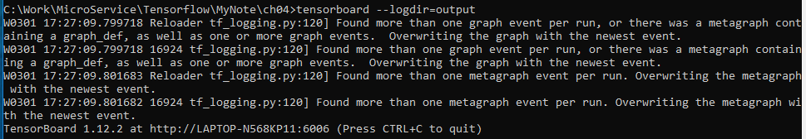
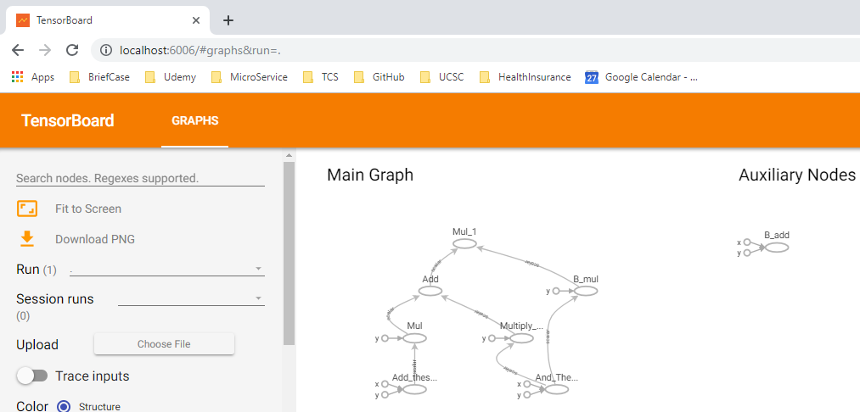
4 Working with TensorBoard (3)
https://www.tensorflow.org/tutorials/
Graphs for TensorBoard (5)
with tf.Session() as sess: # tb-graph2.py
print(sess.run(h))
writer = tf.summary.FileWriter("output", sess.graph)
print(sess.run(h))
writer.close()
# 1. python tb-graph2.py
# 2. tensorboard –logdir=output
# 3. open chrome enter “localhost:6006”

Slide 11
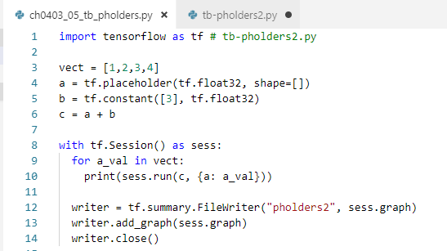

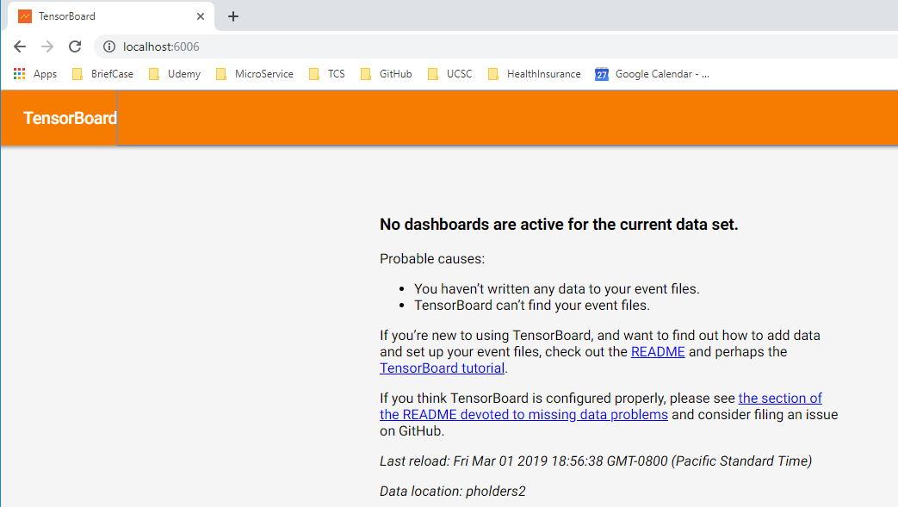
4 Working with TensorBoard (3)
https://www.tensorflow.org/tutorials/
Vectors in TensorBoard (1)
import tensorflow as tf # tb-pholders2.py
vect = [1,2,3,4]
a = tf.placeholder(tf.float32, shape=[])
b = tf.constant([3], tf.float32)
c = a + b
with tf.Session() as sess:
for a_val in vect:
print(sess.run(c, {a: a_val}))
writer = tf.summary.FileWriter("pholders", sess.graph)
writer.add_graph(sess.graph)
writer.close()

Slide 12
4 Working with TensorBoard (3)
https://www.tensorflow.org/tutorials/
Scope of TensorBoard (1)
import tensorflow as tf # tb-graph3.py
with tf.name_scope("MyOperationGroup"):
with tf.name_scope("Scope_A"):
a = tf.add(1, 2, name="Add_these_numbers")
b = tf.multiply(a, 3)
with tf.name_scope("Scope_B"):
c = tf.add(4, 5, name="And_These_ones")
d = tf.multiply(c,6,name="Multiply_these_numbers")
with tf.name_scope("Scope_C"): # tb-graph3.py
e = tf.multiply(4, 5, name="B_add")
f = tf.div(c, 6, name="B_mul")
g = tf.add(b, d)
h = tf.multiply(g, f)
with tf.Session() as sess:
print(sess.run(h))
writer = tf.summary.FileWriter("output", sess.graph)
print(sess.run(h))
writer.close()
# => double click on nodes to expand them

Slide 13
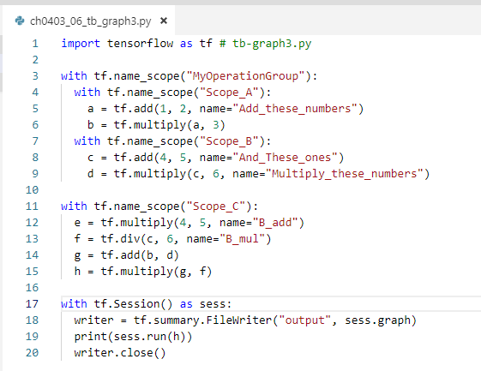
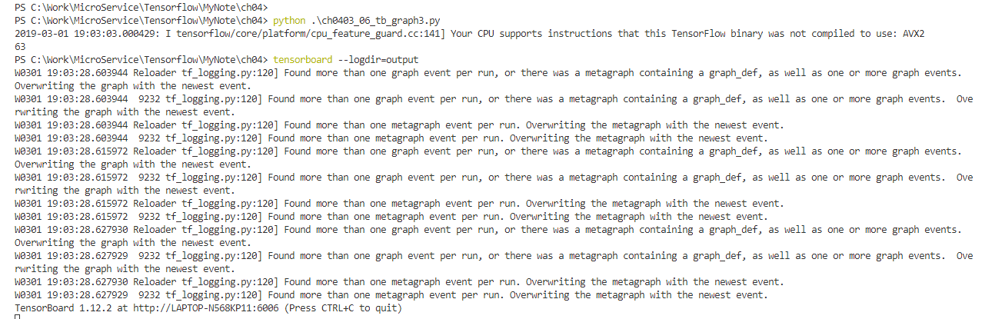
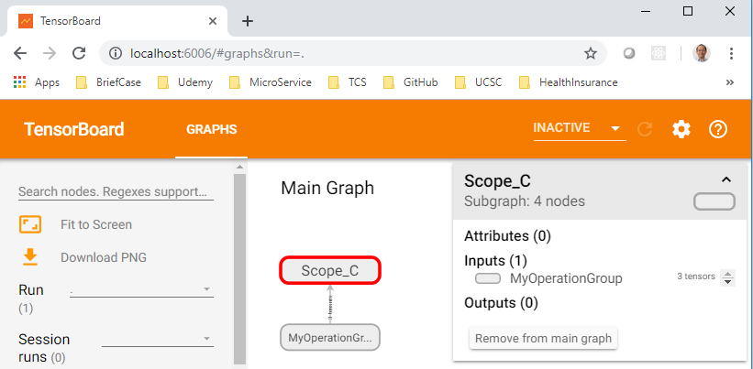
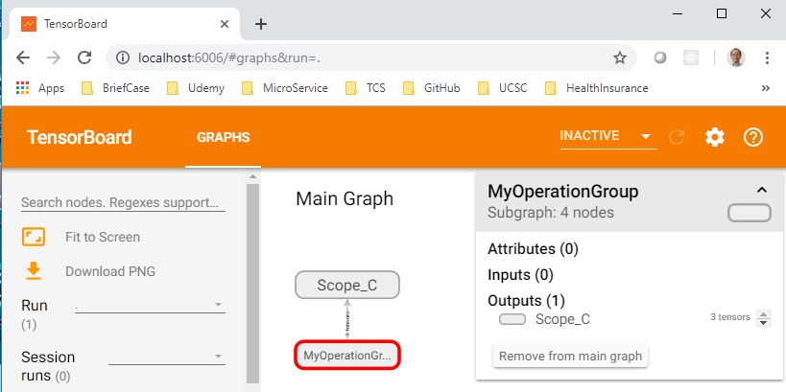
4 Working with TensorBoard (3)
https://www.tensorflow.org/tutorials/
Graphs of TensorBoard (2)

Slide 14
4 Working with TensorBoard (3)
https://www.tensorflow.org/tutorials/
Histogram in TensorBoard s (1)
# define some TF variables here…
Add data to the HISTOGRAMS tab:
tf.summary.histogram('weights1',weights1)
tf.summary.histogram('biases1', biases1)
tf.summary.histogram('fc1', fc1_weights)
tf.summary.histogram('fc2', fc2_weights)
=> in subsections on the HISTOGRAMS tab

Slide 15
4 Working with TensorBoard (3)
https://www.tensorflow.org/tutorials/
Histograms in TensorBoard (2)
import tensorflow as tf # tb-basic2.py
k = tf.placeholder(tf.float32)
# a normal distribution with a shifting mean
mean_moving_normal = tf.random_normal(shape=[1000], mean=(5*k), stddev=1)
# Record that distribution into a histogram summary
tf.summary.histogram("normal/moving_mean", mean_moving_normal)
# define a session and summary writer # tb-basic2.py
sess = tf.Session()
writer = tf.summary.FileWriter("/tmp/histogram_example")
summaries = tf.summary.merge_all()
N = 400
# use a loop to write the summaries to disk
for step in range(N):
k_val = step/float(N)
summ = sess.run(summaries, feed_dict={k: k_val})
writer.add_summary(summ, global_step=step)

Slide 16
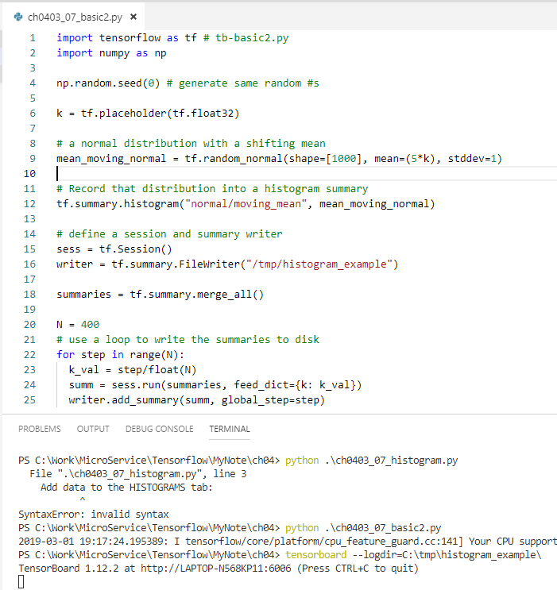
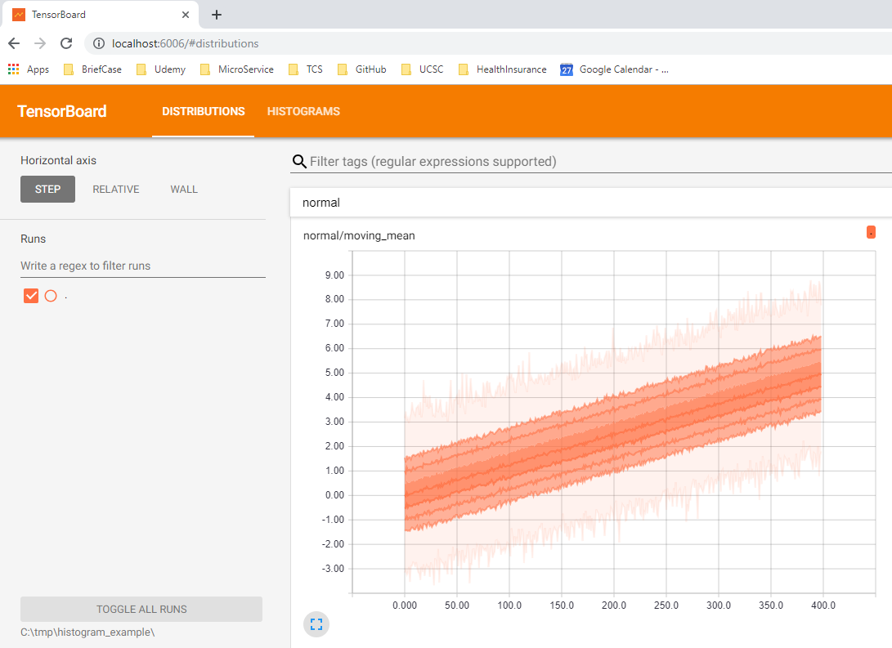
4 Working with TensorBoard (3)
https://www.tensorflow.org/tutorials/
Histograms in TensorBoard (3)

Slide 17
4 Working with TensorBoard (3)
https://www.tensorflow.org/tutorials/
Other TensorBoard Samples
TensorBoard and Linear Regression:
tb-linreg.py
More advanced TB code samples:
tb-summary-advanced.py
tb-mnist-advanced.py

Slide 18
4 Working with TensorBoard (3)
https://www.tensorflow.org/tutorials/
Other TensorBoard Features
Color (displays nodes in different colors)
Devices (which CPU/GPUs in use)
Trace inputs
Compute time
Memory
TPU compatibility

Slide 19
4 Working with TensorBoard (3)
https://www.tensorflow.org/tutorials/
TensorBoard APIs (1)
writer = tf.summary.FileWriter(...)
writer.add_graph(sess.graph)
writer.add_summary(...)
writer.add_run_metadata(...)
tf.summary.scalar(...)
tf.summary.merge_all()
tf.summary.histogram(...)
TensorBoard APIs (2)
tf.summary.tensor_summary
tf.summary.audio
tf.summary.image
tf.summary.merge
tf.summary.merge_all

Slide 20
4 Working with TensorBoard (3)
https://www.tensorflow.org/tutorials/
TensorFlow layers/wrappers (1)
Keras
TF-Slim
tf.contrib.learn (skflow)
PrettyTensor
TFlearn (week #5)
TensorLayer
SugarTensor
TensorFlow layers/wrappers (1)
http://tflearn.org
https://github.com/tflearn/tflearn
https://tensorlayer.readthedocs.io/en/latest/

Slide 21
4 Working with TensorBoard (3)
https://www.tensorflow.org/tutorials/
TensorBoard in Colaboratory (1)
The following code uses ngrok
https://www.dlology.com/blog/quick-guide-to-run-tensorboard-in-google-colab/
https://colab.research.google.com/github/google/dopamine/blob/master/dopamine/colab/tensorboard.ipynb

Slide 22
4 Working with TensorBoard (3)
https://www.tensorflow.org/tutorials/
TensorBoard in Colaboratory (2)
This code uses pipeline instead of ngrok
LOG_DIR = './log'
get_ipython().system_raw(
'tensorboard --logdir {} --host 0.0.0.0 --port 6006 &'
.format(LOG_DIR)
)
# Install
! npm install -g localtunnel
# Tunnel port 6006 (TensorBoard assumed running)
get_ipython().system_raw('lt --port 6006 >> url.txt 2>&1 &')
# Get url
! cat url.txt

Slide 23
4 Working with TensorBoard (3)
https://www.tensorflow.org/tutorials/
TensorBoard in Keras
from keras.callbacks import TensorBoard
tbCallBack = TensorBoard(log_dir='./log',
histogram_freq=1,
write_graph=True,
write_grads=True,
batch_size=batch_size,
write_images=True)
model.fit(x_train, y_train,
batch_size=batch_size,
epochs=epochs,
verbose=1,
validation_data=(x_test, y_test),
callbacks=[tbCallBack])
https://colab.research.google.com/notebooks/welcome.ipynb

Slide 24
End of Chapter

