Slide 1

8 Introduction to GRUs (2)
Peter H. Chen

Slide 2
8 Introduction to GRUs (2)
https://www.tensorflow.org/tutorials/
List of Topics
What are GRUs
Use cases for GRUs
Tradeoffs in GRUs
Major types of GRUs

Slide 3
8 Introduction to GRUs (2)
https://www.tensorflow.org/tutorials/
What are GRUs?
Long short-term memory (GRU) networks
Hochreiter/Schmidhuber in 1997
set accuracy records in multiple applications

Slide 4
8 Introduction to GRUs (2)
https://www.tensorflow.org/tutorials/
What are GRUs?
Gated Recurrent Units (GRU):
contain two gates instead of three
a gating mechanism:
Similar to (and simpler than) LSTMs

Slide 5
8 Introduction to GRUs (2)
https://www.tensorflow.org/tutorials/
Advantages of GRU Over LSTM
Only one state vector
Fewer internal gates / NNs
Better performance
A “light weight” LSTM

Slide 6
8 Introduction to GRUs (2)
https://www.tensorflow.org/tutorials/
GRUs versus LSTMs
simpler model than LSTMs
combines the forget and input gates
merges state and hidden state
performance on speech signal modeling comparable to LSTMs

Slide 7
8 Introduction to GRUs (2)
https://www.tensorflow.org/tutorials/
GRUs versus LSTMs
simpler model than LSTMs
combines the forget and input gates
merges state and hidden state
performance on speech signal modeling comparable to LSTMs

Slide 8
8 Introduction to GRUs (2)
https://www.tensorflow.org/tutorials/
GRUs versus LSTMs
performance on speech signal modeling comparable to LSTMs
LSTM is a more generic vision of GRU
LSTM requires 1/4 additional parameter
https://www.quora.com/In-which-cases-do-GRUs-completely-outperform-LSTMs
“no one fully understands why GRU outperforms LSTM”

Slide 9
8 Introduction to GRUs (2)
https://www.tensorflow.org/tutorials/
GRUs can outperform LSTMs
GRU can outperform LSTM (speed/accuracy) for:
1) basic sequence prediction
2) sequential variational autoencoder
Try both GRU and LSTM architectures
determine which one works better
Andrew Ng:
GRU is faster than LSTM and produces similar results

Slide 10
8 Introduction to GRUs (2)
https://www.tensorflow.org/tutorials/
GRU: Update Gate
1) helps the model to determine how much of the past information (from previous time steps) needs to be passed along to the future
2) the model can decide to copy all the information from the past and eliminate the risk of vanishing gradient problem

Slide 11
8 Introduction to GRUs (2)
https://www.tensorflow.org/tutorials/
GRU: Reset Gate
this gate is used from the model to decide how much of the past information to forget
the formula is the same as the one for the update gate
The difference comes in the weights and the gate's usage

Slide 12
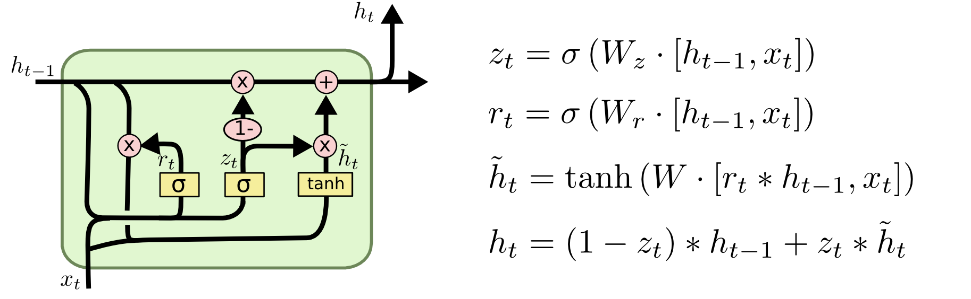
8 Introduction to GRUs (2)
https://www.tensorflow.org/tutorials/
Gated Recurrent Unit (GRU)
h_{t}
h_{t-1}
C_{t}
X
+
X
r_{t}
1-
z_{t}
X
σ
σ
tanh
x_{t}

Slide 13
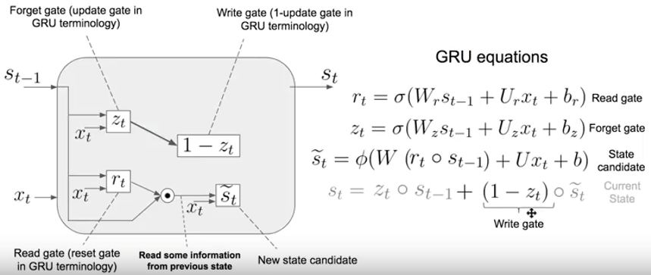
8 Introduction to GRUs (2)
https://www.tensorflow.org/tutorials/
Generic GRU Diagram

Slide 14
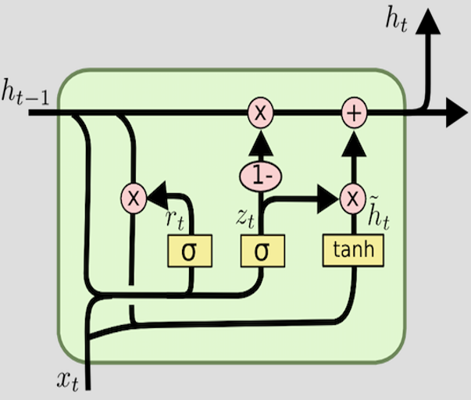
8 Introduction to GRUs (2)
https://www.tensorflow.org/tutorials/
GRU Internal Diagram

Slide 15
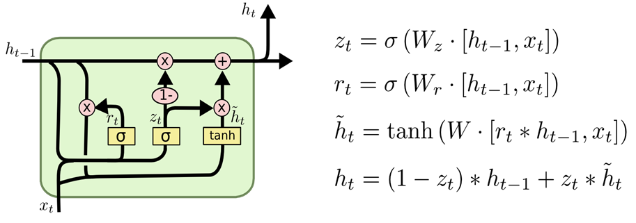
8 Introduction to GRUs (2)
https://www.tensorflow.org/tutorials/
GRU Internal Diagram

Slide 16
8 Introduction to GRUs (2)
https://www.tensorflow.org/tutorials/
Convert LSTM to GRU
The LSTM output with these gates:
ft = zt (zt is from the GRU)
it = 1−ft (open output-gate)
ot = 1
equals the GRU output with open-reset gate:
rt = 1
provided that the output-activation function of the LSTM (e.g., tanh) is replaced by a linear function

Slide 17
8 Introduction to GRUs (2)
https://www.tensorflow.org/tutorials/
Training GRUs
BPPT Back propagation through time
Gradient descent
Global optimization methods

Slide 18
End of Chapter

