Slide 1

8 Introduction to Autoencoders (3)
Peter H. Chen

Slide 2
8 Introduction to Autoencoders (3)
https://www.tensorflow.org/tutorials/
List of Topics
What are Autoencoders
Use cases for Autoencoders
Tradeoffs in Autoencoders
Major types of Autoencoders

Slide 3
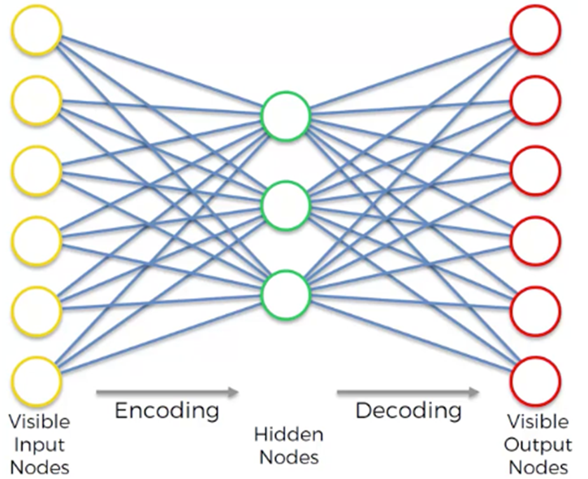
8 Introduction to Autoencoders (3)
https://www.tensorflow.org/tutorials/
“Vanilla” Autoencoder

Slide 4
8 Introduction to Autoencoders (3)
https://www.tensorflow.org/tutorials/
What are Autoencoders? (1)
An autoencoder is neural network
similar to a multi-layer perceptron model
the target is the same as the input
used to learn an efficient data encoding
=> their purpose is dimensionality reduction

Slide 5
8 Introduction to Autoencoders (3)
https://www.tensorflow.org/tutorials/
What are Autoencoders? (2)
unsupervised learning
uses backpropagation
sets the target values equal to the inputs
=> the NN tries to find the identity function

Slide 6
8 Introduction to Autoencoders (3)
https://www.tensorflow.org/tutorials/
What are Autoencoders? (3)
They involve a data compression algorithm
the compression/decompression functions are:
1) data-specific
2) lossy results
3) learned automatically from examples
4) implemented with neural networks

Slide 7
8 Introduction to Autoencoders (3)
https://www.tensorflow.org/tutorials/
What are Autoencoders? (4)
Autoencoders are data-specific
they only work with similar data
they differ from image compression
mediocre for data compression
=> an autoencoder trained on faces would work poorly on pictures of trees

Slide 8
8 Introduction to Autoencoders (3)
https://www.tensorflow.org/tutorials/
What are Autoencoders? (5)
The goal of an autoencoder:
1) “squeeze” the input to a smaller layer
2) to learn a representation for a set of data
3) typically for dimensionality reduction
=> KEEP ONLY THE MIDDLE “COMPRESSED” LAYER

Slide 9
8 Introduction to Autoencoders (3)
https://www.tensorflow.org/tutorials/
What are Autoencoders? (6)
Unsupervised Techniques:
Principal Component Analysis (PCA)
Anomaly detection
=> Autoencoders
Deep Belief Nets
Hebbian Learning
Generative Adversarial Networks (GANs)
Self-Organizing maps

Slide 10
8 Introduction to Autoencoders (3)
https://www.tensorflow.org/tutorials/
Autoencoders: general steps
1) compress the input to an output vector with fewer dimensions than the input data
2) transforms the output vector back into a tensor with the same shape as the input
3) may involve several hidden neural net layers
=> “vanilla” autoencoder has one hidden layer

Slide 11
8 Introduction to Autoencoders (3)
https://www.tensorflow.org/tutorials/
Use Cases for Autoencoders (1)
document retrieval
classification
anomaly detection
can be used for feature extraction
they yield better results than PCA

Slide 12
8 Introduction to Autoencoders (3)
https://www.tensorflow.org/tutorials/
Use Cases for Autoencoders (2)
Adversarial autoencoders
image denoising (generating clear images)
Semantic Hashing: use dimensionality reduction to speed up information retrieval
https://yuanwangblog.files.wordpress.com/2016/07/semantichashvae-g971968480-995448957-y.pdf

Slide 13
8 Introduction to Autoencoders (3)
https://www.tensorflow.org/tutorials/
Autoencoder: High-Level Example
consider a 10x10 image (100 pixels)
inputs: 100 neurons
hidden layer: 50 neurons
outputs: 100 (final layer)
the network "compresses" 100 nodes to 50 nodes
the algorithm tries to discover correlations
new representation is similar to PCAs
[Principal Component Analysis]

Slide 14
8 Introduction to Autoencoders (3)
https://www.tensorflow.org/tutorials/
Types of Autoencoders
LSTM autoencoders
Denoising autoencoders
Contractive autoencoders
Sparse autoencoders
Stacked autoencoders
Deep autoencoders
Linear autoencoders

Slide 15
8 Introduction to Autoencoders (3)
https://www.tensorflow.org/tutorials/
LSTM Autoencoders
encode the input to a compact value (same as regular autoencoders)
they can also handle sequences as input (regular autoencoders cannot)
They can take variable length inputs while regular autoencoders take only fixed size inputs

Slide 16
8 Introduction to Autoencoders (3)
https://www.tensorflow.org/tutorials/
Use Cases for LSTM Autoencoders
Semantic Hashing:
http://www.cs.utoronto.ca/~rsalakhu/papers/semantic_final.pdf
Anomaly Detection:
http://msdresearch.blogspot.com/2015/09/recurrent-neural-networks-can-detect.html

Slide 17
8 Introduction to Autoencoders (3)
https://www.tensorflow.org/tutorials/
Denoising Autoencoders (1)
# hidden neurons > # input neurons
Use a regularization technique
Duplicate input layer
Randomly drop neurons in new layer

Slide 18
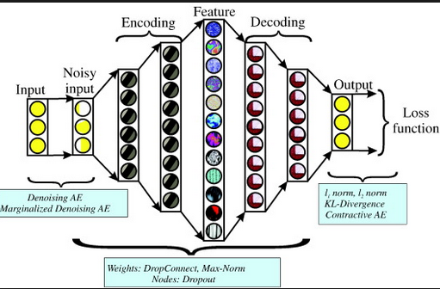
8 Introduction to Autoencoders (3)
https://www.tensorflow.org/tutorials/
Denoising Autoencoders (2)

Slide 19
8 Introduction to Autoencoders (3)
https://www.tensorflow.org/tutorials/
Contractive autoencoders
# hidden neurons > # input neurons
Use a regularization technique
Add a “penalty” to back propagation: similar to Kullback-Leibler (KL) divergence

Slide 20
8 Introduction to Autoencoders (3)
https://www.tensorflow.org/tutorials/
Sparse Autoencoders (1)
# hidden neurons > # input neurons
Use a regularization technique
technique is similar to “drop-rate”
http://www.ericlwilkinson.com/blog/2014/11/19/deep-learning-sparse-autoencoders

Slide 21
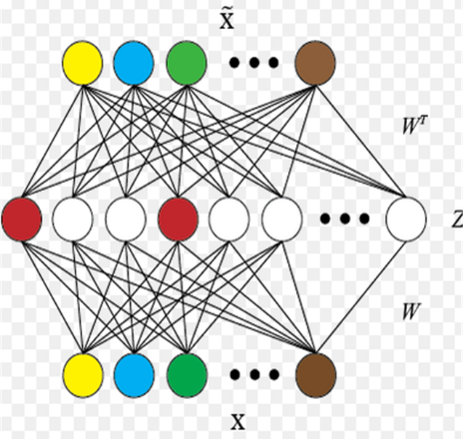
8 Introduction to Autoencoders (3)
https://www.tensorflow.org/tutorials/
Sparse Autoencoders (2)

Slide 22
8 Introduction to Autoencoders (3)
https://www.tensorflow.org/tutorials/
Stacked Autoencoders
an NN consisting of multiple layers of sparse autoencoders
outputs of a layer are wired to the inputs of the next layer
=> the features from the stacked autoencoder can be used for classification problems by feeding the last layer to a softmax classifier
More in-depth discussion:
http://ufldl.stanford.edu/wiki/index.php/Stacked_Autoencoders

Slide 23
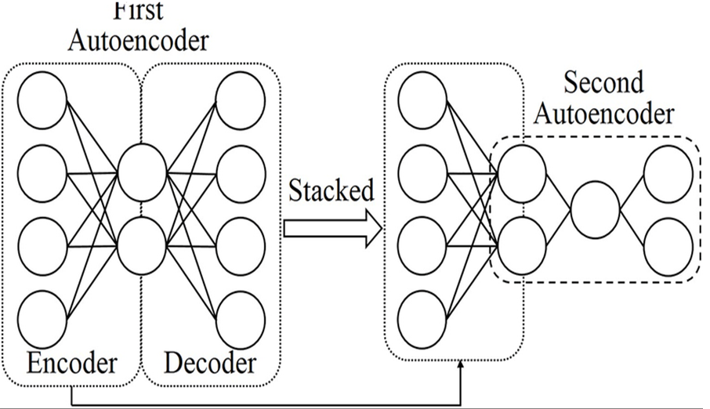
8 Introduction to Autoencoders (3)
https://www.tensorflow.org/tutorials/
Stacked Autoencoders (example)

Slide 24
8 Introduction to Autoencoders (3)
https://www.tensorflow.org/tutorials/
Deep Autoencoders
Comprise two symmetrical deep-belief networks (DBNs)
one DBN for the encoding
one DBN for the decoding
each DBN typically has four or five shallow layers
Details about DBNs:
https://en.wikipedia.org/wiki/Deep_belief_network

Slide 25
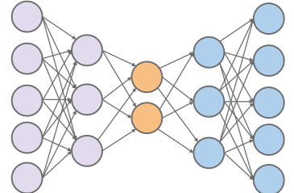
8 Introduction to Autoencoders (3)
https://www.tensorflow.org/tutorials/
Deeper Autoencoder (1)

Slide 26
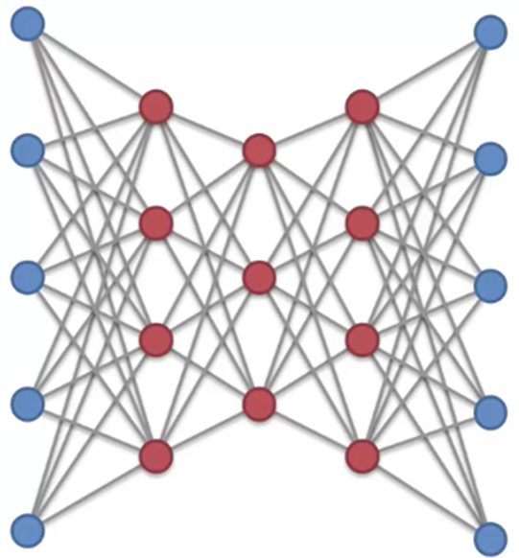
8 Introduction to Autoencoders (3)
https://www.tensorflow.org/tutorials/
Deeper Autoencoder (2)

Slide 27
8 Introduction to Autoencoders (3)
https://www.tensorflow.org/tutorials/
Variational Autoencoders (1)
they learn the probability distribution of the data
the hidden code is from a probability distribution that is learned during the training
More in-depth details here:
https://hsaghir.github.io/data_science/denoising-vs-variational-autoencoder/

Slide 28
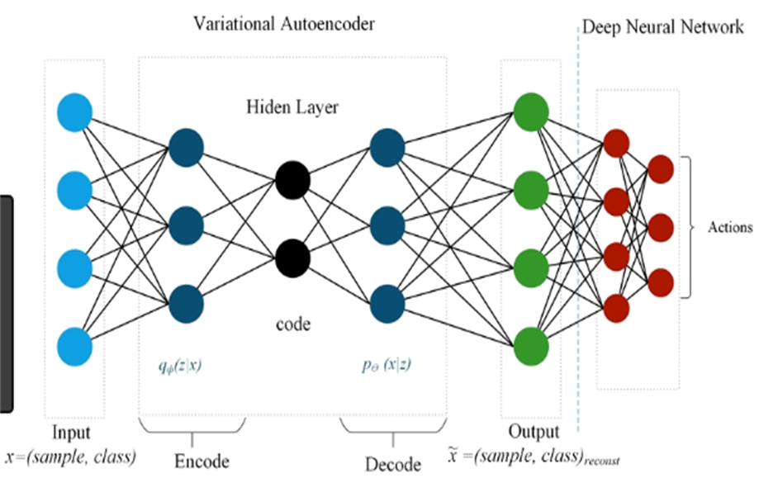
8 Introduction to Autoencoders (3)
https://www.tensorflow.org/tutorials/
Variational Autoencoders (2)

Slide 29
8 Introduction to Autoencoders (3)
https://www.tensorflow.org/tutorials/
Linear Autoencoders
you can use Stochastic Gradient Descent (SGD) to train a linear autoencoder
hence there is no need to load all the training samples in the main memory at once, which can be problematic with large-scale tasks
A single layer auto encoder with linear transfer function is nearly equivalent to PCA
More in-depth details here:
https://arxiv.org/abs/1804.10253

Slide 30
8 Introduction to Autoencoders (3)
https://www.tensorflow.org/tutorials/
Linear Autoencoders (2)
you can use Stochastic Gradient Descent (SGD) to train a linear autoencoder
hence there is no need to load all the training samples in the main memory at once, which can be problematic with large-scale tasks
A single layer auto encoder with linear transfer function is nearly equivalent to PCA
More in-depth details here:
https://arxiv.org/abs/1804.10253

Slide 31
8 Introduction to Autoencoders (3)
https://www.tensorflow.org/tutorials/
What About GANs?
Generative Adversarial Networks
the "opposite" of autoencoders
they operate on low dimensional input vectors
they output high dimensional data in the middle
they involve unsupervised learning

Slide 32
8 Introduction to Autoencoders (3)
https://www.tensorflow.org/tutorials/
Miscellaneous Links
Photo restoration with autoencoders:
https://www.cc.gatech.edu/~hays/7476/projects/Avery_Wenchen/
PCA versus autoencoders:
https://towardsdatascience.com/pca-vs-autoencoders-1ba08362f450
https://www.datacamp.com/community/tutorials/autoencoder-keras-tutorial
https://codeburst.io/deep-learning-types-and-autoencoders-a40ee6754663

Slide 33
8 Introduction to Autoencoders (3)
https://www.tensorflow.org/tutorials/
Autoencoder Samples (Keras)
keras-autoencoder1.py
https://blog.keras.io/building-autoencoders-in-keras.html
https://github.com/keras-team/keras/tree/master/examples
https://github.com/ardendertat/Applied-Deep-Learning-with-Keras/blob/master/notebooks/Part%203%20-%20Autoencoders.ipynb

Slide 34
8 Introduction to Autoencoders (3)
https://www.tensorflow.org/tutorials/
Autoencoder Samples (TF)
TensorFlow and autoencoder:
basic-autoencoder.py
LSTM autoencoder:
variational-autoencoder.py

Slide 35
8 Introduction to Autoencoders (3)
https://www.tensorflow.org/tutorials/
Which Type of NN to Use (1)
When to Use Multilayer Perceptrons?
When to Use CNNs?
When to Use RNNs?
Hybrid Network Models
https://machinelearningmastery.com/when-to-use-mlp-cnn-and-rnn-neural-networks/

Slide 36
8 Introduction to Autoencoders (3)
https://www.tensorflow.org/tutorials/
Which Type of NN to Use (2)
Use MLPs For:
Tabular datasets
Classification prediction problems
Regression prediction problems
Try MLPs On:
Image data
Text Data
Time series data

Slide 37
8 Introduction to Autoencoders (3)
https://www.tensorflow.org/tutorials/
Which Type of NN to Use (3)
Use CNNs For:
Image data
Classification prediction problems
Regression prediction problems
Try CNNs On:
Text data
Time series data
Sequence input data
Audio(?)

Slide 38
8 Introduction to Autoencoders (3)
https://www.tensorflow.org/tutorials/
Which Type of NN to Use (4)
Use RNNs For:
Text data
Speech data
Classification prediction problems
Regression prediction problems
Generative models
Don't Use RNNs For:
Tabular data
Image data (maybe)

Slide 39
8 Introduction to Autoencoders (3)
https://www.tensorflow.org/tutorials/
Which Type of NN to Use (5)
A CNN LSTM architecture (hybrid):
a stack of layers
a CNN on the input
LSTM in the middle
MLP at the output
this model is useful for:
read a sequence of image inputs
including video
can generate a prediction

Slide 40
End of Chapter

