Slide 1

2 Introduction to numpy (1)
Peter H. Chen

Slide 2
2 Introduction to numpy (1)
https://www.tensorflow.org/tutorials/
List of Topics
What is numpy?
Lists and arrays
Working with subranges
Working with “-1” subranges
Useful numpy methods
Numpy examples

Slide 3
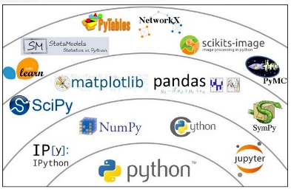
2 Introduction to numpy (1)
https://www.tensorflow.org/tutorials/
Python Scientific Ecosystem

Slide 4
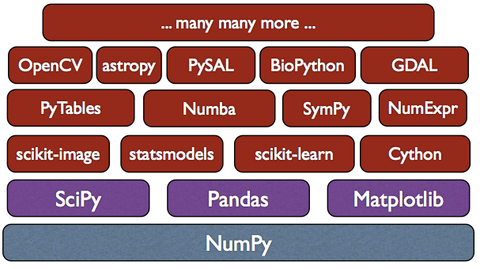
2 Introduction to numpy (1)
https://www.tensorflow.org/tutorials/
What is numpy? (1)
Core library for scientific computing in Python
Provides performant multi-dimensional arrays
Good vectorized math functions
Supports linear algebra, random numbers and FS
https://www.quora.com/What-is-the-relationship-among-NumPy-SciPy-Pandas-and-Scikit-learn-and-when-should-I-use-each-one-of-them
Numpy: Adds Python support for large, multi-dimensional arrays and matrices, along with a large library of high-level mathematical functions to operate on these arrays.
SciPy is a collection of mathematical algorithms and convenience functions built on the Numpy extension of Python. It adds significant power to the interactive Python session by providing the user with high-level commands and classes for manipulating and visualizing data.
Pandas: Software library written for data manipulation and analysis in Python. Offers data structures and operations for manipulating numerical tables and time series.
Scikit-learn is a Python module for machine learning built on top of SciPy and distributed under the 3-Clause BSD license.

Slide 5
2 Introduction to numpy (1)
https://www.tensorflow.org/tutorials/
What is numpy? (2)
modeled after MatLab
Supports lists, arrays, etc (uses less memory)
Very common in TF/Python code
Numpy treats arrays as vectors
Math ops are performed element-by-element
“doubling” an array: multiplies each element by 2
“doubling” a list: appends a list to itself
=> for loops with large arrays are slow in Python

Slide 6
2 Introduction to numpy (1)
https://www.tensorflow.org/tutorials/
Lists and arrays (1)
# nparray1.py
import numpy as np
list1 = [1,2,3,4,5]
print(list1)
# [1, 2, 3, 4, 5]
arr1 = np.array([1,2,3,4,5])
print(arr1)
# [1 2 3 4 5]
Lists and arrays (2)
# nparray2.py
import numpy as np
list2 = [(1,2,3), (4,5,6)]
print(list2)
#[(1, 2, 3), (4, 5, 6)]
arr2 = np.array([(1,2,3),(4,5,6)])
print(arr2)
#[[1 2 3]
# [4 5 6]]

Slide 7
2 Introduction to numpy (1)
https://www.tensorflow.org/tutorials/
Lists, arrays, and loops
# loop1.py
import numpy as np
list = [1,2,3]
arr1 = np.array([1,2,3])
for e in list:
print e
for e in arr1:
print e

Slide 8
2 Introduction to numpy (1)
https://www.tensorflow.org/tutorials/
Appending to Lists
# append1.py
import numpy as np
list = [1,2,3]
list.append(4)
list = list + [5]
for e in list:
print e

Slide 9
2 Introduction to numpy (1)
https://www.tensorflow.org/tutorials/
Appending to Arrays (1)
# append2.py
import numpy as np
arr1 = np.array([1,2,3])
# these do not work:
#arr1.append(4)
#arr1 = arr1 + [5]
arr1 = np.append(arr1,4)
arr1 = np.append(arr1,[5])
for e in arr1:
print e
arr2 = arr1 + arr1
for e in arr2:
print e
Appending to Arrays (2)
# append2b.py
import numpy as np
arr1 = np.array([1,2,3])
arr1 = np.append(arr1,4)
for e in arr1:
print e
Appending to Arrays (3)
# append2c.py
import numpy as np
arr1 = np.array([1,2,3])
arr1 = np.append(arr1,4)
arr2 = arr1 + arr1
for e in arr2:
print e

Slide 10
2 Introduction to numpy (1)
https://www.tensorflow.org/tutorials/
Multiply Lists and Arrays
# multiply1.py
import numpy as np
list = [1,2,3]
arr1 = np.array([1,2,3])
print('list: ',list)
print('arr1: ',arr1)
print('2*list:',2*list)
print('2*arr1:',2*arr1)
('list: ', [1, 2, 3])
('arr1: ', array([1, 2, 3]))
('2*list:', [1, 2, 3, 1, 2, 3])
('2*arr1:', array([2, 4, 6]))

Slide 11
2 Introduction to numpy (1)
https://www.tensorflow.org/tutorials/
Double a List
# double-list.py
import numpy as np
list = [1,2,3]
list2 = []
for e in list:
list2.append(2*e)
print('list: ',list)
print('list2:',list2)
('list: ', [1, 2, 3])
('list2:', [2, 4, 6])

Slide 12
2 Introduction to numpy (1)
https://www.tensorflow.org/tutorials/
Lists and Exponents
# exponent-list.py
import numpy as np
list = [1,2,3]
list2 = []
for e in list:
list2.append(e*e) # e*e*e = cubed
print('list: ',list)
print('list2:',list2)
('list: ', [1, 2, 3])
('list2:', [1, 4, 9])

Slide 13
2 Introduction to numpy (1)
https://www.tensorflow.org/tutorials/
Arrays and Exponents
# exponent-array.py
import numpy as np
arr1 = np.array([1,2,3])
arr2 = arr1**2
arr3 = arr1**3
print('arr1:',arr1)
print('arr2:',arr2)
print('arr3:',arr3)
# ('arr1:', array([1, 2, 3]))
# ('arr2:', array([1, 4, 9]))
# ('arr3:', array([ 1, 8, 27]))

Slide 14
2 Introduction to numpy (1)
https://www.tensorflow.org/tutorials/
Math Operations and Arrays
# mathops-array.py
import numpy as np
arr1 = np.array([1,2,3])
sqrt = np.sqrt(arr1)
log1 = np.log(arr1)
exp1 = np.exp(arr1)
print('sqrt:',sqrt)
print('log1:',log1)
print('exp1:',exp1)
#('sqrt:', array([1. , 1.41421356, 1.73205081]))
#('log1:', array([0. , 0.69314718, 1.09861229]))
#('exp1:', array([2.71828183, 7.3890561, 20.08553692]))

Slide 15
2 Introduction to numpy (1)
https://www.tensorflow.org/tutorials/
Working with “-1” subranges
# npsubarray2.py
import numpy as np
# -1 => “all except the last element in …” (row or col)
arr1 = np.array([1,2,3,4,5])
print('arr1:',arr1)
print(‘arr1[0:-1]:’,arr1[0:-1])
print(‘arr1[1:-1]:’,arr1[1:-1])
print(‘arr1[::-1]:’, arr1[::-1]) # reverse!
#(‘arr1:’, array([1, 2, 3, 4, 5]))
#(‘arr1[0:-1]:’, array([1, 2, 3, 4]))
#(‘arr1[1:-1]:’, array([2, 3, 4]))
#(‘arr1[::-1]:’, array([5, 4, 3, 2, 1]))

Slide 16
2 Introduction to numpy (1)
https://www.tensorflow.org/tutorials/
Working with “-1” subranges (1)
# npsubarray2.py
import numpy as np
# -1 => “all except the last element in …” (row or col)
arr1 = np.array([1,2,3,4,5])
print('arr1:',arr1)
print(‘arr1[0:-1]:’,arr1[0:-1])
print(‘arr1[1:-1]:’,arr1[1:-1])
print(‘arr1[::-1]:’, arr1[::-1]) # reverse!
#(‘arr1:’, array([1, 2, 3, 4, 5]))
#(‘arr1[0:-1]:’, array([1, 2, 3, 4]))
#(‘arr1[1:-1]:’, array([2, 3, 4]))
#(‘arr1[::-1]:’, array([5, 4, 3, 2, 1]))

Slide 17
2 Introduction to numpy (1)
https://www.tensorflow.org/tutorials/
Working with “-1” subranges (2)
# np2darray2.py
import numpy as np # -1 => “the last element in …” (row or col)
arr1 =
np.array([(1,2,3),(4,5,6),(7,8,9),(10,11,12)])
print('arr1:',arr1)
print(‘arr1[-1,:]:’, arr1[-1,:])
print(‘arr1[:,-1]:’, arr1[:,-1])
print(‘arr1[-1:,-1]:’,arr1[-1:,-1])
#(arr1:’, array([[1, 2, 3],
# [4, 5, 6],
# [7, 8, 9],
# [10, 11, 12]]))
#(arr1[-1,:]]', array([10, 11, 12]))
#(arr1[:,-1]:', array([3, 6, 9, 12]))
#(arr1[-1:,-1]]', array([12]))

Slide 18
2 Introduction to numpy (1)
https://www.tensorflow.org/tutorials/
Useful numpy Methods
np.zeros(), np.ones(), np.empty(), np.arange()
np.shape()
np.reshape() <= VERY USEFUL!
np.linspace() <= USEFUL (REGRESSION)
np.mean(), np.std()

Slide 19
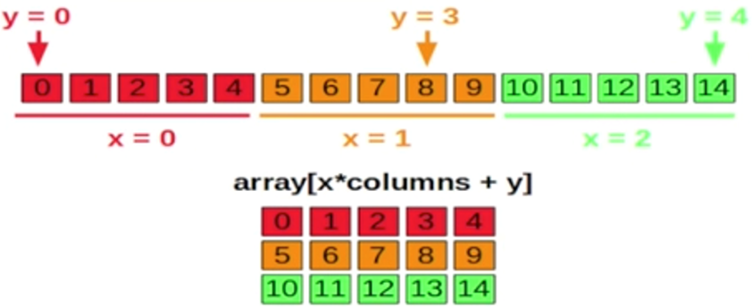
2 Introduction to numpy (1)
https://www.tensorflow.org/tutorials/
Reshaped/Flattened Array

Slide 20
2 Introduction to numpy (1)
https://www.tensorflow.org/tutorials/
Arrays and Vector Operations (1)
# array-vector.py
import numpy as np
a = np.array([[1,2], [3, 4]])
b = np.array([[5,6], [7,8]])
print('a: ', a)
print('b: ', b)
print('a + b: ', a+b)
print('a - b: ', a-b)
print('a * b: ', a*b)
print('a / b: ', a/b)
print('b / a: ', b/a)
print('a.dot(b):',a.dot(b))
Arrays and Vector Operations (2)
('a : ', array([[1, 2], [3, 4]]))
('b : ', array([[5, 6], [7, 8]]))
('a + b: ', array([[ 6, 8], [10, 12]]))
('a - b: ', array([[-4, -4], [-4, -4]]))
('a * b: ', array([[ 5, 12], [21, 32]]))
('a / b: ', array([[0, 0], [0, 0]]))
('b / a: ', array([[5, 3], [2, 2]]))
('a.dot(b):', array([[19, 22], [43, 50]]))

Slide 21
2 Introduction to numpy (1)
https://www.tensorflow.org/tutorials/
numpy and dot products1 (1)
# dotproduct1.py
import numpy as np
a = np.array([1,2])
b = np.array([2,3])
dot2 = 0
for e,f in zip(a,b):
dot2 += e*f
print('a: ‘,a)
print('b: ‘,b)
print('a*b: ',a*b)
print('dot1:',a.dot(b))
print('dot2:',dot2)
numpy and dot products1 (2)
('a: ', array([1, 2]))
('b: ', array([2, 3]))
('a*b: ', array([2, 6]))
('dot1:', 8)
('dot2:', 8)

Slide 22
2 Introduction to numpy (1)
https://www.tensorflow.org/tutorials/
numpy and dot products2 (2)
# dotproduct2.py
import numpy as np
a = np.array([1,2])
b = np.array([2,3])
print('a: ‘,a)
print('b: ‘,b)
print('a.dot(b): ’,a.dot(b))
print('b.dot(a): ',b.dot(a))
print('np.dot(a,b):',np.dot(a,b))
print('np.dot(b,a):',np.dot(b,a)))
numpy and dot products2 (2)
('a: ', array([1, 2]))
('b: ', array([2, 3]))
('a.dot(b): ', 8)
('b.dot(a): ', 8)
('np.dot(a,b):', 8)
('np.dot(b,a):', 8)

Slide 23
2 Introduction to numpy (1)
https://www.tensorflow.org/tutorials/
numpy and vector “norm” (1)
# array-norm.py
import numpy as np
a = np.array([2,3])
asquare = np.square(a)
asqsum = np.sum(np.square(a))
anorm1 = np.sqrt(np.sum(a*a))
anorm2 = np.sqrt(np.sum(np.square(a)))
anorm3 = np.linalg.norm(a)
print('a: ‘,a)
print('asquare:',asquare)
print('asqsum: ',asqsum)
print('anorm1: ',anorm1)
print('anorm2: ',anorm2)
print('anorm3: ',anorm3)
numpy and vector “norm” (2)
('a: ', array([2, 3]))
('asquare:', array([4, 9]))
('asqsum: ', 13)
('anorm1: ', 3.605551275463989)
('anorm2: ', 3.605551275463989)
('anorm3: ', 3.605551275463989)

Slide 24
2 Introduction to numpy (1)
https://www.tensorflow.org/tutorials/
numpy and other products (1)
# otherops.py
import numpy as np
a = np.array([1,2])
b = np.array([3,4])
print('a: ‘,a)
print('b: ‘,b)
print('a*b: ',a*b)
print('np.sum(a*b): ',np.sum(a*b))
print('(a*b.sum()): ',(a*b).sum())
numpy and other products (2)
('a: ', array([1, 2]))
('b: ', array([3, 4]))
('a*b: ', array([3, 8]))
('np.sum(a*b): ', 11)
('(a*b.sum()): ', 11)

Slide 25
2 Introduction to numpy (1)
https://www.tensorflow.org/tutorials/
Summary
numpy methods:
np.zeroes(), np.ones(), np.arange()
np.reshape(), np.mean(), np.std()
np.shape()
PySpark and PyCharm IDEs (optional)
PDF available here: https://github.com/kailashahirwar/cheatsheets-ai

Slide 26
End of Chapter

