Slide 1

2 Introduction to numpy (2)
Peter H. Chen

Slide 2
2 Introduction to numpy (2)
https://www.tensorflow.org/tutorials/
List of Topics
Trigonometric functions
sine/cosine values
Cosine of angle between vectors
Useful numpy methods
Best fit example
np.linspace() method
Matrices and vectors

Slide 3
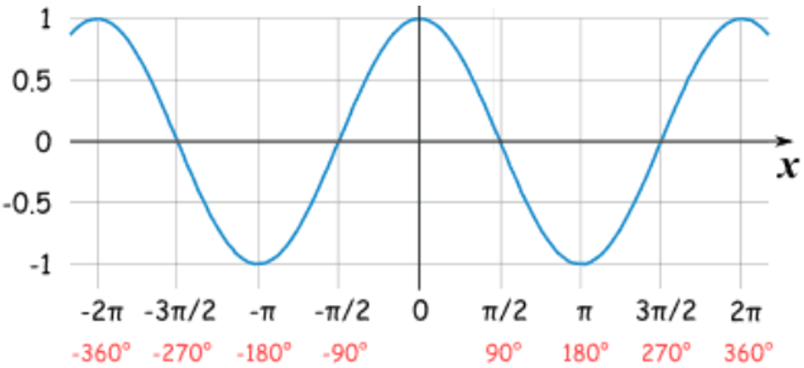
2 Introduction to numpy (2)
https://www.tensorflow.org/tutorials/
Sine and Cosine Values
Cos(0) = 1
Cos(90) = 0
Cos(180) = -1
Cos(270) = 0
Sin(0) = 0
Sin(90) = 1
Sin(180) = 0
Sin(270) = -1
Cosine Function

Slide 4
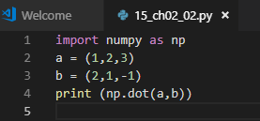
2 Introduction to numpy (2)
https://www.tensorflow.org/tutorials/
Dot Product of Two Vectors (1)
a = (a1,a2,…,an)
b = (b1,b2,…,bn)
np.dot(a,b) = a1*b1+a2*b2+. . . +an*bn
Example 1:
Import numpy as np
a = (1,2,3)
b = (2,1,-1)
np.dot(a,b) # = 2+2-3 = 1
Example 2:
i = (1,0)
j = (0,1)
np.dot(i,j) = 0 + 0 = 0 (orthogonal)
Dot Product of Two Vectors (2)
Example 3:
i = (2,0)
j = (0,5)
np.dot(i,i) = 0 + 0 = 0 (orthogonal)
Example 3:
i = (1,0)
j = (1,0)
np.dot(i,i) = 1 + 0 = 1

Slide 5
2 Introduction to numpy (2)
https://www.tensorflow.org/tutorials/
Cosine of angle between Vectors
a is a 1 x n vector
b is a 1 x n vector
np.dot(a,b) = |a||b|cosine(angle)
angle = angle between a and b
np.dot(i,j) = 0 => angle = 90

Slide 6
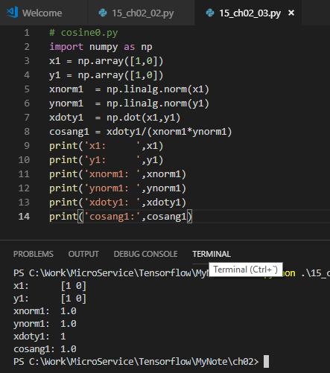
2 Introduction to numpy (2)
https://www.tensorflow.org/tutorials/
Cosine of angle between Vectors (1)
# cosine0.py
import numpy as np
x1 = np.array([1,0])
y1 = np.array([1,0])
xnorm1 = np.linalg.norm(x1)
ynorm1 = np.linalg.norm(y1)
xdoty1 = np.dot(x1,y1)
cosang1 = xdoty1/(xnorm1*ynorm1)
print('x1: ',x1)
print('y1: ',y1)
print('xnorm1: ',xnorm1)
print('ynorm1: ',ynorm1)
print('xdoty1: ',xdoty1)
print('cosang1:',cosang1)

Slide 7
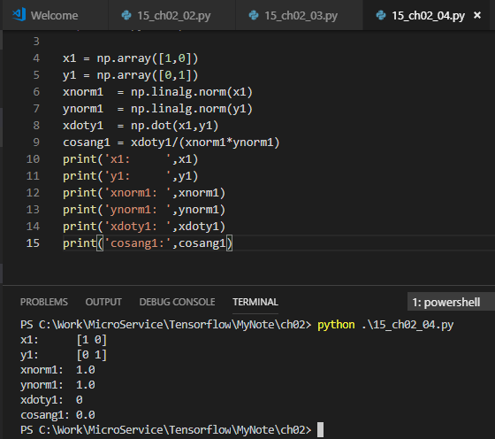
2 Introduction to numpy (2)
https://www.tensorflow.org/tutorials/
Cosine of angle between Vectors (2)
# cosine90.py
import numpy as np
x1 = np.array([1,0])
y1 = np.array([0,1])
xnorm1 = np.linalg.norm(x1)
ynorm1 = np.linalg.norm(y1)
xdoty1 = np.dot(x1,y1)
cosang1 = xdoty1/(xnorm1*ynorm1)
print('x1: ',x1)
print('y1: ',y1)
print('xnorm1: ',xnorm1)
print('ynorm1: ',ynorm1)
print('xdoty1: ',xdoty1)
print('cosang1:',cosang1)

Slide 8
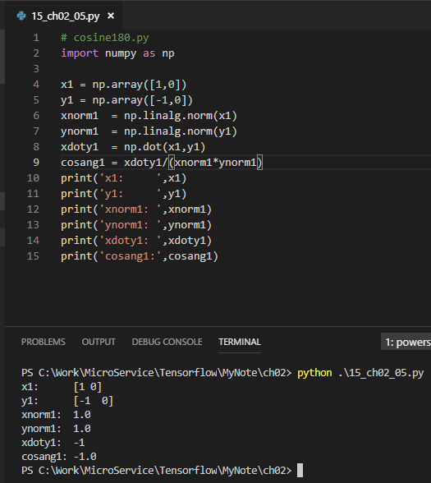
2 Introduction to numpy (2)
https://www.tensorflow.org/tutorials/
Cosine of angle between Vectors (3)
# cosine180.py
import numpy as np
x1 = np.array([1,0])
y1 = np.array([-1,0])
xnorm1 = np.linalg.norm(x1)
ynorm1 = np.linalg.norm(y1)
xdoty1 = np.dot(x1,y1)
cosang1 = xdoty1/(xnorm1*ynorm1)
print('x1: ',x1)
print('y1: ',y1)
print('xnorm1: ',xnorm1)
print('ynorm1: ',ynorm1)
print('xdoty1: ',xdoty1)
print('cosang1:',cosang1)

Slide 9
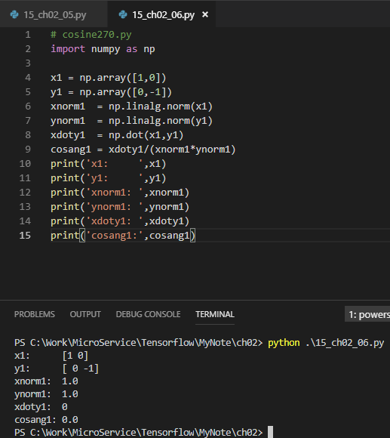
2 Introduction to numpy (2)
https://www.tensorflow.org/tutorials/
Cosine of angle between Vectors (4)
# cosine270.py
import numpy as np
x1 = np.array([1,0])
y1 = np.array([0,-1])
xnorm1 = np.linalg.norm(x1)
ynorm1 = np.linalg.norm(y1)
xdoty1 = np.dot(x1,y1)
cosang1 = xdoty1/(xnorm1*ynorm1)
print('x1: ',x1)
print('y1: ',y1)
print('xnorm1: ',xnorm1)
print('ynorm1: ',ynorm1)
print('xdoty1: ',xdoty1)
print('cosang1:',cosang1)

Slide 10
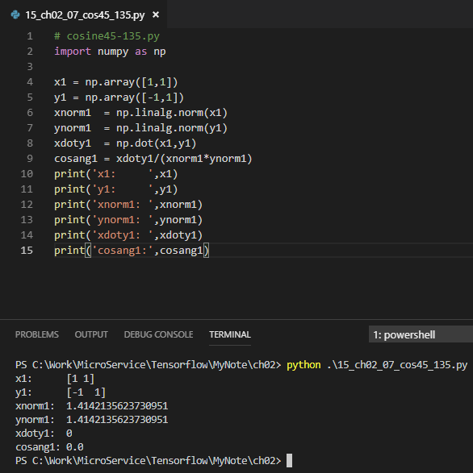
2 Introduction to numpy (2)
https://www.tensorflow.org/tutorials/
Cosine of angle between Vectors (5)
# cosine45-135.py
import numpy as np
x1 = np.array([1,1])
y1 = np.array([-1,1])
xnorm1 = np.linalg.norm(x1)
ynorm1 = np.linalg.norm(y1)
xdoty1 = np.dot(x1,y1)
cosang1 = xdoty1/(xnorm1*ynorm1)
print('x1: ',x1)
print('y1: ',y1)
print('xnorm1: ',xnorm1)
print('ynorm1: ',ynorm1)
print('xdoty1: ',xdoty1)
print('cosang1:',cosang1)

Slide 11
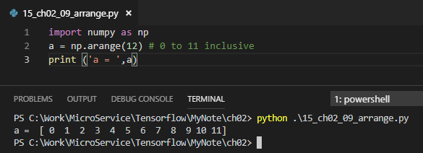
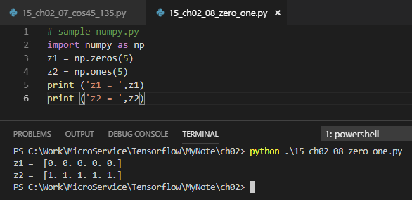
2 Introduction to numpy (2)
https://www.tensorflow.org/tutorials/
Useful numpy methods (1)
# sample-numpy.py
import numpy as np
z1 = np.zeros(5)
z2 = np.ones(5)
print ('z1 = ',z1)
print ('z2 = ',z2)
# z1 = [0. 0. 0. 0. 0.]
# z2 = [1. 1. 1. 1. 1.]
Useful numpy methods (2)
#Filename: sample-arange.py
import numpy as np
a = np.arange(12) # 0 to 11 inclusive
print ('a = ',a)
# a = [0 1 2 3 4 5 6 7 8 9 10 11]

Slide 12
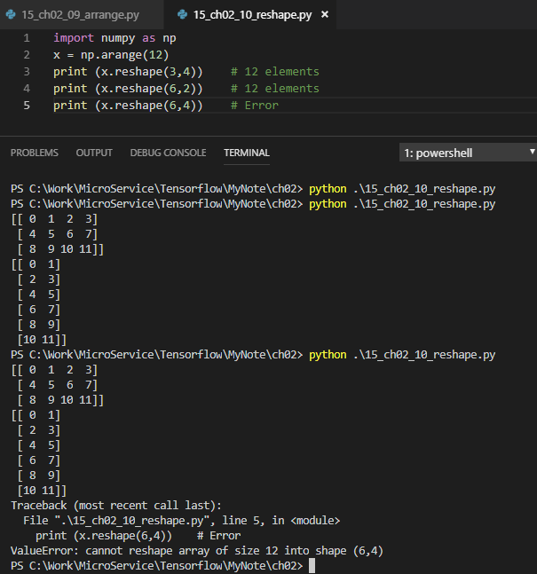
2 Introduction to numpy (2)
https://www.tensorflow.org/tutorials/
Useful numpy methods (3)
Filename: sample-reshape.py
=> “reshapes” into rows x columns
import numpy as np
x = np.arange(12)
print (x.reshape(3,4))
# 12 elements
print (x.reshape(6,2))
# 12 elements
print (x.reshape(6,4))
# Error

Slide 13
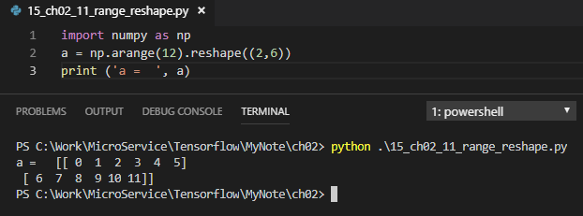
2 Introduction to numpy (2)
https://www.tensorflow.org/tutorials/
Useful numpy methods (4)
Filename: sample-range-reshape.py
import numpy as np
a = np.arange(12).reshape((2,6))
print ('a = ', a)
# a = [[ 0 1 2 3 4 5]
# [ 6 7 8 9 10 11]]

Slide 14
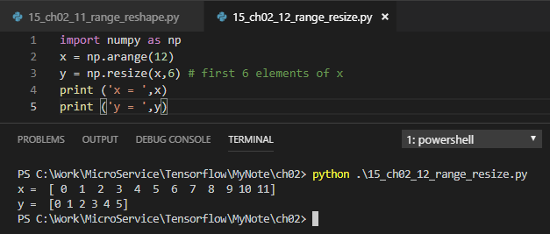
2 Introduction to numpy (2)
https://www.tensorflow.org/tutorials/
Useful numpy methods (5)
Filename: sample-range-resize.py
import numpy as np
x = np.arange(12)
y = np.resize(x,6) # first 6 elements of x
print ('x = ‘,x)
print ('y = ',y)
# x = [ 0 1 2 3 4 5 6 7 8 9 10 11]
# y = [0 1 2 3 4 5]

Slide 15
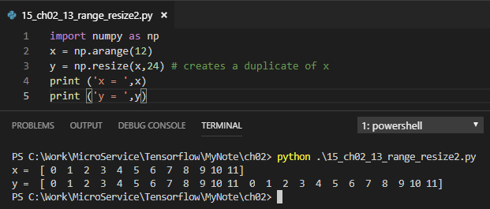
2 Introduction to numpy (2)
https://www.tensorflow.org/tutorials/
Useful numpy methods (6)
Filename: sample-resize2.py
import numpy as np
x = np.arange(12)
y = np.resize(x,24) # creates a duplicate of x
print ('x = ‘,x)
print ('y = ',y)
# x = [ 0 1 2 3 4 5 6 7 8 9 10 11]
# y = [ 0 1 2 3 4 5 6 7 8 9 10 11 0 1 2 3 4 5 6 7 8 9 10 11]

Slide 16
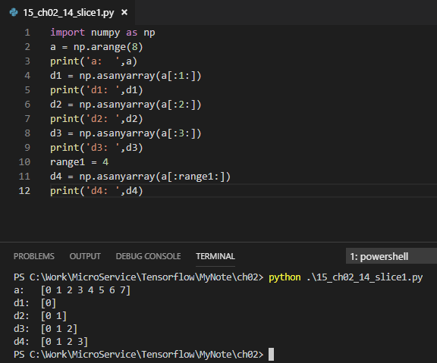
2 Introduction to numpy (2)
https://www.tensorflow.org/tutorials/
Useful numpy methods (7): Slices
# slices1.py
import numpy as np
a = np.arange(8)
print('a: ‘,a)
d1 = np.asanyarray(a[:1:])
print('d1: ',d1)
d2 = np.asanyarray(a[:2:])
print('d2: ',d2)
d3 = np.asanyarray(a[:3:])
print('d3: ',d3)
range1 = 4
d4 = np.asanyarray(a[:range1:]) print('d4: ',d4)
#a: [0 1 2 3 4 5 6 7]
#d1: [0]
#d2: [0 1]
#d3: [0 1 2]
#d4: [0 1 2 3]

Slide 17
2 Introduction to numpy (2)
https://www.tensorflow.org/tutorials/
Useful numpy methods (9): Slices
# slices2.py
import numpy as np
a = np.arange(8)
print(‘a: ‘,a)
d1 = np.asanyarray(a[0:1])
print(‘d1: ‘,d1)
d2 = np.asanyarray(a[0:4])
print(‘d2: ’,d2)
d3 = np.asanyarray(a[2:5])
print(‘d3: ’,d3)
d4 = np.asanyarray(a[1:])
print(‘d4: ’,d4)
d5 = np.asanyarray(a[:-1])
print(‘d5: ',d5)
Useful numpy methods (10): Slices
Output from slices2.py:
(‘a: ’, array([0,1,2,3,4,5,6, 7]))
(‘d1: ‘, array([0]))
(‘d2: ‘, array([0, 1, 2, 3]))
(‘d3: ’, array([2, 3, 4]))
(‘d4: ‘ , array([1, 2,3,4,5,6,7]))
(‘d5: ‘, array([0,1,2,3,4,5,6]))

Slide 18
2 Introduction to numpy (2)
https://www.tensorflow.org/tutorials/
Useful numpy methods (11): Slices
# slices3.py
import numpy as np
a = np.array([[1,2,3],[4,5,6],[7,8,9]])
print(‘a: ‘,a)
d1 = np.asanyarray(a[0:1])
print(‘d1: ‘,d1)
d2 = np.asanyarray(a[1:3])
print(‘d2: ‘,d2)
d3 = np.asanyarray(a[1:])
print(‘d3: ‘,d3)
d4 = np.asanyarray(a[:-1]) # omit last one
print(‘d4: ‘,d4)
d5 = np.asanyarray(a[-1])
print(‘d5: ‘,d5)
a: [[1 2 3]
[4 5 6]
[7 8 9]]
d1: [[1 2 3]]
d2: [[4 5 6]
[7 8 9]]
d3: [[4 5 6]
[7 8 9]]
d4: [[1 2 3]
[4 5 6]]
d5: [7 8 9]

Slide 19
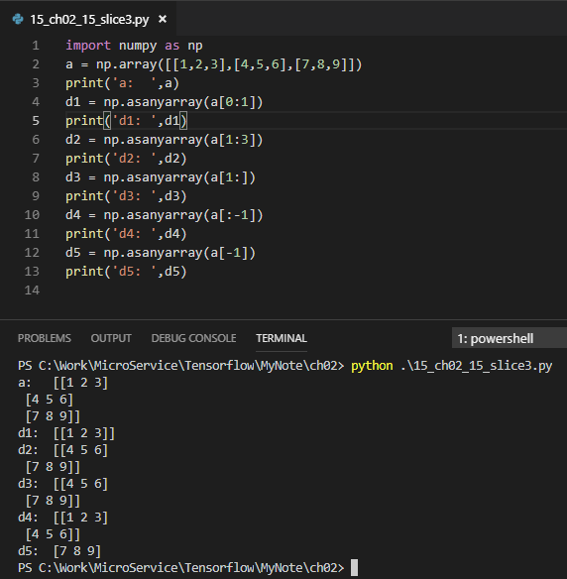
2 Introduction to numpy (2)
https://www.tensorflow.org/tutorials/
Useful numpy methods (11): Slices
# slices3.py
import numpy as np
a = np.array([[1,2,3],[4,5,6],[7,8,9]])
print(‘a: ‘,a)
d1 = np.asanyarray(a[0:1])
print(‘d1: ‘,d1)
d2 = np.asanyarray(a[1:3])
print(‘d2: ‘,d2)
d3 = np.asanyarray(a[1:])
print(‘d3: ‘,d3)
d4 = np.asanyarray(a[:-1]) # omit last one
print(‘d4: ‘,d4)
d5 = np.asanyarray(a[-1])
print(‘d5: ‘,d5)
a: [[1 2 3]
[4 5 6]
[7 8 9]]
d1: [[1 2 3]]
d2: [[4 5 6]
[7 8 9]]
d3: [[4 5 6]
[7 8 9]]
d4: [[1 2 3]
[4 5 6]]
d5: [7 8 9]

Slide 20
2 Introduction to numpy (2)
https://www.tensorflow.org/tutorials/
Useful numpy methods (11): Stats
Filename: sample-mean-std.py
x2 = np.arange(8) # 0, 1, 2, 3, 4, 5, 6, 7
print 'x2.mean = ',x2.mean()
print 'x2.std = ',x2.std()
x3 = (x2 - x2.mean())/x2.std()
print 'x3 mean = ',x3.mean()
print 'x3 std = ',x3.std()
x2 mean = 3.5
x2 std = 2.29128784748
x3 mean = 0.0
x3 std = 1.0

Slide 21
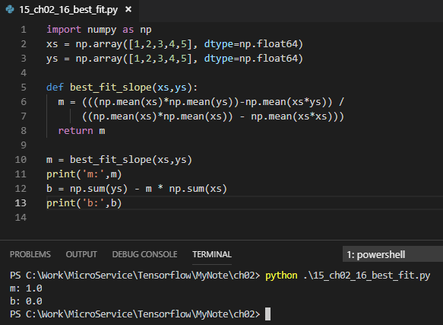
2 Introduction to numpy (2)
https://www.tensorflow.org/tutorials/
Best Fit for Lines (1)
import numpy as np
xs = np.array([1,2,3,4,5], dtype=np.float64)
ys = np.array([1,2,3,4,5], dtype=np.float64)
def best_fit_slope(xs,ys):
m = (((np.mean(xs)*np.mean(ys))-np.mean(xs*ys)) /
((np.mean(xs)*np.mean(xs)) - np.mean(xs*xs)))
return m
m = best_fit_slope(xs,ys)
print('m:’,m)
b = np.sum(ys) - m * np.sum(xs)
print('b:',b)

Slide 22
2 Introduction to numpy (2)
https://www.tensorflow.org/tutorials/
Best Fit for Lines (2)
# plot-best-fit2.py
import numpy as np
xs = np.array([1,2,3,4,5], dtype=np.float64)
ys = np.array([1,2,3,4,5], dtype=np.float64)
def best_fit_slope(xs,ys):
m = (((np.mean(xs)*np.mean(ys))-np.mean(xs*ys)) /
((np.mean(xs)**2) - np.mean(xs**2)))
b = np.sum(ys) - m * np.sum(xs)
return m, b
m,b = best_fit_slope(xs,ys)
print('m:',m,'b:',b)

Slide 23
2 Introduction to numpy (2)
https://www.tensorflow.org/tutorials/
Best Fit for Lines (3)
regression_line = [(m*x)+b for x in xs]
#regression_line = []
#for x in xs:
# regression_line.append((m*x)+b)
import matplotlib.pyplot as plt
from matplotlib import style
style.use('ggplot’)
plt.scatter(xs,ys,color='#0000FF’)
plt.plot(xs, regression_line)
plt.show()
Best Fit for Lines (4)
regression_line = [(m*x)+b for x in xs]
#regression_line = []
#for x in xs:
# regression_line.append((m*x)+b)
import matplotlib.pyplot as plt
from matplotlib import style
style.use('ggplot’)
plt.scatter(xs,ys,color='#0000FF’)
plt.plot(xs, regression_line)
plt.show()

Slide 24
2 Introduction to numpy (2)
https://www.tensorflow.org/tutorials/
What is Numpy linspace()? (1)
The linspace function generates linearly spaced vectors. It is similar to the colon operator ":", but gives direct control over the number of points. y = linspace(a,b) generates a row vector y of 100 points linearly spaced between and including a and b.
numpy.linspace(start, stop, num=50, endpoint=True, retstep=False, dtype=None, axis=0

Slide 25
2 Introduction to numpy (2)
https://www.tensorflow.org/tutorials/
What is Numpy linspace()? (1)
Generates evenly-spaced values
# linspace1.py
import numpy as np
x1 = np.linspace(0.0, 6.0, 4)
print('x1:',x1)
#('x1:', array([0., 2., 4., 6.]))
x2 = np.linspace(-10.0, 10.0, 21)
print('x2:',x2)
#('x2:’,array([-10., -9., -8., ..., 9.,10.]))

Slide 26
2 Introduction to numpy (2)
https://www.tensorflow.org/tutorials/
What is Numpy linspace()? (2)
# linspace2.py
import numpy as np
x1 = np.linspace(0.0, 6.0, 10)
print('x1:',x1)
x2 = np.linspace(4.0, 10.0, 20)
print('x2:',x2)
What is Numpy linspace()? (3)
('x1:', array([0., 0.66666667, 1.33333333,
2., 2.66666667, 3.33333333,
4., 4.66666667, 5.33333333, 6.]))
('x2:’,
array([4., 4.31578947, 4.63157895, 4.94736842,
5.26315789, 5.57894737, 5.89473684,
6.21052632, 6.52631579, 6.84210526,
7.15789474,7.47368421, 7.78947368,
8.10526316, 8.42105263, 8.73684211,
9.05263158, 9.36842105, 9.68421053,10.]))

Slide 27
2 Introduction to numpy (2)
https://www.tensorflow.org/tutorials/
What is Numpy linspace()?
import tensorflow as tf # linspace3.py
import numpy as np
trainX = np.linspace(-1, 1, 6)
trainY = 3*trainX+ np.random.randn(*trainX.shape)*0.5
with tf.Session() as sess:
print( "trainX: ”, trainX)
print( "trainY: ”, trainY)

Slide 28
2 Introduction to numpy (2)
https://www.tensorflow.org/tutorials/
What is Numpy linspace()?
# output from linspace3.py
trainX:
[-1. -0.6 -0.2 0.2 0.6 1.]
trainY:
[-3.33147863 -2.33299867 -0.44767251
1.28224251 0.91729746 2.85391381]

Slide 29
2 Introduction to numpy (2)
https://www.tensorflow.org/tutorials/
Useful numpy methods
import numpy as np
import matplotlib.pyplot as plt
# Generate dataset
trX = np.linspace(-1, 1, 21)
plt.plot(trX, 'ro-')
plt.ylabel('Height')
plt.xlabel('Weight')
plt.show()

Slide 30
2 Introduction to numpy (2)
https://www.tensorflow.org/tutorials/
Useful numpy methods (random)
import numpy as np
import matplotlib.pyplot as plt
# Generate dataset
trX = np.linspace(-1, 1, 21)
trY = 2*trX + np.random.randn(*trX.shape)*0.2
plt.plot(trX, trY, 'ro-')
plt.ylabel('Height')
plt.xlabel('Weight')
plt.show()

Slide 31
2 Introduction to numpy (2)
https://www.tensorflow.org/tutorials/
Multiply Matrices and Vectors
import numpy as np # matrix-times-vector.py
a = np.array([[1], [2]])
b = np.array([[3, 4]])
c = np.dot(a,b)
print('a = ',a)
print('b = ',b)
print('c = ',c)
Multiply Matrices and Vectors
a = [[1]
[2]]
b = [[3 4]]
c = [[3 4]
[6 8]]

Slide 32
2 Introduction to numpy (2)
https://www.tensorflow.org/tutorials/
Multiply Two Matrices
import numpy as np # matrix-times-matrix.py
a = np.array([[1, 0], [0, 1]])
b = np.array([[4, 1], [2, 2]])
c = np.matmul(a, b)
print('a = ',a)
print('b = ',b)
print('c = ',c)
#array([[4, 1],
# [2, 2]])

Slide 33
2 Introduction to numpy (2)
https://www.tensorflow.org/tutorials/
Other useful numpy methods
np.sum(), np.max(), np.min()
np.sum(axis=0), np.sum(axis=1)
np.square(), np.sqrt()
np.random.randint()

Slide 34
2 Introduction to numpy (2)
https://www.tensorflow.org/tutorials/
Working with numpy
Numpy tutorials:
https://docs.scipy.org/doc/numpy-dev/user/quickstart.html
https://docs.scipy.org/doc/numpy/reference/generated/numpy.inner.html

Slide 35
2 Introduction to numpy (2)
https://www.tensorflow.org/tutorials/
Summary of Session (1)
numpy methods: np.zeroes(), np.ones(), np.arange(), np.reshape(), np.mean(), np.std(), np.shape()
PDF available here: https://github.com/kailashahirwar/cheatsheets-ai

Slide 36
End of Chapter

