Slide 1

2 Introduction to numpy (3)
Peter H. Chen

Slide 2
2 Introduction to numpy (3)
https://www.tensorflow.org/tutorials/
List of Topics
What is pandas?
What are dataframes?
What is matplotlib?
Plotting data/graphs
What is seaborn?

Slide 3
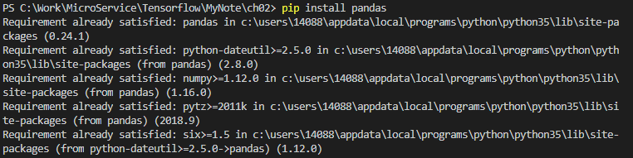
2 Introduction to numpy (3)
https://www.tensorflow.org/tutorials/
What is Panda?
pandas is a Python package
Compatible with numpy/matplotlib/etc
semantics of a spreadsheet
works with xsl, xml, html, csv file types
Dataframes: similar to Python dictionaries
pip install pandas

Slide 4
2 Introduction to numpy (3)
https://www.tensorflow.org/tutorials/
Series and Dataframes
Series CRUD
Series Indexing
Series Methods
Series Plotting
Data Frame Methods
Data Frame Statistics
Grouping, Pivoting, and Reshaping
Dealing With Missing Data
Joining Data Frames

Slide 5
2 Introduction to numpy (3)
https://www.tensorflow.org/tutorials/
Panda Dataframes
Very convenient data structure
Resembles an Excel spreadsheet
Created programmatically
Created from data files, web services, and etc.

Slide 6
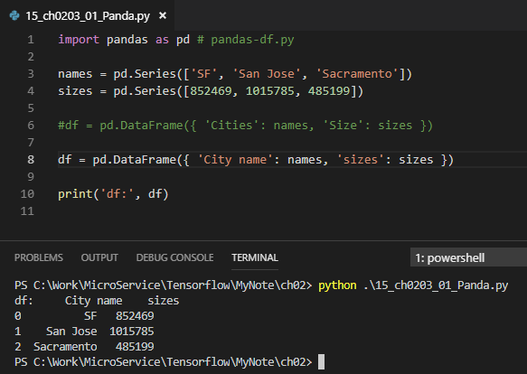
2 Introduction to numpy (3)
https://www.tensorflow.org/tutorials/
Panda Dataframes
import pandas as pd # pandas-df.py
names = pd.Series(['SF', 'San Jose', 'Sacramento’])
sizes = pd.Series([852469, 1015785, 485199])
#df = pd.DataFrame({ 'Cities': names, 'Size': sizes })
df = pd.DataFrame({ 'City name': names,’sizes': sizes })
print('df:',df)
('df:',
City name Sizes
0 SF 852469
1 San Jose 1015785
2 Sacramento 485199)

Slide 7
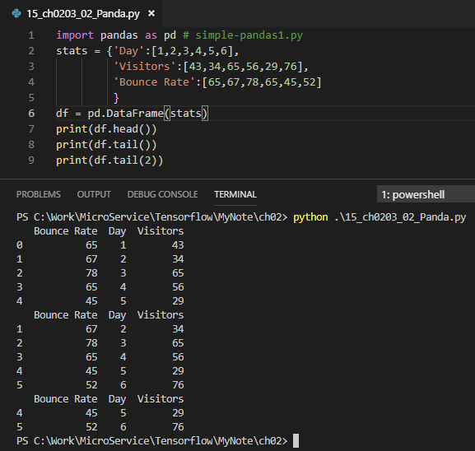
2 Introduction to numpy (3)
https://www.tensorflow.org/tutorials/
Panda Dataframes
import pandas as pd # simple-pandas1.py
stats = {'Day':[1,2,3,4,5,6],
'Visitors':[43,34,65,56,29,76],
'Bounce Rate':[65,67,78,65,45,52]
}
df = pd.DataFrame(stats)
print(df.head())
print(df.tail())
print(df.tail(2))

Slide 8
2 Introduction to numpy (3)
https://www.tensorflow.org/tutorials/
Panda Dataframes
print(df.head())
Bounce Rate Day Visitors
0 65 1 43
1 67 2 34
2 78 3 65
3 65 4 56
45 5 29
print(df.head())
Bounce Rate Day Visitors
0 65 1 43
1 67 2 34
2 78 3 65
3 65 4 56
4 45 5 29
Panda Dataframes
print(df.tail(2))
Bounce Rate Day Visitors
4 45 5 29
5 52 6 76

Slide 9
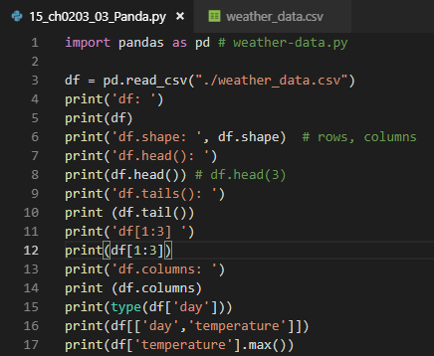
2 Introduction to numpy (3)
https://www.tensorflow.org/tutorials/
Panda Dataframes
import pandas as pd # weather-data.py df = pd.read_csv("./weather_data.csv")
print('df: ')
print(df)
print('df.shape: ', df.shape) # rows, columns
print('df.head(): ')
print(df.head()) # df.head(3)
print('df.tails(): ')
print (df.tail())
print('df[1:3] ')
print(df[1:3])
print('df.columns: ')
print (df.columns)
print(type(df['day']))
print(df[['day','temperature']])
print(df['temperature'].max())

Slide 10
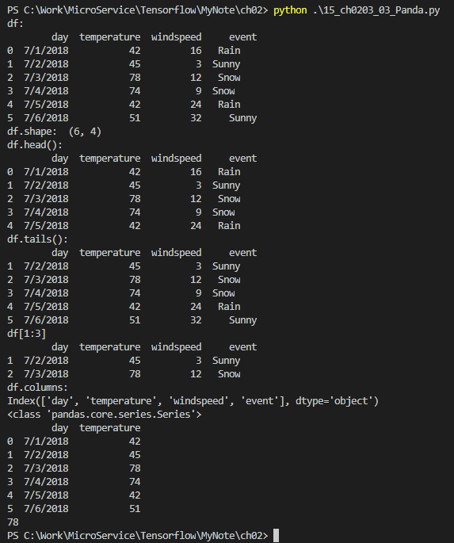
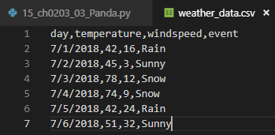
2 Introduction to numpy (3)
https://www.tensorflow.org/tutorials/
Panda Dataframes
day,temperature,windspeed,event
7/1/2018,42,16,Rain
7/2/2018,45,3,Sunny
7/3/2018,78,12,Snow
7/4/2018,74,9,Snow
7/5/2018,42,24,Rain
7/6/2018,51,32,Sunny

Slide 11
2 Introduction to numpy (3)
https://www.tensorflow.org/tutorials/
Panda Dataframes
PS C:\Work\MicroService\Tensorflow\MyNote\ch02> python .\15_ch0203_03_Panda.py
df:
day temperature windspeed event
0 7/1/2018 42 16 Rain
1 7/2/2018 45 3 Sunny
2 7/3/2018 78 12 Snow
3 7/4/2018 74 9 Snow
4 7/5/2018 42 24 Rain
5 7/6/2018 51 32 Sunny
df.shape: (6, 4)
df.head():
day temperature windspeed event
0 7/1/2018 42 16 Rain
1 7/2/2018 45 3 Sunny
2 7/3/2018 78 12 Snow
3 7/4/2018 74 9 Snow
4 7/5/2018 42 24 Rain
df.tails():
day temperature windspeed event
1 7/2/2018 45 3 Sunny
2 7/3/2018 78 12 Snow
3 7/4/2018 74 9 Snow
4 7/5/2018 42 24 Rain
5 7/6/2018 51 32 Sunny
df[1:3]
day temperature windspeed event
1 7/2/2018 45 3 Sunny
2 7/3/2018 78 12 Snow
df.columns:
Index(['day', 'temperature', 'windspeed', 'event'], dtype='object')
<class 'pandas.core.series.Series'>
day temperature
0 7/1/2018 42
1 7/2/2018 45
2 7/3/2018 78
3 7/4/2018 74
4 7/5/2018 42
5 7/6/2018 51
78

Slide 12
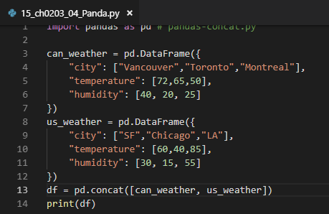
2 Introduction to numpy (3)
https://www.tensorflow.org/tutorials/
Panda Dataframes
import pandas as pd # pandas-concat.py can_weather = pd.DataFrame({
"city": ["Vancouver","Toronto","Montreal"],
"temperature": [72,65,50],
"humidity": [40, 20, 25]
})
us_weather = pd.DataFrame({
"city": ["SF","Chicago","LA"],
"temperature": [60,40,85],
"humidity": [30, 15, 55]
})
df = pd.concat([can_weather, us_weather])
print(df)

Slide 13
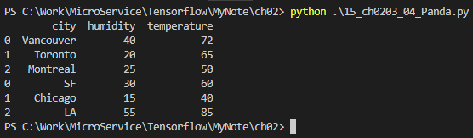
2 Introduction to numpy (3)
https://www.tensorflow.org/tutorials/
Panda Dataframes
city humidity temperature
0 Vancouver 40 72
1 Toronto 20 65
2 Montreal 25 50
0 SF 30 60
1 Chicago 15 40
2 LA 55 85

Slide 14
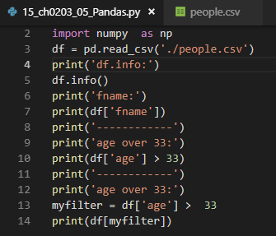
2 Introduction to numpy (3)
https://www.tensorflow.org/tutorials/
Panda Dataframes
import numpy as np
df = pd.read_csv('./people.csv')
print('df.info:')
df.info()
print('fname:')
print(df['fname'])
print('------------')
print('age over 33:')
print(df['age'] > 33)
print('------------')
print('age over 33:')
myfilter = df['age'] > 33
print(df[myfilter])

Slide 15
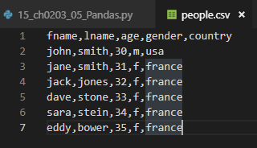
2 Introduction to numpy (3)
https://www.tensorflow.org/tutorials/
Panda Dataframes: people.csv
fname,lname,age,gender,country
john,smith,30,m,usa
jane,smith,31,f,france
jack,jones,32,f,france
dave,stone,33,f,france
sara,stein,34,f,france
eddy,bower,35,f,france

Slide 16
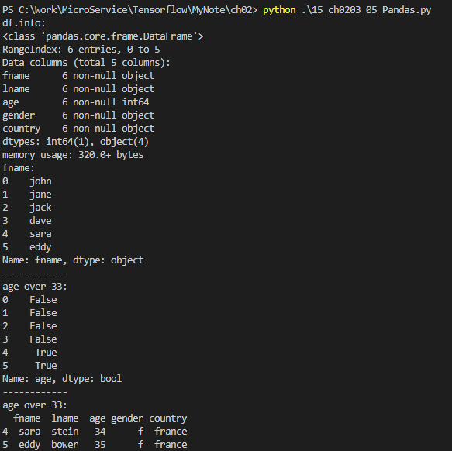
2 Introduction to numpy (3)
https://www.tensorflow.org/tutorials/
Panda Dataframes: people.csv
PS C:\Work\MicroService\Tensorflow\MyNote\ch02> python .\15_ch0203_05_Pandas.py
df.info:
<class 'pandas.core.frame.DataFrame'>
RangeIndex: 6 entries, 0 to 5
Data columns (total 5 columns):
fname 6 non-null object
lname 6 non-null object
age 6 non-null int64
gender 6 non-null object
country 6 non-null object
dtypes: int64(1), object(4)
memory usage: 320.0+ bytes
fname:
0 john
1 jane
2 jack
3 dave
4 sara
5 eddy
Name: fname, dtype: object
------------
age over 33:
0 False
1 False
2 False
3 False
4 True
5 True
Name: age, dtype: bool
------------
age over 33:
fname lname age gender country
4 sara stein 34 f france
5 eddy bower 35 f france
PS C:\Work\MicroService\Tensorflow\MyNote\ch02>

Slide 17
2 Introduction to numpy (3)
https://www.tensorflow.org/tutorials/
Useful link for Pandas
Jupyter notebook for pandas:
http://pandas.pydata.org/pandas-docs/stable/10min.html
Pandas techniques for large datasets:
https://medium.com/towards-data-science/pandas-tips-and-tricks-33bcc8a40bb9
https://pythonprogramming.net/basics-data-analysis-python-pandas-tutorial/
Dask with pandas for very large datasets:
https://tomaugspurger.github.io/modern-8-scaling.html

Slide 18
2 Introduction to numpy (3)
https://www.tensorflow.org/tutorials/
What is matlibplot?
data vizualization tool
Python module

Slide 19
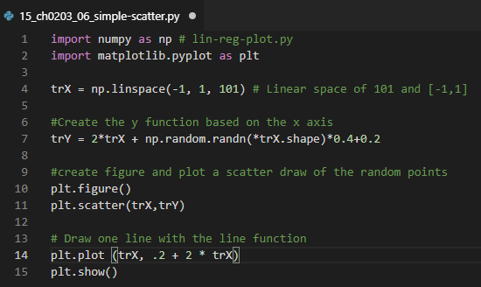
2 Introduction to numpy (3)
https://www.tensorflow.org/tutorials/
Simple Scatter plot
> pip install –U scikit-learn scipy matplotlib
# option –U means upgrade.
import numpy as np # lin-reg-plot.py
import matplotlib.pyplot as plt trX = np.linspace(-1, 1, 101) # Linear space of 101 and [-1,1] #Create the y function based on the x axis
trY = 2*trX + np.random.randn(*trX.shape)*0.4+0.2 #create figure and plot a scatter draw of the random points
plt.figure()
plt.scatter(trX,trY) # Draw one line with the line function
plt.plot (trX, .2 + 2 * trX)
plt.show()

Slide 20
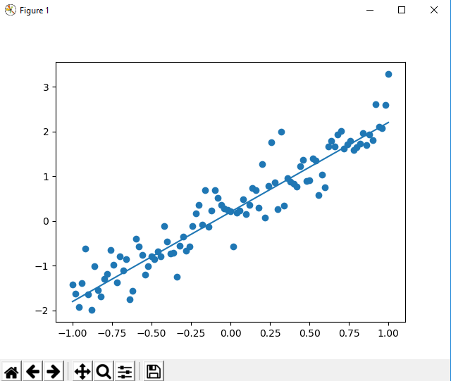
2 Introduction to numpy (3)
https://www.tensorflow.org/tutorials/
Simple Scatter plot
> PS C:\Work\MicroService\Tensorflow\MyNote\ch02> python .\15_ch0203_06_simple-scatter.py

Slide 21
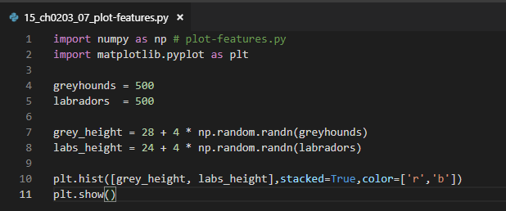
2 Introduction to numpy (3)
https://www.tensorflow.org/tutorials/
Working with Matplotlib
import numpy as np # plot-features.py
import matplotlib.pyplot as plt
greyhounds = 500
labradors = 500
grey_height = 28 + 4 * np.random.randn(greyhounds)
labs_height = 24 + 4 * np.random.randn(labradors)
plt.hist([grey_height, labs_height],stacked=True,color=['r','b'])
plt.show()

Slide 22
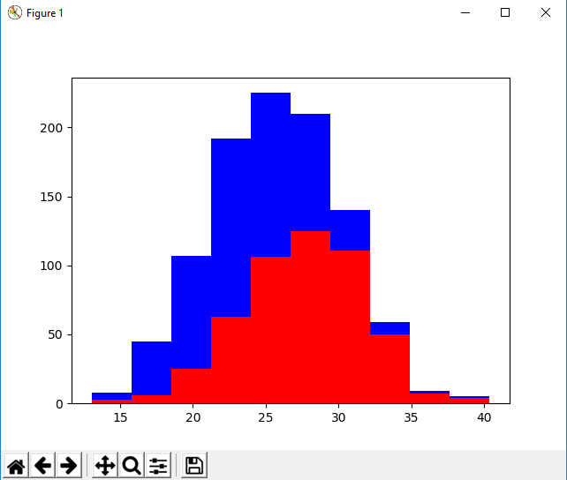
2 Introduction to numpy (3)
https://www.tensorflow.org/tutorials/
Plot frequency
> PS C:\Work\MicroService\Tensorflow\MyNote\ch02> python .\15_ch0203_07_plot-features.py

Slide 23
2 Introduction to numpy (3)
https://www.tensorflow.org/tutorials/
Useful Matplotlib Method
import Matplotlib.pyplot as plt
plt.xlabel('x axis')
plt.ylabel('y axis')
plt.plot()
plt.show()

Slide 24
2 Introduction to numpy (3)
https://www.tensorflow.org/tutorials/
Useful Matplotlib Method
import matplotlib.pyplot as plt
plt.annotate()
plt.legend()
plt.ylim(0,1)
plt.savefig('sample.png', dpi=300)

Slide 25
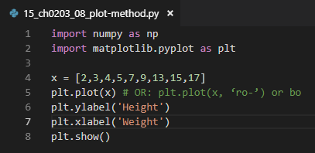
2 Introduction to numpy (3)
https://www.tensorflow.org/tutorials/
Python plot (command line)
import numpy as np
import matplotlib.pyplot as plt
x = [2,3,4,5,7,9,13,15,17]
plt.plot(x) # OR: plt.plot(x, ‘ro-’) or bo
plt.ylabel(’Height')
plt.xlabel(’Weight')
plt.show()

Slide 26
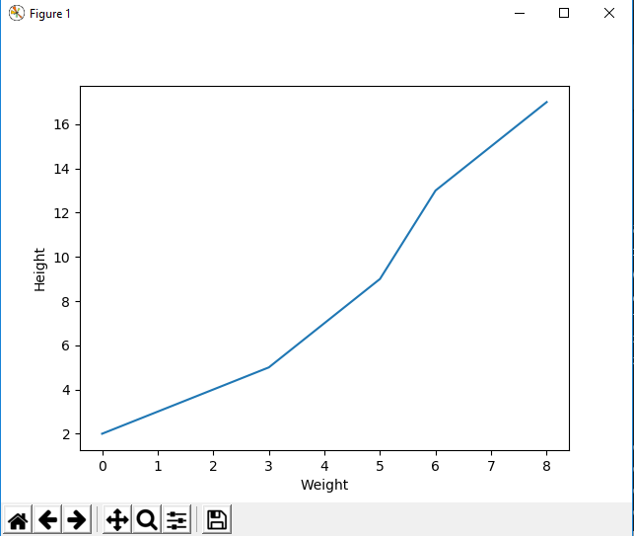
2 Introduction to numpy (3)
https://www.tensorflow.org/tutorials/
Python plot (command line)
> pyhton 15_ch0203-08_plot-method.py

Slide 27
2 Introduction to numpy (3)
https://www.tensorflow.org/tutorials/
What is Seaborn?
good for data visualization
a high-level interface to Matplotlib
Easier than Matplotlib
Extends Matplotlib
Not as powerful as Matplotlib

Slide 28
2 Introduction to numpy (3)
https://www.tensorflow.org/tutorials/
Seaborn Code Sample
good for data visualization
a high-level interface to Matplotlib
Easier than Matplotlib
Extends Matplotlib
Not as powerful as Matplotlib

Slide 29
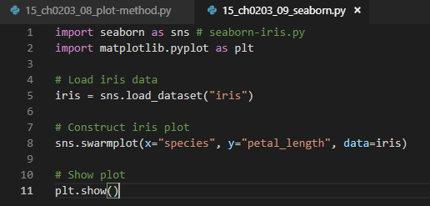
2 Introduction to numpy (3)
https://www.tensorflow.org/tutorials/
Seaborn Code Sample
> pip install –U seaborn
import seaborn as sns # seaborn-iris.py
import matplotlib.pyplot as plt # Load iris data
iris = sns.load_dataset("iris") # Construct iris plot
sns.swarmplot(x="species", y="petal_length", data=iris) # Show plot
plt.show()

Slide 30
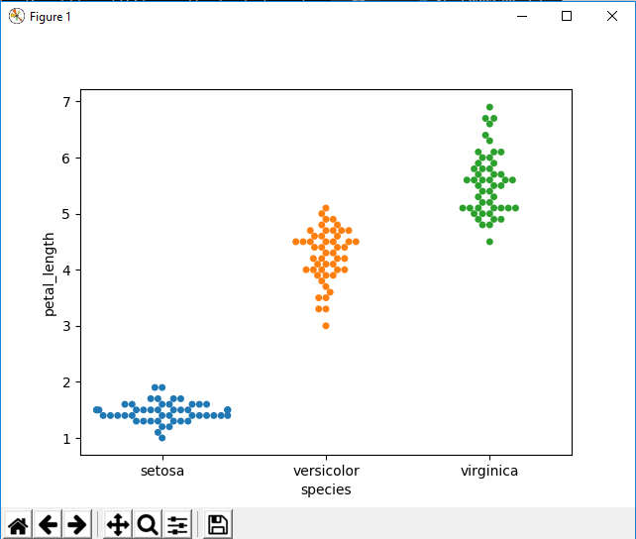
2 Introduction to numpy (3)
https://www.tensorflow.org/tutorials/
Seaborn Code Sample
> python 15_ch0203_09_seaborn.py

Slide 31
2 Introduction to numpy (3)
https://www.tensorflow.org/tutorials/
Other Options for Seaborn
scale seaborn plots
set the plot style
set the figure size
rotate label text
set xlim or ylim
set log scale
add titles

Slide 32
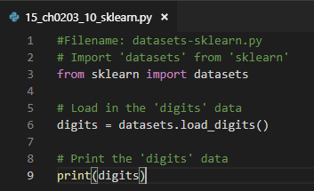
2 Introduction to numpy (3)
https://www.tensorflow.org/tutorials/
Working with sklearn (datasets)
> pip install –U sklearn
#Filename: datasets-sklearn.py
# Import 'datasets' from 'sklearn'
from sklearn import datasets # Load in the 'digits' data
digits = datasets.load_digits() # Print the 'digits' data
print(digits)

Slide 33
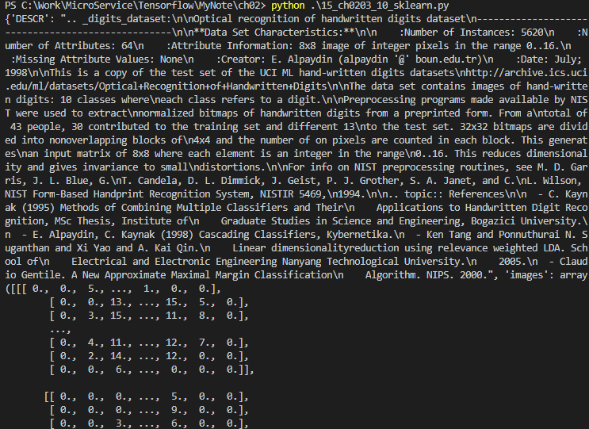
2 Introduction to numpy (3)
https://www.tensorflow.org/tutorials/
Working with sklearn (datasets)
Output from datasets-sklearn.py
{images': array(
[[[0., 0., 5., ..., 1., 0., 0.],
[0., 0., 13., ..., 15., 5., 0.],
[0., 3., 15., ..., 11., 8., 0.],
...,
[0., 4., 11., ..., 12., 7., 0.],
[0., 2., 14., ..., 12., 0., 0.],
[0., 0., 6., ..., 0., 0., 0.]],

Slide 34
2 Introduction to numpy (3)
https://www.tensorflow.org/tutorials/
Basic Predictions with
from sklearn import tree # Filename: predict-sklearn.py
# step 1: collect training data
features = [[130,1], [140,1], [150,0], [170,0]]
labels = [0, 0, 1, 1]
# step 2: train the classifier via a decision tree
clf = tree.DecisionTreeClassifier()
# "fit" learning algorithm ("find patterns in data")
clf = clf.fit(features, labels)
# step 3: make a prediction
print ('a fruit of weight 160 =',clf.predict([[160,0]]), ' where 0 is an apple and 1 is an orange')

Slide 35
2 Introduction to numpy (3)
https://www.tensorflow.org/tutorials/
Summary of Session (1)
pandas:
import pandas as pd
df = pd.read_csv('people.csv’)
matplotlib methods:
plt.xlabel('x axis’)
plt.ylabel('y axis’)
plt.plot()
plt.show()

Slide 36
2 Introduction to numpy (3)
https://www.tensorflow.org/tutorials/
Summary of Session (2)
scipy:
import numpy as np
from scipy import linalg
A = np.array([[1,2], [3,4]])
print 'A: ‘,A
print('A inverse: ',linalg.inv(A))
sklearn:
from sklearn import tree
clf = tree.DecisionTreeClassifier()

Slide 37
End of Chapter

