Slide 1

6 Convolutional Neural Network (3)
Peter H. Chen

Slide 2
6 Convolutional Neural Network (3)
https://www.tensorflow.org/tutorials/
List of Session Topic
TFLearn APIs
CNNs and TFLearn:
http://tflearn.org/
tflearn-cnn.py (http://tflearn.org/models/dnn/)
Additional CNN code samples:
complex-cnn.py
input-data.py
simple-cnn.py

Slide 3
6 Convolutional Neural Network (3)
https://www.tensorflow.org/tutorials/
Useful TFLearn APIs
from tflearn.layers.conv:
conv_2d, max_pool_2d
from tflearn.layers.core
input_data, dropout, fully_connected
from tflearn.layers.estimator:
Regression
tflearn.datasets.mnist

Slide 4
6 Convolutional Neural Network (3)
https://www.tensorflow.org/tutorials/
TFLearn and CNNs (tflearn-cnn.py)
import tflearn
from tflearn.layers.conv import conv_2d, max_pool_2d
from tflearn.layers.core import input_data, dropout, fully_connected
from tflearn.layers.estimator import regression
import tflearn.datasets.mnist as mnist
X, Y, test_x, test_y = mnist.load_data(one_hot=True)
X = X.reshape([-1, 28, 28, 1])
test_x = test_x.reshape([-1, 28, 28, 1])

Slide 5
6 Convolutional Neural Network (3)
https://www.tensorflow.org/tutorials/
TFLearn and CNNs (tflearn-cnn.py)
convnet = input_data(shape=[None, 28, 28, 1], name='input’)
convnet = conv_2d(convnet, 32, 2, activation='relu')
convnet = max_pool_2d(convnet, 2)
convnet = conv_2d(convnet, 64, 2, activation='relu')
convnet = max_pool_2d(convnet, 2)
convnet = fully_connected(convnet, 1024, activation='relu’)

Slide 6
6 Convolutional Neural Network (3)
https://www.tensorflow.org/tutorials/
TFLearn and CNNs (tflearn-cnn.py)
convnet = dropout(convnet, 0.8)
convnet = fully_connected(convnet, 10, activation='softmax')
convnet = regression(convnet, optimizer='adam', learning_rate=0.01, loss='categorical_crossentropy', name='targets')
# create/train the model:
model = tflearn.DNN(convnet)
model.fit({'input': X}, {'targets': Y}, n_epoch=3, validation_set=({'input': test_x}, {'targets': test_y}), snapshot_step=500, show_metric=True, run_id='mnist')

Slide 7
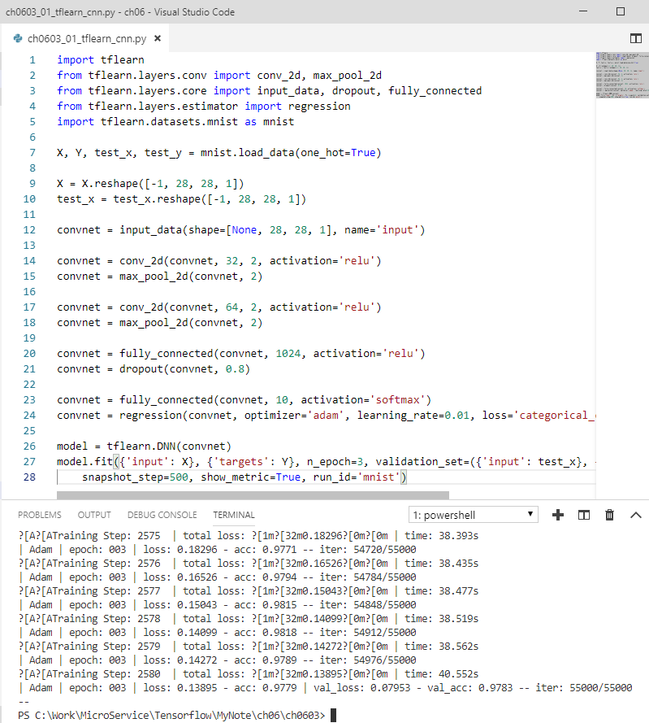
6 Convolutional Neural Network (3)
https://www.tensorflow.org/tutorials/
TFLearn and CNNs (tflearn-cnn.py):

Slide 8
6.1 More Code Examples
Peter H. Chen

Slide 9
6.1 More Code Examples
https://www.tensorflow.org/tutorials/
More Code Samples (1)
simple-cnn.py:
Constructs CNN
Saves data for TensorBoard
complex-cnn.py:
useful TensorBoard techniques
input-data.py:
+ Alternative to deprecated code:
from tensorflow.examples.tutorials.mnist import input_data

Slide 10
6.2 Sinple-cnn.py
Peter H. Chen

Slide 11
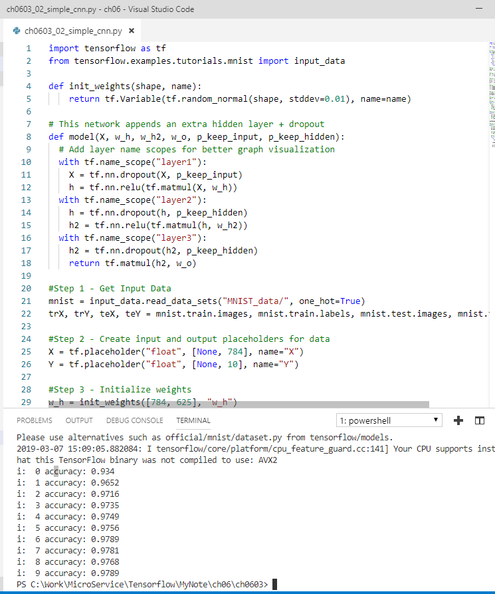
6.2 Sinple-cnn.py
https://www.tensorflow.org/tutorials/
More Code Samples (2)
simple-cnn.py:
Constructs CNN
Saves data for TensorBoard
complex-cnn.py:
useful TensorBoard techniques
input-data.py:
+ Alternative to deprecated code:
from tensorflow.examples.tutorials.mnist import input_data

Slide 12
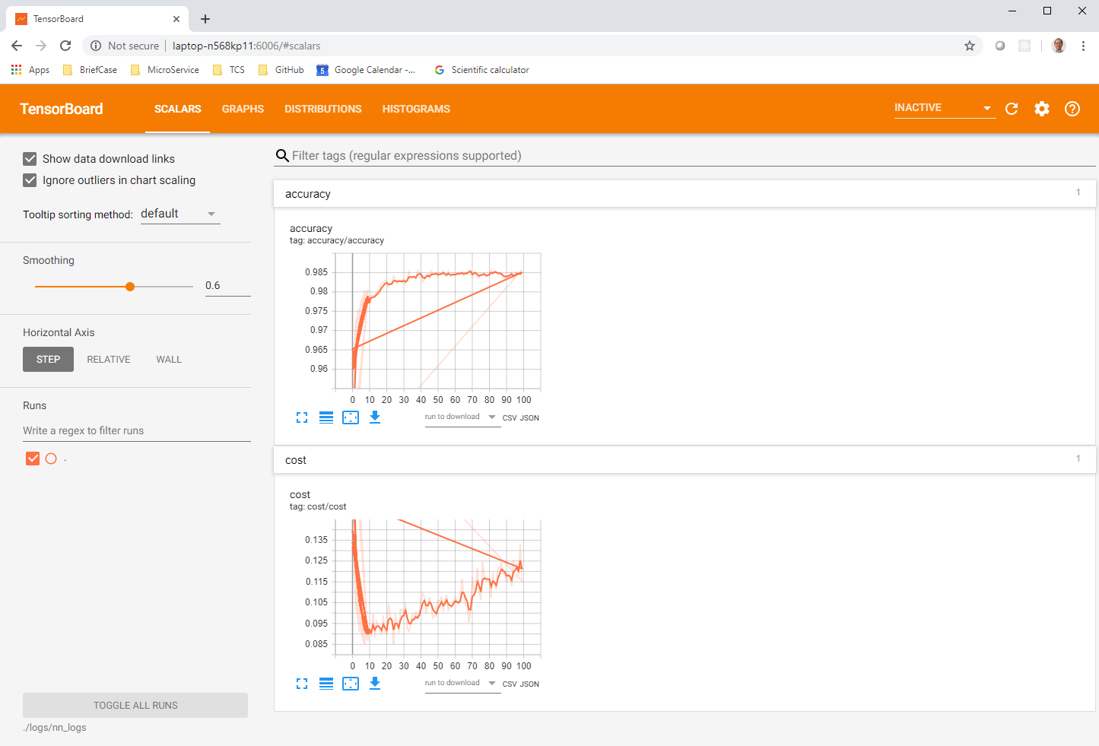
6.2 Sinple-cnn.py
https://www.tensorflow.org/tutorials/
More Code Samples (2)
simple-cnn.py:
Constructs CNN
Saves data for TensorBoard
complex-cnn.py:
useful TensorBoard techniques
input-data.py:
+ Alternative to deprecated code:
from tensorflow.examples.tutorials.mnist import input_data
> python simple-cnn.py
> tensorboard –logdir ./logs/nn_logs

Slide 13
6.3 Complex-cnn.py
Peter H. Chen

Slide 14
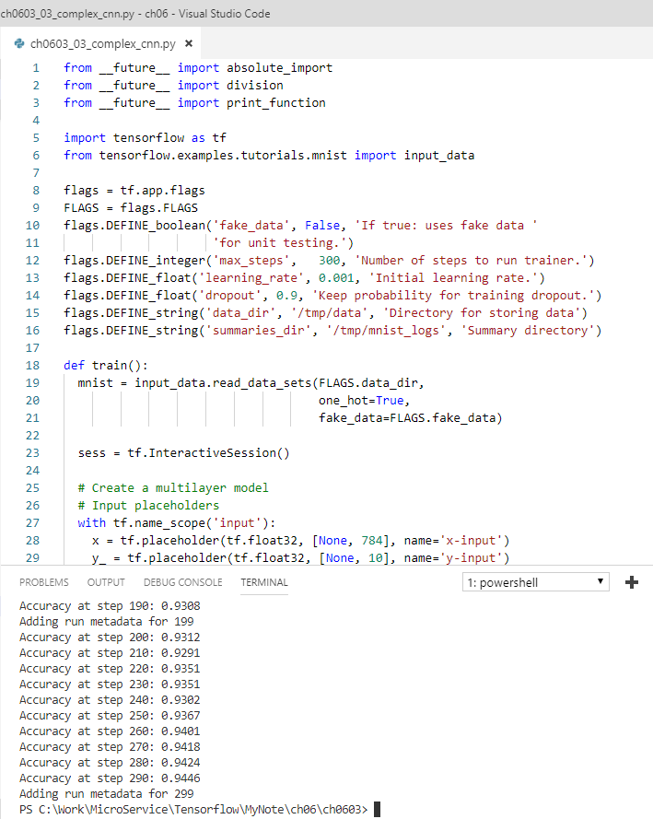
6.3 Complex-cnn.py
https://www.tensorflow.org/tutorials/
More Code Samples (3)
simple-cnn.py:
Constructs CNN
Saves data for TensorBoard
complex-cnn.py:
useful TensorBoard techniques
input-data.py:
+ Alternative to deprecated code:
from tensorflow.examples.tutorials.mnist import input_data

Slide 15
6.4 input-data.py
Peter H. Chen

Slide 16
6.4 Input-data.py
https://www.tensorflow.org/tutorials/
More Code Samples (3)
simple-cnn.py:
Constructs CNN
Saves data for TensorBoard
complex-cnn.py:
useful TensorBoard techniques
input-data.py:
+ Alternative to deprecated code:
from tensorflow.examples.tutorials.mnist import input_data

Slide 17
6.5 tf.layers.py and tf.estimator.py
Peter H. Chen

Slide 18
6.5 tf.layers.py and tf.estimator.py
https://www.tensorflow.org/tutorials/
More Code Samples
TensorFlow r1.9 code sample:
Uses tf.layers and tf.estimator APIs
does not use deprecated code
(does not work in week 6 code samples)
mnist = tf.contrib.learn.datasets.load_dataset("mnist")
Complete code location:
https://github.com/tensorflow/tensorflow/blob/r1.9/tensorflow/examples/tutorials/layers/cnn_mnist.py
Use tf.data.TFRecordDataset + Iterator(?)

Slide 19
End of Chapter

