Slide 1

1 Angular/Java Fullstack
Peter H. Chen

Slide 2
1 Angular/Java Fullstack
https://www.apress.com/us/book/9781484231975
We overview the front end to back end technology stack.
We will use angular for Front end and H2 I memory database for backend.
The hibernate for database framework. Tomcat is used for default web server.
Fullstack Angular/Java: Spring is too big. Use spring boot instead for micro-service is opinionated for 80% application.
This chapter installs the STS (Spring Tool Suite).
You can configure the POM.XML by Spring Initializr and STS.
In this chapter, we STS to configure the basic web provided by Spring boot.
We run “Hello world” using Tomcat web server.
Web Application
Server Application
Client Libraries
(Bootstrap, Angular, jQuery)
REST API
Spring Boot
Database
HTTP
Native Client Technologies
(CSS, HTML, JS)
Java

Slide 3
1.1 Spring Intializr

Slide 4
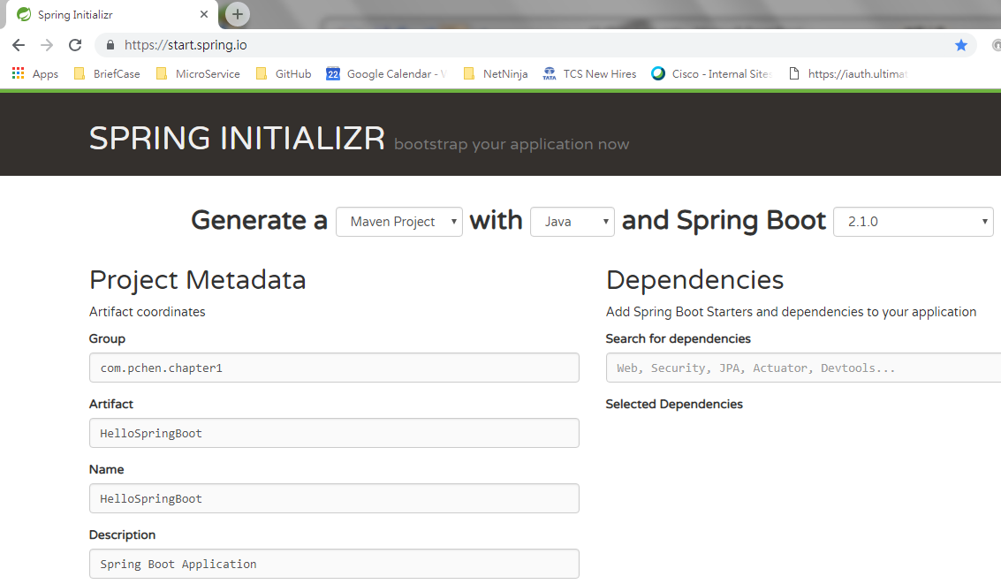
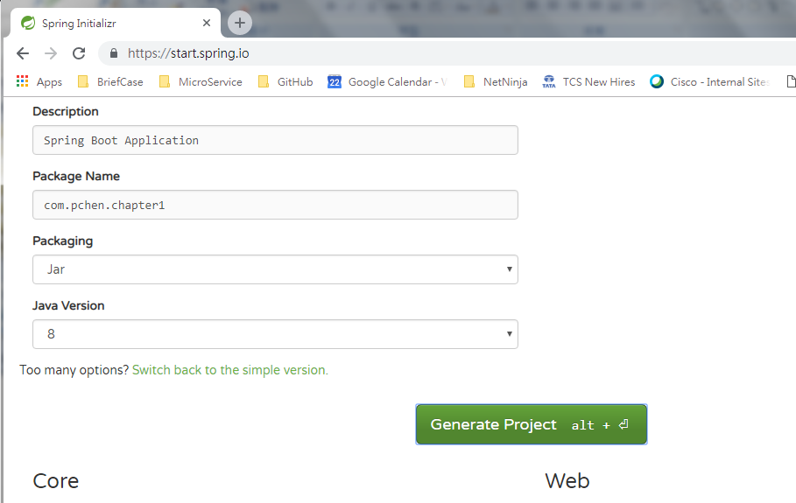
1.1 Spring Intializr
https://www.apress.com/us/book/9781484231975
Spring Initializr: Click Generate Project button to generate the HelloSpringBoot.zip.

Slide 5
1.2 Download STS

Slide 6
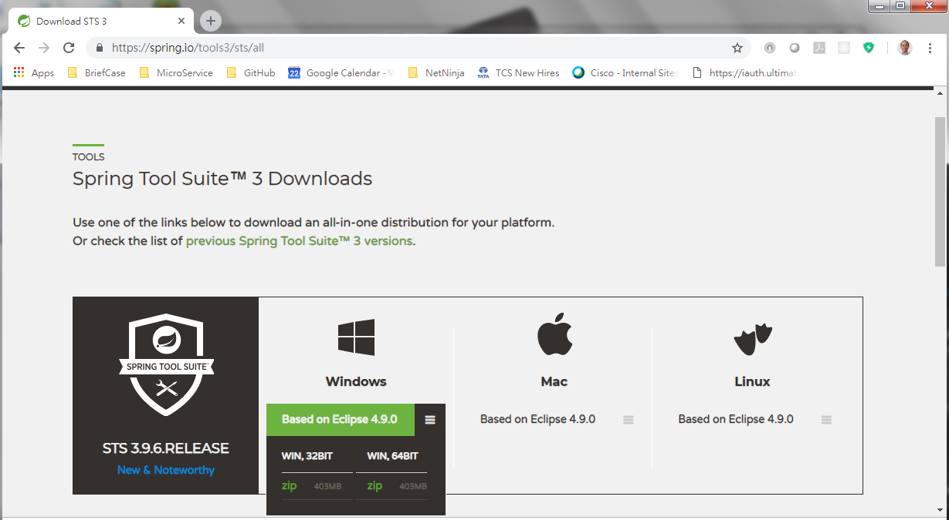
1.2 Download STS
https://www.apress.com/us/book/9781484231975
Go to: https://spring.io/tools/sts/all, Download and unzipped STS (Spring Tool Suite for Windows)

Slide 7
1.3 Start STS

Slide 8
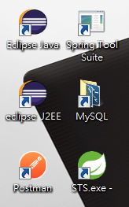

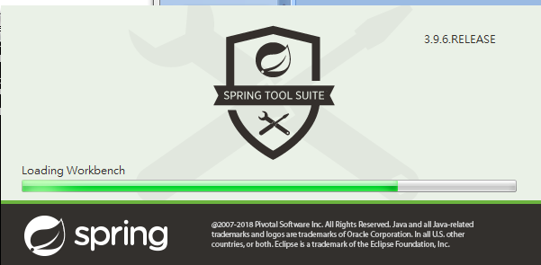
1.3 Start STS
https://www.apress.com/us/book/9781484231975
Unzip the STS. You will find ecipse.exe in the release folder send it to desktop and rename it into “Spring Tool Suite”.
Double click “Spring Tool Suite (STS.exe)” to start.

Slide 9
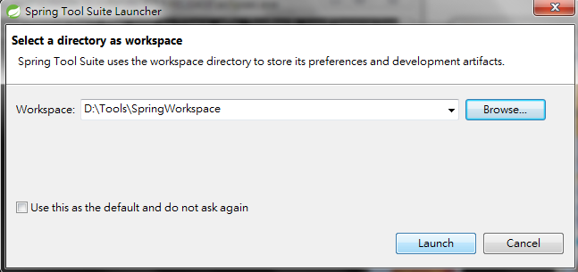
1.3 Start STS
https://www.apress.com/us/book/9781484231975
Select the workspace for STS.
Click “Launch”

Slide 10
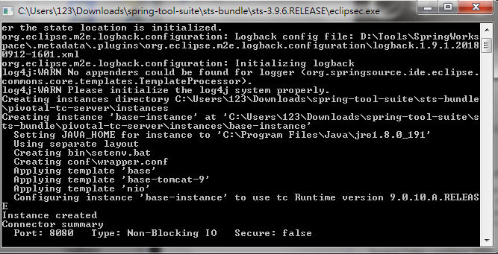
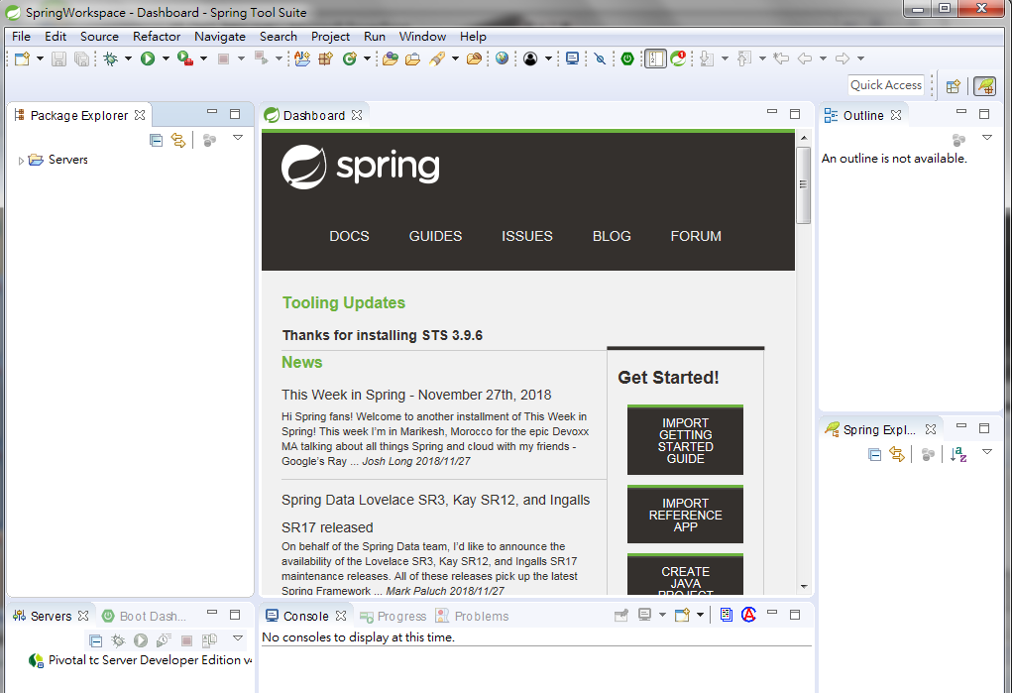
1.3 Start STS
https://www.apress.com/us/book/9781484231975
STS Dashboard

Slide 11
1.4 New Spring Starter Project

Slide 12
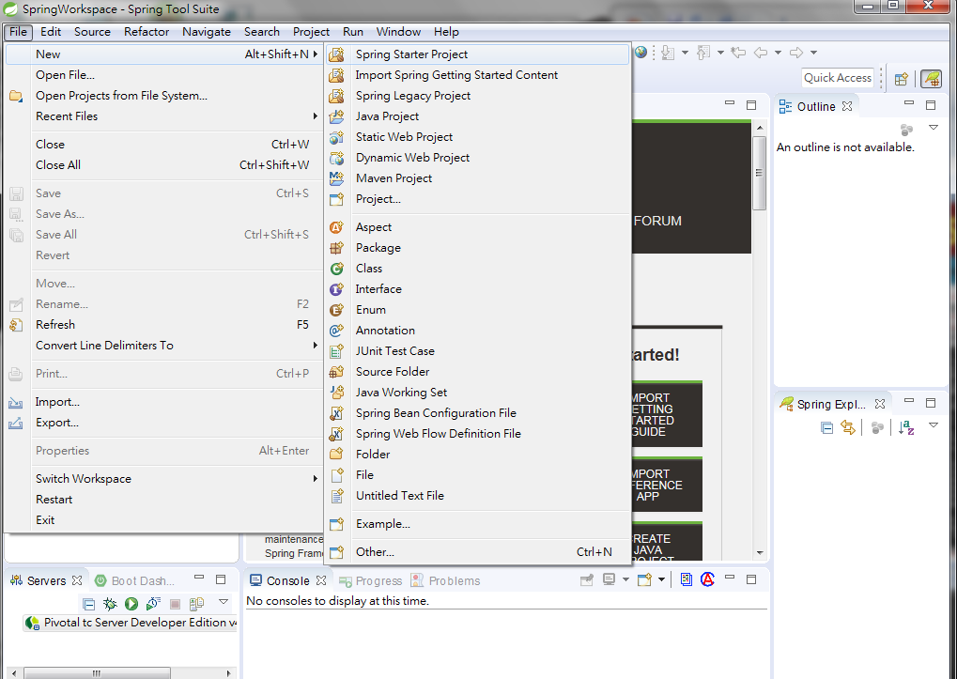
1.4 Spring Starter Project
https://www.apress.com/us/book/9781484231975
File > New > Spring Starter Project

Slide 13
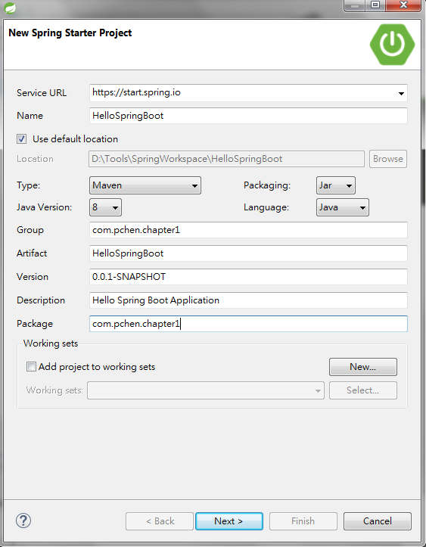
1.4 Spring Starter Project
https://www.apress.com/us/book/9781484231975
File > New > Spring Starter Project. Fill service URL: https://start.spring.io, group and package information and click next.

Slide 14
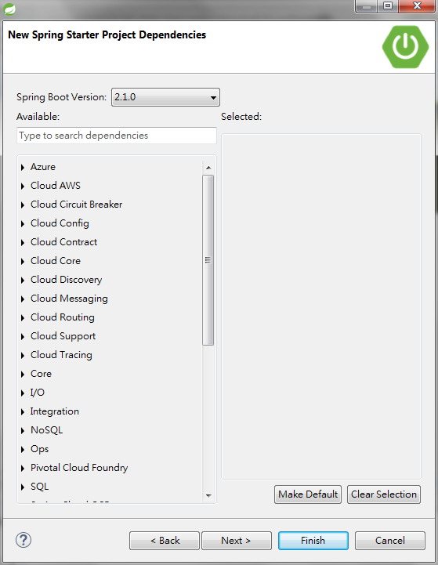
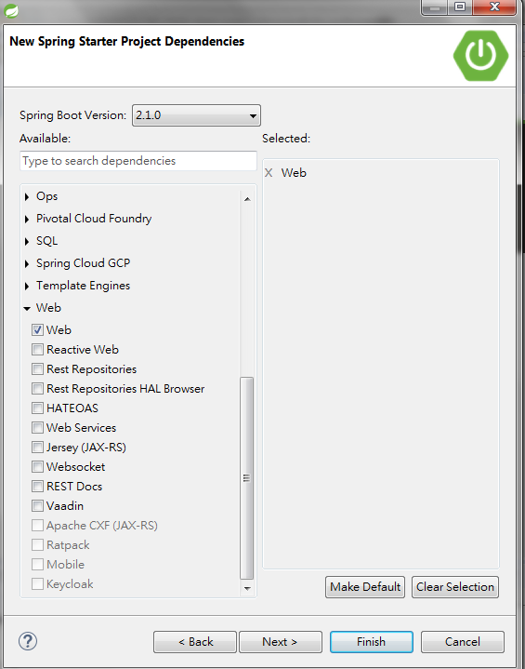
1.4 Spring Starter Project
https://www.apress.com/us/book/9781484231975
Select “Web” and click finish.

Slide 15
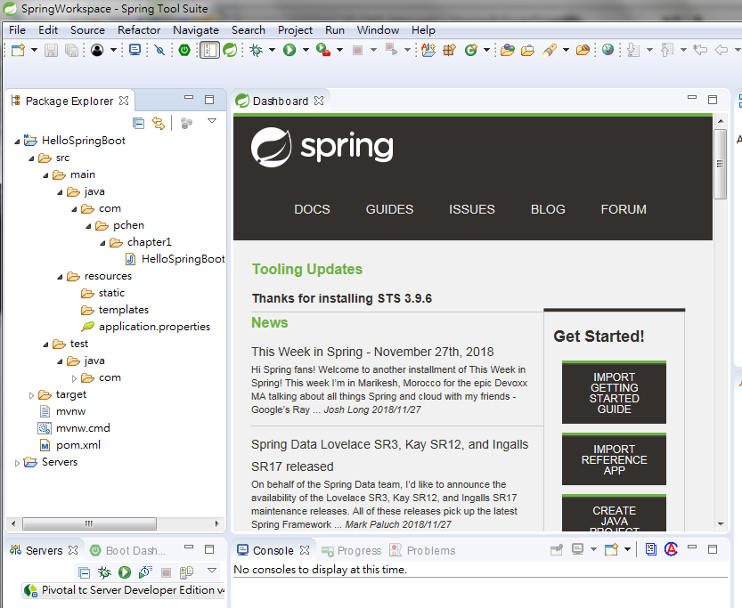
1.4 Spring Starter Project
https://www.apress.com/us/book/9781484231975
The final structure of the project is as follow. The pom.xml is generated.

Slide 16
1.5 POM.XML

Slide 17
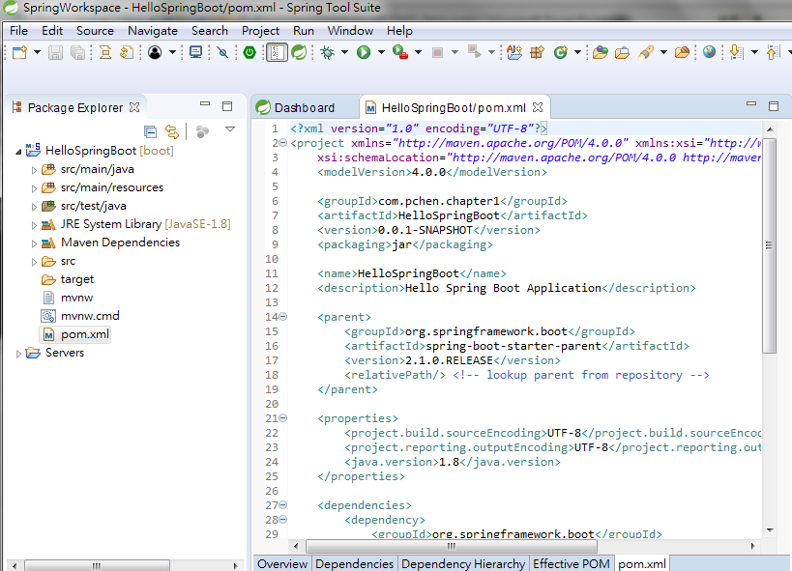
1.5 POM.XML
https://www.apress.com/us/book/9781484231975
The POM.XML is as follow.

Slide 18
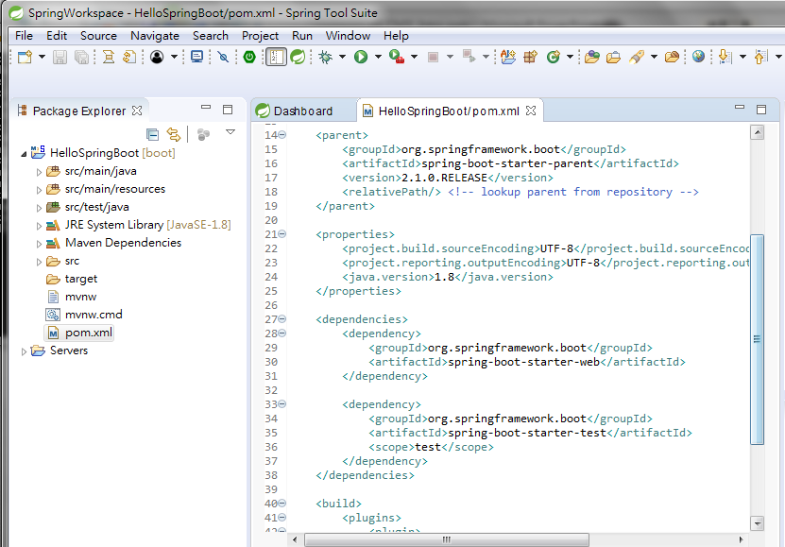
1.5 POM.XML
https://www.apress.com/us/book/9781484231975
<parent> ..</parent> contains the spring-boot-starter-parent element is from Spring boot. Our project inherits in from spring boot.
The first <dependency> .. </dependency> spring-boot-starter-web element is selected by us and generated by spring boot.

Slide 19
1.6 Maven Dependencies

Slide 20
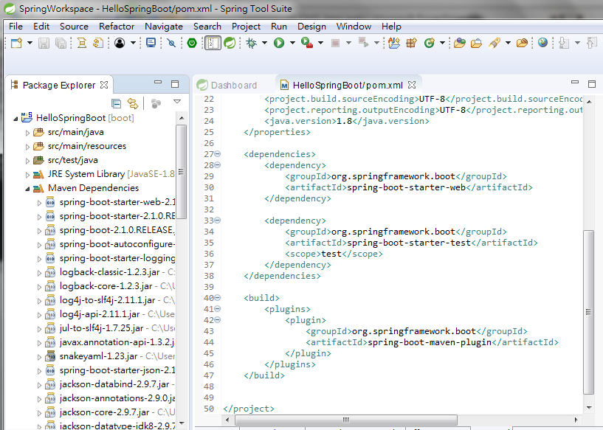
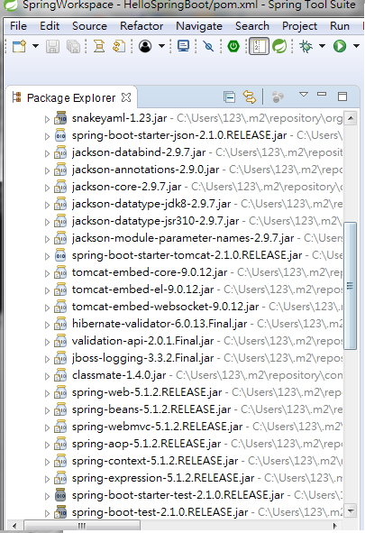
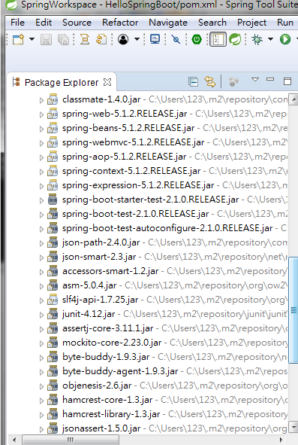
1.6 Maven Dependencies
https://www.apress.com/us/book/9781484231975
The maven dependencies are spring boot setup in STS. They are 80% of commonly used in STS and Spring boot selected for us.
Tomcat is the web server, Jackson for data-type/data-binding, Hibernate is ORM Java Object Relational Mapping, and spring web dependency selected by project.

Slide 21
1.7 Backend Code

Slide 22
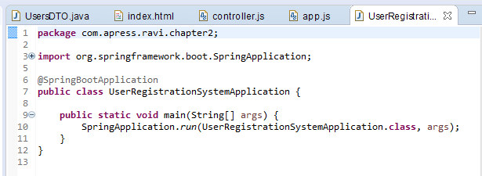
1.7 Backend Code
https://www.apress.com/us/book/9781484231975
Dependencies Injection inject the interface class UserRegistrationSystemApplicaiton.
The interface class is single defined as “private static” and interface with “pubic static” interface method UserRegistrationSystemApplicaiton.
“static” means always available in the memory and private mean no one can access except public method. This is the meaning of “singleton”.

Slide 23
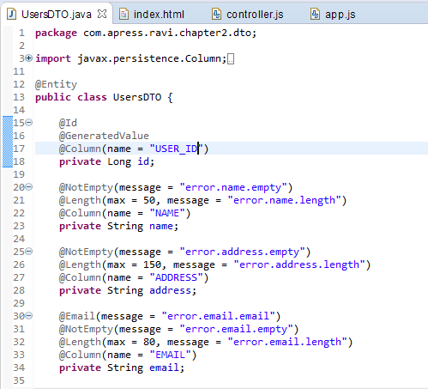
1.7 Backend Code
https://www.apress.com/us/book/9781484231975
Java Directory contains all the backend codes.
@Entity Decorator specified the JPA database with Hibernate ORM (Object Relation Mapping) with MySQL column specification.

Slide 24
1.7 Backend Code

Slide 25
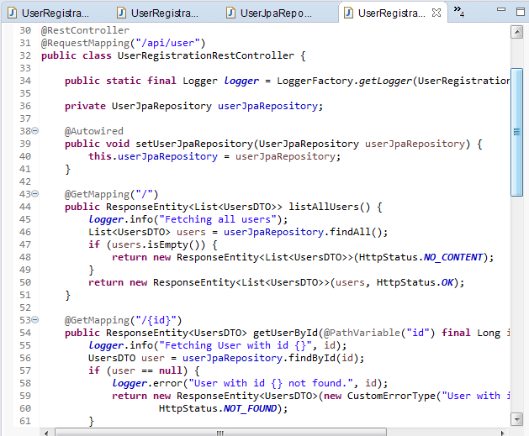
1.7 Backend Code
https://www.apress.com/us/book/9781484231975
The @Autowired is used to setter method.
The RestController () control the routing path, such as, “/” (Home), “/{id}” for different routes.

Slide 26
1.8 Frontend Code

Slide 27
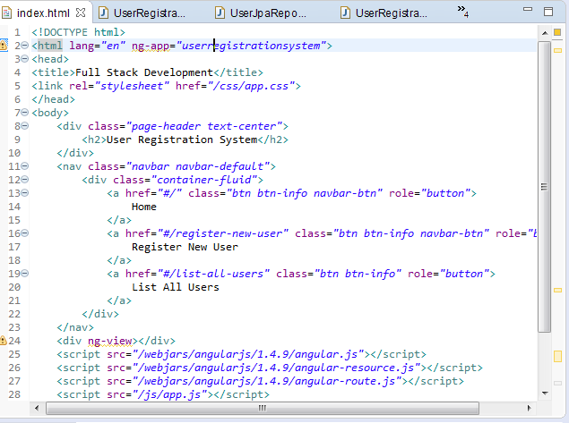
1.7 Backend Code
https://www.apress.com/us/book/9781484231975
The static directory contains all the frontend codes (CSS, Images, and JS, and Index.html).
The index.html define the HTML element .

Slide 28
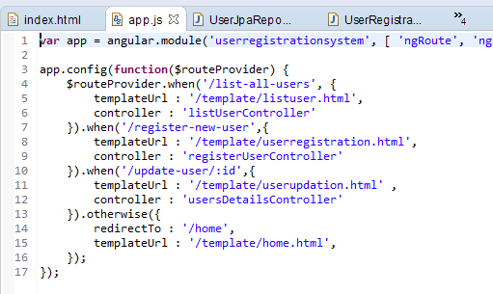
1.7 Backend Code
https://www.apress.com/us/book/9781484231975
The App is the root module.

Slide 29
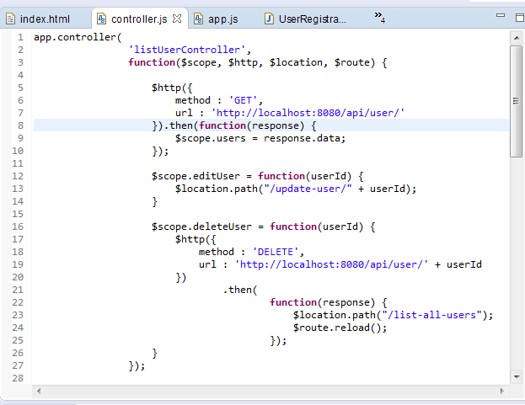
1.7 Backend Code
https://www.apress.com/us/book/9781484231975
Controller makes HTTP request by CRUD (Create, Read, Update, Delete) using URL and path with promise (then).

Slide 30
1.9 Run Spring Boot App

Slide 31
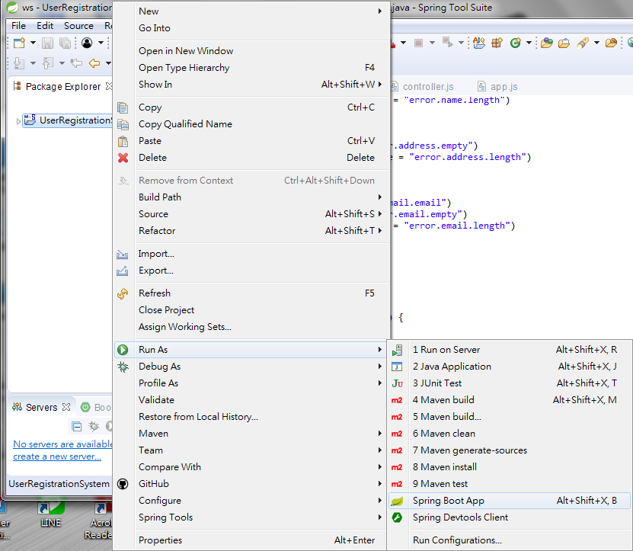
1.9 Run Spring Boot App
https://www.apress.com/us/book/9781484231975
Select Project Folder. RMB (Right Mouse Button) Run > Run As > Java Application or Run > Run as > Spring Boot App.

Slide 32
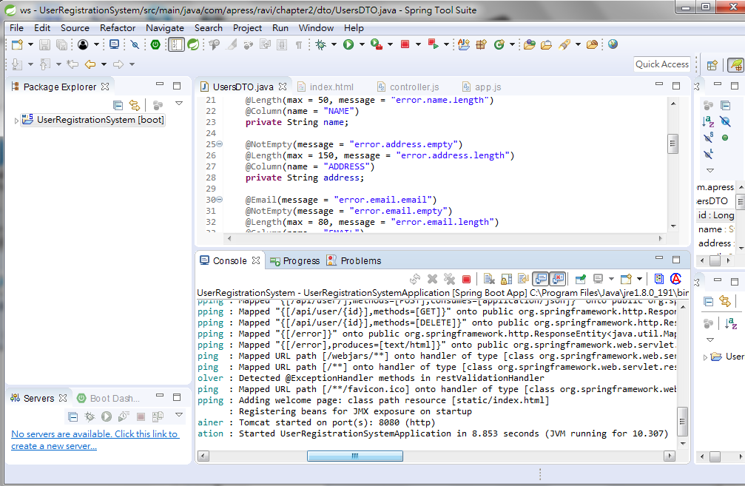
1.9 Run Spring Boot App
https://www.apress.com/us/book/9781484231975
Console display “Spring” running on port 8080

Slide 33
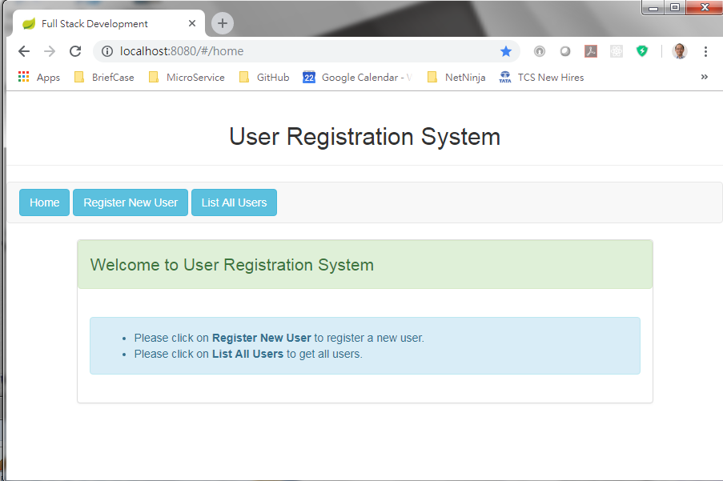
1.8 Run Spring Boot App
https://www.apress.com/us/book/9781484231975
Open chrome and enter “localhost:8080”

Slide 34
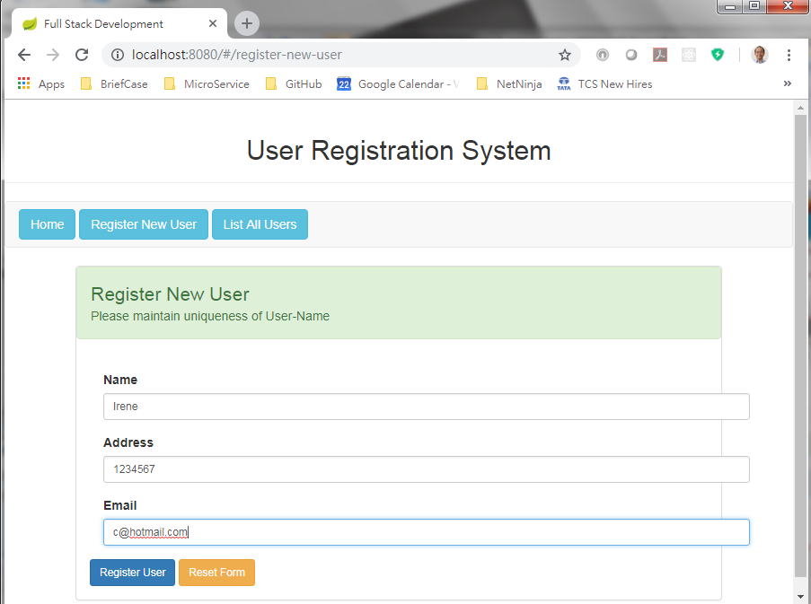
1.9 Run Spring Boot App
https://www.apress.com/us/book/9781484231975
Register the people to H2 database.

Slide 35
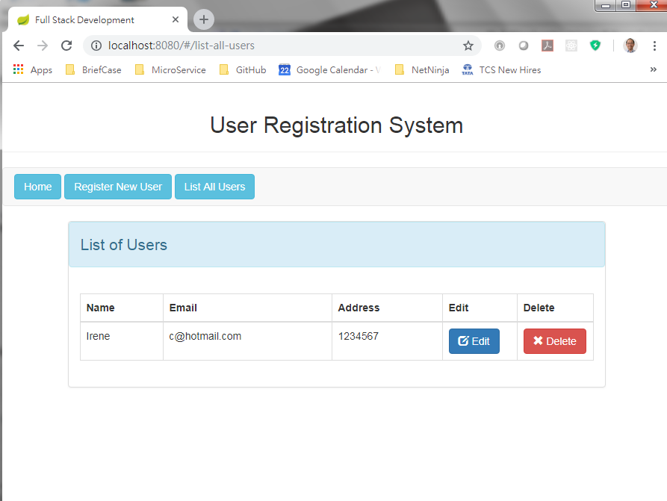
1.9 Run Spring Boot App
https://www.apress.com/us/book/9781484231975
List the user.

Slide 36
End of Chapter

