Slide 1

8 Pointer Receiver
Peter H. Chen

Slide 2
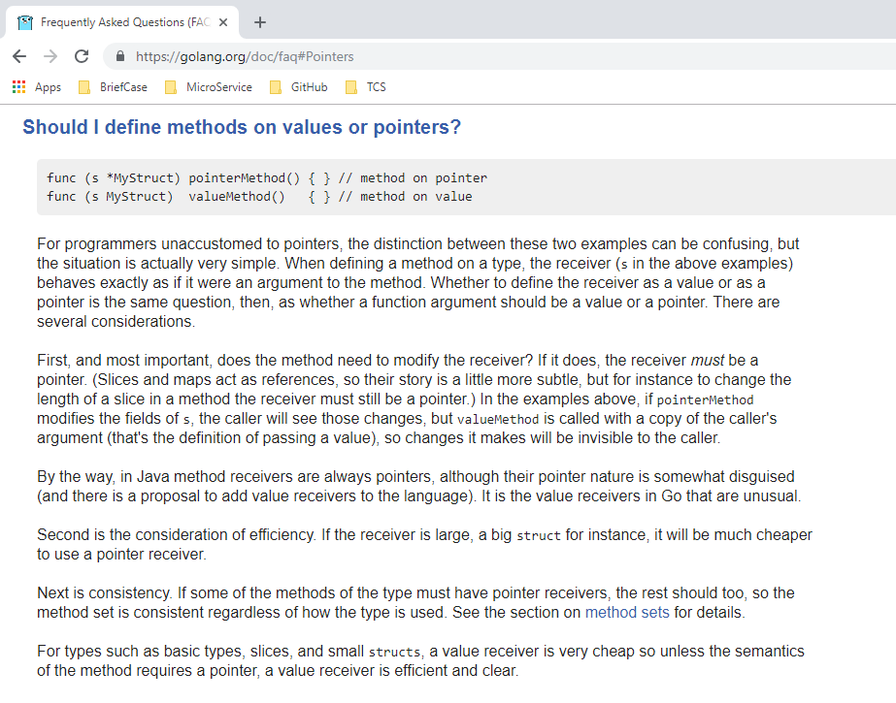
8 Pointer Receiver
ttps://www.youtube.com/watch?v=nSYFfWijl8U&index=2&list=PLQVvvaa0QuDeF3hP0wQoSxpkqgRcgxMqX
Go to: https://golang.org/doc/faq#Pointers

Slide 3
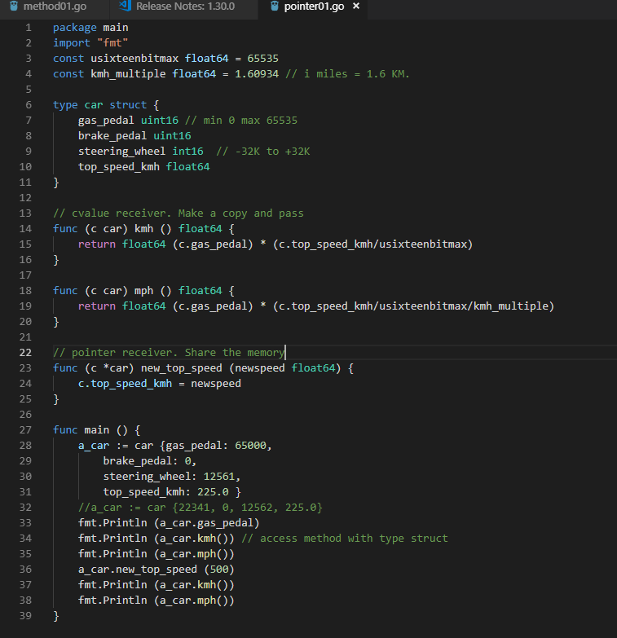
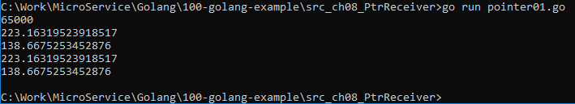
8 Pointer Receiver
ttps://www.youtube.com/watch?v=nSYFfWijl8U&index=2&list=PLQVvvaa0QuDeF3hP0wQoSxpkqgRcgxMqX
Value Receiver (c car)

Slide 4
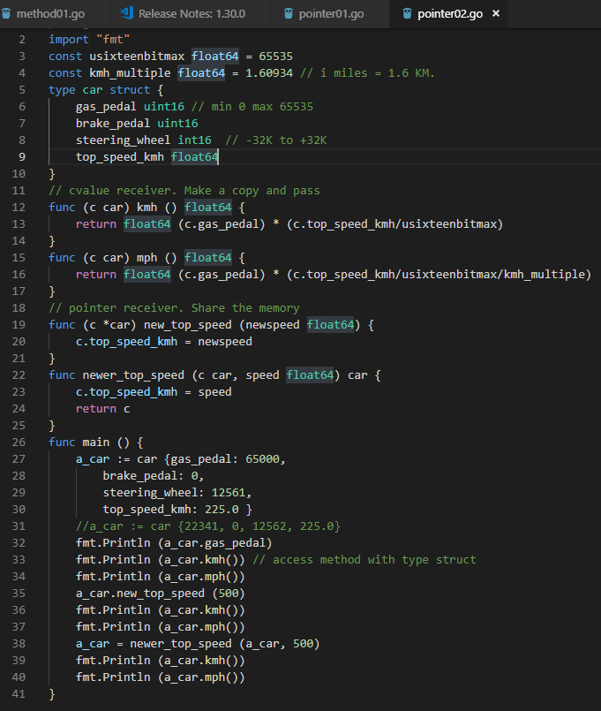
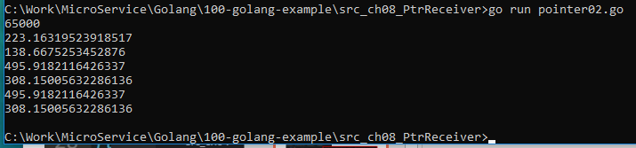
8 Pointer Receiver
ttps://www.youtube.com/watch?v=nSYFfWijl8U&index=2&list=PLQVvvaa0QuDeF3hP0wQoSxpkqgRcgxMqX
Write a function and pass parameter to do calculation.

Slide 5
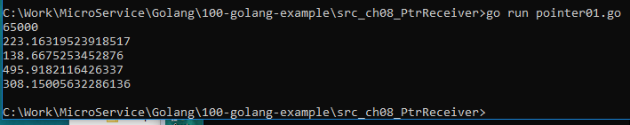
8 Pointer Receiver
ttps://www.youtube.com/watch?v=nSYFfWijl8U&index=2&list=PLQVvvaa0QuDeF3hP0wQoSxpkqgRcgxMqX
Pointer Receiver (c *car)

Slide 6
End of Chapter

