Slide 1

12 Looping
Peter H. Chen

Slide 2
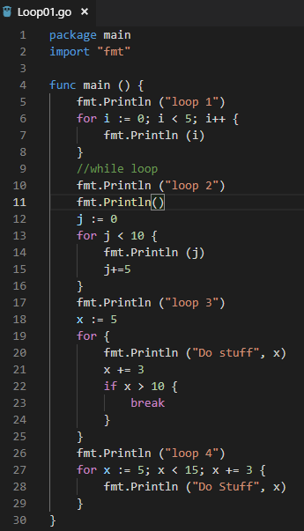
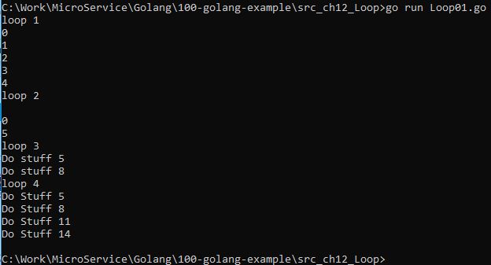
12 Looping
ttps://www.youtube.com/watch?v=nSYFfWijl8U&index=2&list=PLQVvvaa0QuDeF3hP0wQoSxpkqgRcgxMqX
Looping in go.

Slide 3
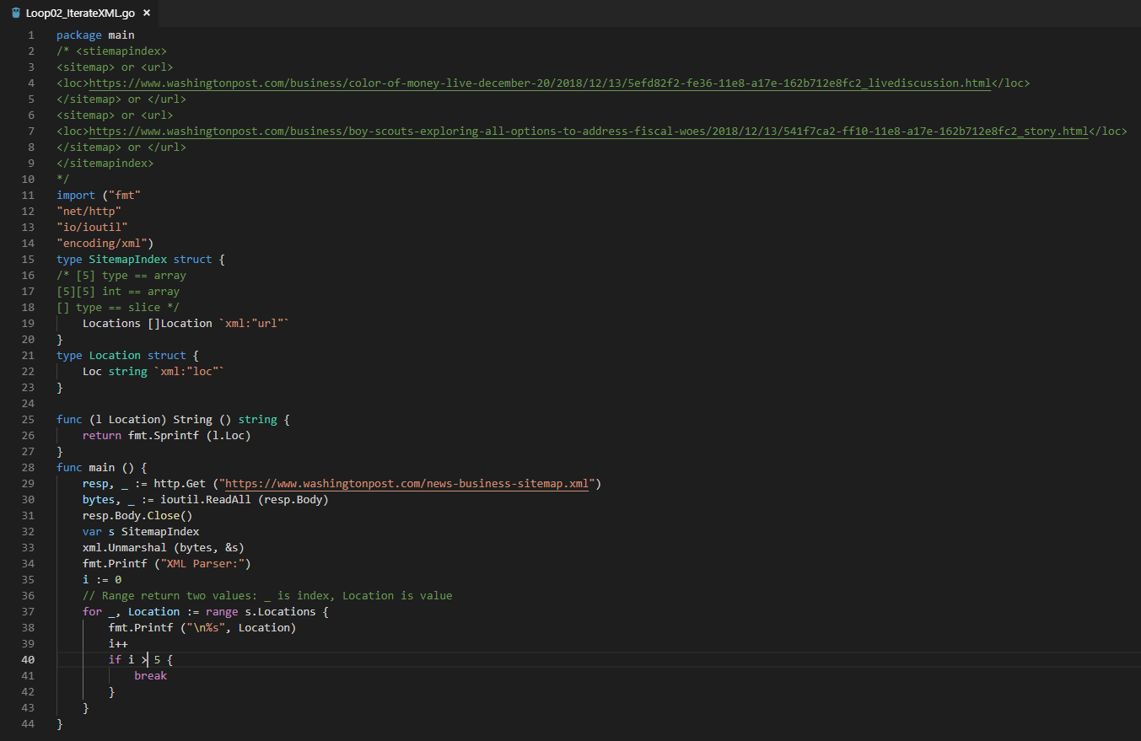
12 Looping
ttps://www.youtube.com/watch?v=nSYFfWijl8U&index=2&list=PLQVvvaa0QuDeF3hP0wQoSxpkqgRcgxMqX
Looping for XMPL Parser.

Slide 4
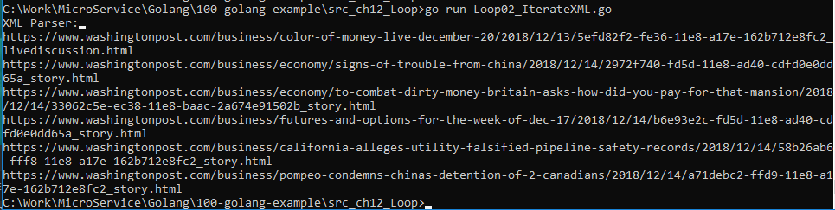
12 Looping
ttps://www.youtube.com/watch?v=nSYFfWijl8U&index=2&list=PLQVvvaa0QuDeF3hP0wQoSxpkqgRcgxMqX
Looping for XMPL Parser to x <= 5.

Slide 5
End of Chapter

